Slide 1
Talos Origins Progress

Slide 2
Changes
[STORY] No more Greek Mythology -> Sci-fi
[MECHANIC] Grapple Exploration
[MECHANIC] BreadCrumb Trail -> Track Exploration

Slide 3
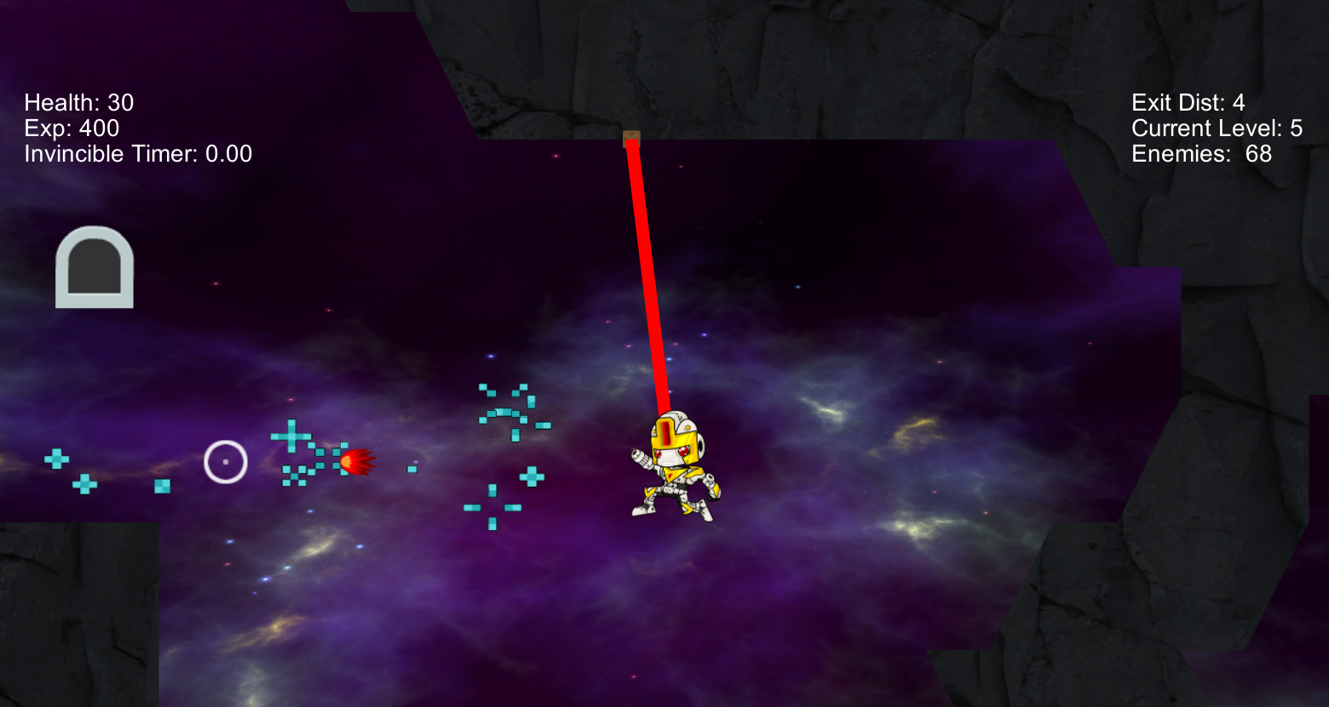
Gamplay ScreenShot

Slide 4
Work In Progress
[MECHANIC] Purchase Upgrades in Ship
[GAMEPLAY] Enemy kills matter -> Currency
[ENEMIES] Enemy Variety + Behaviour
[MECHANIC] Navigation improvements
[GAMEPLAY] Controller Support
[VISUAL] User Interface
[GAMEPLAY] Random Level Button

