Slide 1

Real Time Car Trajectory
By
MITU22BTCS0165 Raashi Lokhande
MITU22BTCS0181 Atharv Jadhav
MITU22BTCS0127 Anshita Nair MITU21BTCS0953 Vaibhav Kadam
Guided By
Prof. Deepak Naik
Department of Computer Science & Engineering, MITSoE, Loni Kalbhor

Slide 2
Outline
1 INTRODUCTION
2 PROBLEM STATEMENT
3 OBJECTIVE
4 FLOW CHART
5 CONCEPTS AND METHODS
6 LITERATURE SURVEY
7 TOOLS AND LANGUAGES
8 PROCESS AND IMPLEMENTATION
9 OUTPUT
10 CONCLUSION AND FUTURE WORK
ANNEXURE A: List of Publications and Research Paper (In its Original formats)
ANNEXURE B: Plagiarism Report
Department of Computer Science & Engineering, MITSoE, Loni Kalbhor

Slide 3
1. Introduction
Artificial Intelligence (AI) has become a buzzword in the tech industry and is slowly making its way into various sectors, including the veterinary industry. AI has the potential to transform the way veterinarians diagnose, treat and monitor animal health. With the use of AI in the veterinary industry, veterinarians can now detect illnesses earlier, offer more precise diagnoses, and provide better treatment options for their patients. Through this project, we will be able to briefly explore possible solutions on how AI could transform the veterinary industry and the benefits it provides for veterinarians and their animal patients.
The benefits of AI in the veterinary industry are numerous. AI can improve the accuracy and speed of diagnoses, leading to better treatment outcomes for animal patients. It can also help veterinarians detect illnesses earlier and prevent serious health issues. AI can provide insights into animal behavior, allowing veterinarians to provide more personalized care. Additionally, AI can help to speed up the drug discovery process, leading to the development of more effective treatments for animal patients.
Department of Computer Science & Engineering, MIT SOE, Loni Kalbhor

Slide 4
2. Problem Statement
The challenge is to effectively monitor the motion of objects over time and conduct behavior analysis. This is crucial for various applications such as surveillance, security, and research, where understanding the trajectories of objects is essential for pattern recognition and anomaly detection.
Department of Computer Science & Engineering, MITSOE, Loni Kalbhor

Slide 5
3. Objectives
Object Detection and Tracking:
Develop a system to detect and track objects in real-time.
Utilize computer vision algorithms to identify and monitor the motion of objects within a given area.
Trajectory Analysis:
Collect and analyze the trajectories of objects over time.
Calculate the speed, direction, and acceleration of the moving objects to understand their behavior.
Pattern Recognition:
Identify recurring patterns in the motion and behavior of objects.
Develop algorithms to recognize and categorize these patterns for predictive analysis.
Department of Computer Science & Engineering, MITSOE, Loni Kalbhor.

Slide 6
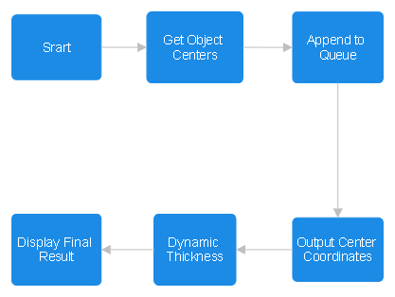

4. Flow Chart
.
Department of Computer Science & Engineering, MITSOE, Loni Kalbhor.

Slide 7
5. Concepts and Methods
Object Detection:
Deep Learning-based Detection: Utilize pre-trained neural networks like YOLO (You Only Look Once).
Object Tracking:
SORT (Simple Online and Realtime Tracking): A tracking framework that uses.
Trajectory and Behavior Analysis:
Data Analysis: Analyze the trajectories and motion patterns of objects using mathematical and statistical methods.
Anomaly Detection: Implement machine learning-based anomaly detection algorithms to identify abnormal behaviors.
Department of Computer Science & Engineering, MITSoE, Loni Kalbhor

Slide 8
6. Literature Survey
Y. LeCun, L. Bottou, Y. Bengio, and P. Haffner, "Gradient-based learning applied to document recognition," Proceedings of the IEEE, 1998.
This paper introduced the concept of using convolutional neural networks (CNN) for object detection and recognition, laying the foundation for modern deep learning-based object detection methods.
Z. Kalal, K. Mikolajczyk, and J. Matas, "Tracking-Learning-Detection," IEEE Transactions on Pattern Analysis and Machine Intelligence, 2012.
This paper presents the TLD (Tracking-Learning-Detection) algorithm, which combines object detection, tracking, and learning in a unified framework.
Department of Computer Science & Engineering, MITSoE, Loni Kalbhor

Slide 9
7. Tools and Languages
Tools:-
VS Code, PyCharm
Supervision
OpenCV
Tqdm
Inference
gdown
Language:-
Python
Python is widely used in machine learning, computer vision, and data analysis, making it an excellent choice for implementing the algorithms and developing the monitoring system.
Department of Computer Science & Engineering, MITSoE, Loni Kalbhor

Slide 10
8.Process and Implementation
Dataset selection.
Model Training.
Integrate hardware and software.
Image Processing.
Prediction and decision matrix.
Testing and validation.
Deployment.
Department of Computer Science & Engineering, MITSoE, Loni Kalbhor

Slide 11
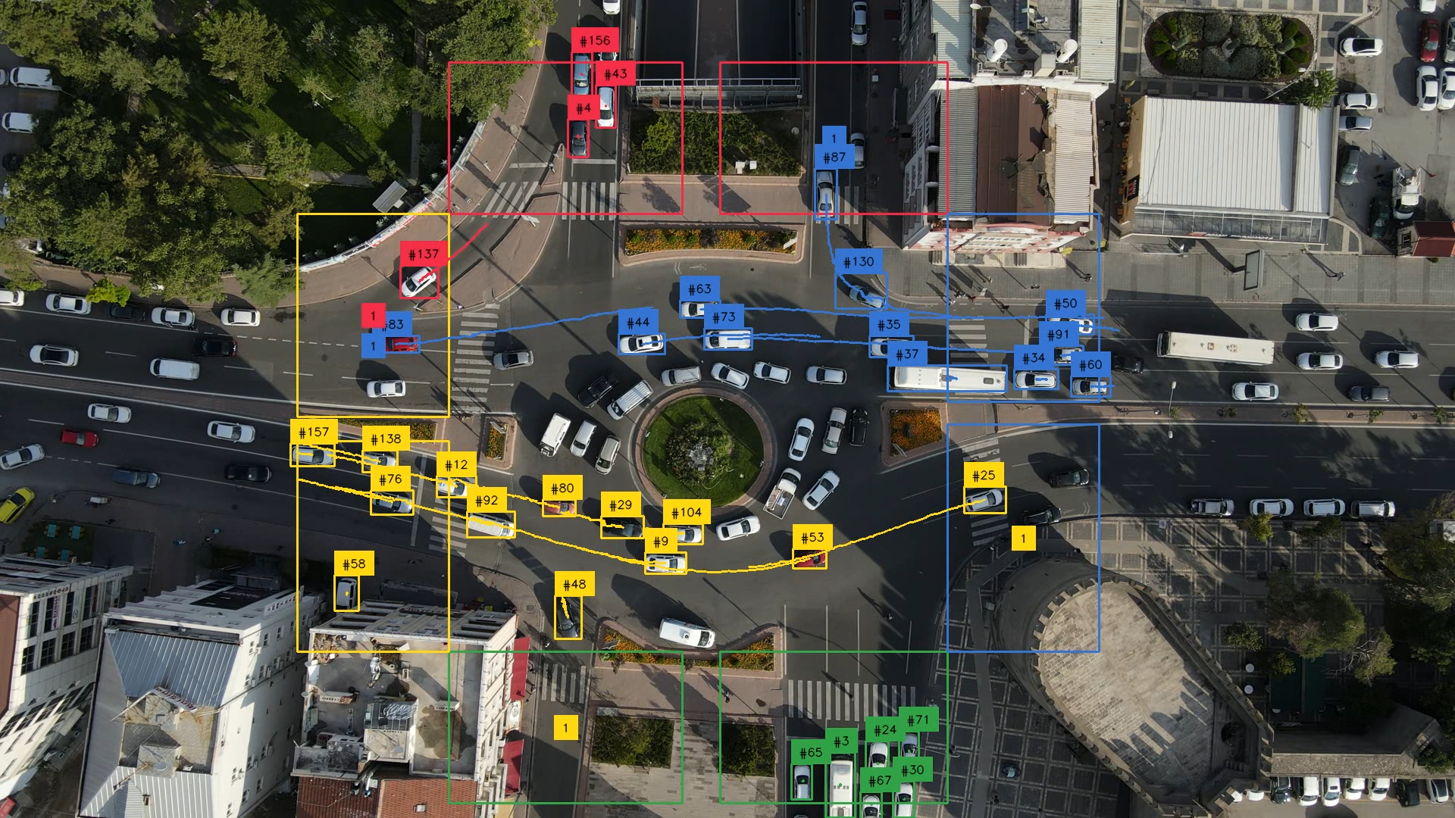
9. Output
Department of Computer Science & Engineering, MITSoE, Loni Kalbhor

Slide 12
10. Conclusion and Future Work
The project focuses on developing a feasible object trajectory analysis system to enhance security. It includes trajectory tracking, behavior analysis, seamless integration, and scalability, leveraging available tracking algorithms for both technological and financial feasibility. The goal is to provide valuable insights for improved situational awareness.
Department of Computer Science & Engineering, MITSoE, Loni Kalbhor

Slide 13
References
LeCun, Y., Bottou, L., Bengio, Y., & Haffner, P. (1998). Gradient-based learning applied to document recognition. Proceedings of the IEEE.
Kalal, Z., Mikolajczyk, K., & Matas, J. (2012). Tracking-Learning-Detection. IEEE Transactions on Pattern Analysis and Machine Intelligence.
Kalman, R. E. (1960). A New Approach to Linear Filtering and Prediction Problems. Transactions of the ASME–Journal of Basic Engineering.
Julier, S. J., & Uhlmann, J. K. (2004). Unscented Filtering and Nonlinear Estimation. Proceedings of the IEEE.
Department of Computer Science & Engineering, MITSoE, Loni Kalbhor

Slide 14
Thank You
Department of Computer Science & Engineering, MITSoE, Loni Kalbhor

