Slide 1

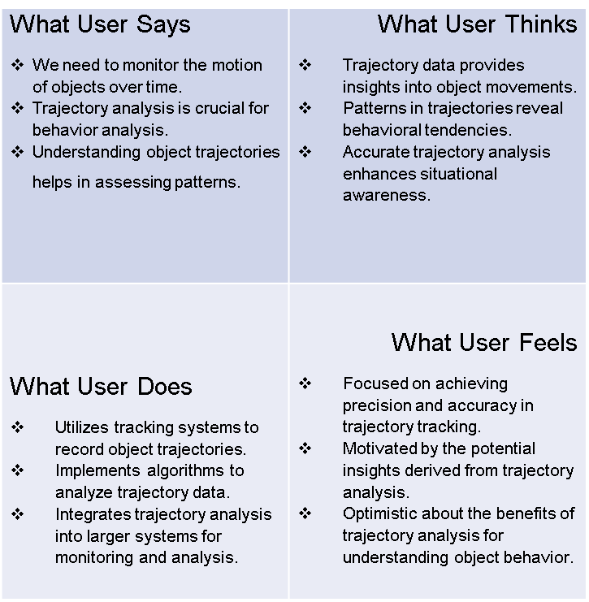
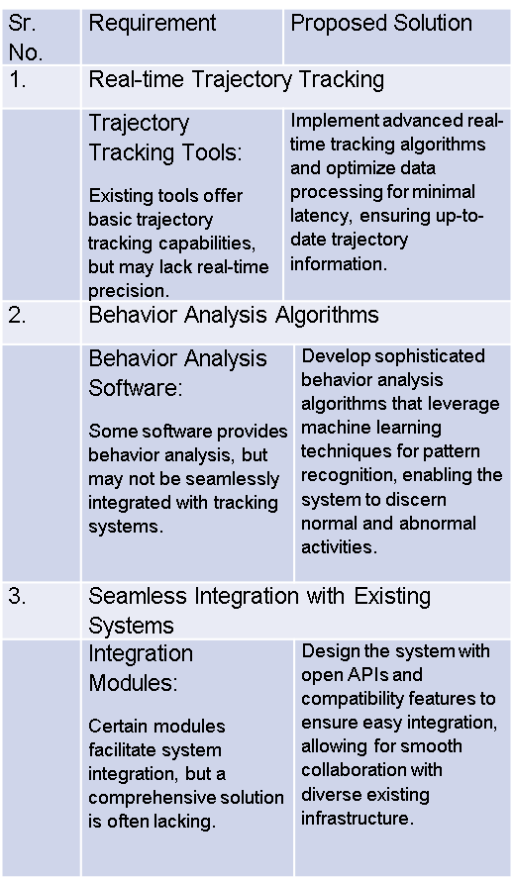
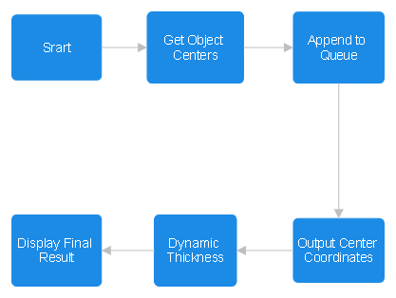
Proposed Architecture/ Diagram:
MIT SCHOOL OF COMPUTING
Class : TYAIA04
Group Id: 11
DEPARTMENT OF COMPUTER SCIENCE & ENGINEERING
Real Time Car Trajectory
Real-Time Tracking and Behavior Recognition using yolor
Raashi Lokhande, Atharv Jadhav, Anshita Nair, Vaibhav Kadam
Faculty Guide:
Prof. Deepak Naik
User
Problem statement
The challenge is to effectively monitor the motion of objects over time and conduct behavior analysis. This is crucial for various applications such as surveillance, security, and research, where understanding the trajectories of objects is essential for pattern recognition and anomaly detection.
Proposed Solution
Our proposed solution involves the development and implementation of a comprehensive object trajectory analysis system. This system will utilize advanced tracking algorithms and computer vision techniques to capture and interpret the motion of objects accurately. The solution will include real-time monitoring capabilities, behavior pattern recognition, and data visualization tools for enhanced analysis.
Scope and Feasibility
The project focuses on developing a feasible object trajectory analysis system to enhance security. It includes trajectory tracking, behavior analysis, seamless integration, and scalability, leveraging available tracking algorithms for both technological and financial feasibility. The goal is to provide valuable insights for improved situational awareness.

