Slide 1
HDX Update
Yulia

Slide 2
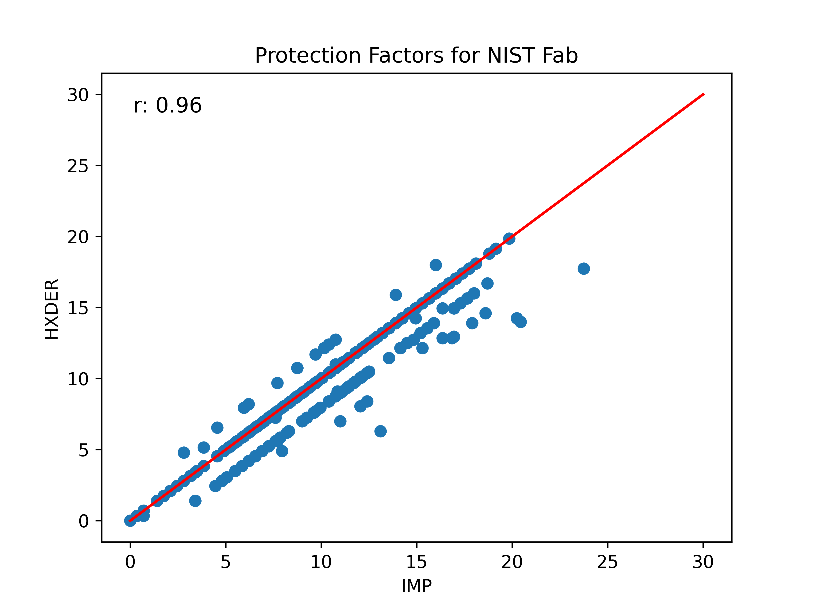
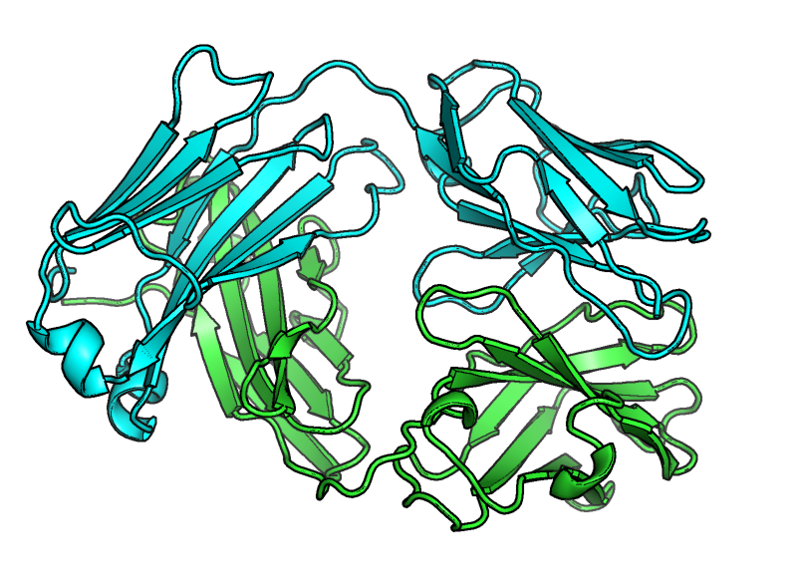
HDXer and IMP PFs correlate for NIST Fab

Slide 3
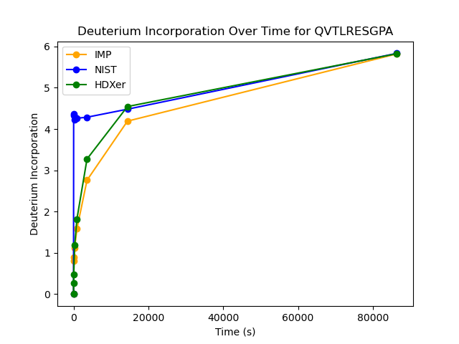
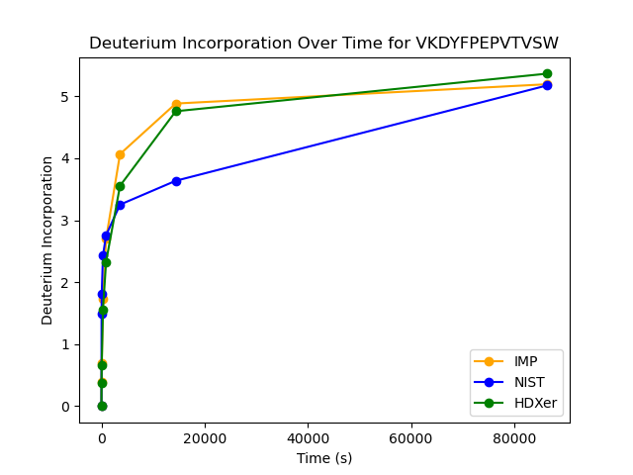
HDXer and IMP PFs seem to capture experimental data for NIST Fab for some peptides

Slide 4
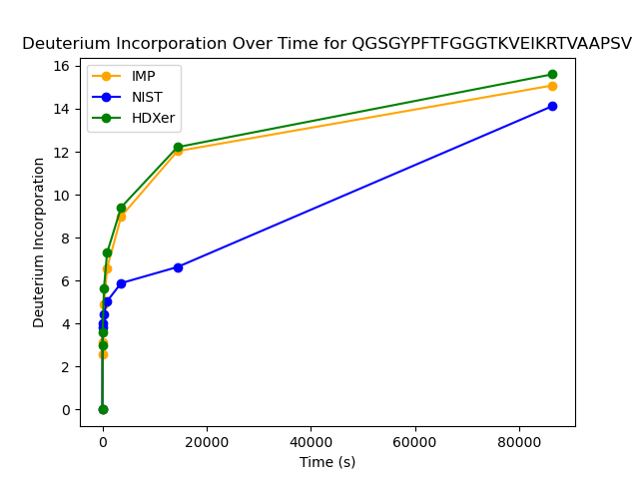
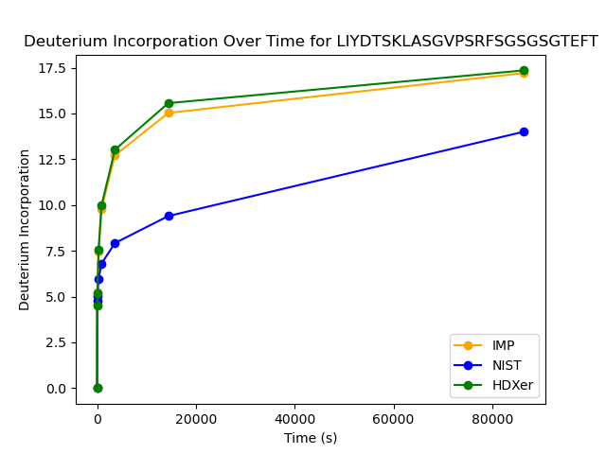
Some cases show HDXer and IMP %D agree but experimental data is different
Notes:
-look at different peptides in dimer, tetramer, octamer (esp ones you expect may change)
-potentially make weighted protection factors for peptides that change a lot depending on oligomeric state

Slide 5
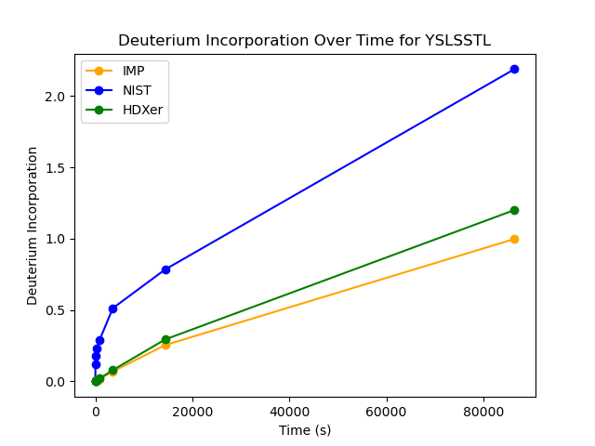
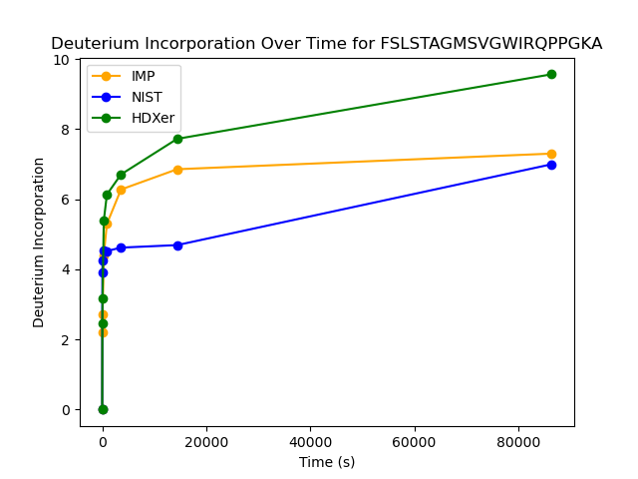
Some cases show HDXer and IMP %D agree but experimental data is different

