Slide 1
HDX Update
Yulia

Slide 2
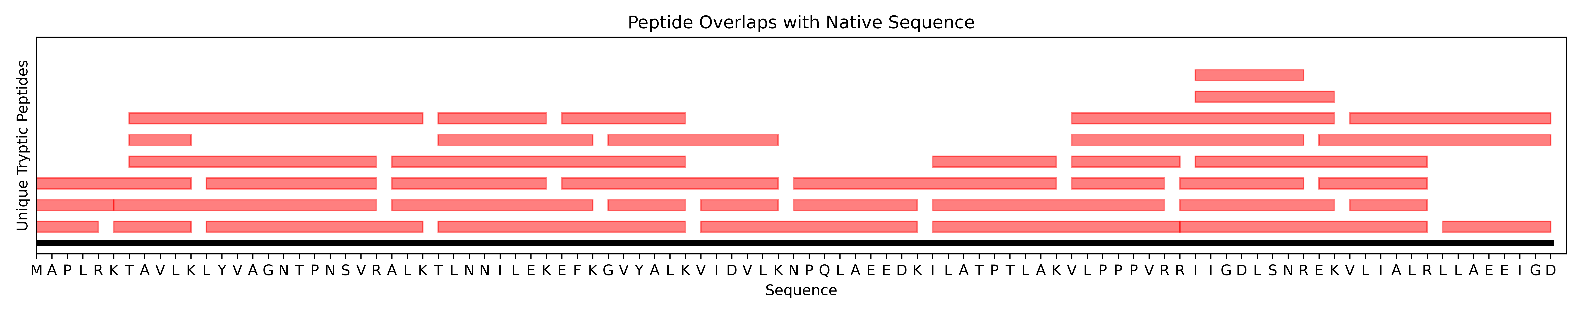
Generated all unique tryptic peptides between 5-20 residues

Slide 3
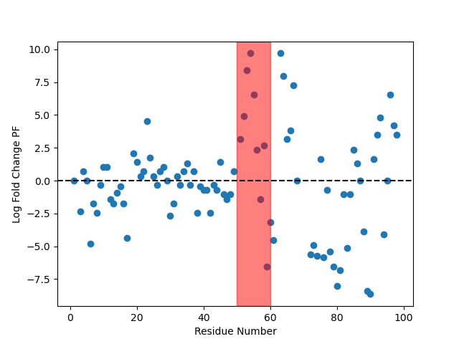
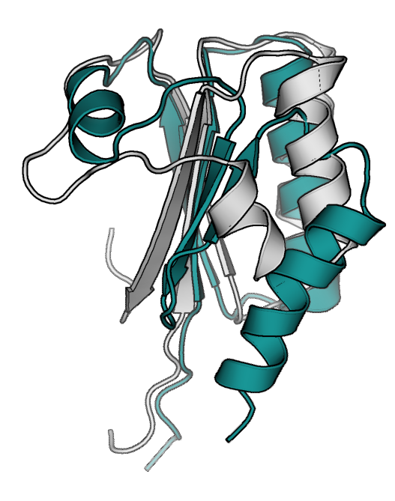
Using HDXer, predicted PFs for our model fold-switch showed big protection changes

Slide 4
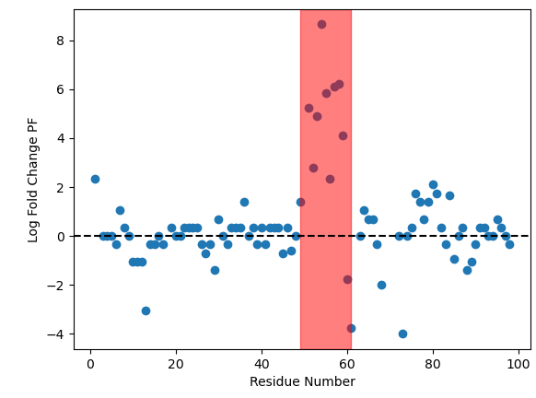
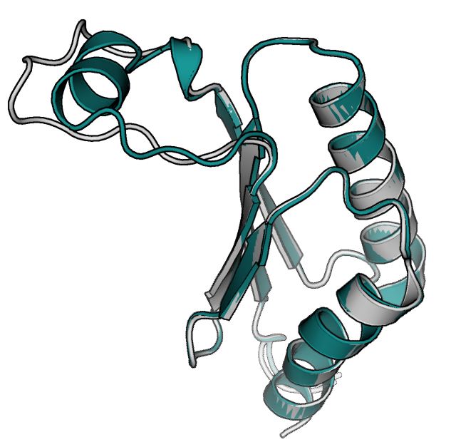
New models allow for better control over the fold switch synthetic data - HDXer

Slide 5
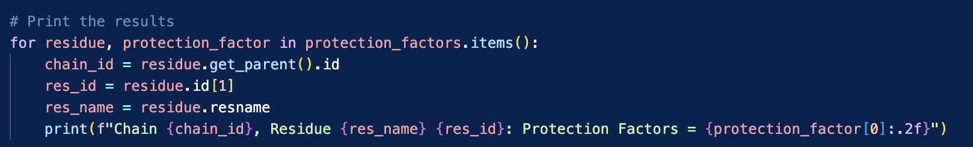
IMP PF script works now (mostly), bug fixed
The script was outputting the number of hydrogen bonds per residue, not the PFs
The data is structured as a dictionary where the key is a BioPython residue object and values are tuples of the structure (#hbonds, #HA contacts, PFs)
Fixed to be protection_factor[2]

Slide 6
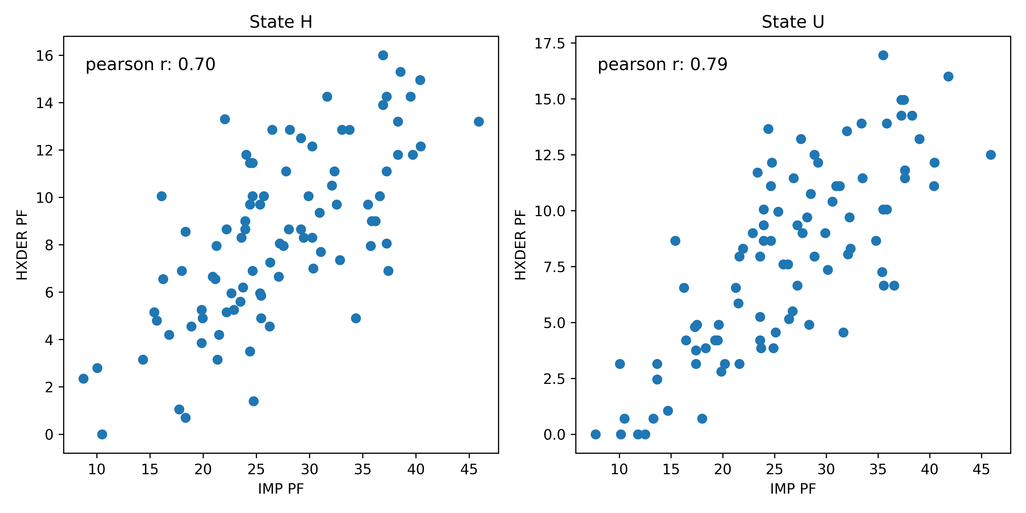
IMP protection factors correlate with HDXer PFs – Vanilla

Slide 7
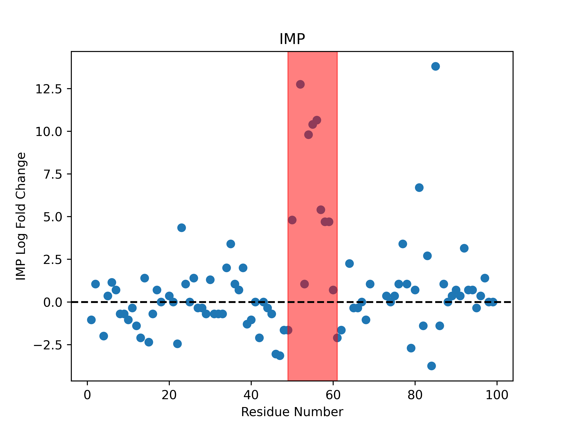
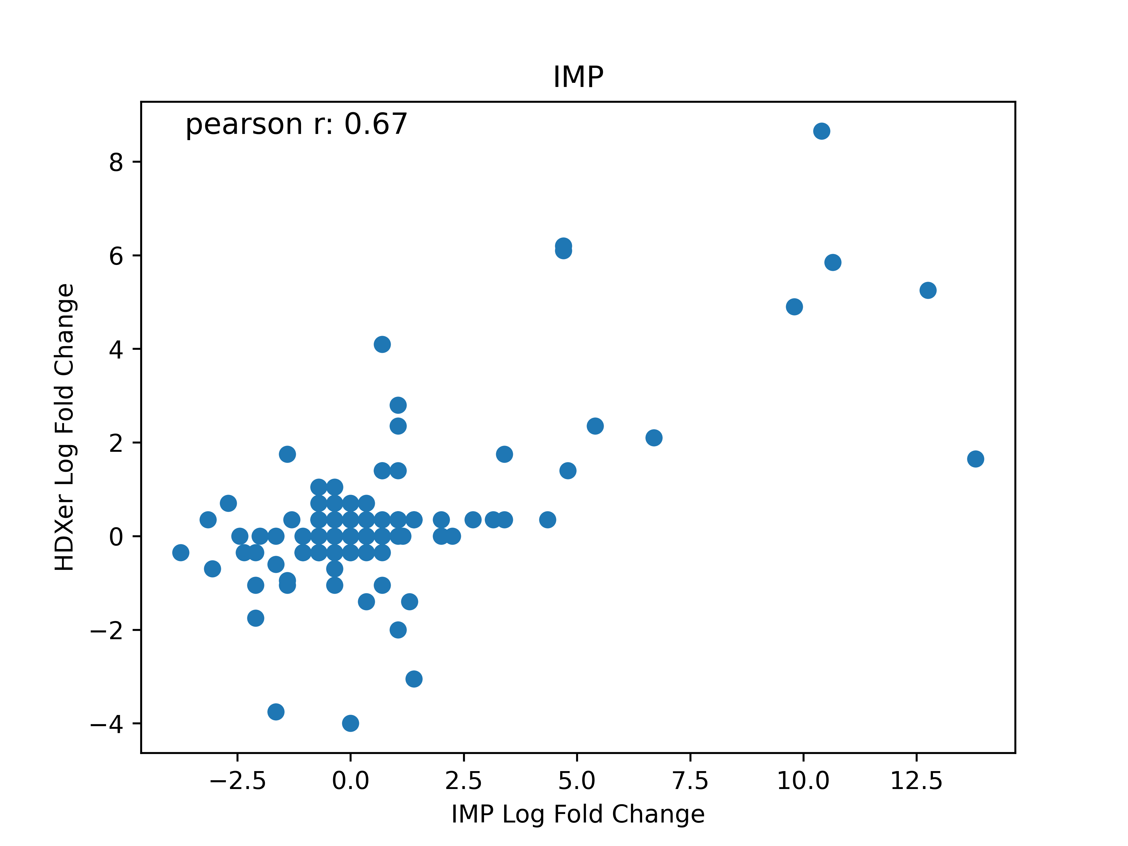
Log fold changes correlate nearly as well - IMP
Notes:
Remove proline glycine

Slide 8
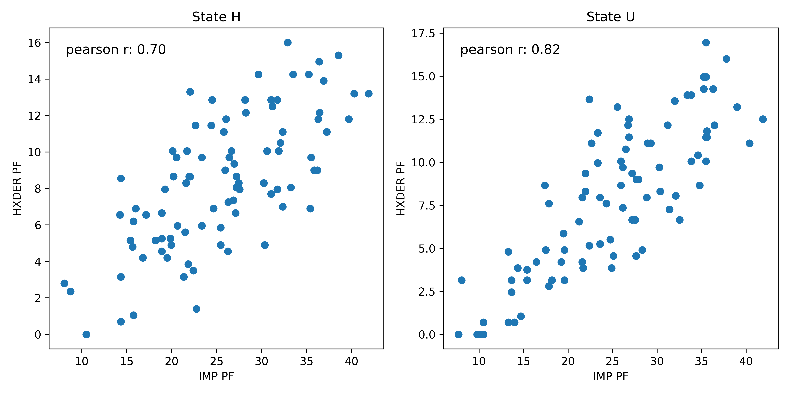
IMP protection factors correlate with HDXer PFs – Baker Hubbard*
Criteria:
Rda < 2.5 A
Θ > 120°

Slide 9
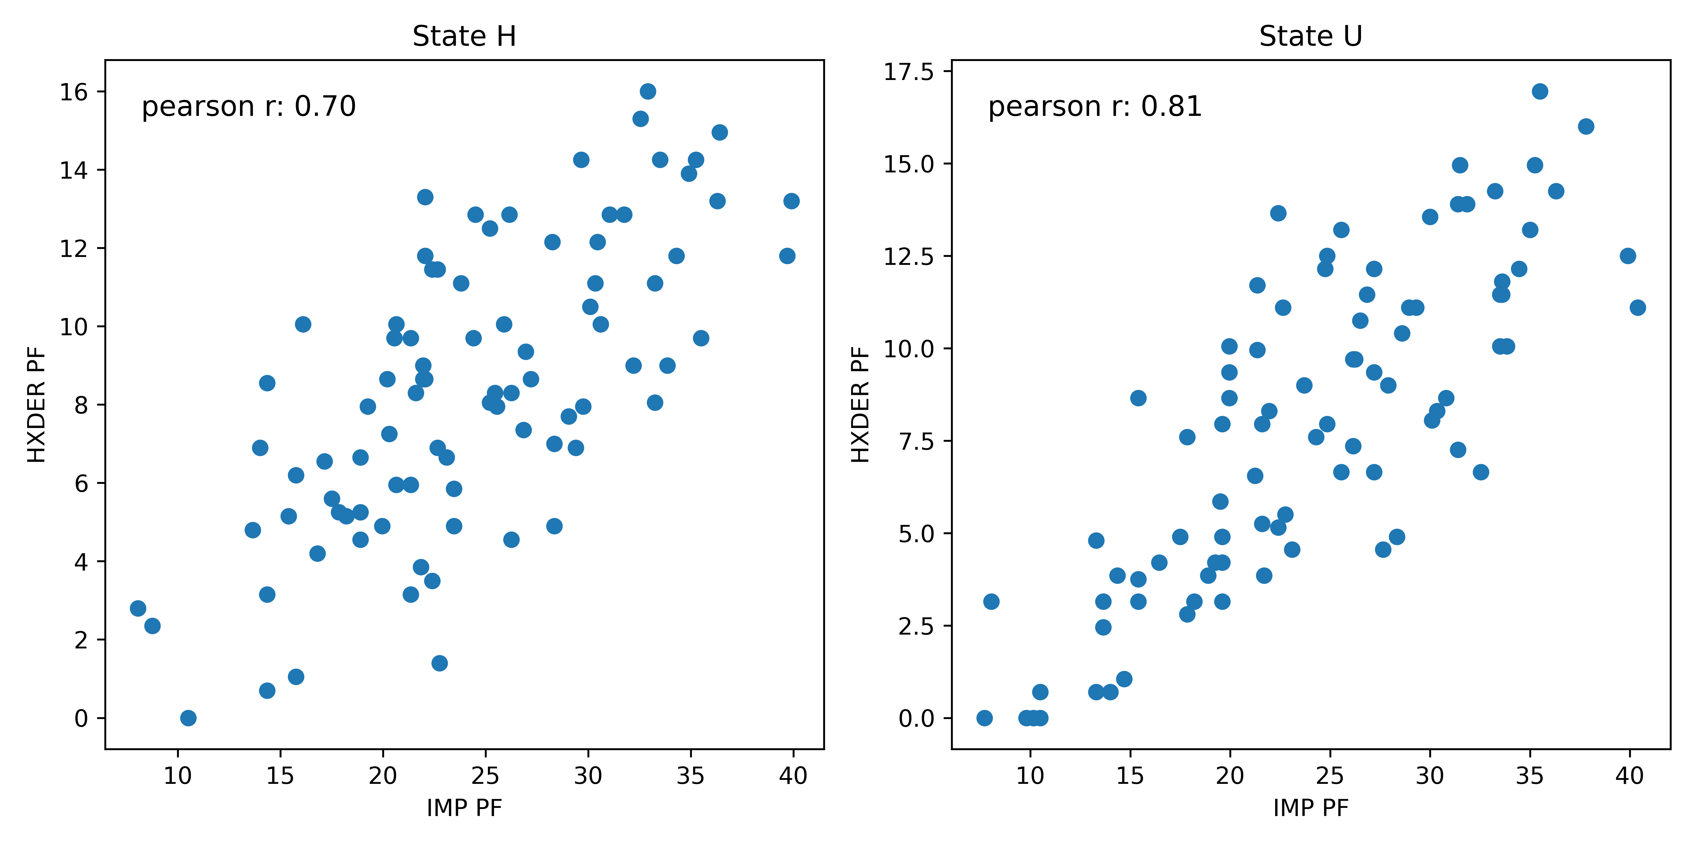
IMP protection factors correlate with HDXer PFs – Wernet Nilsson
Criteria:
Rda < 3.3A - 0.00044∗( Θ 𝐻𝐷𝐴)^2
Notes:
-magnitudes of PFs are huge though, not exactly sure why. Need to look into calculating heavy atom contacts

Slide 10
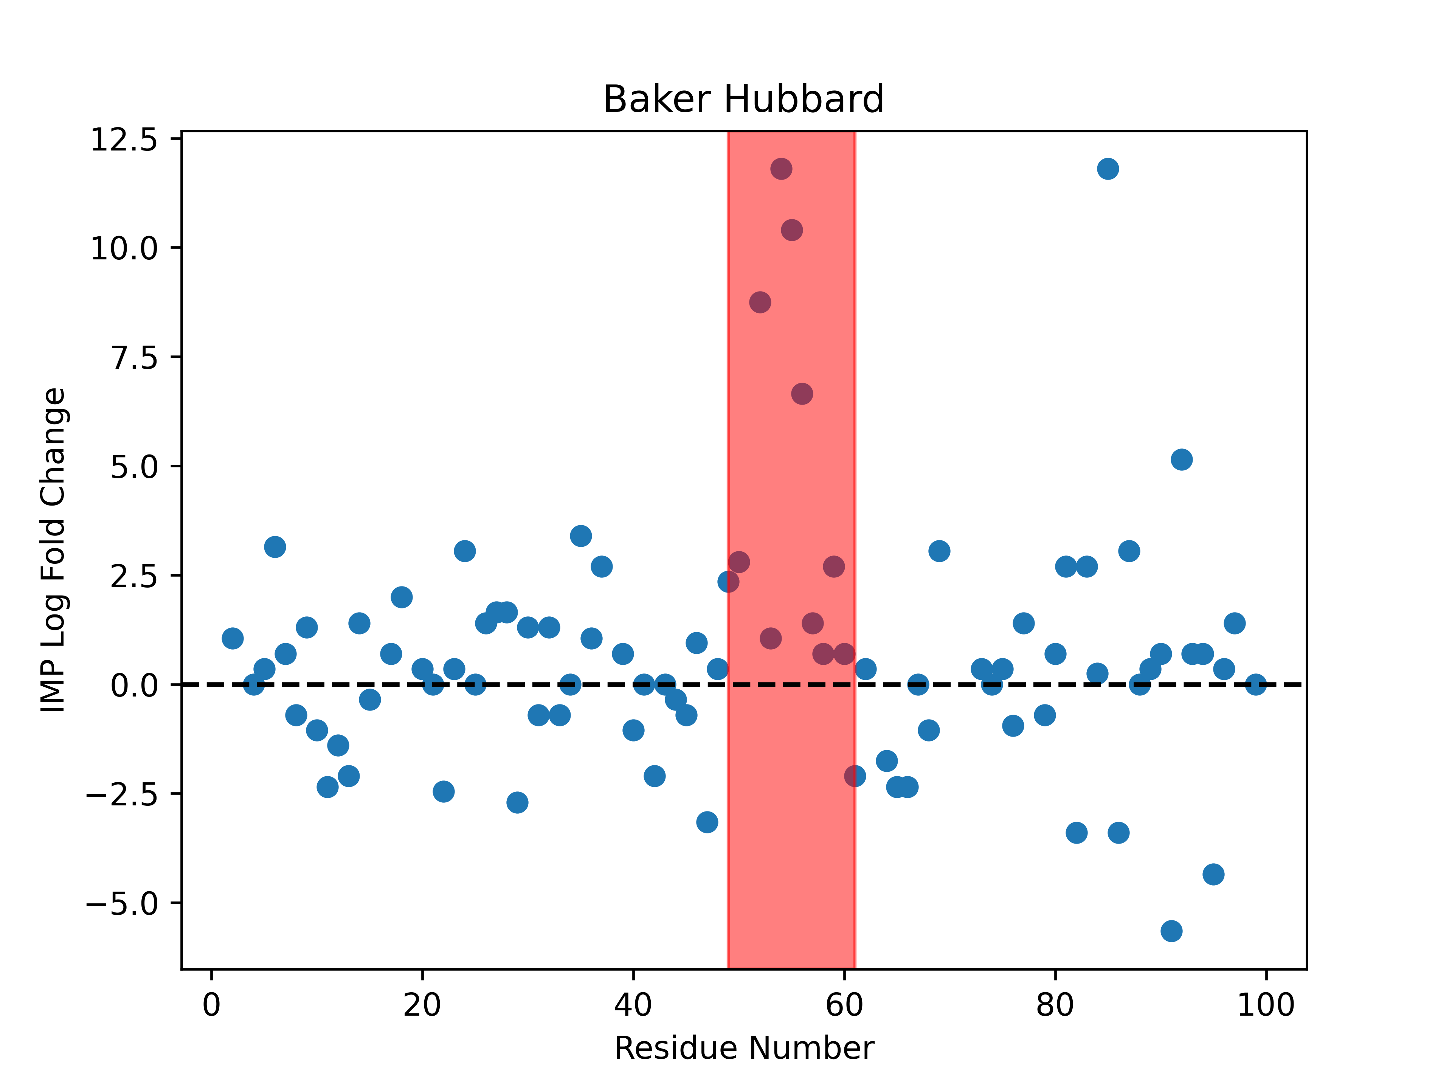
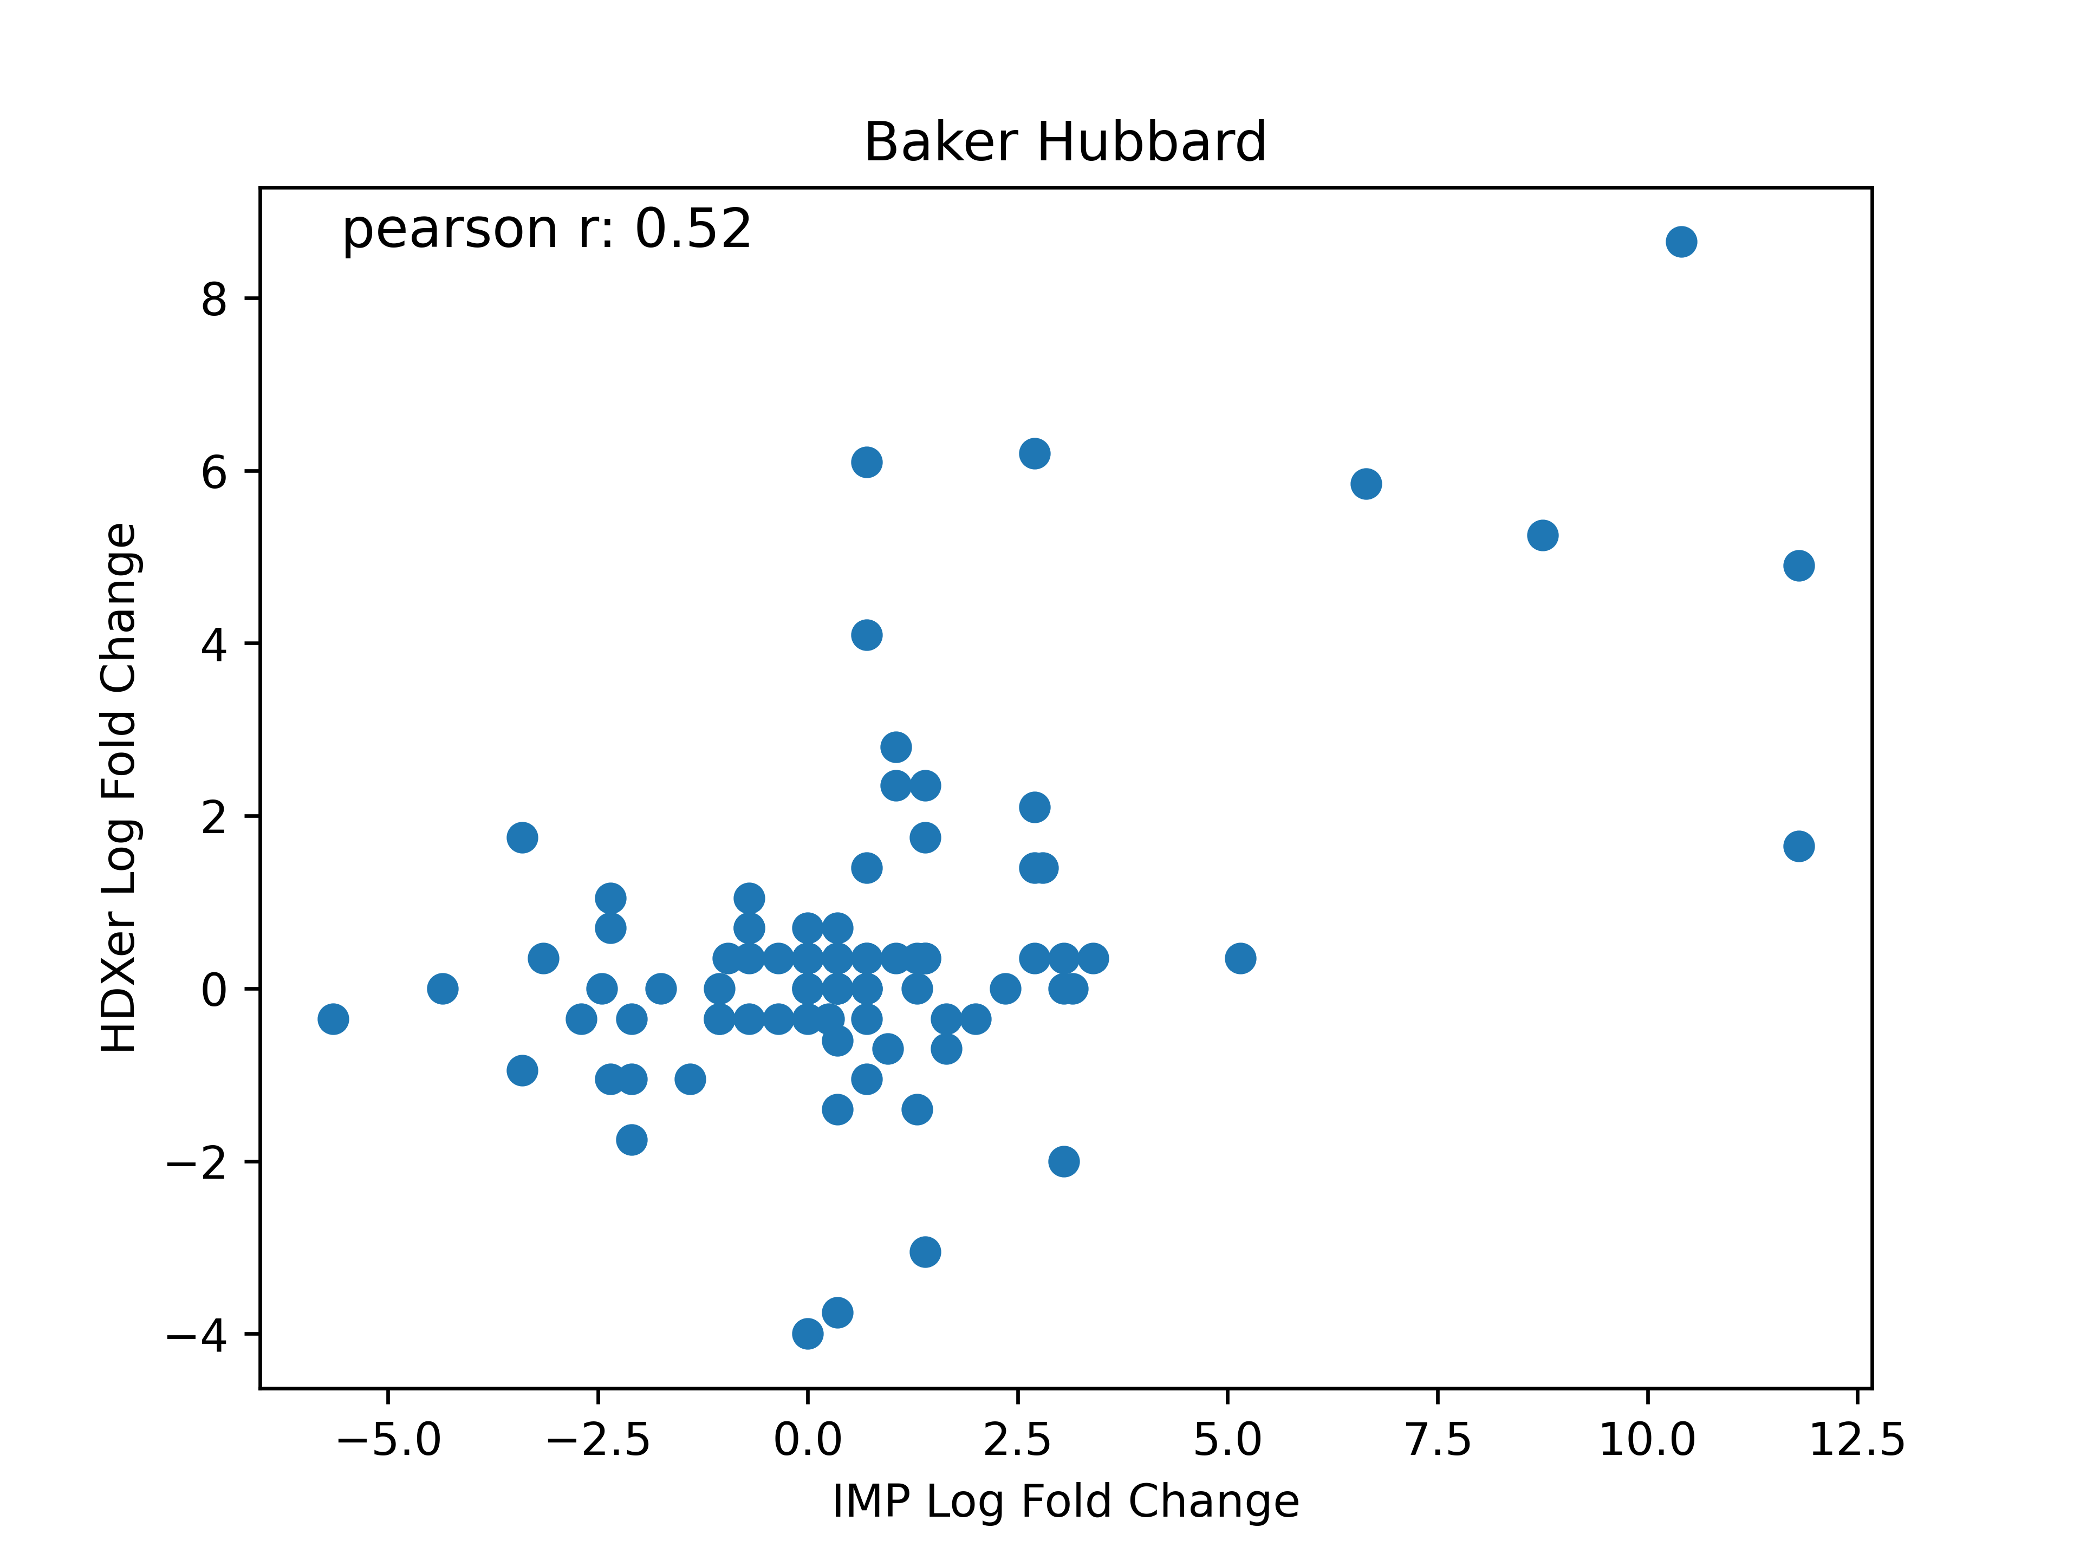
Log fold changes don’t correlate as well – Baker Hubbard

Slide 11
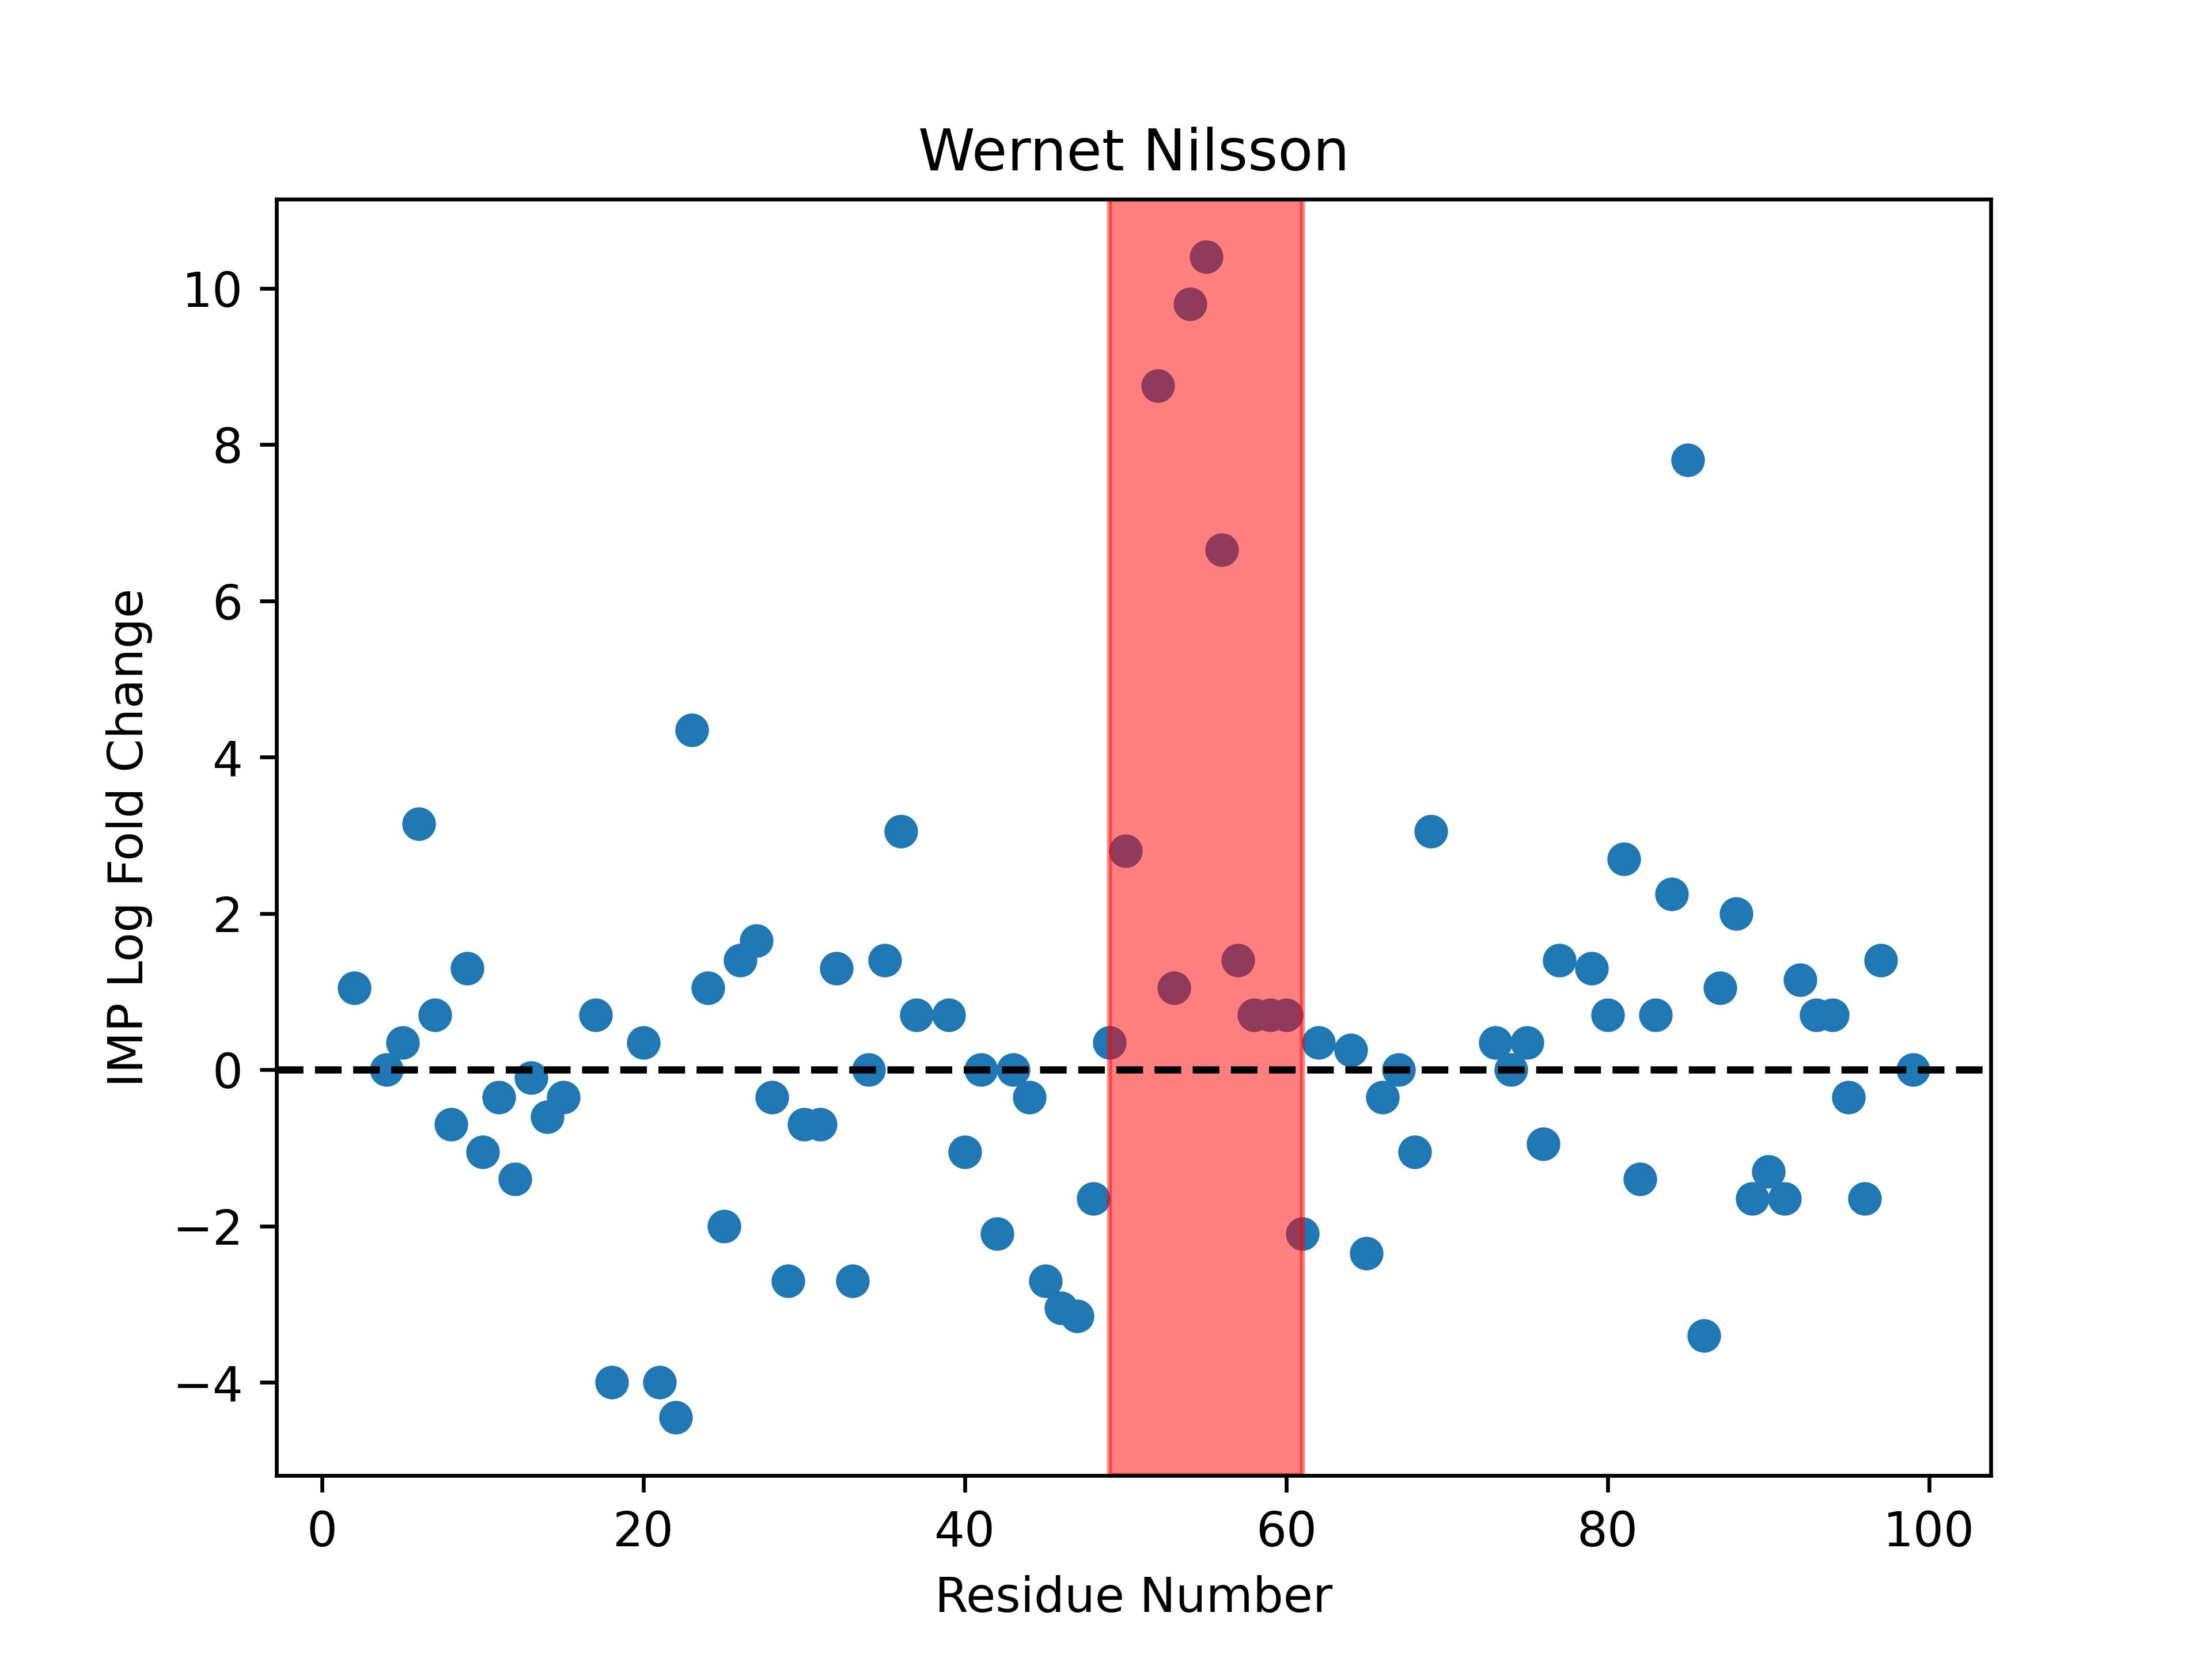
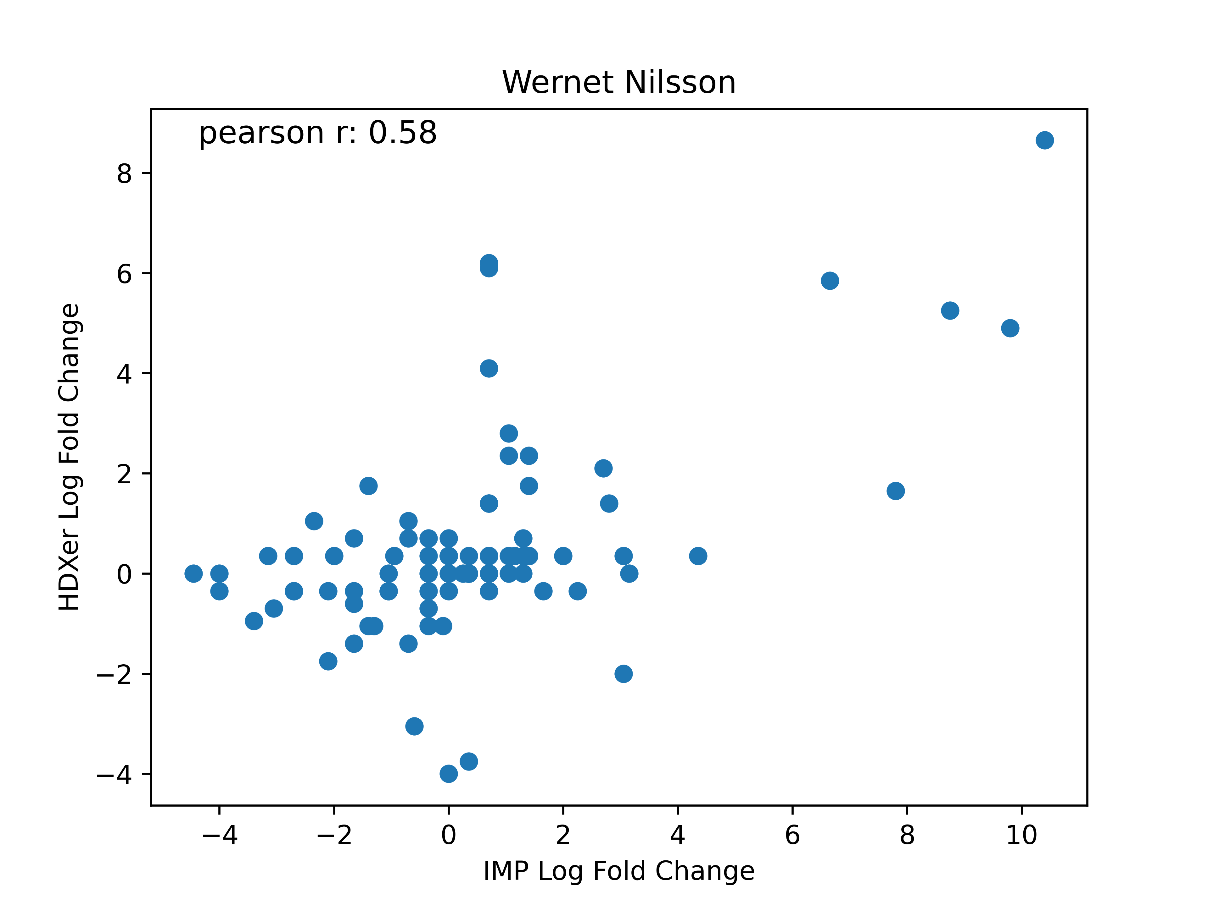
Log fold changes don’t correlate as well - Wernet Nilsson

Slide 12
Moving forward with PF script
Will use as is to calculate % deuteration, but will do some troubleshooting in the calculation of heavy atom contacts
Seems to make the PF estimation really sensitive
K85 points in a different direction in StateH --> StateU, going from 84 --> 56 heavy atoms contacts
Compare HDXer & IMP PFs to experimentally determined ones (FAb)

Slide 13
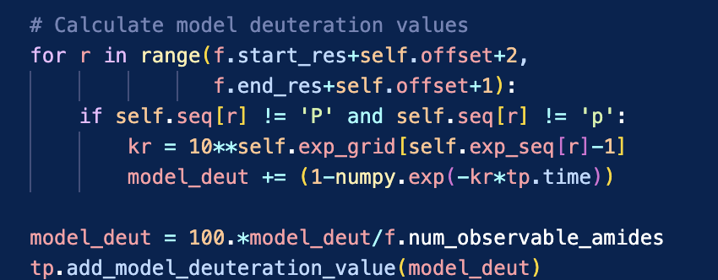
I’ve calculated the % deuteration for each peptide using Daniel’s forward model
Now:
Thinking about implementing score function

