Slide 1
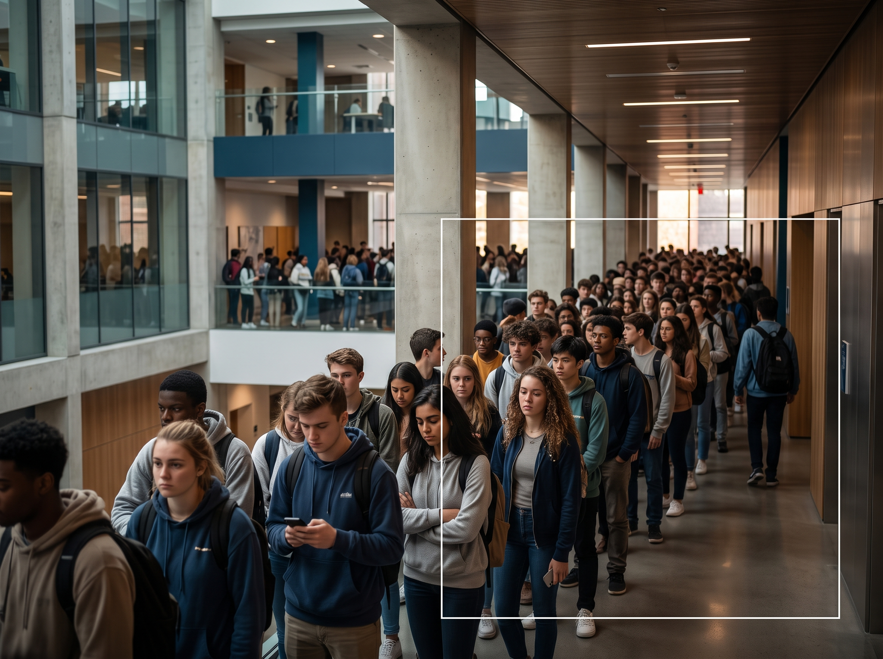
Lunch queues are stealing up to half an hour
Peak-meal waits reach 15–30 min — a repeated pain students cannot plan around.
15–30 min
peak wait
The problem is not just queue length; it is uncertainty about whether a cafeteria is worth walking to right now.
Source: QueueZero controlled benchmark brief

Slide 2
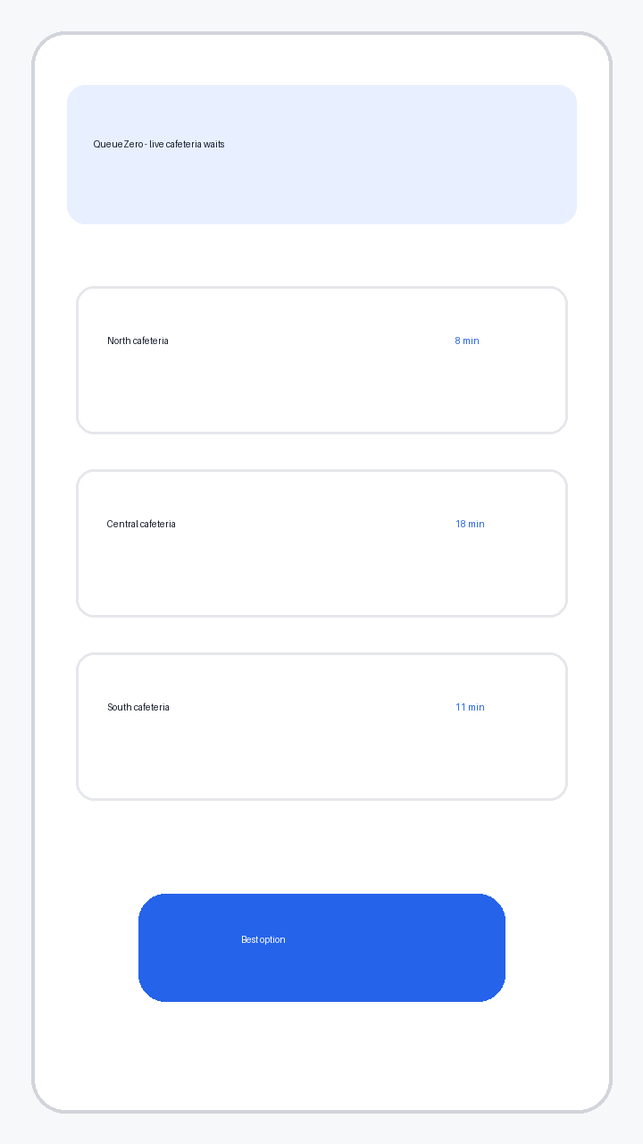
From camera feed to a wait-time decision in three steps
Observe the queue → estimate the wait → tell students whether to go now.
Go now / choose
Camera feed
Queue length
Wait prediction
another cafeteria
Source: QueueZero controlled benchmark brief

Slide 3
Early testing clears the bar for a semester pilot
Technical accuracy and user intent are promising; retention and paid adoption remain unproven.
3.8 min
76%
prediction MAE
would use weekly
42
3
students tested
cafeterias
Next proof: one-university semester pilot
Source: QueueZero controlled benchmark brief

