Slide 1

Drug Free Safety Program
Ohio Bureau of Workers’ Compensation

Slide 2


SAFETY IN THE WORKPLACE
Having a drug-free workplace shows our commitment to a safe workplace for everyone.
We have zero tolerance for alcohol and drug use in the workplace!!!

Slide 3

THE POLICY STATES THAT:
The distribution, possession, sale or use of illegal drugs or alcohol during working hours and on all company worksites is prohibited. “Worksite” means any office, building or property owned or operated by Construction Labor Contractors or any site at which an employee is to perform work
for Construction Labor Contractors or their client.

Slide 4
THE POLICY STATES THAT:
All employees are required to be fit for work and free from the effects of alcohol, illegal drugs and the abuse or misuse of prescribed drugs or over-the-counter drugs at all times during working hours. Employees are responsible for following the instructions of the prescribing physician when taking prescription medication. Employees are responsible for following the manufacturer’s instructions when taking over-the-counter medication.

Slide 5

POSITIVE DRUG TEST CUTOFFS
Drug EMIT GC/MC Screen(ng/ml) Confirmation(ng/ml)
Amphetamines 1000 500
Cannabinoids(THC) 50 15
Cocaine & Crack 300 150
Opiates 2000 2000
Phencyclidine(PCP 25 25
Positive Alcohol Cutoff .04%

Slide 6

EMPLOYEE EDUCATION
Employees will be trained one time only.
All new employees will be educated prior to being on the job site.

Slide 7

SUPERVISOR EDUCATION
Supervisor awareness and training will include the following:
One hour of employee education and one hour supervisor skill-building
New supervisors will receive at least two hours of training within six weeks of becoming a supervisor.

Slide 8

THE POLICY STATES THAT:
In testing for drugs, a urine specimen will be collected. If the drug test reveals a positive result, a test from the original specimen will automatically be verified through a second, more detailed test.

Slide 9


THE POLICY STATES THAT:
In testing for alcohol, a breathalyzer test will be administered. The positive result of 0.04% or greater for alcohol from a breathalyzer test will constitute a violation of this Program. An employee may avoid reliance on the breathalyzer sample by voluntarily providing a blood sample within one hour of the time a breathalyzer sample is collected.

Slide 10

TYPES OF TESTING
New-Hire Testing
All persons receiving an offer of employment will have an unannounced test within 90 days of the commencement of employment.

Slide 11

TYPES OF TESTING
Random Testing
On contracts or projects administered by the State of Ohio, there will be random testing of a minimum of 5% of employees working on those job sites.

Slide 12

TYPES OF TESTING
Reasonable Suspicion.
Supervisors who have received training under this Program may require an employee to submit to testing if they have a reasonable and articuable belief that the employee is using or under the influence of a substance based on specific physical, behavioral, or performance indicators.

Slide 13

TYPES OF TESTING
Post-Incident Testing
Any employee who may have caused or contributed to an on-the-job incident at any worksite will be required to submit to testing. Employees will be given a job site injury referral card and are responsible to report for testing within 8 hours of the incident. Failure to report within 8 hours will be treated as a positive result.

Slide 14

THE POLICY STATES THAT
Test results and other information concerning substance investigations will be treated confidentially.
Test results and other documents relating to investigations and/or rehabilitative treatment will be kept separate from other personnel records.

Slide 15

THE POLICY STATES THAT:
Positive results
When an employee has tested positive they will be terminated

Slide 16
THE POLICY STATES THAT:
Construction Labor Contractors recognizes its commitment and responsibility to employees by providing an opportunity for employees to deal with drug and alcohol related problems. The Administrator of the Program will provide any employee with an explanation of available assessment services and a list of resources. Each employee is responsible for paying for any and all services associated with assessment.

Slide 17

THE POLICY STATES THAT:
Employees are encouraged to voluntarily seek assistance with substance abuse before alcohol and drug problems lead to disciplinary actions. The decision to seek prior assistance will not be used against an employee in any disciplinary proceeding. Construction Labor Contractors will support all employees who seek prior assistance by working with the employee and, where appropriate, granting a reasonable medical leave of absence.

Slide 18

CONSEQUENCES
An applicant who refuses to submit to testing, or who receives a positive test result from a new-hire employment test, will not be granted continued employment with Construction Labor Contractors.

Slide 19

CONSEQUENCES
After testing negative on the new-hire employment test administered within the first 90 days, any employee thereafter testing positive as a result of any test will be provided with a Conditional Employment Agreement. After signing the Conditional Employment Agreement, the employee will be temporarily suspended without pay and must consult with a qualified facility for substance abuse assessment and referral. Time off from work will be treated as an approved medical leave of absence. Upon returning to work, the employee will be expected to abide by the Conditional Employment Agreement and will agree to submit to a minimum of four tests at Construction Labor Contractor’s discretion for a period of up to 12 months. Any cost of rehabilitation that is not covered by health insurance is the responsibility of the employee who receives a positive test.

Slide 20

TERMS AND CONDITIONS
Refusing to sign the Conditional Employment Agreement upon testing positive will result in immediate discharge.
Any refusal to submit to testing upon Construction Labor Contractor’s request will result in immediate discharge
Possession or sale of illegal drugs on company premises will result in immediate discharge.
Any refusal to sign the Policy Acknowledgement Form and the Consent and Release Forms, or otherwise cooperate with Construction Labor Contractor’s enforcement of the Program, will result in immediate discharge.
!

Slide 21

TERMS AND CONDITIONS
Any attempt to hinder, affect, change or falsify a specimen for testing will result in immediate discharge.
Any attempt to hinder or refusal to submit to a search and inspection will result in immediate discharge.
A violation of this program will not be reported to law enforcement officials unless required by a regulatory body or by criminal law provisions. When required, law enforcement authorities may be contacted and requested to come onto company property in conjunction with a referral for criminal prosecution
!

Slide 22

CONFIDENTIALITY
All aspects of any employee assistance or testing procedures are considered private and will be treated in a confidential manner limited only to individuals with a right to know. Law enforcement authorities may be contacted and requested to come onto company property, when appropriate, in conjunction with a referral for criminal prosecution.

Slide 23
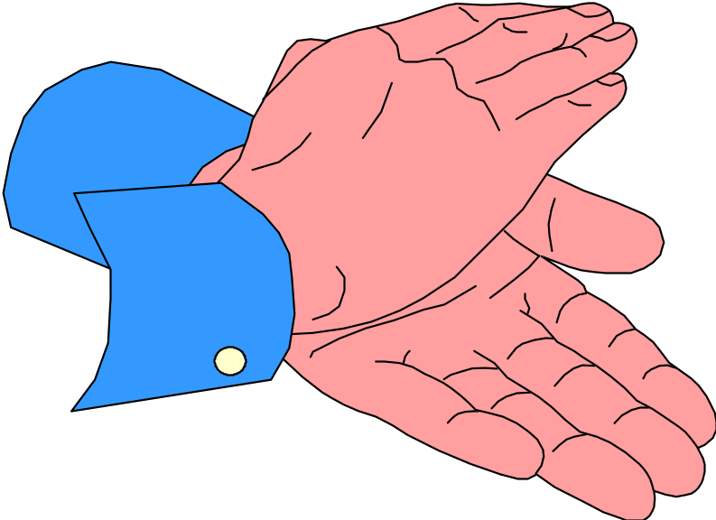
THANK-YOU

Slide 24
EMPLOYEE QUIZ:
Employee Drug Free Safety Program Quiz
Employee name: ________________________ Date: __________________________
Fill is the circle next to the correct response: When complete, PRINT this page and turn it in to you local CLC office.
Respecting zero tolerance, and being clean and sober at work mean:
Leaving your twelve pack in the truck
Only smoking weed across the street from the job site
Monitoring drinking the night before to make sure blood alcohol levels are below the DFSP limits
Not smoking marijuana
Which of the situations below would require a drug test?
If you miss a week of work
Have an accident at work
Appear to be impaired
There is a rumor you are high
Which of the statements below are facts:
Marijuana can be detected in urine for up to six weeks
Eating marigold flowers can produce clean urine
It is okay to take all prescription drugs while at work
Why does the Drug Free Safety Program exist?
Contractors need more bureaucracy
Constructions workers are being injured by workplace substance abuse
DFSP prevents some injury, stealing, low productivity, etc.

