Slide 1
BUILDING BETTER
WORLDS
PROXIMATA × HOIV × START VIENNA // 13–14 NOV 2026 // VIENNA
A 24-hour hackathon at Home of InnoVation. Real cases from real companies, four themes, 200+ builders. You have 24 hours to build something that works.
FOUR THEMES
SCHEDULE
ON THE TABLE
01 Systems for built space
02 Robotics and embodied AI
03 Agentic AI and infrastructure
04 Fintech, crypto and payments
Fri 12:00 Keynote, Hubert Rhomberg
Fri 14:00 Hacking starts
Sat 11:00 n8n & Adaption workshops
Sat 15:00 Code freeze
Sat 16:00 Demos & winners
Sat 18:00 Close & networking
€290,000+ in prizes, credits and tools
Cash track prizes per case
Credits for every participant
Teams of 2–4
HOIV · Arsenalstraße 11, 1030 Vienna · proximata.io · contact@proximata.io
Notes:
Welcome everyone. Keep this slide up while people settle. Two sentences: who we are, what happens in the next 24 hours. Point at the schedule column and flag the two times that matter most: code freeze 15:00 Saturday, demos 16:00.

Slide 2



ORGANISER
A Vienna-based builder space and tech agency. We take on the most ambitious technical challenges and help serious teams in the EU ship real systems, not prototypes that die in a slide deck.
What we do
How we work
Our goal
Enterprise AI automation · agentic systems · on-premise AI · legacy system retrofitting · sales and distribution infrastructure · EU regulatory compliance
A curated bounty system: vetted builders matched to real client problems by skill fit, with fixed scope and outcome-based pricing.
Build the community that makes Vienna a place where ambitious technical work actually happens. This hackathon is part of that.
proximata FlexCo · Vienna · proximata.io
Notes:
Keep this to 60 seconds. The point is credibility, not a sales pitch: we build this kind of system for clients, which is why the cases here are real. Mention that the bounty model is how some of you could end up working with us after the weekend.

Slide 3
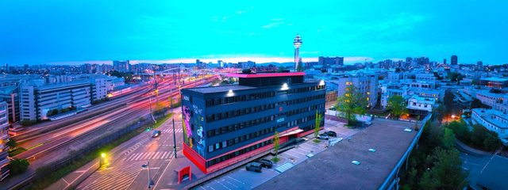
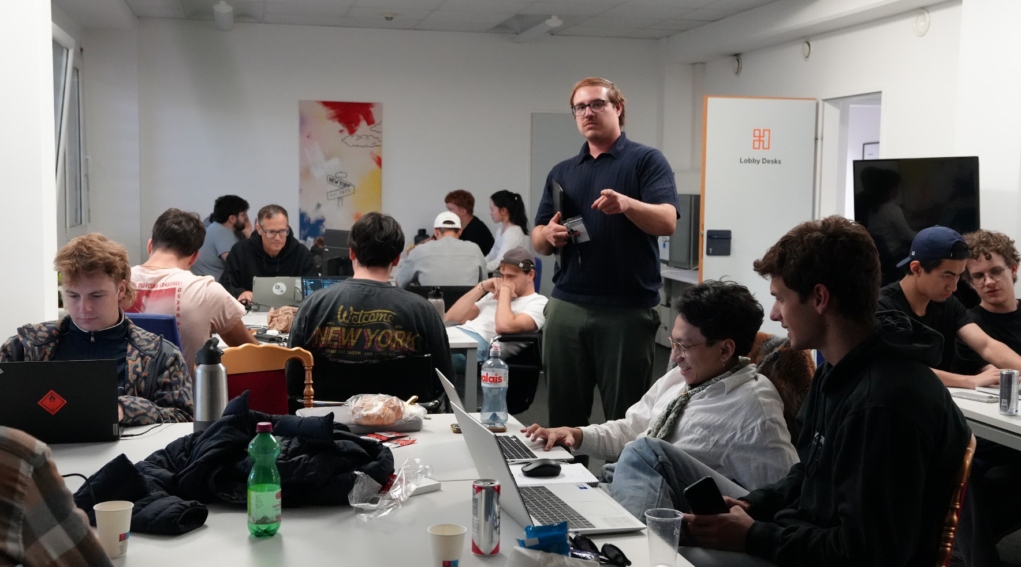
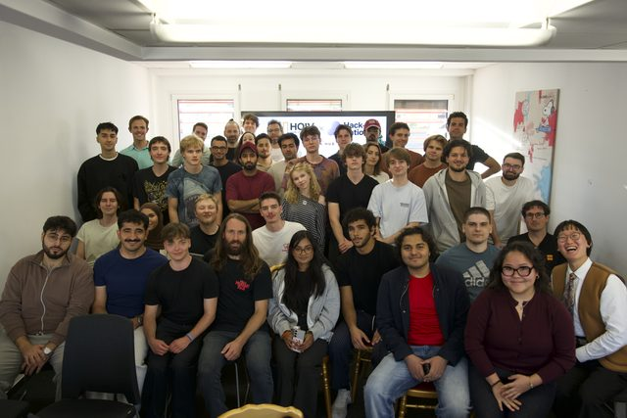


CO-ORGANISER
Vienna’s premier innovation and creative platform, and the hub you are standing in. It is a platform for innovators, founders and creatives, and a launchpad for ideas that need space, hardware and people around them. Apart from being a physical space for the most disruptive ideas to take shape, HOIV also develops tools that help turning these ideas into reality.
What they bring
Where you are
Their goal
The venue and its infrastructure for 24 hours, the robot lab space, the community around it, and the doorbell the D1 is going to answer.
Arsenalstraße 11, 1030 Vienna. You can stay overnight if you want to keep building. Respect the house and the people in it.
Make Vienna a place where innovators find each other and have somewhere to build. Powered by HOIV.
homeofinnovationx.com
Notes:
Hand over to the HOIV team if someone from HOIV is in the room. Otherwise: thank them for the space, and flag the practical bit — overnight stays are allowed, treat the building well.

Slide 4
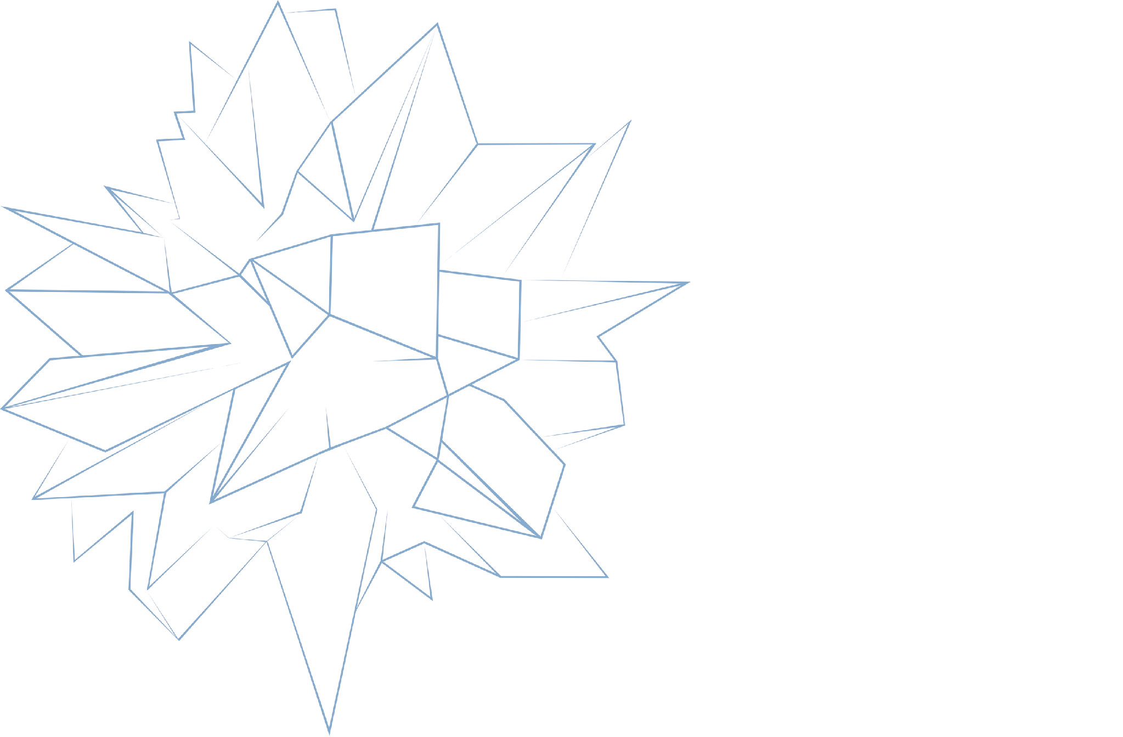

START VIENNA
Notes:
- schirftarten udn großen anpassen

Slide 5

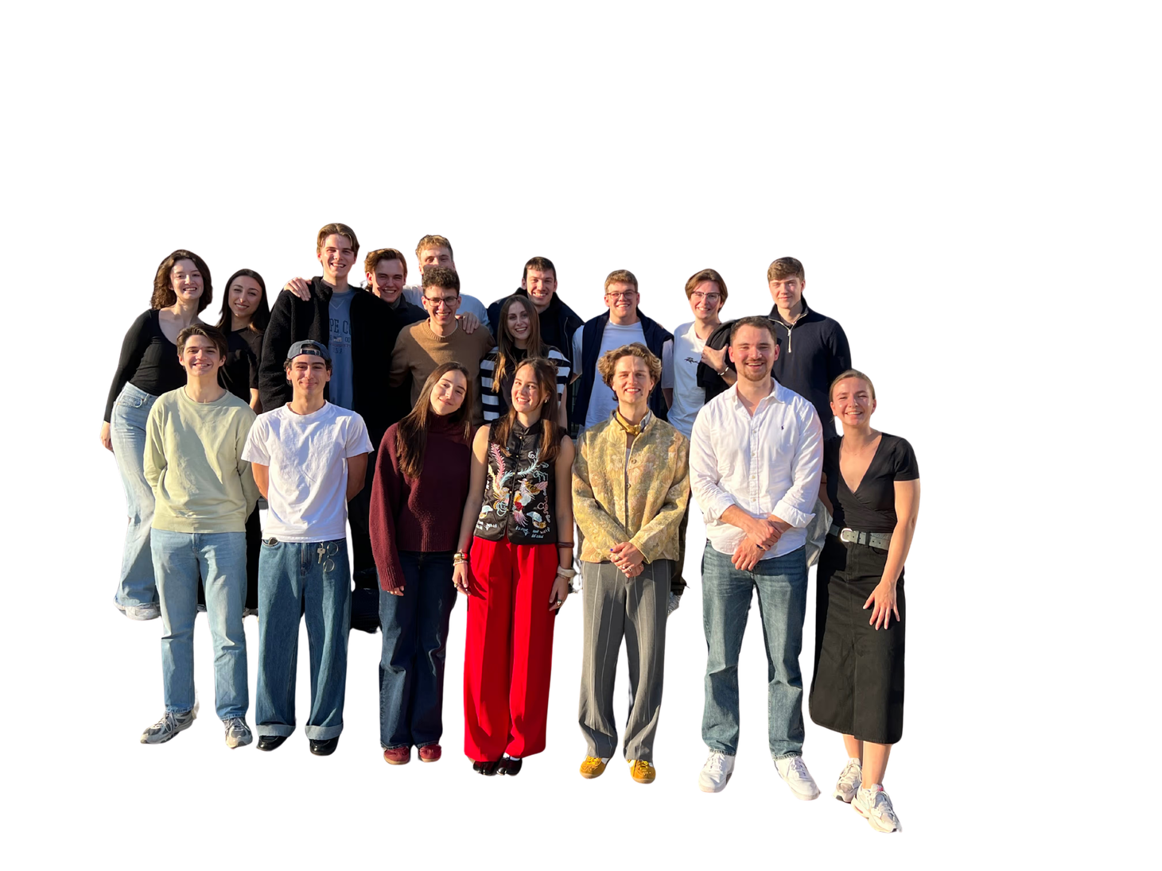






WHO WE ARE
Part of the global START network, rooted in Vienna
VISION
MISSION
Our Vision is to establish START Vienna as an indispensable part of the Viennese startup ecosystem, building a pipeline of exceptional founders and startup talent.
START Vienna connects entrepreneurial students with the skills, mindset and network they need to thrive in the startup world, through hands-on programs, founder access and a community that pushes them to grow.
40+ MEMBERS 15+ NATIONALITIES
sponsored by:

Slide 6
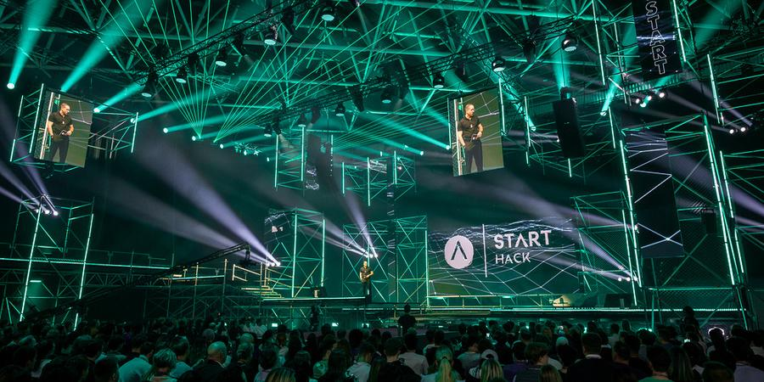
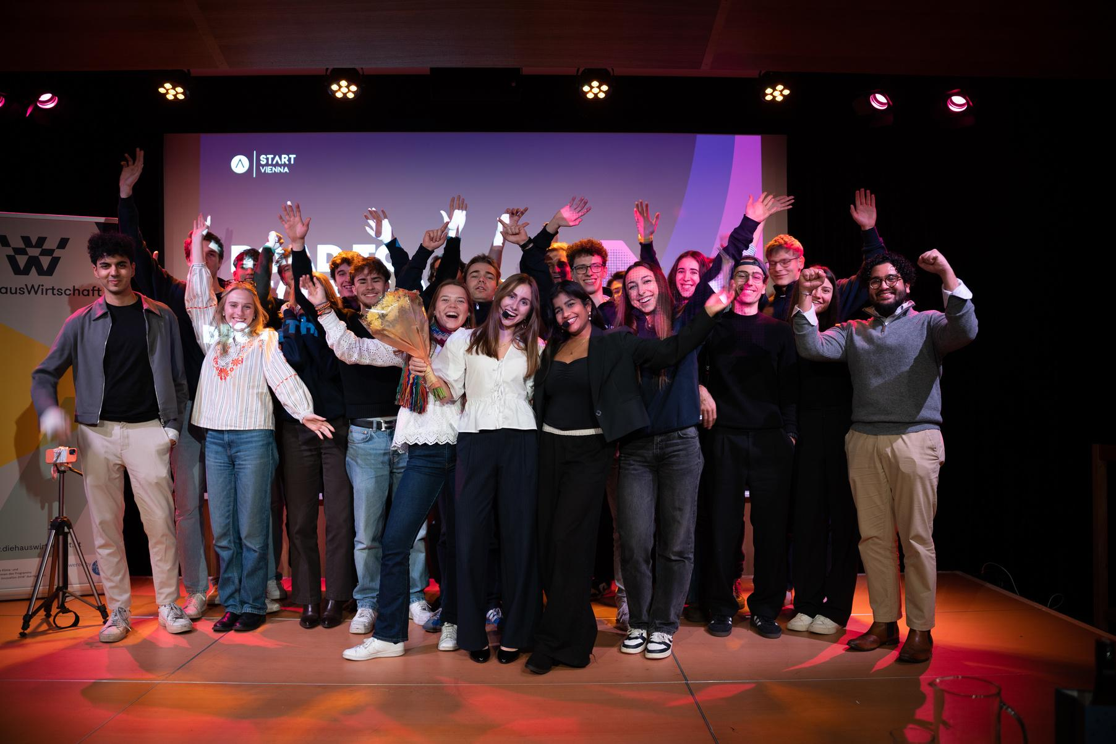
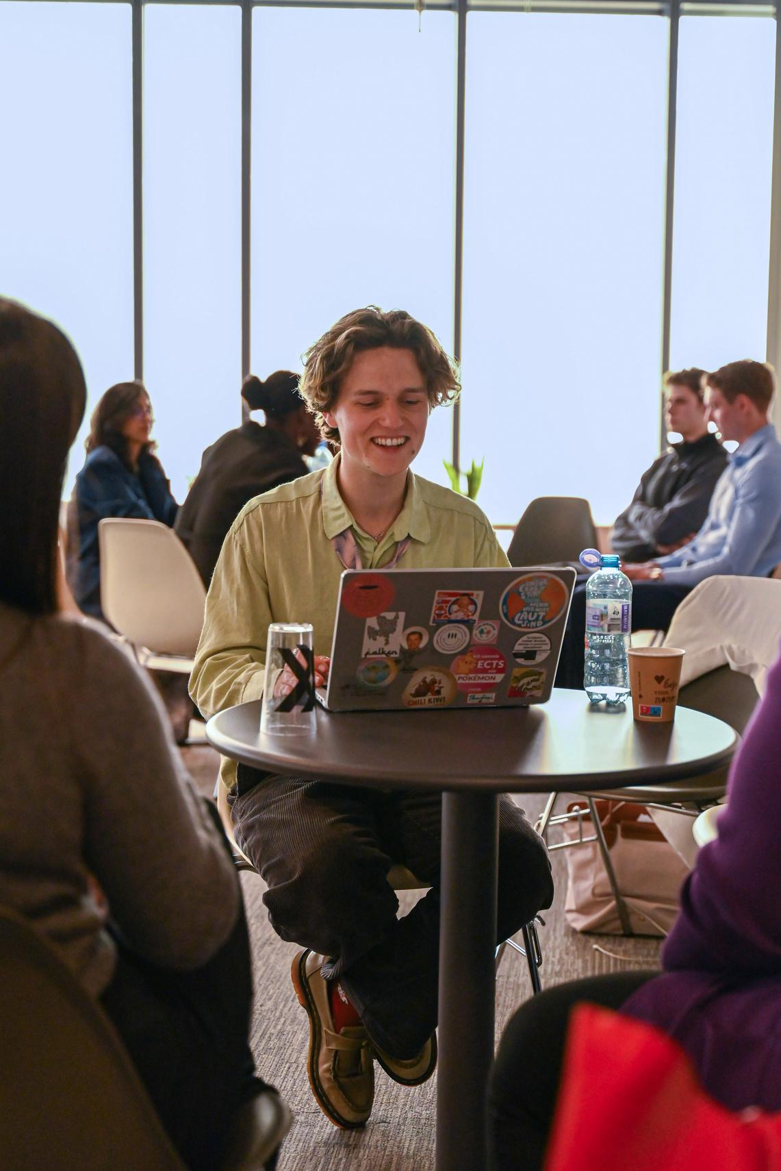
WHAT WE DO
PITCHING COMPETITIONS
TALENT MATCHING
HACKATHONS
50 hackers
36 hours
5 prizes
120 attendees
10 pitches
1 prize
100+ applicants
60 students
8 startups
Notes:
sinah fragen

Slide 7
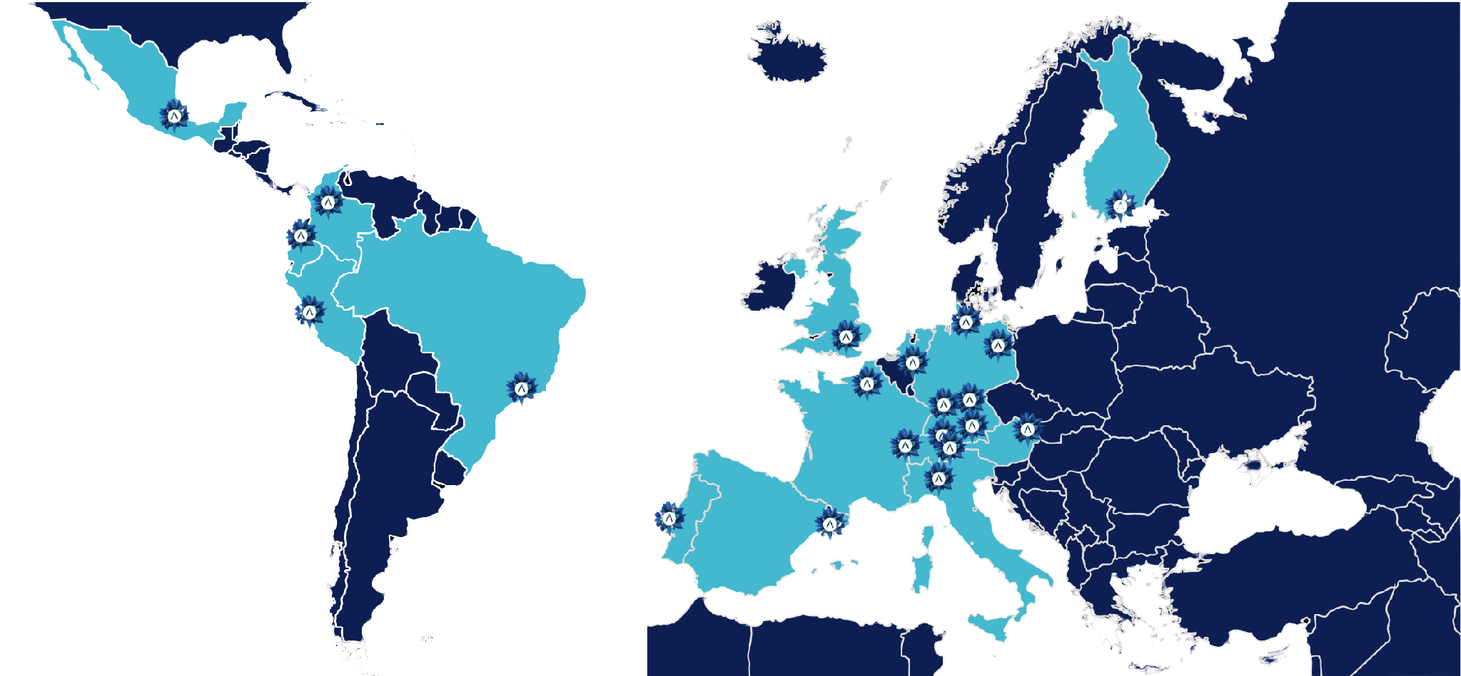

WHO WE ARE CONNECTED TO
We are part of START Global, the leading initiative dedicated to empowering the next generation of entrepreneurs who are shaping our world through
entrepreneurship, technology and innovation.
30 YEARS
1000+ ALUMNI
#1 in Europe & LATAM

Slide 8


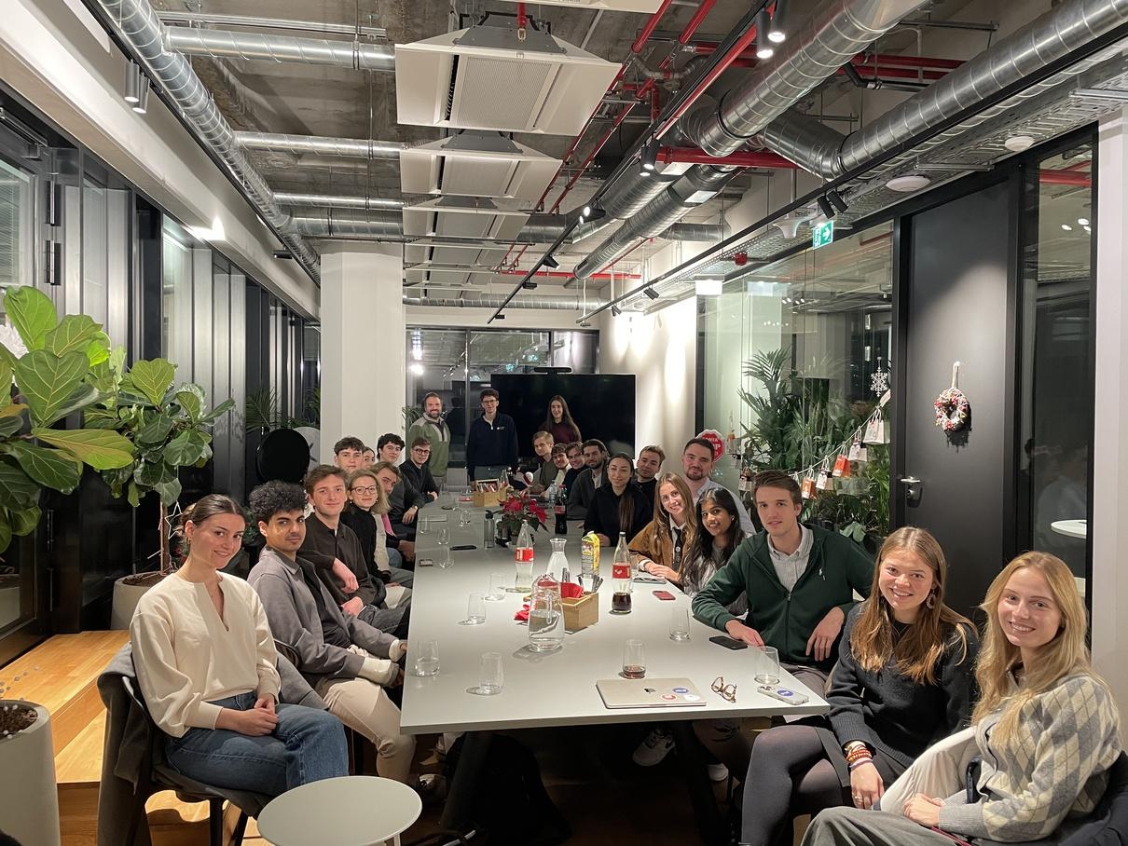
JOIN US
TO SHAPE
VIENNA’S
ECOSYSTEM
TOGETHER!
contact us
www.start-vienna.com
START Vienna
start.vienna
Notes:
BASEEEEEE
https://pitch.com/v/base-presentations-j6iypy

Slide 9
Four themes.
Seven real cases.
THE CASES
01
02
03
04
Systems for built space
Robotics and embodied AI
Agentic AI and infrastructure
Fintech, crypto and payments
Talona · Dorabella · Rhomberg
TU Wien Robotics Club
Biscuit · proximata
Crypto Club Vienna
Pick your case preferences in Discord. We match every team to a case.
Notes:
Transition slide. Say it plainly: every case comes from a company with a real problem, and the partner picks their own winner. Then explain the matching process once, before you go through the cases one by one.

Slide 10

Context for the Physical World
TRACK 01 · SYSTEMS FOR BUILT SPACE · TALONA
PRIZE
$1,000
Construction runs on group chats, email threads and spreadsheets. One crew closes a wall before the inspection, another builds from last week’s drawings. Bad data and miscommunication cost the industry an estimated $1.85 trillion in 2020.
Build either
What wins
Standard terms
Catch a problem on site. A missed change, work out of sequence, a stale drawing early enough for someone to act. Or build a live picture of a physical place that people, agents and robots can act on.
Connect to what the site already uses. Keep one live record of what changed and who decided it. Flag issues as they happen. Decisions go to the superintendent.
Public GitHub repository under MIT, in the proximata organisation. Talona gets a non-exclusive licence to use what you build. A portfolio piece you can show anyone
Notes:
Call out the IP terms clearly, out loud, not just on the slide. Anyone picking this track gives up the public MIT repo. If that is a problem for them, they should pick another case.

Slide 11

RadiCal: From Submission Plan to Price
TRACK 01 · SYSTEMS FOR BUILT SPACE · DORABELLA
PRIZE
€2,500
Plan in — traceable values, quantities and, ideally, a price out. The formulas are known. What is missing is reliable reading: plans arrive in every quality, and today’s AI hallucinates on interior areas.
Four levels
Rule no. 1: no black box
NDA and IP
1 Extraction: room schedule, openings list
2 Calculation: ÖNORM B 1800, 14 key ratios
3 Quantities and bill of quantities
4 Price, bonus, only after level 3
Every value carries its unit, where it was found, the method, the calculation path and a confidence. 100 parameters: 78 mandatory, 22 bonus.
Real plans under NDA. Work belongs to Dorabella, private repo. Sign before you get the data package. Mentor: Stefan Radic.
Notes:
Two things to stress: the data package only goes to people who have signed, and the key-ratio self-check is how they catch their own errors — window area over facade area should sit around 0.15 to 0.20.

Slide 12

PLATO · CLARA Future — The Autonomous Building
TRACK 01 · SYSTEMS FOR BUILT SPACE · RHOMBERG
PRIZE
€1,500
One building. One year. Thousands of decisions. Run a 40-room self-check-in hotel through a full year of synthetic data with agents, robots and automations — detect problems, decide and act safely, and feed what you learn back into the next building.
Three levels
The data
Safe by design
1 Operate & detect: turnaround conflicts, a hidden water leak, energy versus comfort
2 Act autonomously: maintenance cascades, an event weekend, energy and logistics
3 Learn & feed back: what CLARA should do differently, what PLATO should build differently
Quickstart: 21 days. Dev: a full year of bookings, telemetry, water, energy, weather, tariffs, staff and guest messages. Missing values, late alarms and benign look-alikes are in there on purpose. A hidden holdout set drops before code freeze.
Autonomous actions log and explain themselves. Technicians, blocked rooms and cost need approval. Entering an occupied room needs guest consent. Never release an uncleaned room.
Notes:
Two things to stress. One: the holdout set means they cannot memorise the dev data, so the pipeline must be one documented command. Two: PLATO-40 is fictional, so any finding is about the dataset, never about a real Rhomberg building.

Slide 13

Hack the D1: Unlock a real robot
TRACK 02 · ROBOTICS AND EMBODIED AI · TU WIEN ROBOTICS CLUB
No docs, no API, 24 hours. The D1 is a full-size Hyundai service robot: 58 × 58 × 129 cm, 74 kg, Ubuntu on its display and everything below it undocumented. Unlock every sensor and the drive, then prove it by making the D1 answer the door.
Five levels
Scored out of 100
House rules
1 Get in: map the interfaces
2 Unlock sensors as ROS 2 topics
3 Take the wheel via /cmd_vel
4 Navigate with Nav2
5 Answer HOIV’s doorbell
Levels reached 35 · live demo 25 · safety 20 · documentation 20. Every level is a demo on its own.
UV-C and plasma stay disconnected. First drives on a stand. A hand on the stop whenever it moves. Never flash firmware.
Notes:
Read the house rules out loud, word for word. This is the only track with a real safety risk. Mention that teams with no robot time can build levels 4 and 5 in Gazebo and port them over.

Slide 14

Build the Missing Tools
PRIZE
TRACK 03 · AGENTIC AI AND INFRASTRUCTURE · BISCUIT
$1,000 in Adaption credits
Every company has software it wishes existed: the dashboard nobody has time to build, the workflow still run in spreadsheets, the internal system that would make everyone’s job easier. Now you can build it.
The challenge
What wins
What you get
Pick a company, real or fictional. Find the tools it is missing. Build 2–3 interconnected applications on Biscuit that help its teams work better together.
Not one standalone app. Show how different teams build their own tools while everything stays connected, with shared data moving between them.
Biscuit credits and support throughout the hackathon — for this track and for every other track too.
Notes:
Flag that Biscuit credits are available to every team, not just this track. Fill in the prize figure before you present, or say it is announced on Discord.

Slide 15

Think Fast: Local Decision Models
PRIZE
TRACK 03 · AGENTIC AI AND INFRASTRUCTURE · PROXIMATA
Build your project with us with full ecosystem support
Millions of small judgment calls. No tokens, no cloud, no waiting. Pick a real problem made of small judgment calls, build a decision model for it that runs on your own hardware, and prove it works.
Your problem, your data
Judged live, out of 100
Wi-Fi off earns points
Bring your own, take a ready-made task from Dataset Factory, or use our starter kit: test suite, scorer and baseline engine.
Problem worth solving 20 · evidence on held-out data 30 · local, fast, cheap 20 · put to work 20 · make it yours 10. No hidden test suite: you bring the evidence.
Hosted models are allowed, but the top score needs your model answering live with Wi-Fi off. Fine-tune with your Adaption credits; Best use of Adaption is open to this track.
Notes:
Our own case, so set the standard: the winning number is how many decisions they automate at a 5% error budget, not how clever the architecture sounds. Remind them the engine is graded offline, so no API keys in the pipeline.

Slide 16

Bringing Crypto to Everyday Life
1:1 Mentorship from crypto company experts; Regulatory orientation; Stage slot at CCV event
TRACK 04 · FINTECH AND CRYPTO · CRYPTO CLUB VIENNA
Crypto is still mostly about trading and investment. Build a functional product that brings it into everyday life, or puts blockchain underneath a traditional financial service. Take something people already do, and add crypto at the back.
Three directions
Scored out of 100
Out of scope
Transform an everyday product or process through crypto. Or solve an existing FinTech challenge with blockchain. Or build something that becomes relevant in the next 5–10 years.
Technical implementation 35 · innovation and creativity 30 · impact, future potential and user experience 35. Show at least one core feature running live.
Trading, speculation or price prediction. Crypto bolted on without real integration. Concepts with no working prototype. Copies of existing products.
Jury: Daria Rybakova and Nazar Barabash, Crypto Club Vienna · cryptoclubvienna@gmail.com
Notes:
Hand over to Daria or Nazar if they are presenting. The line worth repeating: no working prototype, no prize — this track will not reward a pitch deck.

Slide 17
Code freeze: Saturday, 15:00
SUBMITTING YOUR WORK
One submission per team, through the form on Discord. Late submissions are not accepted. Demos by winners start right after the judging is finished.
What you submit
Repository requirements
Two exceptions
A public GitHub repository under MIT, in the proximata organisation, in your track’s folder. A 3-minute demo video of the thing working end to end. A written submission: title, one-line pitch, team and members, problem, solution overview, tech stack and links.
Public at submission time, with an MIT LICENSE file at the root. A real README: setup, run, environment, architecture, assumptions. A .env.example, and no secrets committed. Code the jury can actually run.
Talona and Dorabella tracks: work belongs to the partner, goes to a private repository and is not published under MIT. Every member accepts those terms before matching. Everything else is unchanged.
Submission form and track folders: Discord, #Hackatho26
Notes:
Say the time twice: code freeze is 15:00 on Saturday, not 16:00. Tell people to push early and push often, because last-minute git problems are the most common way to lose a submission.

Slide 18

Best use of Adaption
OPEN TO EVERY TRACK · ADAPTION
PER TEAM MEMBER
$1,000 IN CREDITS
This runs alongside your track, not instead of it. Any team in any case can win it. The winning team also moves to Adaption’s Builder tier, and swag ships after the event.
For example
Everyone gets credits
Workshop, Sat 11:00
An agentic AI team trains a small model on Vienna building-permit and maintenance records, so an agent can triage which construction-site requests need a human engineer first.
$1,250 in Adaption credits for every participant who signs up through our referral link. Sign up directly and you will not get them. All platform access is on the free tier.
30 minutes with an Adaption engineer on training a model from your own data. Worth your time even if you are deep in a build.
Notes:
Push the referral link hard here. Credits only arrive for people who sign up through it, and this is the single biggest perk in the whole event. Put the link in the chat while you talk.

Slide 19

Best use of maritime
OPEN TO EVERY TRACK · ADAPTION
TOP 3 TEAMS
$100/50/50
Serverless containers with memory, triggers and channels that sleep when idle and wake on command. If your build runs agents rather than a single request-response app, this is the infrastructure it was designed for.
Every participant gets
Top 3 teams
Vienna connection
3 months of the Growth plan, free. Redemption steps are in Discord. Worth claiming on Friday evening, not Saturday afternoon..
LLM credits straight into your Maritime account: $100 for first, $50 for second, $50 for third. Judged across all tracks.
Two proximata builders are Maritime’s first ambassadors in Europe. Find them on the floor if you want help getting an agent deployed tonight.
Notes:
Push the referral link hard here. Credits only arrive for people who sign up through it, and this is the single biggest perk in the whole event. Put the link in the chat while you talk.

Slide 20
What every one of you gets
TOOLS, CREDITS AND SPONSOR PRIZES
Sponsor | What you get | How to claim it
Adaption | $1,250 in credits | Sign up through our referral link
Maritime | 3 months of the Growth plan | Steps in Discord
n8n | 1 month of Cloud Pro | n8n’s link in Discord, nothing to set up
Lovable | Pro Plan 1, 100 credits, free | Discount code in Discord — redeem before the event ends, EUR checkout only
Biscuit | Credits and support, all tracks | Ask the Biscuit team on the floor
Maritime, top 3 teams
N8n & Adaption workshops, Sat 11:00
$100 / $50 / $50 in LLM credits, straight to your Maritime account.
Workflow automation and agents, alongside the Adaption session.
All codes and links live in Discord. Do not share them outside this event.
Notes:
One line that matters: the Lovable code expires when the event does, and only works on EUR checkout. Tell people to redeem everything on Friday evening rather than Saturday afternoon.

Slide 21



Who else
THE PEOPLE AROUND THIS EVENT
EWOR
Hackathonhub
TU Wien Robotics Club
Crypto Club Vienna
An elite fellowship for outlier founders building transformative tech, backing the top 0.1% with up to €500,000 in funding. Winners get fast-tracked.
The fastest growing hackathon platform in the EU. Organisation and promotion support, and where you find the next one after this.
The most ambitious student robotics association in Vienna. They brought the D1 and the mentors who got Ubuntu running on it.
A student-driven Web3 community making crypto and blockchain practical. Your people if you are on the fintech and crypto track.
A leading Austrian managed IT provider for small and mid-size businesses, with a focus on cybersecurity. 170 specialists, 1,200+ customers.
In charge of energy.
Every partner has people on the floor. Use them.
Notes:
Keep this short and point at the people in the room as you name them. The real message: the network here is worth more than the prize money, and nobody will come find you — you have to walk over.

Slide 22
Everything happens on Discord
HOUSE RULES
Discord is the only channel
No team yet?
The building
Everything lives in the Hackathon26 category: case briefs, credit links and codes, mentor channels, team finding, announcements. Submission through the website platform.
Form one in Discord or on site, right now. Teams are 2–4 people. Then pick your case preferences and we match you.
You can stay overnight if you want to keep building. Snacks, coffee and drinks run through the 24 hours.
Mocktails — Friday & Saturday 18:00–20:00
Everything else
Come up for air, meet the case partners and the other teams.
Schedule, tracks, prizes and FAQ live on the event site. Questions nobody can answer: contact@proximata.io ir Discord
Notes:
Make everyone open Discord right now, in the room, before you move on. The single most common failure is people who never join and then miss the submission form.

Slide 23
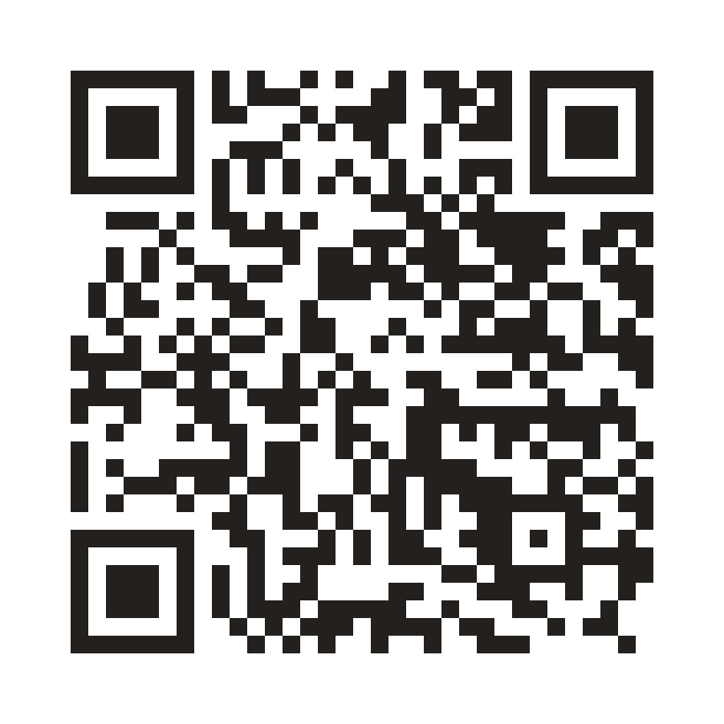
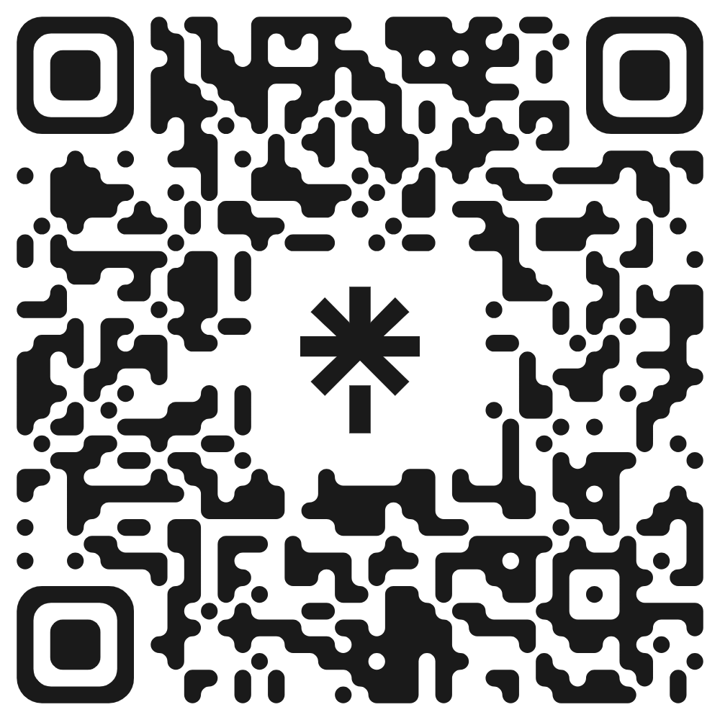
SCAN BEFORE YOU LEAVE THIS ROOM
Join Discord
proximata links
Briefs, mentors, submissions
Our ecosystem
Notes:
Drop the four QR images into the grey squares before the event. Leave this slide on screen through the break so stragglers can still scan. Have the Discord link written on a flipchart as a fallback.

Slide 24
Go build something that works
THE NEXT 24 HOURS
FRIDAY 13 NOVEMBER
SATURDAY 14 NOVEMBER
12:00 | Keynote panel — Hubert Rhomberg, CEO of Rhomberg
14:00 | Hacking starts
18:00 | Mocktails, until 20:00
Night | Keep building — you can stay over
11:00 | n8n and Adaption workshops
15:00 | Code freeze — submissions close
16:00 | Demos and winner announcement
18:00 | Close and networking
Questions? Ask in Discord, or find any of us in the room.
proximata × HOIV × START Vienna · contact@proximata.io
Notes:
Last slide: leave it up for the whole break and during the build if a screen is free. End on the code freeze time, 15:00 Saturday, and then get out of the way.

