Slide 1
MongoDB
An overview
Rochester Institute of Technology
Computer science department

Slide 2
Document Based
Similar to key-value
Can query on any attribute, as opposed to just the key
There is no standard for Document Based
Our benchmark will be MongoDB

Slide 3
MongoDB
Used BSON for file formats (binary JSON)
Hierarchy is Database -> Collection -> Documents
Collection is a bunch of related documents
Not every document needs to have the same attributes (this can be a problem)

Slide 4
Mongo Security
Mongo by default does not have usernames and passwords
This makes databased vulnerable to compromise
Why is it like this by default?

Slide 5
Mongo Scalability
Mongo supports good horizontal scaling and fault tolerance
When a server goes down, they can vote to have a machine take it’s place

Slide 6
Creating a Collection
db.createcollection(<collectionName>)
Ex: db.createcollection(“foobar”)

Slide 7
CRUD Operations
Search (find)
Insert (insert)
Update (update)
Delete (delete)

Slide 8
Insert
db.<collectionName>.insert(<document>)
Ex: db.products.insert({ "id": "1234", "name": "John", "age": "32"});
There is no checking for schema
Every document is created with an _id attribute. This is the primary key.
You can set your own _id, or add other indexes, or change the name of the primary key
This is the only required attribute

Slide 9
Basic Find operation
db.<collectionName>.find(<document>)
Ex: db.products.find()
Ex: db.products.find({"name": "John"})
Ex: db.products.find({age: {$lt: 30}})
Gets all documents with an age greater than 20
Ex: db.products.find({available_quantity: {$lt: 100}}, {name: 1})
Gets all documents with a quantity less than 100, and projects just the name and _id
Ex: db. products.find().sort({name: 1})
Gets all the documents in foobar and sorts them ascending by name

Slide 10
Projections
Projections can be inclusive or exclusive
Previous example was inclusive
For exclusive, we set {attribute: 0}
Ex: db.products.find({available_quantity: {$lt: 100}}, {name: 0})
_id is always included unless it’s excluded – needed to ensure that documents remain unique
Ex: db.products.find({available_quantity: {$lt: 100}}, {name: 1, _id: 0})
Sorting always happens before projections. Make sure you sort on indexed attributes
Can also rename attributes here (will see later)

Slide 11
Updates/Replace
db.<collectionName>.updateOne()
db.<collectionName>.updateMany()
Ex: db.products.updateOne({Name: “Smith”}, {$set: {age: 34}})
First document is the find piece of the update
Second document is what you want to update
Be sure to include $set, otherwise, it will set the entire document that matched to the criteria in the 2nd document
Use db.<collectionName>.replaceOne() to replace docs

Slide 12
Delete
db.<collectionName>.deleteMany()
db.<collectionName>.deleteOne()
Ex db.foobar.deleteMany()
Ex: db.foobar.deleteOne({name: “Smith”})

Slide 13
Aggregation
Aggregation is the fundamental query structure of mongo
Takes items in a list and performs them in order, with the output of the first operation going to the second, ad nauseum.
Common aggregation operations
$project – projections
$skip – skips n documents
$sort – sorts documents
$match – finds documents
$group – using to group documents together
$count – counts documents
$limit – limits the result set
$lookup – left join like operation

Slide 14
Aggregation Group
db.<collectionName>.aggregate([{$match: }, {$group}])
Ex: db.suppliers.aggregate([{$group: {_id: "$city", totalStatus: {$sum: "$status"}}}])
Ex: db.suppliers.aggregate([{$group: {_id: "$city", totalStatus: {$sum: "$status"}}}, {$match: {totalStatus: {$gte: 90}}}])

Slide 15
Aggregation Unwind
Takes an array of items and makes documents from them
Allows for query on documents
Given a document with: { "_id" : 1, "item" : "ABC1", sizes: [ "S", "M", "L"] }
Perform unwind on it: aggregate( [ { $unwind : "$sizes" } ] )
Get 3 documents:
{ "_id" : 1, "item" : "ABC1", "sizes" : "S" }
{ "_id" : 1, "item" : "ABC1", "sizes" : "M" }
{ "_id" : 1, "item" : "ABC1", "sizes" : "L" }

Slide 16
Aggregation Lookup
Will perform a join on a collection in the same database
$lookup: {
from: <collection to join>,
localField: <field from the input documents>,
foreignField: <field from the documents of the "from" collection>,
as: <output array field>
} }

Slide 17
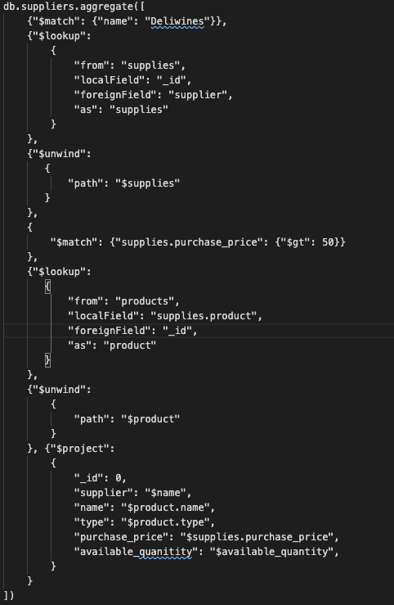
A COMPLEX QUERY
Aggregation Pipeline
$match
$lookup
$unwind
$match
$lookup
$unwind
$project
Notes:
db.suppliers.aggregate([
{"$match": {"name": "Deliwines"}},
{"$lookup":
{
"from": "supplies",
"localField": "_id",
"foreignField": "supplier",
"as": "supplies"
}
},
{"$unwind":
{
"path": "$supplies"
}
},
{
"$match": {"supplies.purchase_price": {"$gt": 50}}
},
{"$lookup":
{
"from": "products",
"localField": "supplies.product",
"foreignField": "_id",
"as": "product"
}
},
{"$unwind":
{
"path": "$product"
}
}, {"$project":
{
"_id": 0,
"supplier": "$name",
"name": "$product.name",
"type": "$product.type",
"purchase_price": "$supplies.purchase_price",
"available_quanitity": "$available_quantity",
}
}
])

Slide 18
Aggregation lookup
{"$lookup":
{
"from": "supplies",
"localField": "_id",
"foreignField": "supplier",
"as": "supplies"
}
}
Joins suppliers on supplies, where supplies.supplier = suppliers._id

Slide 19
Output of Lookup
{ "_id" : 21, "name" : "Deliwines", "address" : "240, Avenue of the Americas", "city" : "New York", "status" : 20, "supplies" :
[
{ "_id" : ObjectId("5f7c6cf47b791bc05e228fd7"), "supplier" : 21, "product" : 119, "purchase_price" : 15.99, "delivery_period" : 1 },
{ "_id" : ObjectId("5f7c6cf47b791bc05e228fd8"), "supplier" : 21, "product" : 178, "purchase_price" : null, "delivery_period" : null },
{ "_id" : ObjectId("5f7c6cf47b791bc05e228fd9"), "supplier" : 21, "product" : 289, "purchase_price" : 17.99, "delivery_period" : 1 },
{ "_id" : ObjectId("5f7c6cf47b791bc05e228fda"), "supplier" : 21, "product" : 327, "purchase_price" : 56, "delivery_period" : 6 },
{ "_id" : ObjectId("5f7c6cf47b791bc05e228fdb"), "supplier" : 21, "product" : 347, "purchase_price" : 16, "delivery_period" : 2 },
{ "_id" : ObjectId("5f7c6cf47b791bc05e228fdc"), "supplier" : 21, "product" : 384, "purchase_price" : 55, "delivery_period" : 2 },
{ "_id" : ObjectId("5f7c6cf47b791bc05e228fdd"), "supplier" : 21, "product" : 386, "purchase_price" : 58.99, "delivery_period" : 2 },
{ "_id" : ObjectId("5f7c6cf47b791bc05e228fde"), "supplier" : 21, "product" : 468, "purchase_price" : 14.99, "delivery_period" : 5 },
{ "_id" : ObjectId("5f7c6cf47b791bc05e228fdf"), "supplier" : 21, "product" : 668, "purchase_price" : 6, "delivery_period" : 1 }
] }

Slide 20
Unwinding this, so we can query
{ "_id" : 21, "name" : "Deliwines", "address" : "240, Avenue of the Americas", "city" : "New York", "status" : 20, "supplies" : { "_id" : ObjectId("5f7c6cf47b791bc05e228fd7"), "supplier" : 21, "product" : 119, "purchase_price" : 15.99, "delivery_period" : 1 } }
{ "_id" : 21, "name" : "Deliwines", "address" : "240, Avenue of the Americas", "city" : "New York", "status" : 20, "supplies" : { "_id" : ObjectId("5f7c6cf47b791bc05e228fd8"), "supplier" : 21, "product" : 178, "purchase_price" : null, "delivery_period" : null } }
{ "_id" : 21, "name" : "Deliwines", "address" : "240, Avenue of the Americas", "city" : "New York", "status" : 20, "supplies" : { "_id" : ObjectId("5f7c6cf47b791bc05e228fd9"), "supplier" : 21, "product" : 289, "purchase_price" : 17.99, "delivery_period" : 1 } }
…..

Slide 21
Match (find) products
{
"$match": {"supplies.purchase_price": {"$gt": 50}}
},

Slide 22
And Join on Product
{"$lookup":
{
"from": "products",
"localField": "supplies.product",
"foreignField": "_id",
"as": "product"
}
},
And unwind $product

Slide 23
Project the result
{"$project":
{
"_id": 0,
"supplier": "$name",
"name": "$product.name",
"type": "$product.type",
"purchase_price": "$supplies.purchase_price",
"available_quanitity": "$available_quantity",
}
}

Slide 24
Geospacial Queries
db.places.find(
{
location:
{ $near:
{
$geometry: { type: "Point", coordinates: [ -73.9667, 40.78 ] },
$minDistance: 1000,
$maxDistance: 5000
}
}
}
)

