Slide 1

VS Code Pets
CSCI 471 - Section 1
Alex Iacob

Slide 2
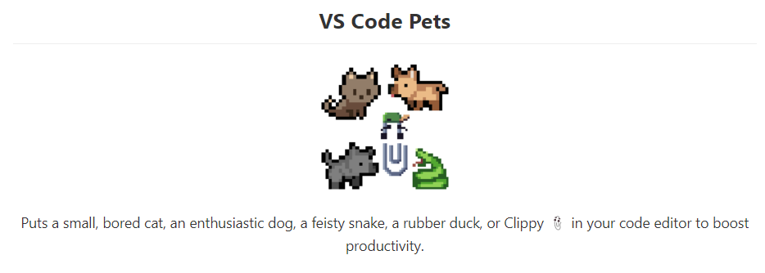
Introduction

Slide 3
Introduction
Created by Anthony Shaw
Over 200,000 downloads
Completely free
Actively getting new features

Slide 4
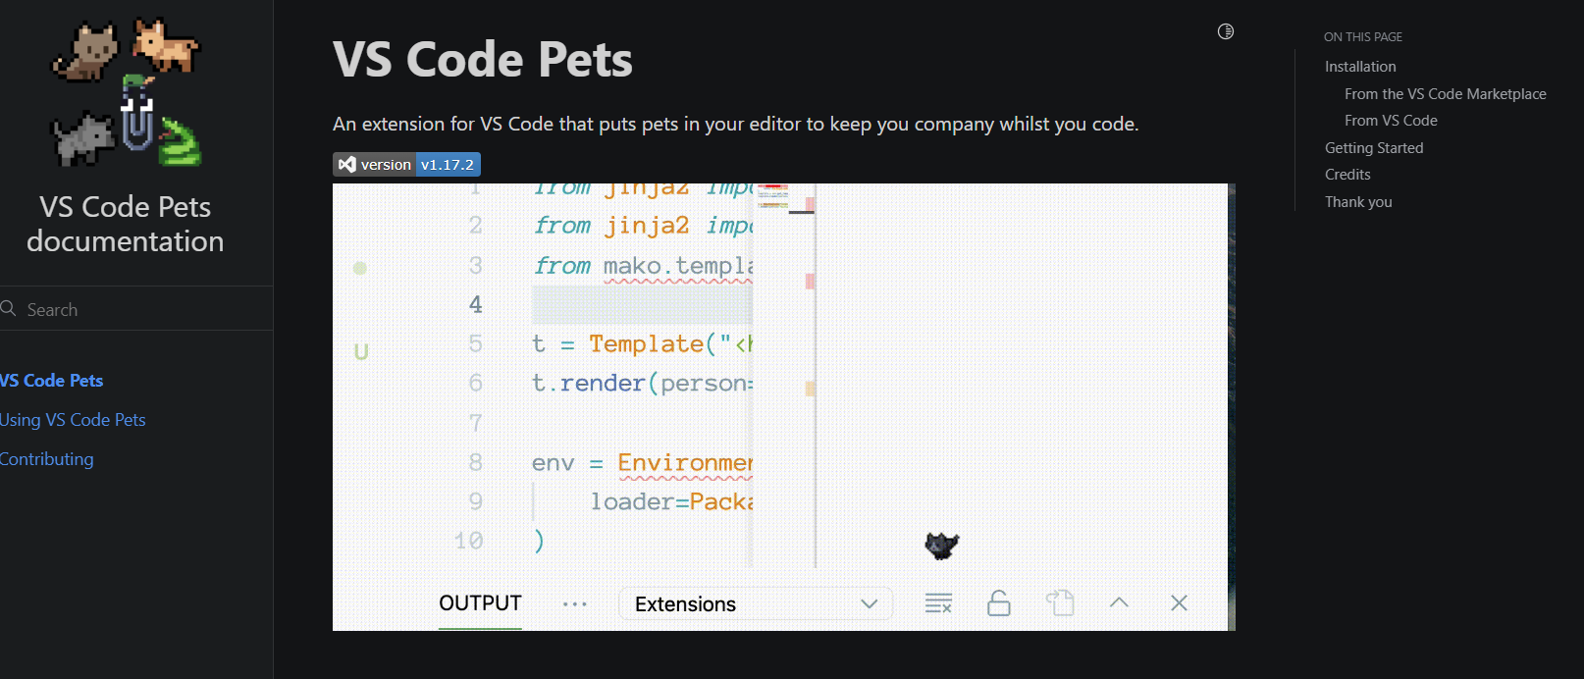
Documentation
All documentation can be found at:
https://tonybaloney.github.io/vscode-pets/

Slide 5
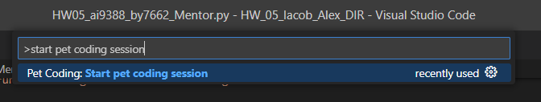
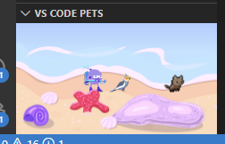
Features

Slide 6
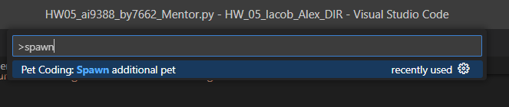
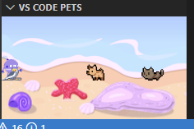
Features

Slide 7
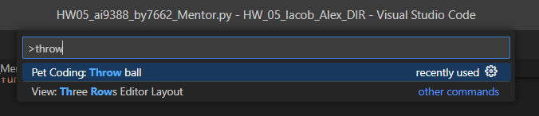
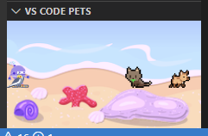
Features

Slide 8
Demo

Slide 9
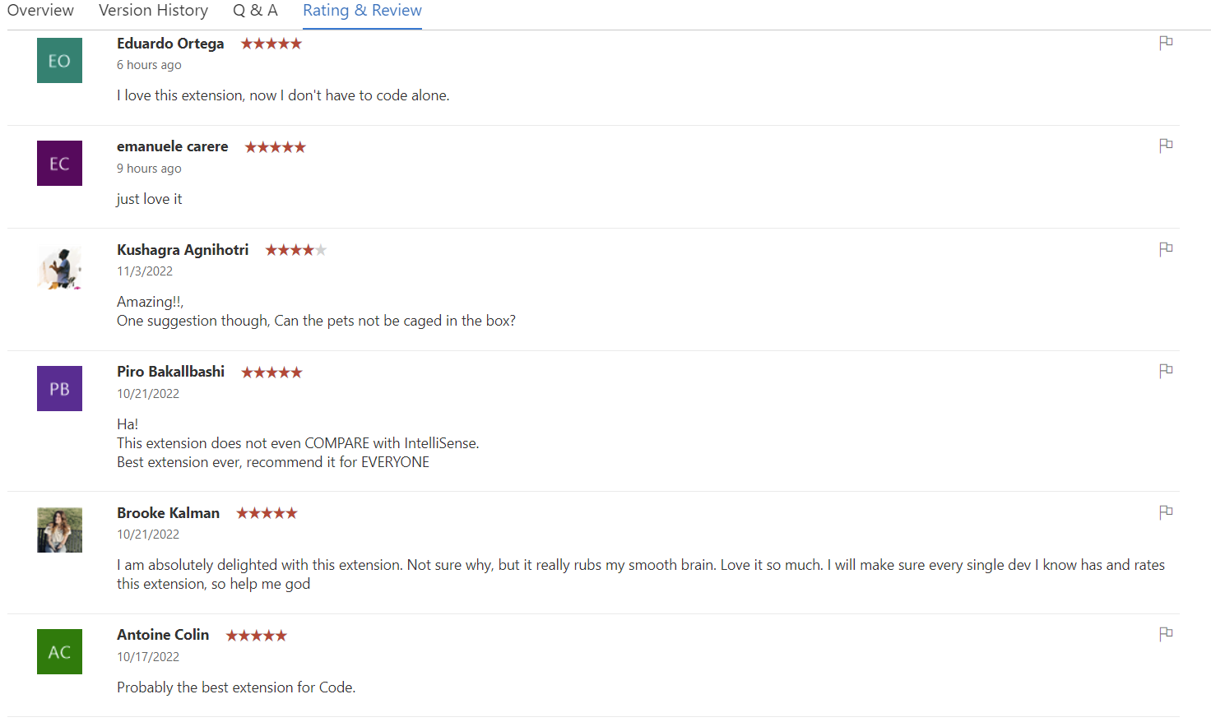
User Satisfaction

Slide 10
Questions?

