Slide 1
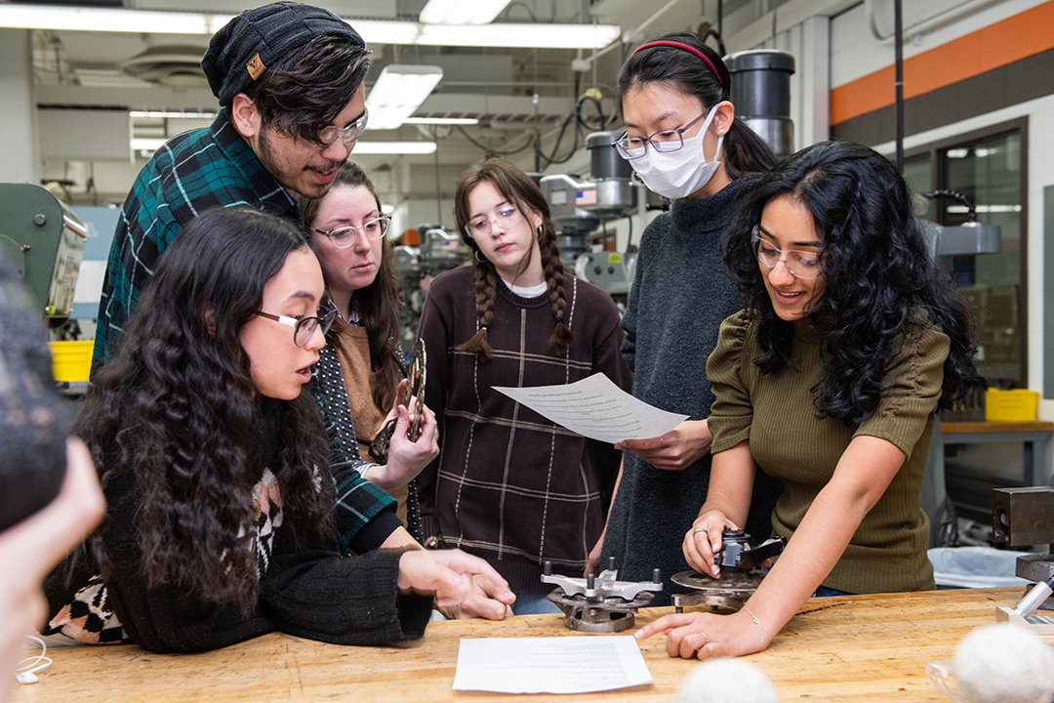
RIT 365
gives new experiences for students
Event Information
Event Information
Sponsors
JULY 11, 2077
Students entering their first year of college face many unknowns. But a unique program at Rochester Institute of Technology helps new students learn more about college life, their peers, and themselves.
1:00–8:00 PM
Golisano 1500
rit.edu.events

