Slide 1
Orders Report
Source: input.xlsx
Generated by office_automation (edit this in templates/ppt_template.pptx)

Slide 2
Preview (top rows)
ID | Name | Department | Category | Qty | UnitPrice | OrderDate | Email | Total
1 | Minho | Sales | C | 9 | 12000 | 2026-02-10 00:00:00 | minho1@example.com | 108000
2 | Sora | Sales | C | 18 | 5000 | 2026-02-04 00:00:00 | sora2@example.com | 90000
3 | Hana | Sales | A | 3 | 12000 | 2026-02-10 00:00:00 | hana3@example.com | 36000
4 | Jisoo | Operations | A | 18 | 35000 | 2026-02-10 00:00:00 | jisoo4@example.com | 630000
5 | Jun | Operations | B | 1 | 12000 | 2026-02-02 00:00:00 | jun5@example.com | 12000
6 | Hana | Finance | B | 5 | 12000 | 2026-02-01 00:00:00 | hana6@example.com | 60000
7 | Seojun | Sales | A | 13 | 5000 | 2026-02-08 00:00:00 | seojun7@example.com | 65000
8 | Seojun | Operations | B | 2 | 35000 | 2026-02-05 00:00:00 | seojun8@example.com | 70000
9 | Minho | R&D | A | 18 | 20000 | 2026-01-31 00:00:00 | minho9@example.com | 360000
10 | Seojun | Operations | A | 3 | 5000 | 2026-02-03 00:00:00 | seojun10@example.com | 15000
11 | Hyunwoo | Finance | A | 8 | 5000 | 2026-02-07 00:00:00 | hyunwoo11@example.com | 40000
12 | Yuna | R&D | C | 12 | 12000 | 2026-02-08 00:00:00 | yuna12@example.com | 144000
Generated by office_automation

Slide 3
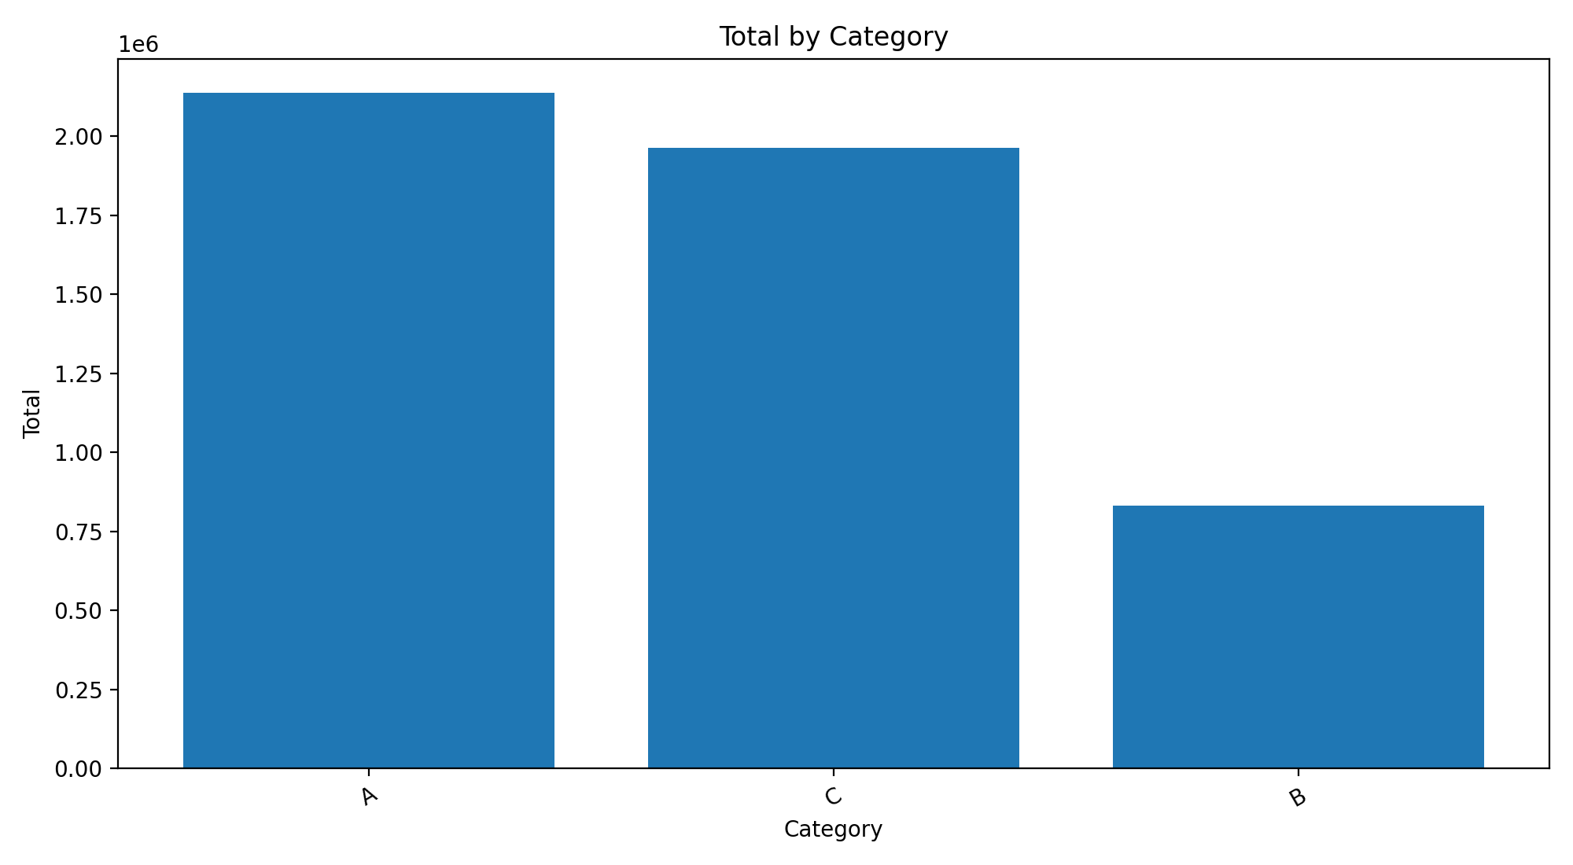
Total by Category
Generated by office_automation

