Slide 1
The Serval Mesh Extender: Using OpenWRT to support disaster communications
Dr. Paul Gardner-Stephen,
President, The Serval Project, Australia
Mercator Fellow, TU-Darmstadt, Germany
Senior Lecturer, Flinders University, Australia
Telecommunications Fellow, Shuttleworth Foundation, South Africa
paul.gardner-stephen@flinders.edu.au / +49 170 476 0665

Slide 2
The Serval Project
Focus on disaster/emergency/remote communications
Mobile ad-hoc communications using unmodified smart-phones
Text messaging, file transfer, voice and other services
Custom P2P-optimised protocols
Primarily store-and-forward/delay-tolerant networking (DTN)
Fully distributed architecture + zero configuration
Can be deployed during a disaster

Slide 3
Motivation for the Serval Mesh Extender
P2P long-range communications between smart-phones hard
Cellular radio? → Use prevented by regulators, carriers, mobile OS vendors, many different chipsets to support etc.
Ad-hoc wi-fi? → Use prevented by Android
Bluetooth? → Poor interoperability and performance
… and we need to minimise power consumption

Slide 4
Serval Mesh Extender Network Architecture
Wi-Fi Access Point (10s – 100s of metres, 1-100mbit/sec)
Low power interface for smart-phones to connect.
Can share a single Mesh Extender among many phones
Wi-Fi performance improves during blackout/in remote areas
Ad-Hoc Wi-Fi (10s – 100s of metres, 1-100mbit/sec)
High-bandwidth interface between Mesh Extenders when they are close-by.
Ad-Hoc UHF Packet Radio (1000s of metres, 1-100kbit/sec)
Increased range, at the cost of bandwidth
Ad-Hoc & P2P VHF/HF Radio (to 1000s of km, 0.01-10kbit/sec)

Slide 5
Serval Mesh Extender Software Architecture
OpenWRT Linux on Atheros 9k hardware
Serval DNA (Serval Core)
Full secure network scheme in ~16MB RAM, single-threaded, all user-land
Serval LBARD (Low-bandwidth Radio Link Management)
On-board Web Server
Instructions / Information about Serval Mesh
Download Serval Mesh Android App
Basic Mesh functions for phones without Serval Mesh App

Slide 6
Australian Outback Field Tests
Arkaroola Wilderness Sanctuary / Resort
Rugged mountainous country, lacking cellular coverage
Temperature range -7C to 50C
Fixed and Vehicle-Mounted Mesh Extenders
Primary field test location

Slide 7
AusAID Pacific Pilot
Pilot Serval Mesh in a Pacific Nation
Intra-village
Inter-village
Intra-island
Inter-island
Cooperation with Red Cross, local cellular carriers, UN World Food Program (WFP) and local government and community groups.
~50 – 100 Mesh Extenders + 100s of Android handsets

Slide 8
Serval Mesh Extender Hardware Prototyping
Initial prototypes based on TP-LINK WR703N/MR3020
USB memory stick for bulk storage
Problematic on non-battery-backed autonomous devices
Serial port used to connect to RFD900 or similar UHF packet radio

Slide 9
Custom Mesh Extender Design (in progress)
GL Domino Core Ath9k module (compatible with GL-AR150)
More RAM, dual-ethernet, more flash
GPIO-based MicroSD interface to end dependence on problematic USB storage
Solar panel / 5v USB / 12v / 24v DC input
Multi-chemistry battery controller
Solar/battery powered solution requires no external circuitry
Socket for RFD900/RFD868 UHF packet radios
Option for external radio, e.g., Codan HF
IP66 weather rated

Slide 10
Tension between Open Firmware & “No modification” Regulation
Community and public benefit demand open firmware, but ...
1. Customs border delays if hardware is not clearly locked to authorised frequencies
e.g., An ambiguously labelled antenna cable joiner caused a 3 week delay in importation of VHF repeaters by NZ RC into Nepal.
2. Regulators in some countries demand that end users cannot modify firmware.
Much lesser issue than the above
US is the main culprit, e.g., recent proposed FCC rules

Slide 11
Our cut at the Gordian Knot
Common Mesh Extender hardware and firmware for all regions
Simpler inventory control, and allows easier forward-positioning of equipment at a regional level.
UHF packet radio firmware reads frequency authorisation from pin-out of power cable
Only alternate power cables are required to “region lock” Mesh Extenders to a given countries spectrum regulation.
Optional 3rd firmware flash lock based on power cable pin-out
Only used for countries where local regulators are problematic, i.e., USA.
Developers can build their own programming cables without the lock.
We acknowledge the imperfection of this, and that it won't please everyone.

Slide 12
Making Hardware is not Cheap
PCB design
Industrial design of casing
Injection moulding tools
FCC/EC/Australian regulatory approvals
IP-rating evaluation
Software development
Help and advice always welcome!

Slide 13
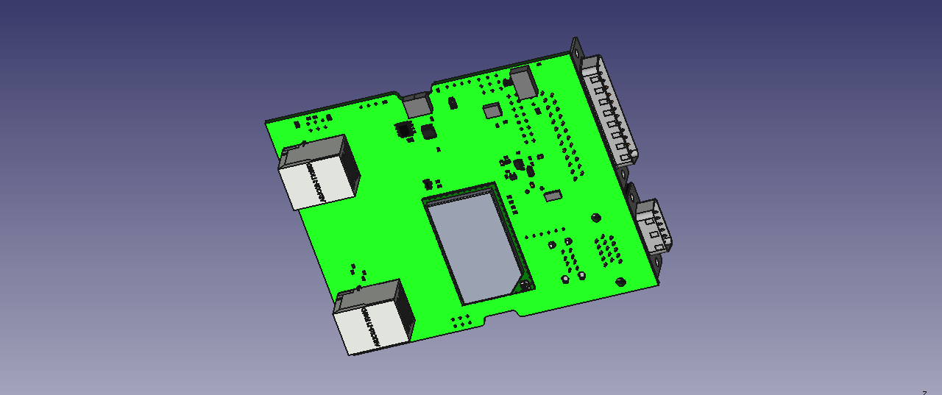

Slide 14
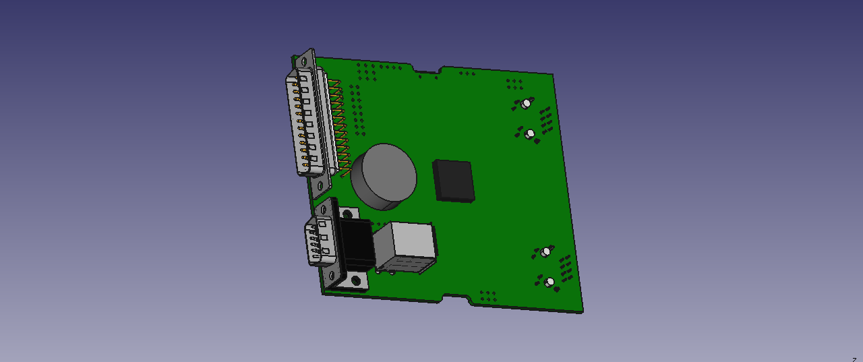

Slide 15
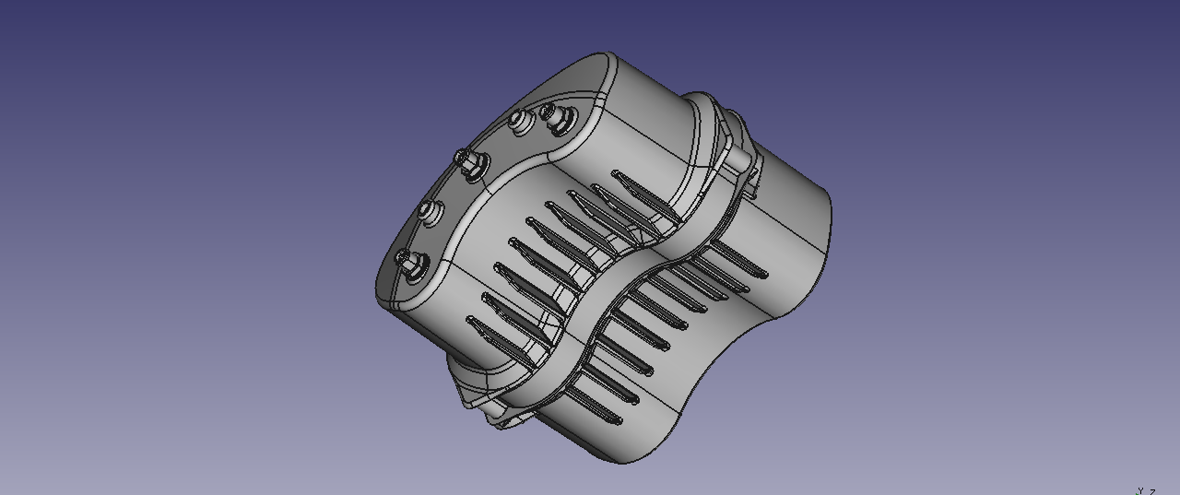

Slide 16
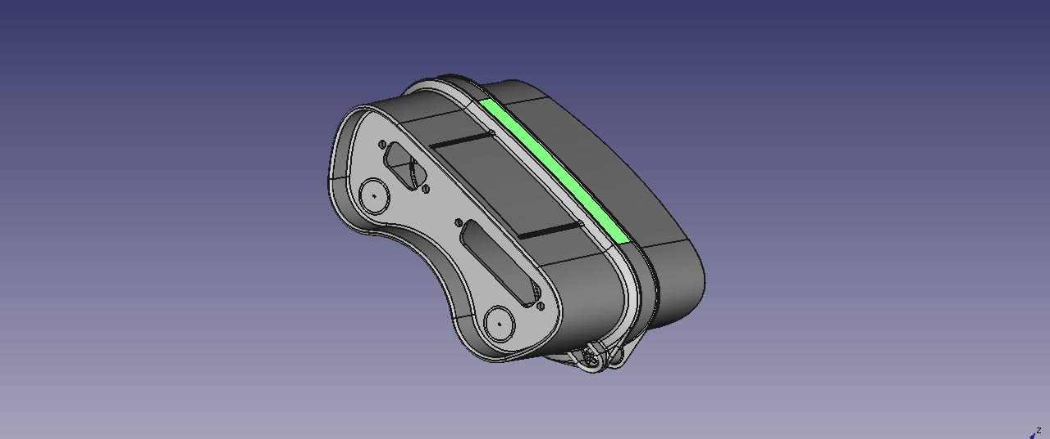

Slide 17
Questions?
http://servalproject.org
https://github.com/servalproject
http://developer.servalproject.org

