Slide 1
PRPL mesh
Agent

Slide 2
Agenda
Processes/Threads
Main Processes
Son Slave thread
AP Manager thread
AP Monitor thread
Backhaul Manager thread
Platform Manager thread

Slide 3











High-level Agent Architecture
PRPL mesh
-
Agent
PRPL mesh
-
Radio Agent
PAL
Multi
Agent UDS
Radio Agent
-
AP
BTL
Agent
Framework
Agent UDS
Backhaul Manager
Radio
Radio
sta manager
eth
Agent UDS
Agent UDS
_
bh
_
monitor
BWL
AP Manager
Monitor
Single Process
Process per Radio
BWL
BWL
Legend
Process
Platform component
BeeRocks component
TFL
BCL
Shared Libraries
(
Used by Agent and Radio Agent
)
Thread
Sheared Library
UDS
:
Unix Domain Socket
BCL
=
BeeRocks Common Library
BUS connection
PAL
=
Platform Abstraction Library
BTL
=
BeeRocks Transport Library
TFL
=
TLV Factory Library

Slide 4
Main Processes
Two executables
beerocks_agent – Certifiable EasyMesh MultiAP Agent
Main Agent
Backhaul manager thread
platform manager thread
Radio Agent
son slave thread
ap manager thread
beerocks_monitor – Radio Agent monitor

Slide 5
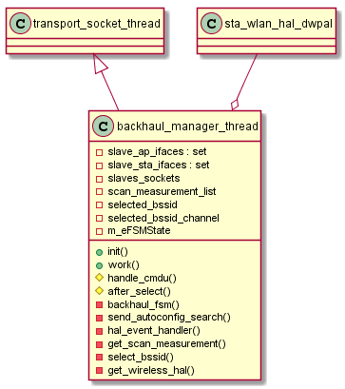
Backhaul Manager Thread
Backhaul connection
Wired
Wireless – using BWL (sta_wlan_hal)
Controller discovery (Autoconfig search)
Local controller treated as “wired backhaul”
Local bus access via BTL
Derives from transport_socket_thread
UDS connectivity with radio agents
https://github.com/prplfoundation/prplMesh/tree/master/agent/src/beerocks/slave/backhaul_manager
Notes:
select_bssid() – helper function to select the best AP for wireless backhaul connection
hal_event_handler() – callback function called by bwl upon internal events

Slide 6
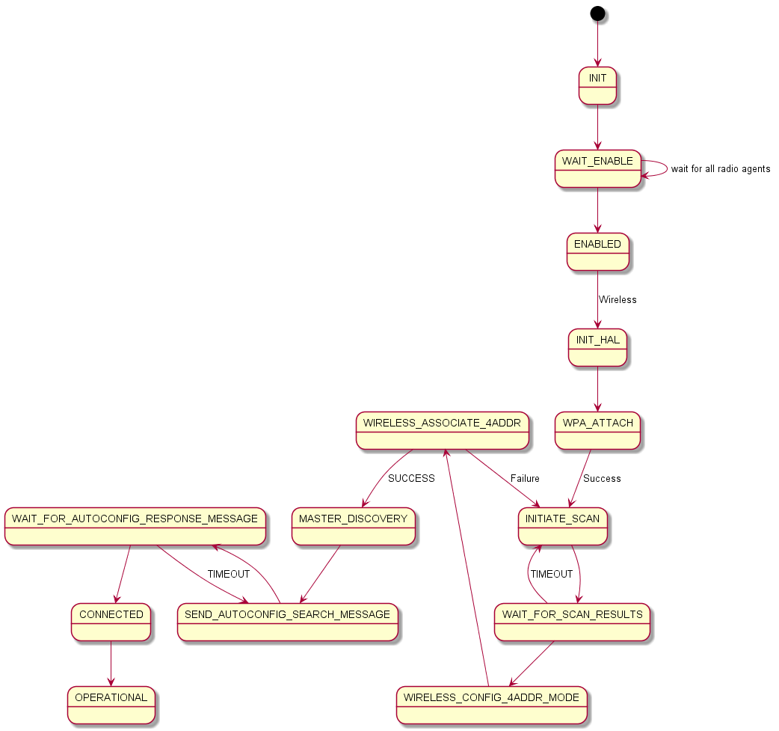
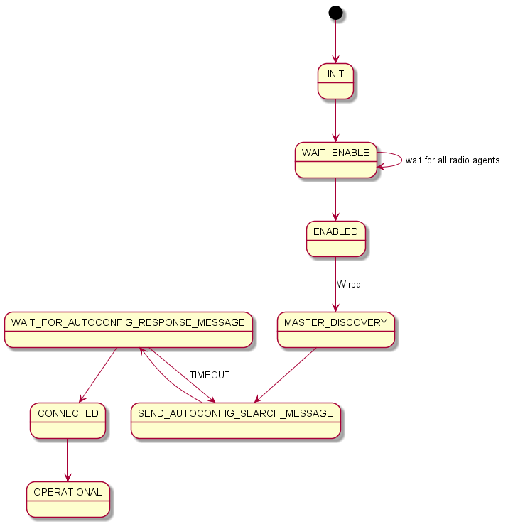
Wireless Backhaul FSM
Wired Backhaul FSM

Slide 7
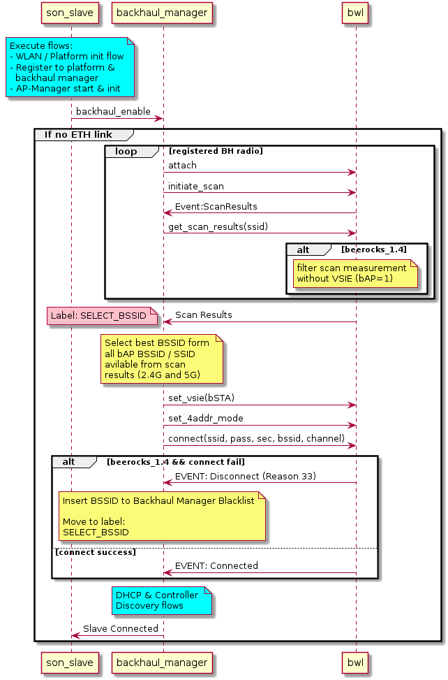
Backhaul Manager Thread - Flow
Notes:
select_bssid() – helper function to select the best AP for wireless backhaul connection
hal_event_handler() – callback function called by bwl upon internal events

Slide 8
Recap - BPL
Beerocks Platform Library
C shared library
Implements platform APIs needed by the agent
Reading configuration from platform DB
For example bpl_cfg_is_wired_bh()
Update platform state / configuration
For example, starting hostapd - bpl_wlan_ap_start()
Update credentials
https://github.com/prplfoundation/prplMesh/tree/master/framework/platform/bpl

Slide 9
Recap - BPL
Passive mode
Preferred mode of operation
Platform update operations compiled out
Build time flag
Platform handles bring up APs / STAs before starting the agent

Slide 10
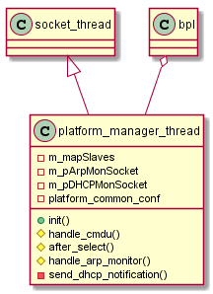
Platform Manager Thread
Only entity in architecture which has access to the platform
Dynamically loads BPL
In addition, handles ARP and DHCP monitoring
Used to identify LAN clients (network map)
Requested by the controller’s client locating task
UDS connectivity with each radio agent
Will move to the framework and renamed as “platform service”
Will be connected to the local bus
https://github.com/prplfoundation/prplMesh/tree/master/agent/src/beerocks/slave/platform_manager

Slide 11
Son Slave Thread
Implements MultiAP Radio Agent
Spawns AP Manager thread and AP Monitor (process)
Orchestrates all radio operations requests coming from the controller
Implements AP AutoConfig M1/M2 flows (dev in progress)
Currently using Intel implementation (Join flow) using VS CMDU
https://github.com/prplfoundation/prplMesh/tree/master/agent/src/beerocks/slave

Slide 12
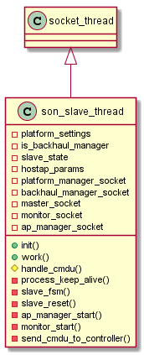
Son Slave Thread
Derives from socket_thread
UDS connectivity
Backhaul manager – control messages
AP Manager – WLAN AP operations
AP Monitor – AP monitoring
Platform Manager – platform operations
https://github.com/prplfoundation/prplMesh/tree/master/agent/src/beerocks/slave

Slide 13
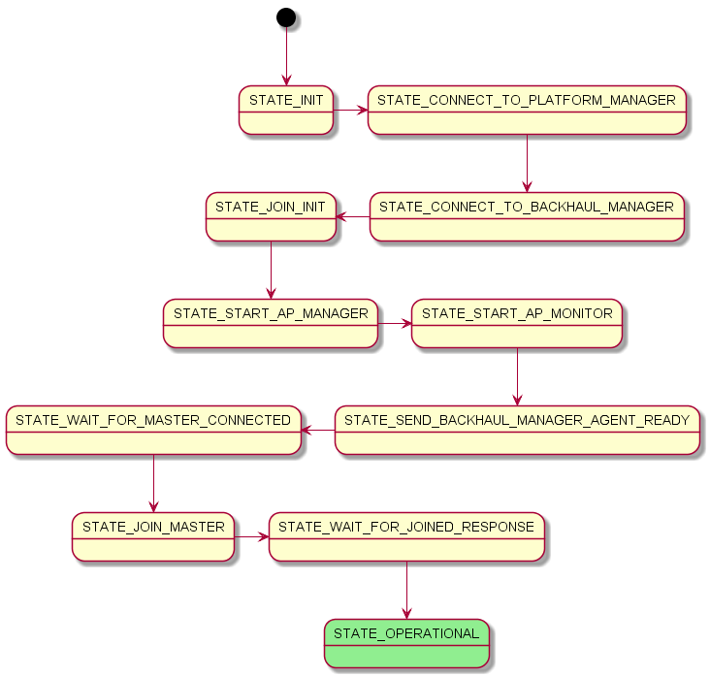
Son Slave Thread - FSM

Slide 14
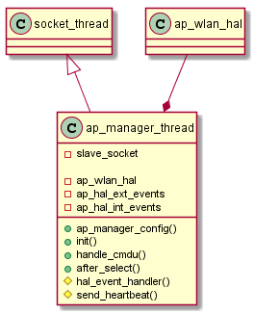
AP Manager Thread
Access Point management and control
One for each radio Agent
Attaches to hostapd
BWL ap_wlan_hal→attach()
Listens to hostapd events / responses
UDS connectivity
Son slave thread
https://github.com/prplfoundation/prplMesh/tree/master/agent/src/beerocks/slave/ap_manager_thread.cpp

Slide 15
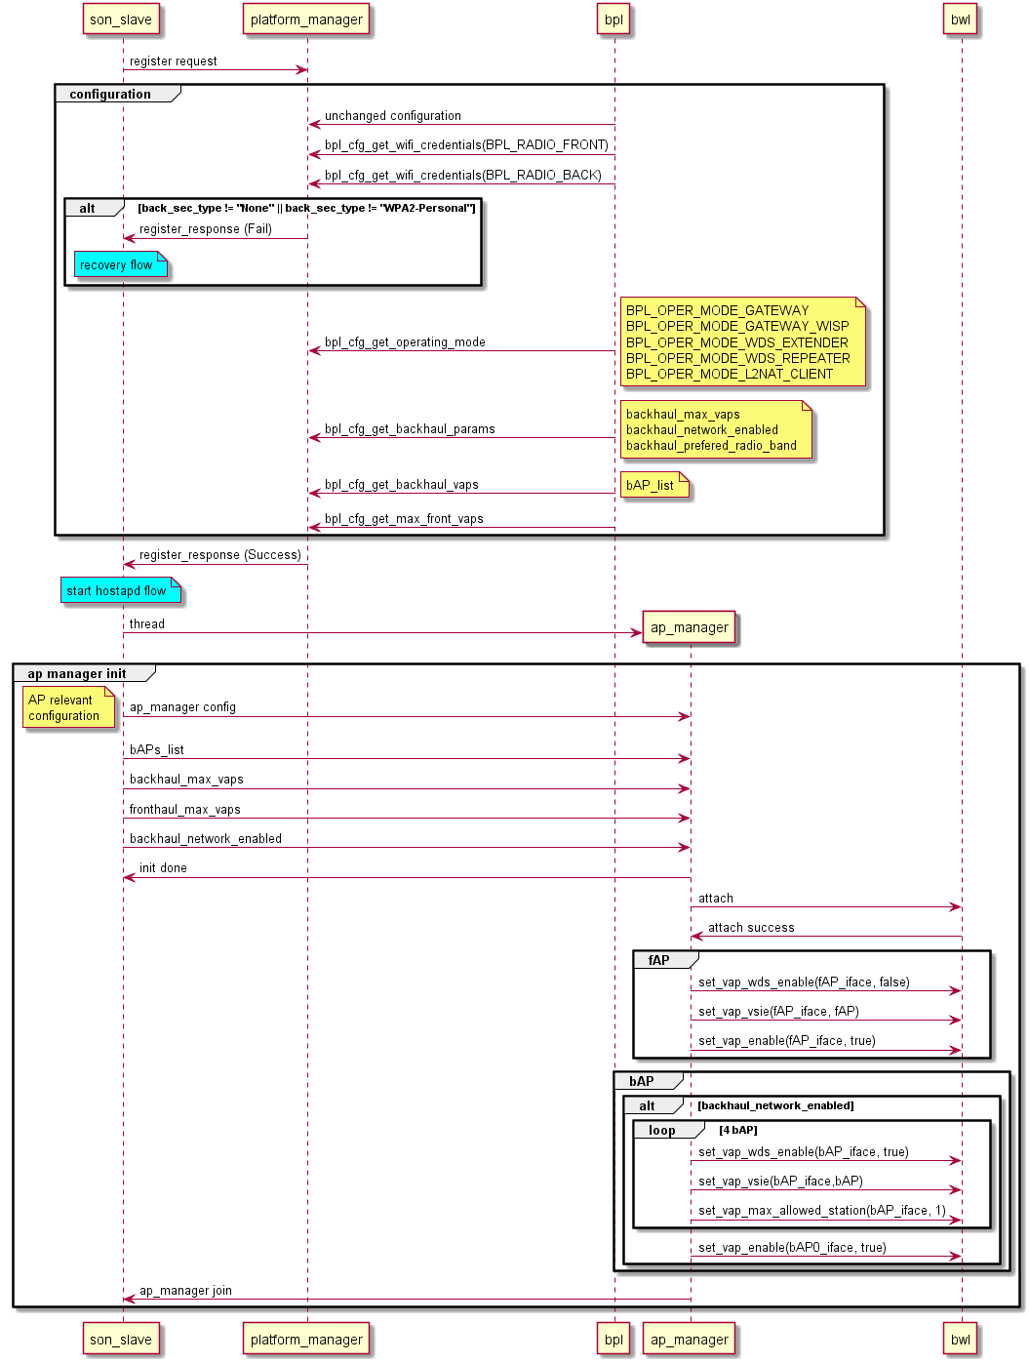
AP Manager – Init

Slide 16
AP Monitor
Access Point activity & statistics (per VAP)
Clients activity & statistics
TX/RX Phy Rate
UL RSSI
Health check using STA probing
https://github.com/prplfoundation/prplMesh/tree/master/agent/src/beerocks/monitor

Slide 17
AP Monitor
Notifies Son slave on thresholds crossing
On Demand measurements
802.11K beacon requests
RSSI measurements using ARP
Easy to add custom monitoring functionality
Implementing derived class
https://github.com/prplfoundation/prplMesh/tree/master/agent/src/beerocks/monitor

Slide 19
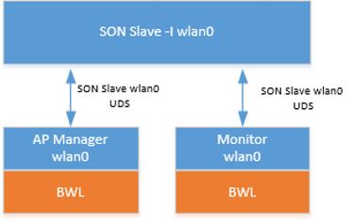
Monitor - Interfaces
The monitor uses BWL to attach to hostapd for receiving events and requesting measurements.
Also it has an UDS socket to the slave to get requests and send notifications to the controller.

