Slide 1
PRPL mesh
Common

Slide 2
Agenda
Infrastructure
BTLVF (Beerocks Vendor specific TLVs library)
BCL (Beerocks Common Library)
BTL (Beerocks Transport Library)
BWL (Beerocks WLAN Library)

Slide 3
BTLVF - Overview
A set of YAML files for all beerocks messages / structs
Relies on Framework’s TLVF python script and base classes
History – Beerocks agent and controller used to communicate over UDS sockets for inter-node (IPC) communication and TCP for intra-node communication
Code location:
https://github.com/prplfoundation/prplMesh/tree/master/common/beerocks/tlvf/

Slide 4
BTLVF
Defines all Intel non-MultiAP messages
Used in all Intel proprietary flows not yet converted to MultiAP flows
Example – Slave Join == Autoconfig M1
Code location:
https://github.com/prplfoundation/prplMesh/tree/master/common/beerocks/tlvf/

Slide 5
BTLVF
Single vendor specific TLV
Intel OUI followed by ACTION_HEADER
Action Header includes action and action op
action – internal destination of the message (son_slave, AP manager, etc.)
action op – operation requested
for internal routing and holds the message data
type
length
oui
data
vendor specific
Intel
action
action op
id
data
action header

Slide 6
BTLVF
son slave main VS cmdu handler

Slide 7
BTLVF
backhaul manager thread VS cmdu handling

Slide 8
BCL - Overview
Beerocks Common Library
Set of utilities and base classes which are used by both agent and controller.
Examples
Network utils & structs – sIPv4Addr, sMacAddr, mac_to_string(), etc.
Socket abstraction classes and utilities
Configuration file parser class
Beerocks definitions
Versioning
FSM abstract class
Synchronization utilities and classes
Scripts (beerocks_utils.sh, beerocks_watchdog.sh, etc.)
Code location:
https://github.com/prplfoundation/prplMesh/tree/master/common/beerocks/bcl/

Slide 9
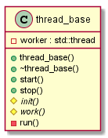
BCL – thread_base
Abstract class for implementing work based threads
single std::thread worker

Slide 10
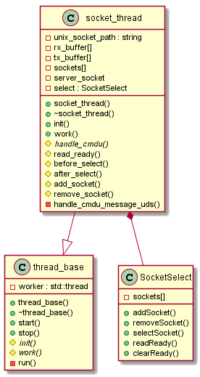
BCL – socket_thread
Abstract class for implementing select based threads
All Main threads derive from socket_thread
AP Manager, son_slave_thread, AP Monitor, etc.
But not the backhaul manager and mrouter…
Work function orchestrating select loop mechanism
Accepting new connections (server socket)
Detecting closed connections
CMDU handling

Slide 11
BCL – socket_thread
Hooking mechanism for derived classes -
before_select – keep alives, fsm, timeouts handling, etc.
after_select – none-CMDUs handling
Supports any Linux fds
Mainly used for IPC using UDS sockets
No support for intra-node communication using the local bus
BTL’s transport_socket_thread to the rescue…

Slide 12
BCL – socket_thread API
init() – socket thread initilization
Creates server socket and adds it to the select
work() – main thread loop
Sleeps on select and iterates on received sockets
Calls
before_select() – thread logic (e.g. FSM)
after_select() – non-CMDU handling (e.g. hostapd events)
socket_connected() – new connected socket handling
handle_cmdu() – pure virtual
socket_disconnected() - pure virtual

Slide 13
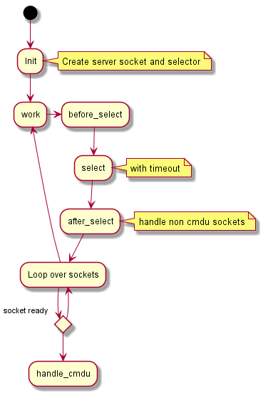
BCL - Socket Thread – Select loop

Slide 14
BTL- Overview
Beerocks Transport Library, defines the transport_socket_thread class
Derives from socket_thread
Provides additional APIs to communicate over the local bus
Sending CMDUs via the transport service
UDS Mode (build flag) – use UDS instead of local bus
Mainly for debug
PRPL mesh Controller
PRPL mesh Agent
BTL
BTL
Code location:
https://github.com/prplfoundation/prplMesh/tree/master/common/beerocks/btl
Multi
-
AP Framework
Local Message Bus
(
)
XSub
-
XPub

Slide 15
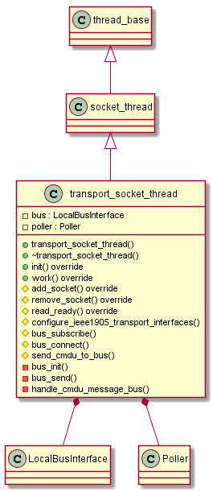
BTL- Transport Socket Thread
Work() – overridden to use LocalBusInterface and Poller
Replacement for select based loop
Server Socket remains for accepting connections over UDS
UDS header
Used for CMDUs internal routing
Source and Destination MAC ← CmduMessageRx’s metadata
Destination MAC == AL MAC - controller ←→ agent communication
Destination MAC == empty - internal messaging
Endianness conversion - controller ←→ agent (intra-node) communication only
dst
src
length
swap_needed
AL MAC
AL MAC

Slide 16
DWPAL - Overview
Dynamic WLAN Platform Abstraction Layer (shared library)
Includes:
wpa control interface abstraction for hostapd / wpa_supplicant
sending hostapd/wpa_supplicant commands
Receiving events / responses
netlink interface for interacting with the wireless driver
Parser for hostapd & wpa_supplicant events / responses

Slide 17
BWL- Overview
Beerocks WLAN Library
hostapd / wpa_supplicant abstraction
send commands, receive responses / events (via DWPAL)
Components
ap_wlan_hal – AP (hostapd) management APIs
sta_wlan_hal – STA (wpa_supplicant) management APIs
mon_wlan_hal – Monitoring (hostapd) APIs
Code Location
https://github.com/prplfoundation/prplMesh/tree/master/common/beerocks/bwl

Slide 18
BWL
Initialization – Attach FSM
Opens socket to hostapd/supplicant (via DWPAL)
Reads radio info (Intel GET_RADIO_INFO patch)
Succeeds once hostapd state reach expected state
ACS_DONE for ACS mode (Intel patch)
ENABLED for static channel
STA/Monitor – on GET_RADIO_INFO success

Slide 19
BWL
ACS_DONE – hostapd patch
hostapd.conf setting - acs_scan_mode=1
hostapd stops after SCAN
No beaconing before autoconfiguration (MultiAP requirement)
Can be implemented with start_disabled=1 (in progress)

Slide 20
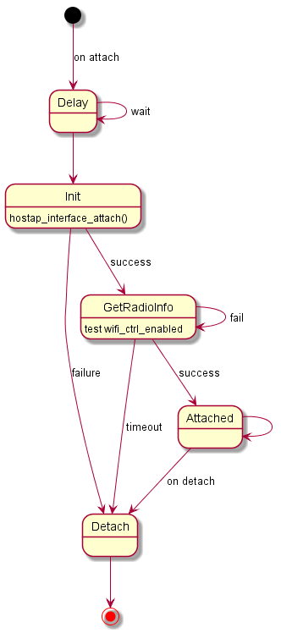
BWL- Attach FSM
Example attach FSM for AP with auto channel (acs) and ACS_DONE enabled
Attach event is fired repeatedly by the attach API method called by the upper layer - ap_wlan_hal->attach()

Slide 21
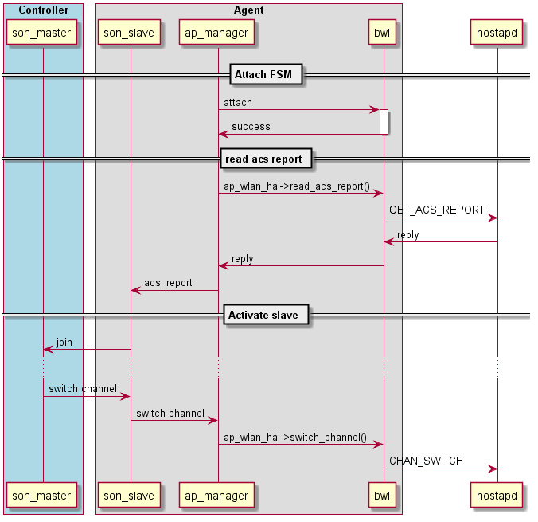
BWL- Example flow

Slide 22
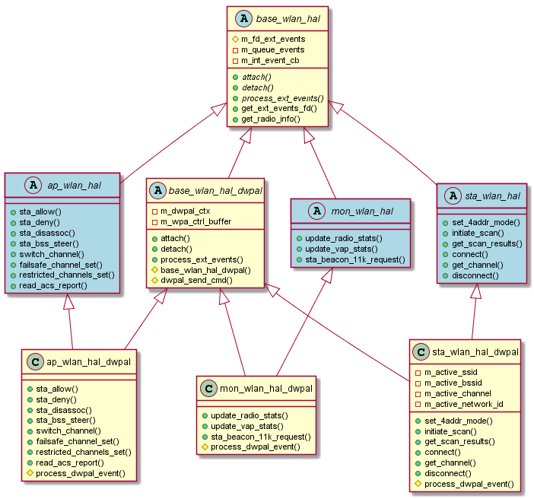
BWL- Class Diagram
Notes:
external events - events from hostapd to the BWL. Those events are pushed into an internal event queue. from the event queue the event is pulled from the event queue and the caller event handler (m_int_event_cb) is called to process the event
attach() - Attach to the WLAN hardware/middleware
detach() - Detach from the WLAN hardware/middleware
get_ext_events_fd() - Returns a file descriptor to the external events queue, the user should add it to the select loop
get_int_events_fd() - Returns a file descriptor to the internal events queue

