Slide 1
prplMesh Controller

Slide 2
Agenda
Overview
Components
Database
Tasks

Slide 3
Overview
Certifiable EasyMesh MultiAP controller.
Single process task scheduler
Each task implements a MultiAP or Intel enhancement functionality
Message Router – Routes CMDUs Controller ←→ Agent

Slide 4





















High-level Controller Architecture
PRPL mesh Controller
BML
Master DB
Task Pool
Multi
-
AP
DB Algo
Statistics Polling
Optimal Path
Framework
Task
Task
BTL
Controller
Health Check
IRE Network
Message Router
Controller
SON Actions
Task
Optimization
UDS
Task
Client Steering
Client Locating
Controller
Controller CLI
Task
Task
Channel
BML
Process
Platform component
BeeRocks component
selection
Task
LAN Clients
Task
Discovery
BML Wifi
Association
Thread
Sheared Library
UDS
:
Unix Domain Socket
Credentials
Handling
Logger
Update Task
Task
BCL
=
BeeRocks Common Library
BUS connection
BML
=
BeeRocks Management Library
BTL
=
BeeRocks Transport Library
BCL
TFL
Persisted DB
Service Fairness
Load Balancer
TFL
=
TLV Factory Library
Shared Library
Task
Task
'
s

Slide 5
Database
Hierarchy of nodes based on network topology
Nodes represent network components
APs, STAs, bridges, etc.
Updated by tasks or asynchronous events
Used by tasks for decision making and normal operation

Slide 6
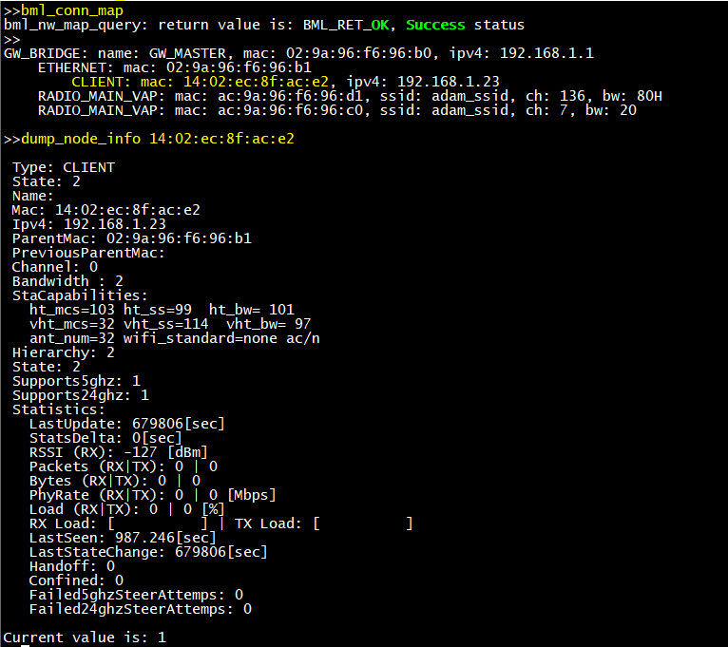
Database Node

Slide 7
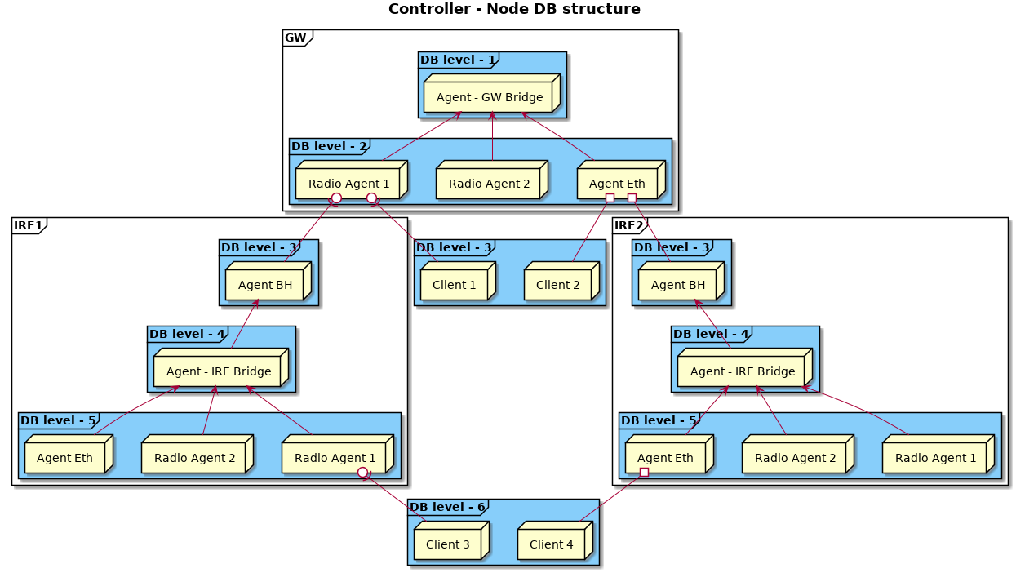
Database Hierarchies

Slide 8
Tasks - Overview
Mechanism for performing background operations
Task pool – group of tasks
Task scheduling by the controller (son_master)
Simple round robin scheduling scheme
Receive data through events from the controller
Notifications / Responses
CMDUs from agents
BML requests

Slide 9
Tasks
Task ID
Task instance id
Used for matching CMDU responses with tasks
Single instance tasks
steering, optimal path (per client)
client association
Multiple instance tasks
steering, optimal path (multiple clients)

Slide 10
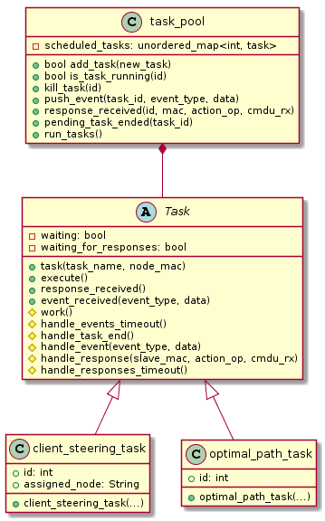
Tasks
Task Pool APIs
add_task(id)
push_event(id, evtype, data)
run_tasks()
Task APIs
execute()
work()
handle_response()
handle_response_timeout()
handle_event()
handle_event_timeout()

Slide 11
Association Handling Task
Triggered on client association
Gathers client statistics
RSSI, Capabilities (11V, 11K, etc) and store it in the DB.
Prevents jittering clients effect on network map
Clients marked connected only after staying connected for some short time
Triggers Optimal Path Task upon success

Slide 12
Optimal Path Task
Selects best AP for connected STAs
Triggered by
Association handling task – on STA successful association
AP Monitor – on RSSI threshold crossing
Triggers steering task based upon decision to steer
Dynamically detects single band clients.
Dynamically detect non 11k (legacy) clients.

Slide 13
Optimal Path Task
Steering decision
Based on maximum estimated downlink PHY rate (Default)
Based on maximum estimated downlink RSSI
Estimated downlink PHY rate calculation using
Number of antennas
TX power
Channel bandwidth
Supported rates
Downlink RSSI
11K for supporting STAs
Unconnected measurements
Estimated uplink RSSI (same box)
Client Steering task is triggered if better target AP found

Slide 14
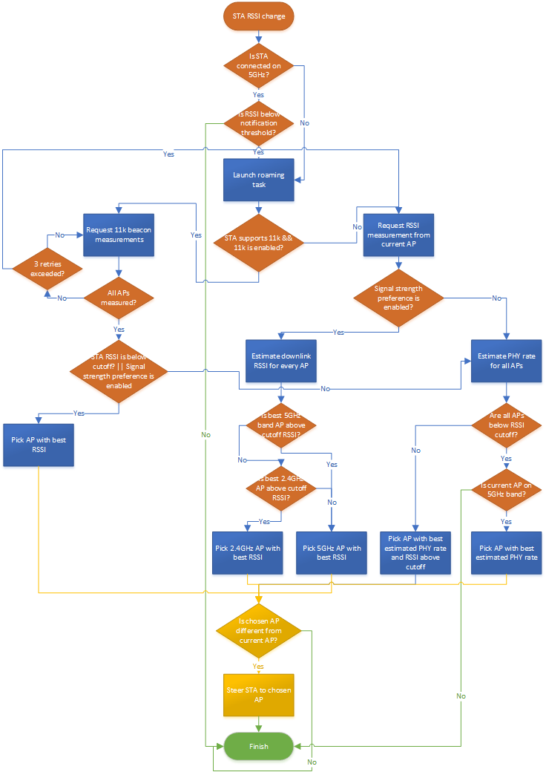
Optimal Path Task

Slide 15
Client Steering Task – Take from Tomer
Orchestrates client steering operation
Triggered by optimal path task
But also supports manual triggering from CLI
Used for debugging, upper layer algorithm, etc.
Legacy steering
Allow client (STA) in target AP
Disallow in all other APs in the network
After steering – allow client in all APs
Prevents STAs from being locked out

Slide 16
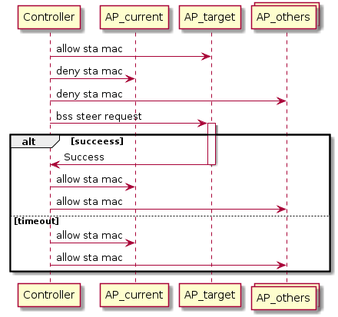
Client Steering Task

Slide 17
Client Steering Task
802.11v Steering – BSS_TM_REQ
For STAs supporting 802.11v
STA marked non 11v if it didn’t respond 3 times in a row
Legacy steering will be used for this STA
3 times, it is considered legacy client.
Imminent – Mandatory steering request
Non-imminent – Optional steering request (STA may refuse)

Slide 18
Client Steering Task
Two steering options available:
1. Optional steering – used only for STAs that support 11v.
The request is sent without any disassociate timer.
If the STA rejects that request, the steering task is cancelled without any consequences.
2. Forced steering – used for 11v clients and legacy clients.
The request using a disassociate timer set to 10sec for 11k clients or set to 1sec for legacy clients (configurable).
In addition, the controller will add the STA to blacklist on all APs except of the one it wants to steer to.

Slide 19
Client Steering Task
In case of forced steering, one of the following scenarios are possible:
The STA accepts the request – and will be steered smoothly.
The STA does not support 11v – and will be disconnected after 1sec, leaving it only single AP to connect to.
The STA supports 11v but rejects the BSS request – and will be disconnected after 10sec leaving it only single AP to connect to.
Dynamically detect 11v supported clients - according to respond to 11v.

Slide 20
Client Locating Task
Wired (Ethernet) clients locating
Sends ARP query to all connected agents
Collects ARP responses
Client connected to deepest agent which answered
Updated clients triggers DB update and BML listeners (for network map)

Slide 21
BML Task
Manages all BML connections to the controller
Registers/Unregisters listeners for network map and statistics updates
Sends updates to all listeners on network map changes or statistics events

Slide 22
BML Wi-Fi Credential Update Task
Synchronizes credentials update between all agents
Triggered by BML request
Algorithm
prepare – sends credentials to all agents
pre-commit – all agents save new credentials in platform DB
commit – all agents reset and start with new credentials
Can be aborted if one of the slave did not respond

Slide 23
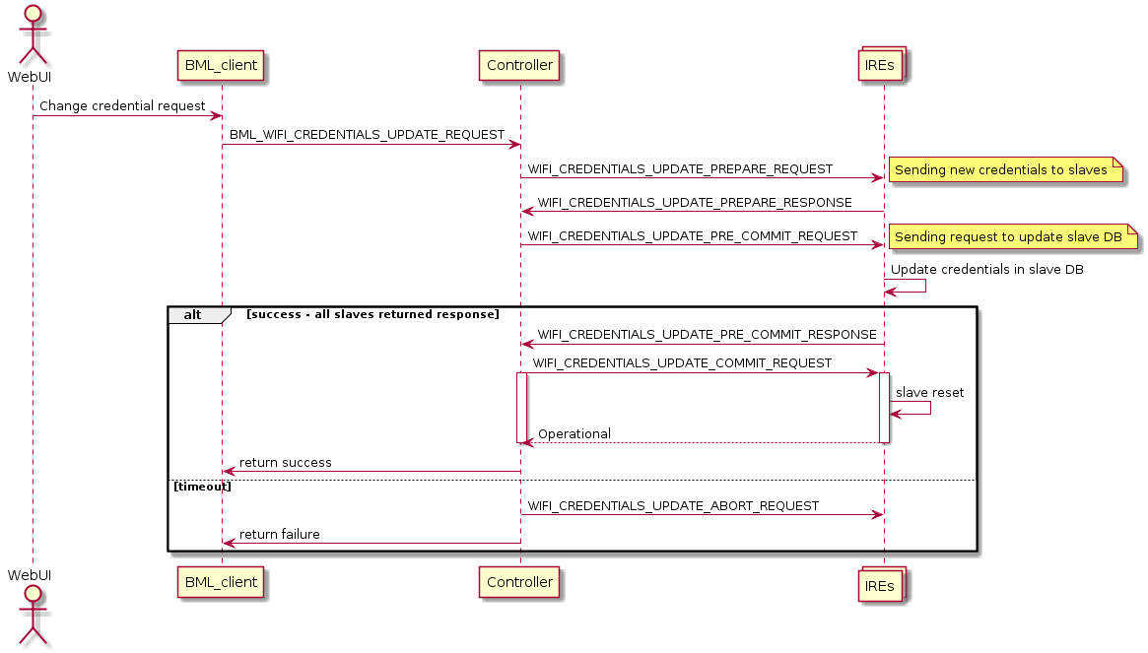
BML Wi-Fi Credential Update Task

