Slide 1
PRPL mesh
Framework

Slide 2
Framework components
The PRPL mesh framework consist of the following components:
Local bus and broker
1905 Transport
Discovery service
WFA_CA
Platform service
management service
Code location:
https://github.com/prplfoundation/prplMesh/tree/master/framework

Slide 3
PRPL EasyMesh architecture
OS
/
Distribution Management Entity
Algorithms
Algorithms
Features
PRPL mesh Controller
TFL
PRPL mesh Agent
TFL
Management
BML
BTL
BTL
PAL
BWL
API
?
s
Multi
-
AP Framework
Local Message Bus
(
)
XSub
-
XPub
MPL
TFL
TFL
TFL
WLAN
1905
API
.
1905
1
.
Management
1
Platform
Topology
Transport
&
D
-
Service
Service
WPAL
discovery service
service
Hostapd
Supplicant
Netlink
PPL
Network Stack
OS
WLAN Driver
/
Distribution
(
cfg
80211
L
)
2
–
Raw Socket
FAPI
TFL
–
TLV factory Library
BML
Sheared
WLAN
–
BeeRocks Management Library
Framework
Controller/agent
PAL
–
Platform Abstraction Library
BTL
–
BeeRocks Transport Library
(
TX
/
RX CMDU
Legend
Library
)
PPL
–
Platform Plugin Library
BWL
–
BeeRocks WLAN Library
MPL
–
Management Plugin Library
D
-
WPAL
Local BUS IPC
API
–
Dynamic WLAN Platform Library

Slide 4
PRPL mesh
Local bus

Slide 5
Agenda
Overview
Recap – PUB/SUB messaging
Components
Class Diagram
Example code

Slide 6
Recap - PUB/SUB messaging
PUB/SUB messaging - asynchronous service to service communication method
Message - Starts with a Topic string (used for filtering)
Subscriber
Subscribes to one or more topics (filter incoming messages)
Subscribing to an empty topic = subscribing to all messages
Filtering - Longest prefix match
Example: “abcdef” will match the “abc” topic

Slide 7
Local bus - overview
Inter-node PUB/SUB bus
Connecting multiple subscribers to multiple publishers over a local broker
Acts as an abstraction layer for any PUB/SUB messaging library
Currently supporting ZMQ and NNG
Easy to support other libraries
Notes:
Explain a bit on PUB/SUB and what is “topic” – topic is a longest prefix match of the message start string used by the PUB/SUB bus to pass messages to subscribers.
It is basically a “filter” for unwanted messages, that allows subscribers to receive only messages of interest

Slide 8
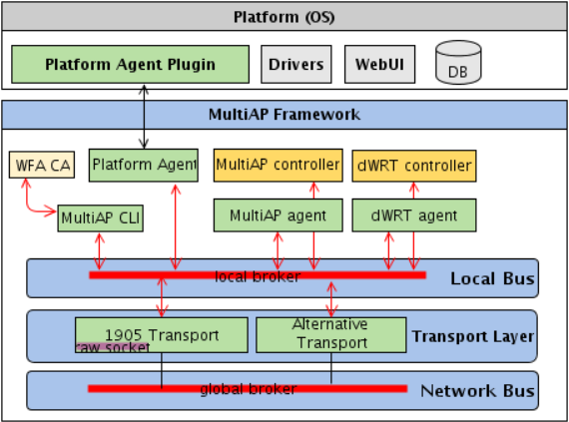
Local bus - overview
Components
local_bus executable
Broker
shared library (mapfcommon.so)
Message, Poller, Socket
Broker Interface
Broker Config
Code location:
https://github.com/prplfoundation/prplMesh/tree/master/framework/common
Notes:
Explain a bit on PUB/SUB and what is “topic” – topic is a longest prefix match of the message start string used by the PUB/SUB bus to pass messages to subscribers.
It is basically a “filter” for unwanted messages, that allows subscribers to receive only messages of interest

Slide 9
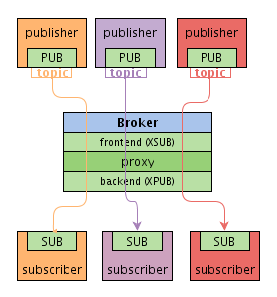
Local bus – Broker
XSUB/XPUB proxy
Multiple subscriber → multiple publisher
Forwards messages – frontend → backend
Endpoints – frontend & backend
Unique string (path name)
Connects publishers and subscribers
Used by underlying messaging library

Slide 10
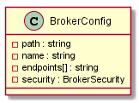
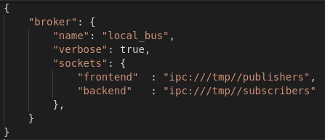
Local bus – Broker Config
Broker configuration class
Input - JSON configuration file
frontend and backend endpoints
Optional security
Shared by Broker and BrokerInterface classes
Default location: <install prefix>/share/local_bus.conf

Slide 11
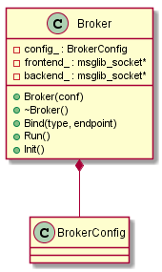
Local bus – Broker API
Init() – parse config and bind endpoints
Run() – start forwarding

Slide 12
Local bus – Message
Any message sent over the local bus is either a message object or a derived message object
Example: CmduMessage
Received messages are constructed using the factory design pattern (based on topic)

Slide 13
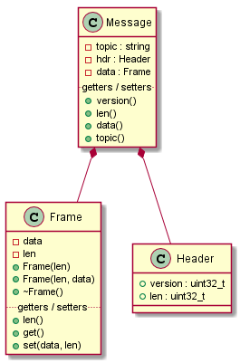
Local bus – Message
Message structure
Topic – message topic
Header – message version (const), message total length (excluding topic & header)
Frame/s – message data (blob)

Slide 14
Local bus – Socket
Socket abstraction over msglib_socket (nng/zmq)
Motivation – replace underlying messaging library with any implementation supporting PUB/SUB
Base class – Socket
Derived classes – PubSocket, SubSocket

Slide 15
Local bus – Socket API
PubSocket
Send(message)
SubSocket
Subscribe<message_type>()
Subscribe(topic)
Unsubscribe(topic)
Receive()

Slide 16
Local bus – Poller
Provides polling abstraction over msglib sockets and linux fds
Based on Linux polling (POLLIN / POLLERR / etc.)
Poller APIs
Add/Modify/Remove(socket)
Add/Modify/Remove(fd)
Poll(timeout = -1)
CheckEvent(socket)
CheckEvent(fd)

Slide 17
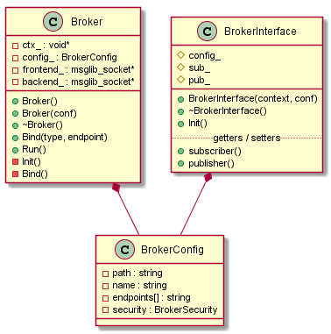
Local bus – Broker Interface
Used for communicating over the bus
Simple wrapper class which contains both a PUB and a SUB socket

Slide 18
Local bus – Broker Interface
APIs
Init() - connects both sockets to the bus based on config
SubSocket connects to config.backend endpoint
PubSocket connects to config.frontend endpoint
subscriber() – subscriber socket getter, used for receive and poll
publisher() – publisher socket getter, used for send

Slide 19
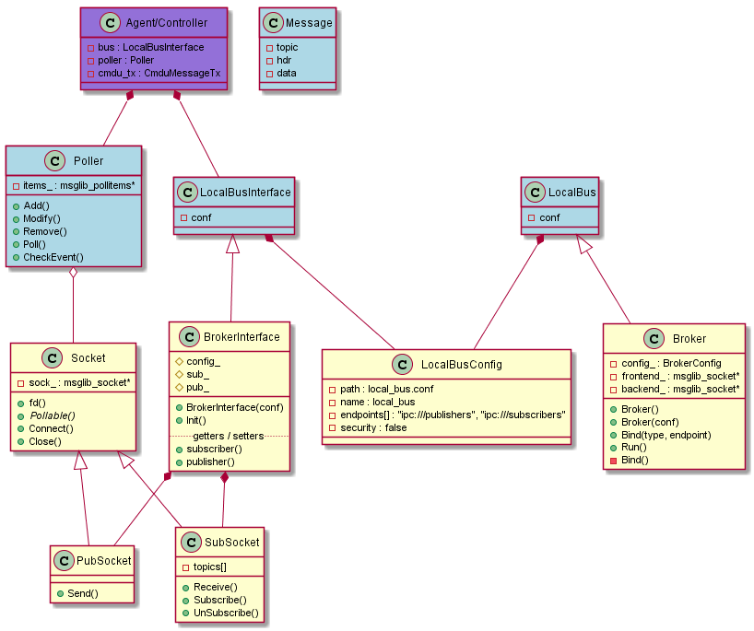
Local bus – Class diagram

Slide 20
Local bus – Example Code
Notes:
Split to client – server

Slide 21
Local bus – Example Code
Notes:
Split to client – server

Slide 22
PRPL mesh
1905 Transport

Slide 23
Agenda
Overview
Features
Flow diagram
Components details

Slide 24
1905 transport - overview
1905 transport is a process that provides a transport service for all entities that wish to send CMDUs outside of the box.
It is not based on the BBF code and was implemented from scratch.
The transport service solves the “MID generation sync issue”
(while we have both agent and controller on the same box).
Supports all EasyMesh features required by the standard.
Code location:
https://github.com/prplfoundation/prplMesh/tree/master/framework/transport

Slide 25
1905 transport - features
Packet filtering, verification and sanity.
MID assignment
Fragmentation/ de-fragmentation
Duplication detection
Multicast relayed/non-relayed
Optional - Alternative transport to support reliability/security (TBD)

Slide 26
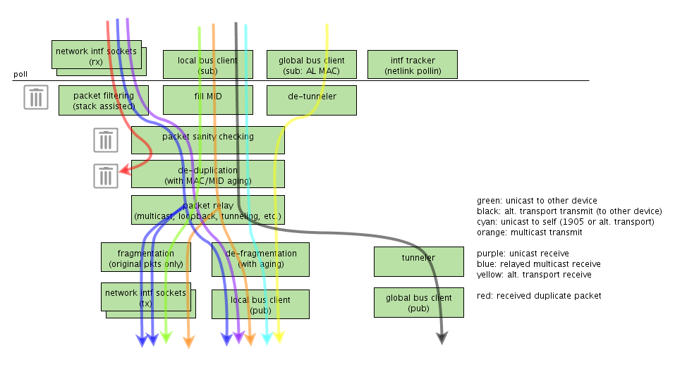
1905 Transport flow diagram
Flow color map:
Received duplicate packet
Relayed multicast receive
Unicast receive
Unicast to other device
Multicast transmit
Alternative transport transmit (to other device)
Unicast to self (1905 or alt. transport).
Alternative transport transmit

Slide 27
1905 transport - Main processing poll loop
A basic design decision for the 1905 Transport is to make it a single thread process with a single central dispatcher/poll loop.
The poll loop gets input from:
Local bus – for outgoing packets (and control).
Network interface sockets – for incoming packets.
Network interface status
Global bus (TBD)

Slide 28
1905 transport - Packet sanity checking
Packet sanity is doing mimmal verfication of the packet.
It parse the headers and check for It is doing some mimimal validation for the packet like:
Correct packet type (LLDP or 1905)
Minimum size of packet.
Consistent of End of Message TLV.
Can be extended if needed..
Notes:
TBD – look at the code and complete

Slide 29
1905 transport - Bridge Configuration
The IEEE1905 standard defines unique behavior for bridging of the protocol's multicast packets.
The 1905 CMDU header contains a "relayIndicator" bit.
Only when this bit is set a packet should be forwarded by the bridge.
In order to support this requirement we:
Modify the default bridge behavior such that it will drop 1905 multicast packets.
Handle the packet forwarding in the transport service itself.
We use the following command to configure the bridge:
ebtables -t filter -I FORWARD 1 -p 0x893a --destination 01:80:c2:00:00:13 -j DROP

Slide 30
1905 transport – Packet Relaying
Origin | Packet Type | Forward To
 |  | Local Bus | Bridge Interface | Individual Network Interfaces
Network | Unicast not to local device | Dropped by the Linux networking stack
Local Bus | Multicast | + | - | + (all)
Network | Multicast && relay==1 | + | - | + (all but originating i/f)
Network | Multicast && relay==0 | + | - | -
Local Bus | Unicast not to local device | - | + | -
Any | Unicast to local device | + | - | -
Code with additional documentation details: https://github.com/prplfoundation/prplMesh/blob/master/framework/transport/ieee1905_transport/ieee1905_transport_packet_processing.cpp

Slide 31
1905 transport - Packet formatting and MID generation
MID as defined by EasyMesh standard should be unique incremental number per box (AL mac). This must be true for every request or notifications.
For responses MID should be the same as the request.
To meet requirement #1 - a single transport entity should allocate the MID.
Problem: how will the agent/controller know if a response has the correct MID ?
There is an option to add “cookie” to the message meta-data
The transport will publish an Ieee1905TxConfirmationMessage with the cookie + the genrated MID.
This is used by the controller to match the respond to the corresponding MID.
TBD – we plan to move the implementation to the transport so that it will handle the mapping.

Slide 32
1905 transport - Network Interfaces - Tracking of Status
The transport listen on the Local Bus for control packets.
These are used to configure the list of network interfaces which will be used by the 1905 Transport.
It holds a table of the relevant interfaces and a table for the bridge interfaces.
The transport track interface status in the poller loop and mark them as active when a netlink event indicates it is UP && RUNNING.
The interfaces from the table are used as explained in the packet relaying slide.
interface index | bridge interface index | active
11 | -1 | 1
4 | 5 | 0

Slide 33
1905 transport - Network Interfaces - Packet Reception
Reception of packets is done using a dedicated raw socket per network interface.
Packets will be received whenever a POLLIN event is detected on a network interface fd.
The originating interface of a packet is important for forwarding relayed multicast packet.
(sent to all interfaces except the originating one).
The transport uses the socket filtering mechanism (based on BPF).
Using the filter only the following packets will be received:
1905 and LLDP multicast
1905 unicast to us - to either AL MAC or any interface MAC
The raw socket has a filter attached which does most of the filtering work in the linux networking stack.
The filter is generated using the following command:
tcpdump -dd '(ether proto 0x893a or ether proto 0x88cc)'

Slide 34
1905 transport - Packet De-duplication
MID's of received packets (for a specific source address) are a monotonously rising number.
That is true, at least within a reasonable timeout - i.e. they can go back upon wrap-around event or when a device reboots.
We can safely assume that if two packets, with the same MID are received after minimal timeslot they are not duplicated.
This period should be long enough to allow for any buffered/in-transit duplicate packets to be flushed.
However, should be short enough to handle the case when a device reboots (and may reuse MID)
Internal data structure:
Key |  |  |  | Value
MAC Address | Frag ID | Message type | MID | Timestamp
9a:96:32:00:12:10 |  |  | 0x0010
9a:96:32:00:13:40 |  |  | 0x2053

Slide 35
1905 transport – Fragmentation/De-fragmentation
When a CMDU is larger than a standard defined threshold (1500 bytes) it will be fregmanted.
Fregmantation is done by the TLV boundary, A TLV larger then the MTU will be dropped.
De-fragmentation of received packets will be done before publishing a CMDU on the local bus.
The fragments of multicast CMDU will be relayed as-is before de-fragmentation is complete.
The fragments of a CMDU are buffered until either:
The complete CMDU is available.
A certain timeout has elapsed (IEEE1905.1 does not specify the duration of this timeout)
Key |  |  | Value
MAC Address | Message type | MID | Last frag num | index (buf offset) | buf | timestamp
9a:96:32:00:12:10 |  | 0x0010 | 1 | ​ | *
9a:96:32:00:13:40 |  | 0x2053 | 0 | ​ | *

Slide 36
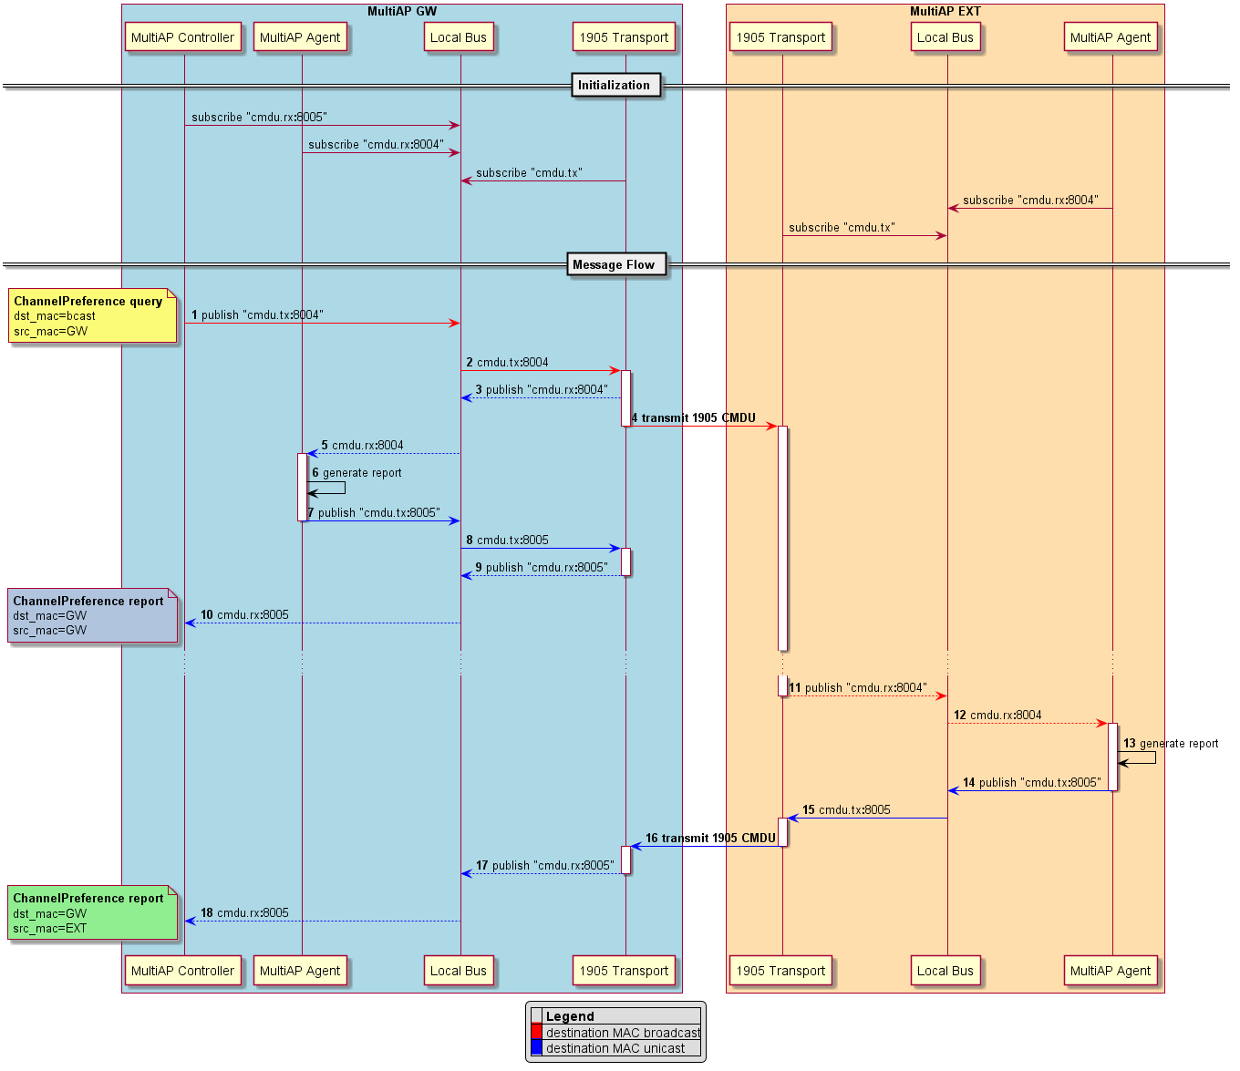
1905 transport – High level messaging flow

Slide 37
PRPL mesh
1905 TLV factory

Slide 38
Agenda
Overview
Motivation
Features
Examples

Slide 39

Overview
Python package, generates C++ code to represent TLVs
Input – yaml configuration file, source path, output path, yamls path
Designed for TLV classes, but not limited to them
Can generate any type of data element
Code Location:
https://github.com/prplfoundation/prplMesh/tree/master/framework/tlvf

Slide 40
Motivation
Easy to read – simple representation for TLVs by yaml format
Easy to use – adding / modifying TLVs is easy by adding / modifying yaml file
Standardize the APIs provided by TLV classes
Single codebase for all TLV classes (easy to maintain)
Alternatives and why we didn’t use them
Google protobuf – no control on byte stream order
Facebook thrift – c++14, we have c++11
Notes:
MultiAP defines multiple types of messages.
Each message is encapsulated within a 1905 cmdu and contains one or more TLVs .

Slide 41
Features
Getter/setter for each TLV field
Fully serializable – no memory copies
Single reusable buffer
Allows static and dynamic size TLVs (dynamic list as a field)
Supports external structs to be used inside TLV

Slide 42
Features
Support namespaces, constants, enums and structs
Support all C++ standard types and C++ strings
Support optional parameters (under development*)
Seamless endianness handling
Automatic length calculation

Slide 43
IEEE1905 / MultiAP message
CMDU Header
TLV 1
…
TLV N
TLV End Of Message
Tlv example: “device information”
Type
Length
AL MAC
Number of local interfaces
local interface 1
local interface 2
…
local interface N
MAC address
Media type
Info length
Media specific information

Slide 44
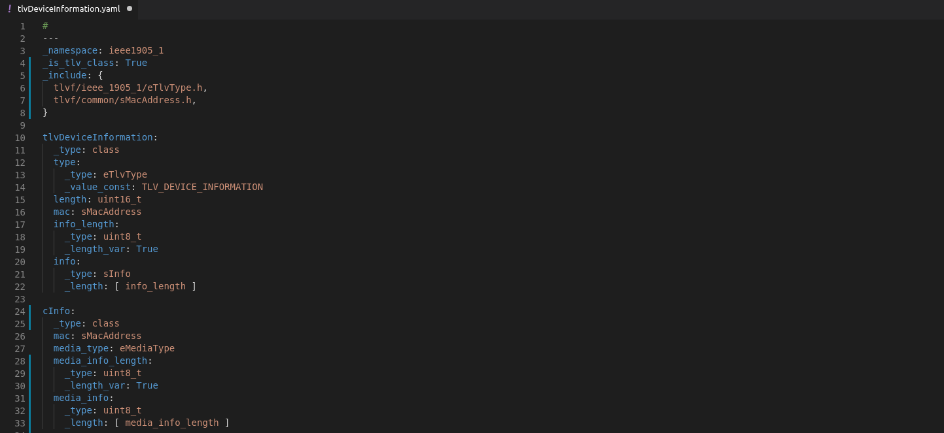
Yaml files
Yaml is a human-readable data serialization language.
All the classes, structs and enums are configured in yaml files and generated based on these configurations.
File attributes (namespace, includes, etc.)
Class name
Class attribute
Class members
Additional internal types

Slide 45
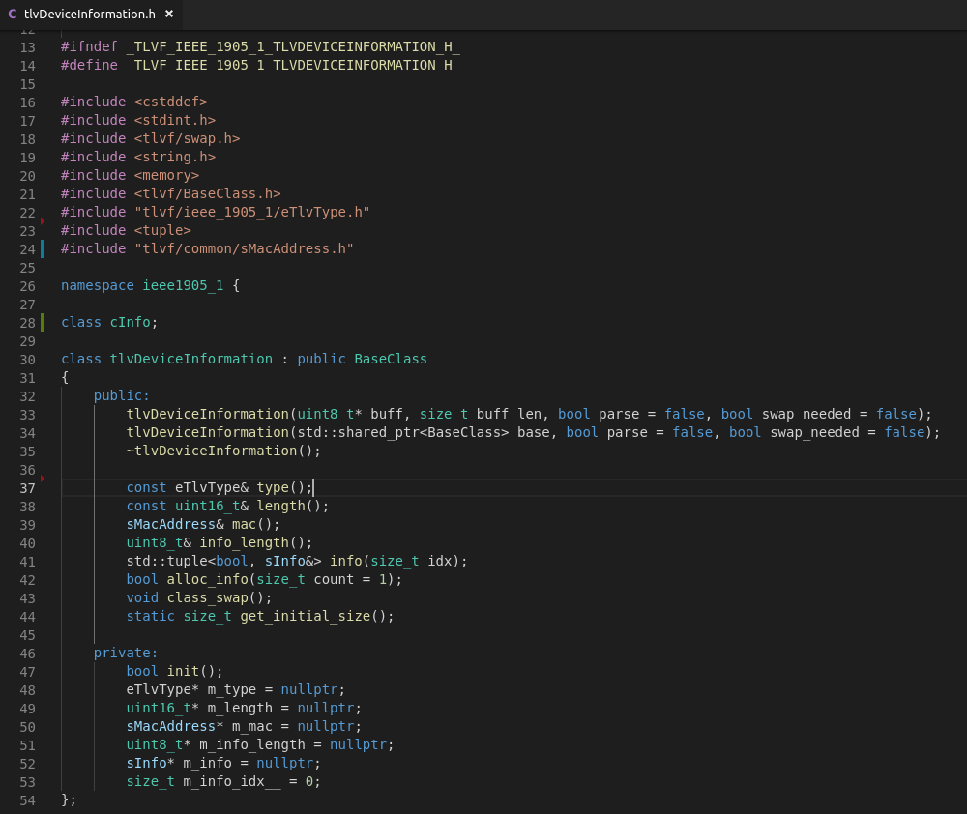
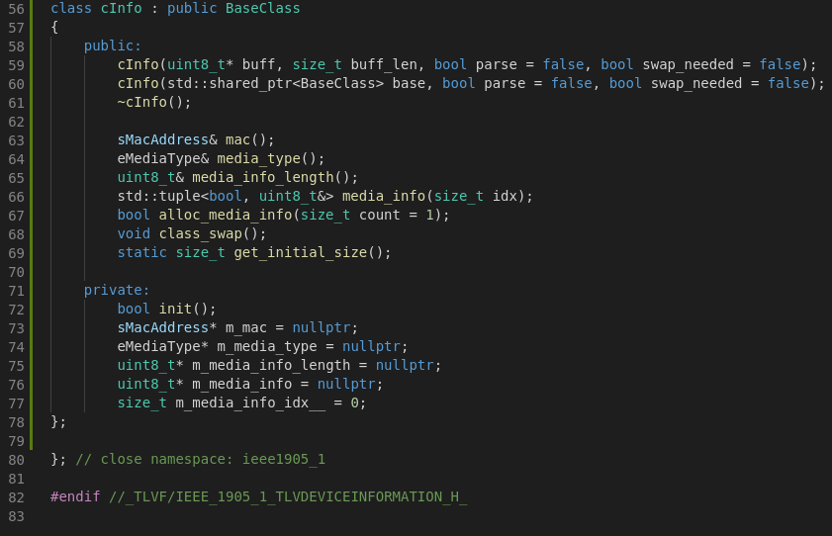
Example generated .h file
File attributes
Internal types
Class API
Class members

Slide 46
Non-generated (copied) source files
cBaseClass
Base class for all the classes generated by the TLVF
Holds the buffer and pointers (similar to sk_buff)
CmduMessageTx / CmduMessageRx
Rx/Tx Descriptor
holds the CMDU header and all TLV classes
swap.h
Endianness conversion utilities
tlvfutils.h
type conversions (e.g. mac_to_string())

Slide 47
Tx Packet flow
Allocate tx_buffer
Construct and assign tx_buffer to a CmduMessageTx descriptor
Create CMDU header with CmduMessageTx::create()
Optional: set values in CMDU header (relay, MID)
Add TLVs with CmduMessage::addClass()for each TLV
Update TLVs data using class getters / setters
Notes:
CmduMessageTx: Class that contains the buffer and manages the cmdu header class and all the TLVs.

Slide 48
Tx Packet flow
Finalize before sending to the network with CmduMessageTx::finalize()
Endianness conversion for the whole message to network byte order
Adds End of Message TLV
Send the message buffer using CmduMessageTx::getMessageBuff()
Notes:
CmduMessageTx: Class that contains the buffer and manages the cmdu header class and all the TLVs.

Slide 49
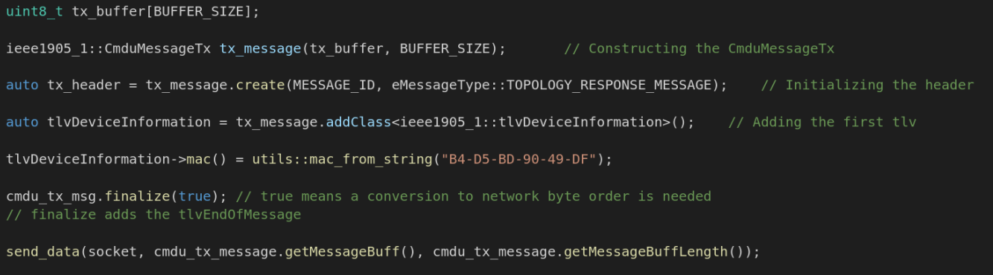
Tx Packet flow
Notes:
CmduMessageTx: Class that contains the buffer and manages the cmdu header class and all the TLVs.

Slide 50
Rx Packet flow
Allocate rx_buffer
Receive packet data into rx_buffer
Construct and assign rx_buffer to a CmduMessageRx descriptor
Parse the CMDU header using CmduMessageRx::parse()
Add TLVs (based on message type) with CmduMessage::addClass()for each TLV
Repeat until reaching End Of Message TLV
Notes:
CmduMessageTx: Class that contains the buffer and manages the cmdu header class and all the TLVs.

Slide 51
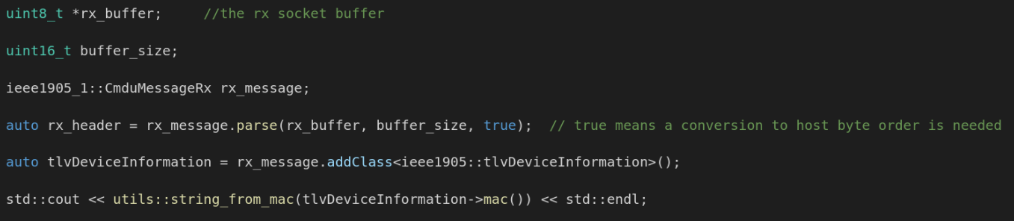
Rx Packet flow

Slide 52
Configuration file options
include_yaml_path – path to yaml files
include_source_path – non-generated (copied) files
source_license_header – optional, path to license file
debug - debugging and logging options

Slide 53
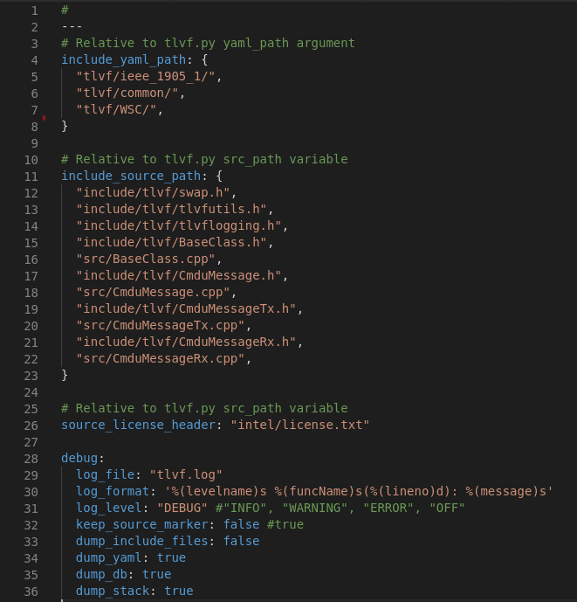

Slide 54
Running TLVF
tlvf.py <source files path> <yaml path> <output directory path> -c <configuration file path>
Options:
--print-dependencies - prints the list of all yaml files read by the script
--print-outputs - prints the list of generated and copied files

Slide 55
TLVF - Backup

Slide 56
Under the hood
Tlvf performs these steps:
Copy all non generated source path files to output dir
Load all yaml files to internal DB and process each file:
Process the yaml file into python dictionary using PyYaml
openObject – preparation - Generate code template based on the object type (class, struct, etc.)
generateObject – Generate object specific code – class members, methods, etc.
closeFile – write the generated code into .h and .cpp files

Slide 57
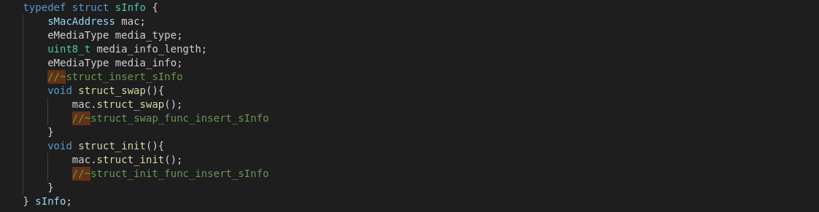
Under the hood Markers
Tlvf uses markers in generated code to easily locate each code line location. for example: //~class_private_func_insert marks where to insert private methods code These markers are ignored when writing to the file and don’t appear in the output (can be changed by configuration for debug purposes).

Slide 58
Under the hood Build optimization – ignore re-compiling files
Tlvf checks for differences when writing files.
If the output files already exists, it compares the file content to the generated code and only writes into the files in case there are differences.
That way the generated files are only touched when their content is changed.
It can be used for build optimizations so that this C++ code will not be compiled again.

Slide 59
PRPL mesh
Discovery service

Slide 60
Agenda
Overview
Flow diagram
Message handling

Slide 61
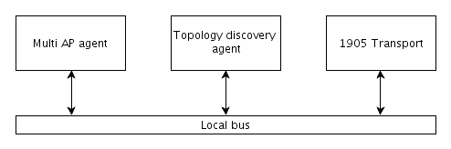
Discovery service- overview
Discovery agent module is responsible for exchanging topology update messages in the network.
It has a database that contains all the information on the device and it‘s direct neighbors and provides an API for the agent to fetch the data.
Using this information the controller (which queries all agents) can build a full network topology map.
It interacts with multi AP agent and 1905 transport over local bus.
Code location:
https://github.com/prplfoundation/prplMesh/tree/master/framework/discovery_agent

Slide 62
Discovery service- overview
Discovery agent support the following messages:
IEEE 802.1 bridge discovery:
A bridge discovery message is an LLDP packet used to find the nearest bridge
Using a special multicast address (01-80-C2-00-00-0E), which is not forwarded by the bridge.
2. Topology discovery protocol:
- Topology discovery message (neighbor multicast)
- IEEE 802.1 bridge discovery message (neighbor multicast)
- Topology query message (unicast)
- Topology response message (unicast)
Topology notification message (relayed multicast)
3. Higher Layer information protocol:
In addition to the topology discovery protocol, a 1905 management entity may discover additional
Higher Layer information using the Higher Layer query/response procedure with the following
messages:
- Higher Layer query message (unicast)
- Higher Layer response message (unicast)

Slide 63
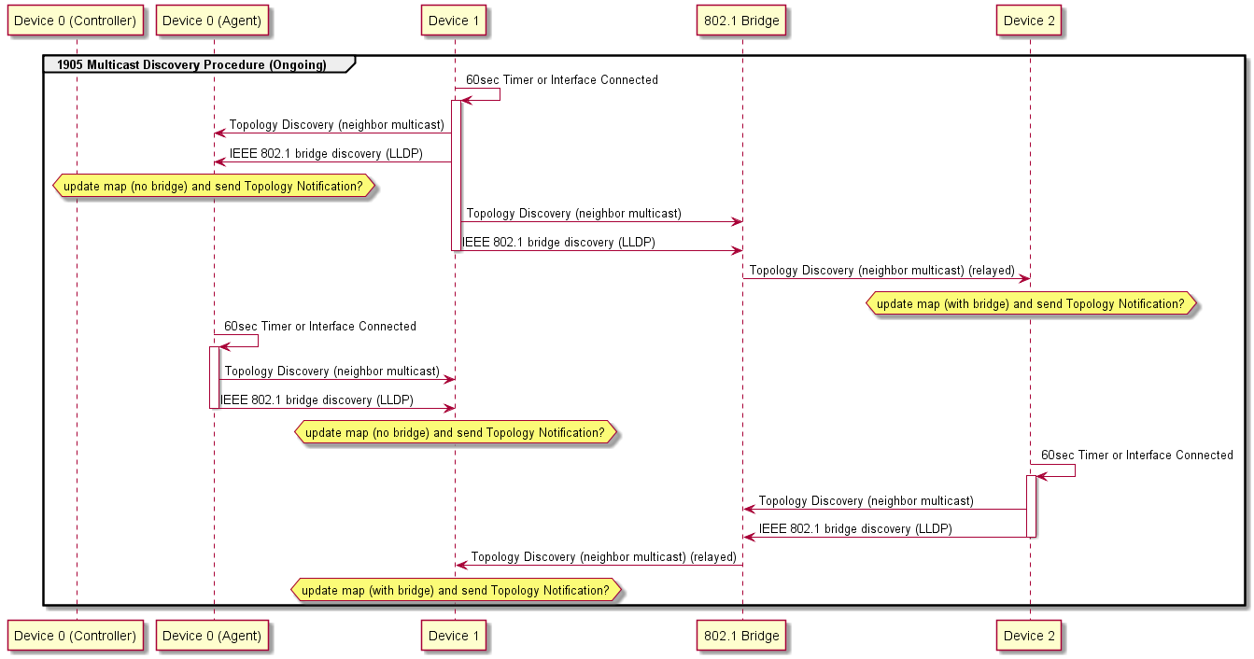
Discovery service- Multicast discovery procedure

Slide 64
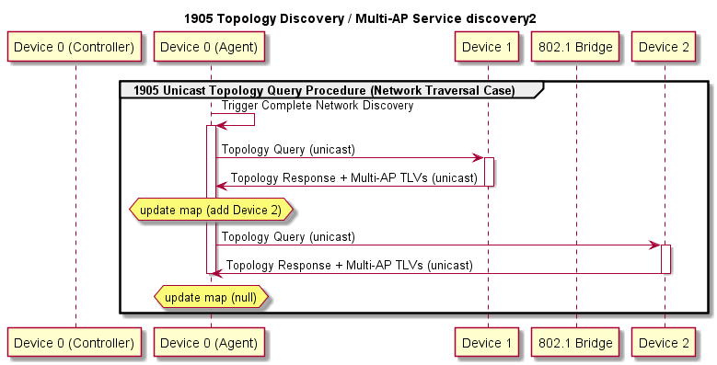
Discovery service- Topology query
Queries the collected information
Usually sent by Controller
Agent should reply with collected topology

Slide 65
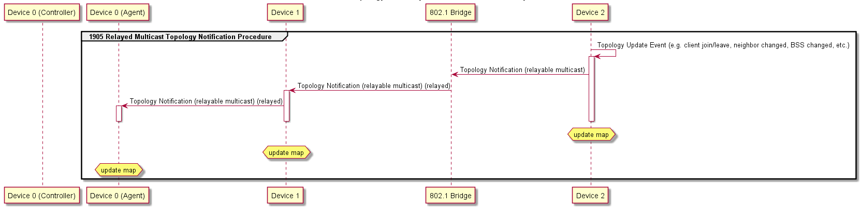
Discovery service- Topology notification

Slide 66
Discovery service- Message handling
Message | Description | Action
wlan_ap_event | WLAN AP state change event | Update local database for WLAN AP list will be used in forming HL query response message
cl_assoc | Client association event | Update local database for associated client list will be used in forming HL query response message
CMDU_TOPL_QUERY_MSG | Topology query message | Prepare and send unicast topology response CMDU message on local bus
CMDU_TOPL_NOTIFY_MSG | Topology notification message | Update local database for neighbor list relayed multicast is handled by transport agent
CMDU_DISC_MSG | Topology discovery message | Update local database for neighbor list
ETH_P_LLDP | LLDP discovery message | Add/update local database for neighbor list, specifically set bridge existence as false for this neighbor
CMDU_HL_QUERY_MSG | Higher Layer query message | Prepare and send unicast HL response CMDU message on local bus
CMDU_IFSTAT_CHANGE_MSG | Interface state change message | Update local database for interface list, trigger topology discovery for interfaces added new

Slide 67
PRPL mesh
WFA_CA

Slide 68
WFA_CA overview
WFA_CA is used to control the agent for citification usage.
It listen on TCP socket and waits for CAPI commands from the WFA setup.
It implements the following CAPI commands:
CA_GET_VERSION - Return ca_version (agent version)
DEVICE_GET_INFO - Return vendor, model and version
DEV_RESET_DEFAULT - Reset the device to its default program specific configuration
DEV_SET_CONFIG - Set device configuration with given parameters.
DEV_GET_PARAMETER - Retrieve the requested parameter information (mac, bssid, Almac).
DEV_SEND_1905 - sending a 1905 message with the specified TLVs.
START_WPS_REGISTRATION
Code location:
https://github.com/prplfoundation/prplMesh/tree/master/framework/wfa_ca

Slide 69
PRPL mesh
Platform service

Slide 70
Platform service overview
Platform service is basically the platform manager that will be explained in the Agent’s slides which is currently part of the agent
Platform service today is not yet connected to the local bus
There is a planned task to move the “platform manager” from the agent and put it on the bus.
The Platform manager has plugin per OS/SDK called bpl.
More details on the platform manger are on the agent slides.

Slide 71
PRPL mesh
Management service

Slide 72
Management service overview
Management service today is not yet connected to the local bus – this is planned task.
Instead, we have a C library called BML to be linked by the orchestration of the OS.
The library is using UDS socket is sending requests to the controller which are routed to the BML task.
More details on the BML task and BML library are on the controller slides.

