Slide 1
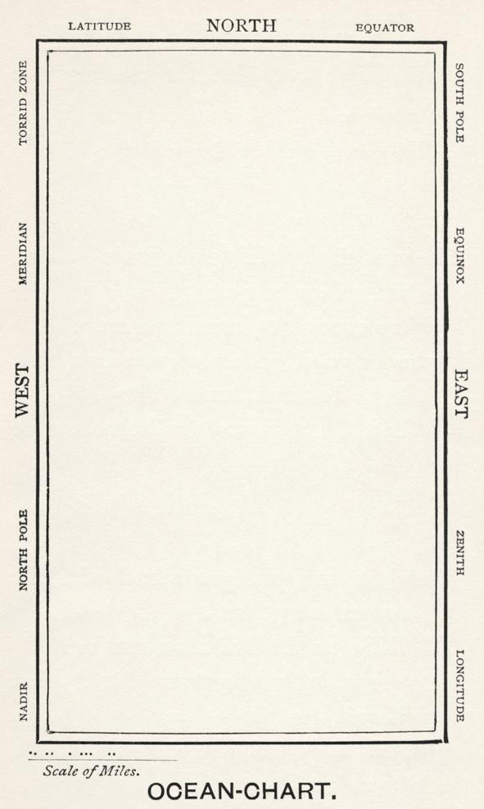
Download dependencies as you arrive:
From https://prpole.github.io
Click on “Talks”
Click first link
Start with Stanford NER, then NLTK, then the rest

Slide 2
Location Extraction and Georeferencing with Python, NLTK, and MapBox

Slide 3
Uses and Challenges
Show the spatial imagination of a text
Automation vs. hand-coding
Proposal: automatic pre-processing

Slide 4
Today’s Presentation
Walk through code with iPython
Upload results to MapBox
Discussion and Questions

