Slide 1

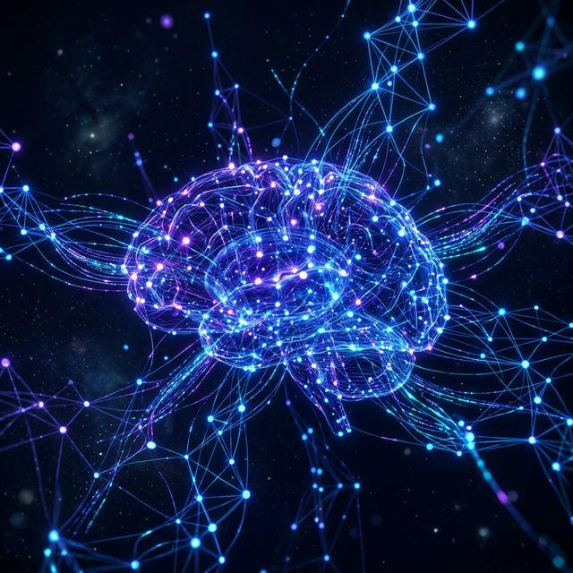
EDU
● NextAIQ-Edu · AI for Indian Schools
The Future of Education
Is Powered by AI
Transforming how Indian schools teach technology — industrial-grade AI, hands-on smart labs, and CBSE-aligned curriculum.
Discover NextAIQ-Edu
Become a Partner School
500+
85%
10x
SCHOOLS READY
JOBS NEED AI
ENGAGEMENT

Slide 2
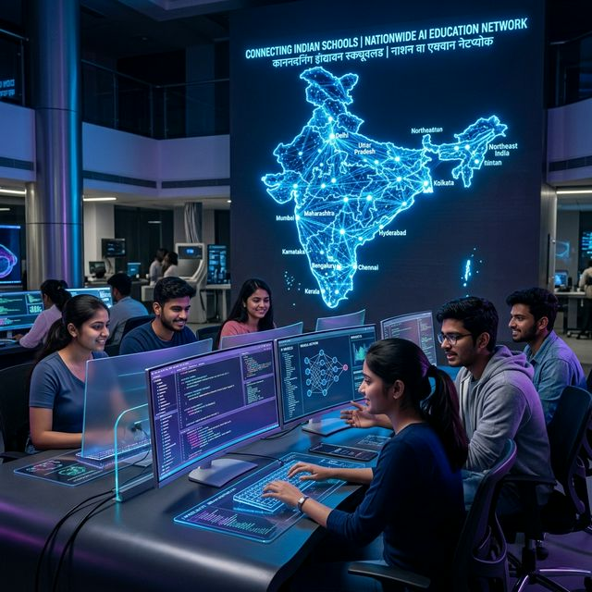
THE PROBLEM
The Current Skill Gap in Indian Schools
Traditional education is falling behind. Students are entering a workforce that demands AI literacy — but schools aren't equipped.
📉
72%
Schools Lack AI Curriculum
No structured AI or ML modules in K-12.
🎓
3.5M
Unfilled STEM Jobs
Graduates lack practical AI experience.
⏳
5 yrs
Curriculum Lag
Schools 5+ years behind industry tech.

Slide 3
THE OPPORTUNITY
Why Industrial AI Exposure Matters
Real-world AI builds critical thinking, problem-solving, and innovation mindsets.
🏭
Real-World Relevance
🧠
Future-Proof Careers
Industrial AI shows students how AI works in factories, hospitals, and cities.
Students who understand neural networks and edge computing will lead every industry.
🇮🇳
India's AI Advantage
🎯
CBSE & NEP 2020 Aligned
With right AI education, India can become the world's #1 AI talent pool by 2030.
Curriculum aligns with NEP 2020's vision of computational thinking.

Slide 4
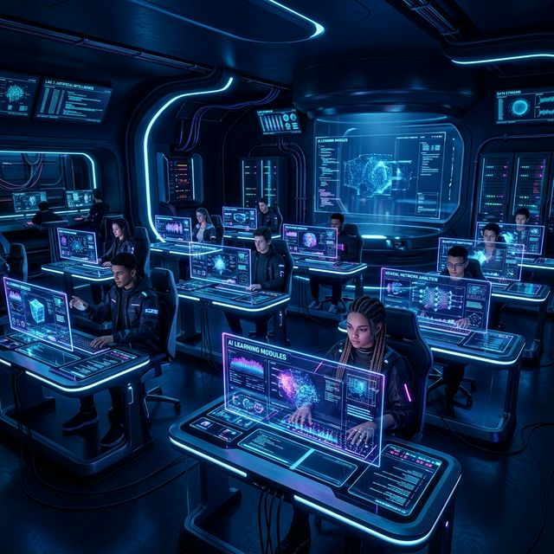
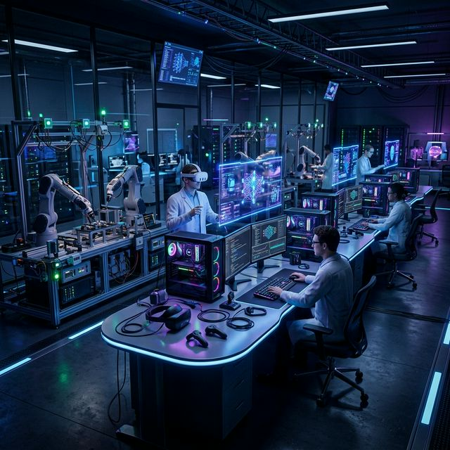
THE SOLUTION
Introducing NextAIQ-Edu
A comprehensive AI education platform bringing industry-grade technology into Indian schools.
🎯 AI-First Curriculum for Grades 6-12
🔬 Smart Lab Infrastructure
ML, CV, NLP, Robotics · Python & TensorFlow · Project-based learning
GPU workstations · IoT kits · Robotics · NVIDIA Jetson · Cloud dashboards

Slide 5













04
INTRODUCING nextaiQ-edu Smart AI Lab
A structured, hands-on Industrial AI exposure program designed for Grades 6–12
Our Mission
🎓
Bridge the gap between academic knowledge and industrial AI — bringing real-world tools, frameworks, and mentorship directly into the classroom.
🔬 Hands-On AI Solution
🏭 Industry-Grade Tools and Exposer
Grades 6–12
240+ Hours of Learning
🎓 AI Instructors
🚀 Live Project Experience
Industry-Aligned
Certification

Slide 6



















ECOSYSTEM
A Structured Institutional AI Ecosystem
NextAIQ Edu is not a workshop program — it is a comprehensive AI integration framework for schools.
Industry Leadership Seminars
Industrial Exposure Visits
AI Club Formation
AI-Enabled Campus Ecosystem
2 sessions/month
1 structured visit/month
Peer-led innovation culture
Smart lab infrastructure
AI Engagement Activities
Intra-School Hackathons
Inter-School Hackathon
Weekly Theory Classes
Weekly quizzes & challenges
2 campus hackathons/year
Annual multi-institution
CBSE-aligned curriculum

Slide 7






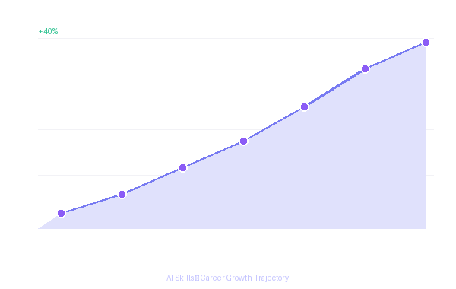
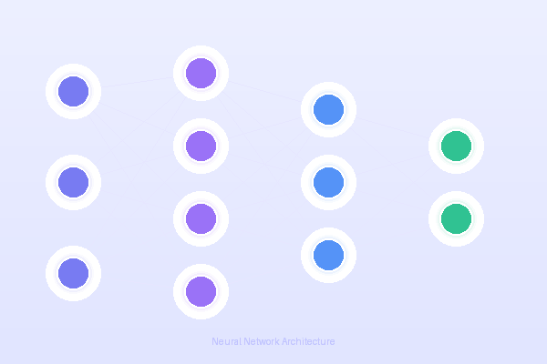
PROGRAM
Industry Engagement & Exposure
Real-world learning bridges academic theory with industrial intelligence
2 MONTHLY
1 MONTHLY
Industry Leadership Seminars
Industrial Exposure Visits
AI Researchers – Leading scientists & academics
Observe AI & Automation – See industrial robots & ML systems
Industry Leaders – CEOs from top AI companies
Smart Manufacturing – Understand AI-driven production lines
Startup Founders – Real-world problem solvers
Meet Technical Professionals – Interact with engineers & architects
CEOs & Innovators – Live industrial challenge sessions
Theory Meets Practice – Connect classroom learning to real plants
"Real exposure builds the bridge between academic theory and industrial intelligence."
"Exposes students to real industrial challenges & practical AI applications in action."

Slide 8







PROGRAM
AI Club & Campus Transformation
From one classroom to an entire AI-immersive campus environment
ONGOING
CAMPUS-WIDE
AI Club Formation
AI-Enabled Campus Ecosystem
Peer-Led Innovation – students run AI projects independently
AI Awareness Displays – screens showing live AI data & insights
Project Collaboration – cross-grade design sprints
Smart Lab Infrastructure – GPU workstations, AR/VR & cloud tools
Student Leadership – AI captains, club presidents & showcases
Innovation Boards – digital dashboards of student AI projects
Community Events – demo days, talks & parent exhibitions
Technology Culture – tech-integrated learning across all subjects
"The AI Club becomes the heartbeat of innovation culture within the institution."
"The whole campus becomes an AI-immersive environment — not just one classroom."

Slide 9










PROGRAM
Innovation Labs & Academic Rigor
From competitive hackathons to CBSE-aligned theory — a complete learning loop
CONTINUOUS
ANNUAL × 2
ANNUAL + WEEKLY
AI Engagement
Activities
Intra-School
Hackathons
Inter-School
Hackathon & Theory
AI-Based Quizzes – weekly assessments
Real-World AI Problems – live industrial challenges
City-Wide Competition – compete against best students
Weekly Challenges – analytical problem-solving
24-48 hr Sprint – ideate, prototype, present
Brand Elevation – school's AI identity on stage
AI Comprehension Games – gamified learning
Cross-Grade Teams – system design thinking
CBSE Skill Objectives – national AI framework
Monthly Competitions – AI problem-solving contests
Industry Panel Judging – AI professionals
Computational Thinking – algorithm design & abstraction

Slide 10








COMPLETE ECOSYSTEM
The Complete AI Ecosystem
8 integrated pillars — designed to work together as a seamless institutional framework
Industry Seminars
2 sessions/month · AI researchers, CEOs & founders sharing real industrial challenges
Industrial Visits
1 visit/month · Students observe AI & automation in live production environments
AI Club Formation
Peer-led AI club · Innovation teams, project collaboration & student AI leadership
Campus Ecosystem
AI displays, smart labs, innovation boards & tech-integrated culture campus-wide
Engagement Activities
Weekly quizzes, challenges, AI games & comprehension competitions for cognitive agility
Intra Hackathons × 2
Two annual campus hackathons · Real problems, time-constrained builds, industry judging
Inter Hackathon × 1
Annual multi-institution event · Competitive excellence, brand elevation & recognition
CBSE Theory Classes
Curriculum-aligned AI theory · Computational thinking, logical reasoning & AI literacy
NextAIQ Edu creates a complete AI ecosystem — integrating theory, industry exposure, innovation culture & structured competency development.

Slide 11
ECOSYSTEM
A Structured Institutional AI Ecosystem
Not a workshop — a comprehensive AI integration framework for schools.
🎤
🏭
🧪
🏫
Industry Seminars
Industrial Visits
AI Club Formation
AI-Enabled Campus
2 sessions/month
1 visit/month
Peer-led innovation
Smart lab infra
🧩
⚡
🏆
📖
Engagement Activities
Intra Hackathons
Inter-School Hackathon
Theory Classes
Weekly challenges
2 per year
Annual event
CBSE-aligned

Slide 12

WHAT STUDENTS LEARN
Three Domains of AI
Our curriculum covers all three AI domains with hands-on projects in each.
👁️
💬
📊
Computer Vision
Natural Language
Statistical Data AI
Input: Images & Videos
Input: Text & Speech
Input: Numbers & Patterns
Machines that SEE — recognize faces, detect objects, read X-rays.
Machines that UNDERSTAND language — translate, converse, generate.
Machines that find PATTERNS — predict weather, detect fraud.
Face ID · Filters · Cricket DRS · Google Lens
Siri · Google Translate · ChatGPT · Chatbots
Weather · Stock Market · IPL · Hospital Data

Slide 13
AI IN ACTION
Real-World AI Examples from India
AI in your pocket, on cricket fields, and in hospitals.
🏏
Cricket DRS — AI on the Field
🗺️
Google Maps — Live Routing
Hawk-Eye uses CV AI to track ball paths. Decides OUT/NOT OUT in 2 seconds.
AI analyzes GPS from millions of phones + traffic data. Predicts fastest route.
Computer Vision
Statistical Data
🔓
Face Unlock — 30,000 Points
🩺
AI Detecting TB in Rural India
Maps 30,000+ points on your face. Unlocks in 0.1s, unique among 8B humans.
AI detects Tuberculosis from X-rays with 90%+ accuracy in 30 seconds.
Computer Vision
CV + Data

Slide 14
THE CURRICULUM
Progressive Learning Framework
4-tier, 20-week curriculum from AI fundamentals to industrial applications — CBSE & NEP 2020 aligned.
Tier 1 · Foundation
Tier 2 · Exploration
Tier 3 · Application
Tier 4 · Mastery
AI Awareness
ML & Data Science
CV & NLP Projects
Industrial AI
4 Weeks
6 Weeks
6 Weeks
4 Weeks
✓ What is AI?
✓ Supervised learning
✓ CNN architectures
✓ Industrial cases
✓ AI vs Automation
✓ Data visualization
✓ Object detection
✓ IoT integration
✓ Python basics
✓ Model training
✓ Chatbot building
✓ Capstone project
✓ Ethics in AI
✓ Kaggle challenges
✓ Edge deployment
✓ Certification
📅 20 Weeks · ⏱️ 240+ Hours · 🎓 Industry Certification

Slide 15
INFRASTRUCTURE
Smart AI Lab Infrastructure
Turnkey AI labs: GPU workstations, IoT kits, robotics, and cloud connectivity.
🖥️
GPU Workstations
🤖
Robotics Kits
NVIDIA RTX-powered, AI frameworks pre-installed
Arduino, Raspberry Pi, ROS-based platforms
📡
IoT Sensor Arrays
☁️
Cloud Dashboard
Temperature, vibration, camera, environmental
Real-time student progress monitoring
🥽
AR/VR Headsets
🔧
Quarterly Upgrades
Complete AI Learning Environment
Immersive learning & industrial simulation
24/7 support & infrastructure refresh
30-seat Smart Lab — Setup, Installed & Maintained

Slide 16
RESULTS
Student Learning Outcomes
Measurable impact on capabilities, engagement, and career readiness.
🎯
94%
Project Completion
Complete hands-on AI projects with functional models.
🚀
3x
STEM Interest Boost
3x higher interest in STEM careers.
🏆
87%
AI Literacy Score
Proficiency in AI concepts, Python, models.
📁
3+
Project Portfolio
Completed AI projects for job interviews.
🌐
50+
Industry Partners
Direct connections to hiring AI companies.

Slide 17
INSTITUTIONAL IMPACT
Benefits to Your School
Elevate your brand, attract top students, lead in future-ready education.
📈
Rankings & Reputation
💼
Placement Excellence
Elevate NIRF rankings with cutting-edge AI programs.
AI-trained students attract top recruiters — 35-45% boost.
🎖️
NEP 2020 Accreditation
💰
Revenue Generation
Meet AICTE guidelines with certified framework.
Premium AI courses as new revenue streams.
🖥️
Infrastructure Upgrade
🌍
Global Recognition
State-of-the-art AI lab at no extra operational cost.
Partner with global AI orgs for research & exchange.

Slide 18
HOW WE WORK
Implementation & Support
We handle everything — from lab design to teacher training.
🛠️ Setup & Deployment
📚 Ongoing Support
✓ School needs assessment
✓ Teacher training & certification
✓ Custom lab design & planning
✓ Monthly curriculum updates
✓ Hardware procurement & install
✓ Dedicated support engineer
✓ Software stack & licensing
✓ Quarterly progress reports
✓ Network & cloud config
✓ Annual hackathon events
✓ Commissioning & testing
✓ Hardware maintenance & upgrades

Slide 19
PARTNERSHIP
Investment & Partnership Plans
Flexible models for schools of every size. Transparent pricing.
Starter
Most Popular
Enterprise
Small schools & pilots
Professional
Multi-campus networks
Established institutions
✓ 10-seat AI lab
✓ Multi-lab deployment
✓ Tier 1 & 2 curriculum
✓ 20-seat GPU lab
✓ Custom curriculum
✓ Basic IoT kit
✓ Full 4-tier curriculum
✓ Research partnership
✓ 2 teacher training
✓ Robotics & IoT full kit
✓ Unlimited training
✓ Email support
✓ 5 teacher training
✓ 24/7 premium support
✓ Dedicated support
✓ Co-branded certs
✓ Hackathon sponsorship

Slide 20
VISION
Roadmap & Long-Term Vision
Scaling from 5 cities to national coverage — India as the global AI-ready leader.
2025 Q1-Q2
2025 Q3-Q4
2026
2027+
Launch
Scale
Expansion
Vision
50 Schools 5 Cities 5,000 Students
200 Schools 15 Cities 20,000 Students
500 Schools 30 Cities Universities
2000+ Schools National Coverage Global Partnerships
🎯 Vision: Make India the global leader in AI-ready graduates by 2030

Slide 21
Ready to Transform
Your School?
Join the NextAIQ-Edu network and give your students the AI advantage they deserve. Let's build the future of education — together.
Schedule a Consultation
↑ Back to Top
📧 edu@nextaiqlabs.com
🌐 nextaiqlabs.com
📞 Contact Sales
© 2026 NextAIQ Labs — NextAIQ-Edu Division. Transforming Education. Empowering Futures.

