Slide 1















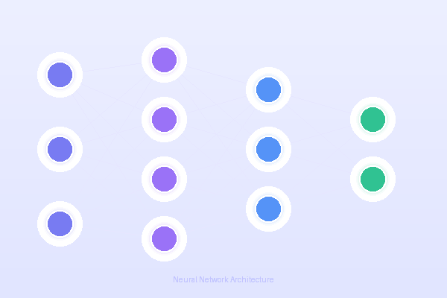
nextaiQ Labs · Industrial AI & Automation
⚡ POWERED BY nextaiQLabs
The Future of
240+
Hours of
Learning
Industry-Aligned Curriculum
20 Weeks
Structured Program
50+
Hiring
Partners
Empowering Students with Industrial AI Skills for Tomorrow's World
nextaiq.in/edu →
Grades 6 – 12

Slide 2



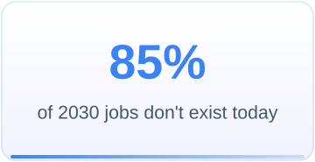
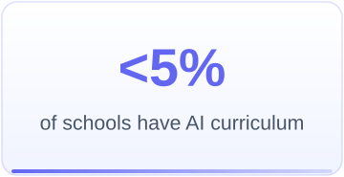
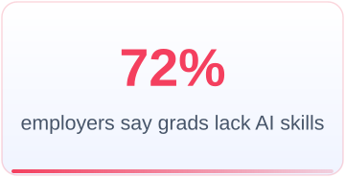

02
The Current Skill Gap in Schools
A widening chasm between what industry needs and what schools deliver
Key Gaps Identified
The Strategic Risk
No exposure to real-world AI tools & platforms
AI readiness is no longer an optional enhancement — it is becoming a strategic institutional differentiator.
Curriculum outdated — still teaching legacy tech
Teachers lack AI training and industry context
What Industry Requires ≠ What Schools Deliver
No hands-on labs or industrial simulation environment

Slide 3







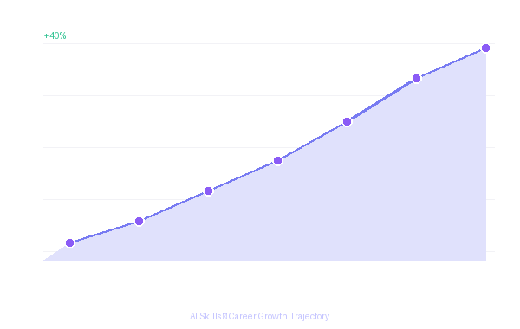
03
Why Industrial AI Exposure Matters
The four pillars that make AI education a national imperative
🎓
Career Readiness
🌍
Global Competitiveness
Students with AI skills command 40% higher starting salaries and are 3× more likely to be promoted within 2 years.
Nations investing in AI education outperform economically. India must prepare students for the global AI-driven workforce.
💡
Innovation Mindset
📈
Industry Demand
Early AI exposure fosters problem-solving, creativity, and entrepreneurial skills that transcend any single career.
Over 1 million AI-related job openings in India alone by 2027 — with only 20% of graduates ready to fill them.

Slide 4




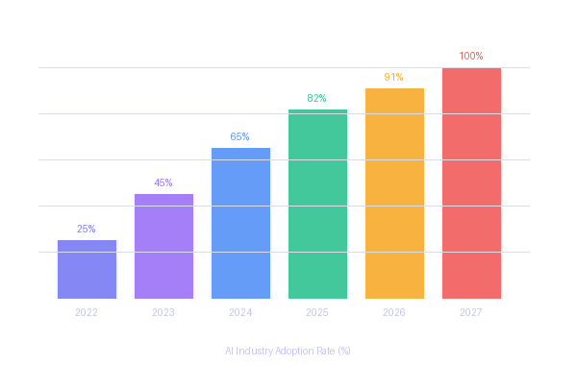
THE PROBLEM
Is Your School Ready?
By 2030, every major industry will be AI-powered — and most institutions are unprepared.
70%
of industries will use AI & automation by 2030
The Educational Disconnect
The Institutional Risk
Computer labs limited to theoretical exposure
AI readiness is no longer an optional enhancement. It is the defining institutional differentiator of 2025 and beyond. Schools not acting now will lose both talent and competitive edge.
3x
more productive: AI-augmented workers vs non-AI
Robotics without industrial alignment
Coding disconnected from real-world application
No structured AI competency roadmap
80%
of manufacturing will be AI-powered within 5 years
⚡ There is a widening gap between What Industry Requires and What Schools Currently Deliver

Slide 5




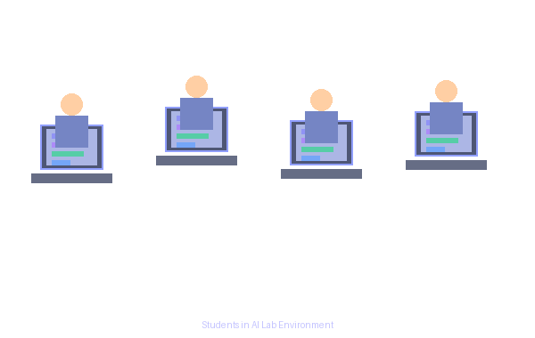
THE SOLUTION
for Grades 6 – 12
Industry-Grade Tools
Certified Instructors
Live Project Experience
nextaiQ-edu Smart AI Lab · nextaiq.in/edu

Slide 6







04
INTRODUCING nextaiQ-edu Smart AI Lab
A structured, hands-on Industrial AI exposure program designed for Grades 6–12
Our Mission
🎓
Bridge the gap between academic knowledge and industrial AI — bringing real-world tools, frameworks, and mentorship directly into the classroom.
🔬 Hands-On AI Solution
🏭 Industry-Grade Tools and Exposer
Grades 6–12
240+ Hours of Learning
🎓 AI Instructors
🚀 Live Project Experience
Industry-Aligned
Certification

Slide 7
















ECOSYSTEM
A Structured Institutional AI Ecosystem
NextAIQ Edu is not a workshop program — it is a comprehensive AI integration framework for schools.
Industry Leadership Seminars
Industrial Exposure Visits
AI Club Formation
AI-Enabled Campus Ecosystem
2 sessions/month
1 structured visit/month
Peer-led innovation culture
Smart lab infrastructure
AI Engagement Activities
Intra-School Hackathons
Inter-School Hackathon
Weekly Theory Classes
Weekly quizzes & challenges
2 campus hackathons/year
Annual multi-institution
CBSE-aligned curriculum

Slide 8




PROGRAM
Industry Engagement & Exposure
Real-world learning bridges academic theory with industrial intelligence
2 MONTHLY
1 MONTHLY
Industry Leadership Seminars
Industrial Exposure Visits
AI Researchers – Leading scientists & academics
Observe AI & Automation – See industrial robots & ML systems
Industry Leaders – CEOs from top AI companies
Smart Manufacturing – Understand AI-driven production lines
Startup Founders – Real-world problem solvers
Meet Technical Professionals – Interact with engineers & architects
CEOs & Innovators – Live industrial challenge sessions
Theory Meets Practice – Connect classroom learning to real plants
"Real exposure builds the bridge between academic theory and industrial intelligence."
"Exposes students to real industrial challenges & practical AI applications in action."

Slide 9







PROGRAM
AI Club & Campus Transformation
From one classroom to an entire AI-immersive campus environment
ONGOING
CAMPUS-WIDE
AI Club Formation
AI-Enabled Campus Ecosystem
Peer-Led Innovation – students run AI projects independently
AI Awareness Displays – screens showing live AI data & insights
Project Collaboration – cross-grade design sprints
Smart Lab Infrastructure – GPU workstations, AR/VR & cloud tools
Student Leadership – AI captains, club presidents & showcases
Innovation Boards – digital dashboards of student AI projects
Community Events – demo days, talks & parent exhibitions
Technology Culture – tech-integrated learning across all subjects
"The AI Club becomes the heartbeat of innovation culture within the institution."
"The whole campus becomes an AI-immersive environment — not just one classroom."

Slide 10










PROGRAM
Innovation Labs & Academic Rigor
From competitive hackathons to CBSE-aligned theory — a complete learning loop
CONTINUOUS
ANNUAL × 2
ANNUAL + WEEKLY
AI Engagement
Activities
Intra-School
Hackathons
Inter-School
Hackathon & Theory
AI-Based Quizzes – weekly assessments
Real-World AI Problems – live industrial challenges
City-Wide Competition – compete against best students
Weekly Challenges – analytical problem-solving
24-48 hr Sprint – ideate, prototype, present
Brand Elevation – school's AI identity on stage
AI Comprehension Games – gamified learning
Cross-Grade Teams – system design thinking
CBSE Skill Objectives – national AI framework
Monthly Competitions – AI problem-solving contests
Industry Panel Judging – AI professionals
Computational Thinking – algorithm design & abstraction

Slide 11








COMPLETE ECOSYSTEM
The Complete AI Ecosystem
8 integrated pillars — designed to work together as a seamless institutional framework
Industry Seminars
2 sessions/month · AI researchers, CEOs & founders sharing real industrial challenges
Industrial Visits
1 visit/month · Students observe AI & automation in live production environments
AI Club Formation
Peer-led AI club · Innovation teams, project collaboration & student AI leadership
Campus Ecosystem
AI displays, smart labs, innovation boards & tech-integrated culture campus-wide
Engagement Activities
Weekly quizzes, challenges, AI games & comprehension competitions for cognitive agility
Intra Hackathons × 2
Two annual campus hackathons · Real problems, time-constrained builds, industry judging
Inter Hackathon × 1
Annual multi-institution event · Competitive excellence, brand elevation & recognition
CBSE Theory Classes
Curriculum-aligned AI theory · Computational thinking, logical reasoning & AI literacy
NextAIQ Edu creates a complete AI ecosystem — integrating theory, industry exposure, innovation culture & structured competency development.

Slide 12













05
Program Structure & Curriculum Framework
A carefully sequenced 20-week journey from AI foundations to live industry projects
4 Weeks
6 Weeks
6 Weeks
4 Weeks
AI Foundations
Core ML & DL
Industrial AI
Capstone Project
Math for AI, Python Basics, Data Literacy, Intro to Machine Learning
Supervised/Unsupervised Learning, Neural Networks, TensorFlow fundamentals
Computer Vision, NLP, Predictive Analytics, Real-world Dataset Analysis
Live Industry Project, Presentation, Certification & Career Preparation
Total Duration: 20 Weeks · 240+ Hours of Learning · Industry-Aligned Certification

Slide 13
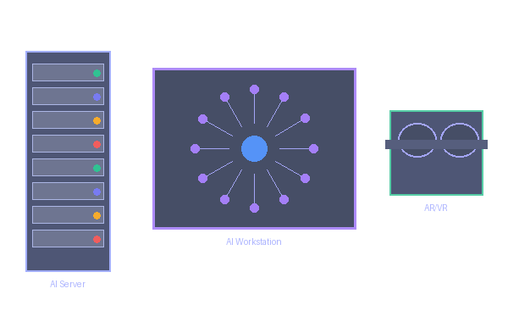






06
Smart AI Lab Infrastructure
State-of-the-art 30-seat AI lab — installed, configured, and maintained by NextAIQ
🖥️
High-Performance Workstations
☁️
Cloud AI Platform Access
📺
Interactive Smart Boards
GPU-enabled machines with AI dev environments pre-configured
AWS, GCP, and Azure AI services for real-world cloud training
Collaborative workspaces for peer learning and hackathons
🗄️
AI Server & NAS Storage
🥽
AR/VR Headsets
🔧
Quarterly Hardware Upgrades
Industrial datasets, simulation environments & open-source AI models
Immersive learning and industrial simulation environments
24/7 remote instructor support & ongoing infrastructure refresh
30-seat Smart Lab per School — Setup, Installed & Maintained

Slide 14
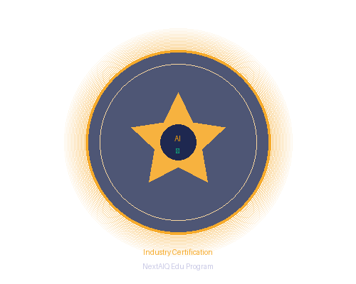
07
Student Learning Outcomes
What students will achieve upon completion of the NextAIQ Edu program
🤖
AI Proficiency
💻
Technical Skills
📊
Data Analysis
Build, train and deploy ML models using industry-standard frameworks
Hands-on coding in Python, TensorFlow, PyTorch, and OpenCV
Analyze, visualize and interpret complex real-world datasets
🏆
Certification
📁
Project Portfolio
🌐
Industry Network
Industry-recognized NextAIQ certification with global validity
Graduate with 3+ completed AI projects ready for job interviews
Direct connections to 50+ hiring partners across AI & tech sectors

Slide 15






08
Benefits to the School Institution
Six strategic advantages that transform your institution's competitive position
Rankings & Reputation
📈
Institution Accreditation
Placement Excellence
🎖️
💼
Elevate NIRF and national rankings by adding cutting-edge AI programs — a key differentiator in 2025+
Meet NEP 2020 and AICTE guidelines for future-ready curricula with our certified program framework
AI-trained students attract top recruiters — directly improving placement rates by an estimated 35–45%
Infrastructure Upgrade
Revenue Generation
🖥️
💰
Global Recognition
🌍
State-of-the-art AI lab infrastructure installed and maintained at no additional operational cost
Offer NextAIQ certified courses as premium add-ons, creating new revenue streams for the institution
Partner with global AI organizations and universities for international student exchange and research

Slide 16








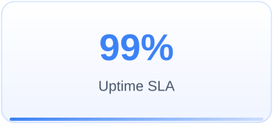
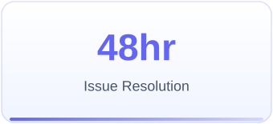
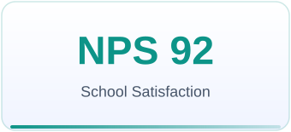
09
Implementation Model & Support Structure
A proven 4-phase rollout with dedicated support at every step
Weeks 1-2
Weeks 3-6
Weeks 7-20
Week 20+
Onboarding
& Setup
Pilot
Launch
Full
Rollout
Certify &
Expand
Ongoing Support
Dedicated Customer Success Manager per school
Monthly progress reviews & curriculum updates
24/7 Technical helpdesk & online portal access
Annual teacher re-certification workshops

Slide 17


10
Investment Structure & Partnership Proposal
Flexible tiers designed to fit every institution — from pilot to full campus transformation
Recommended
Growth
₹9.5L / Year
2 AI Labs (60 seats)
3 Batches (90 students)
Full Curriculum
Dedicated CSM
Industry Certification
Placement Support
*All pricing inclusive of setup, training & first-year support

Slide 18








11
Roadmap & Long-Term Vision
Scaling from 5 cities to national coverage — making India the global leader in AI-ready graduates
2025 Q1-Q2
2025 Q3-Q4
2026 Q1-Q2
2027 Onwards
Launch Phase
Scale Phase
Expansion Phase
Vision Phase
50 Partner Schools
200 Schools
500 Schools
2000+ Schools
5 Cities
15 Cities
30 Cities
National Coverage
5,000 Students
20,000 Students
Universities
Global Partnerships
Launch Phase
Scale Phase
Expansion Phase
Vision Phase
🎯 Vision: Make India the global leader in AI-ready graduates by 2030 — 10 million students, 10,000 schools

Slide 19










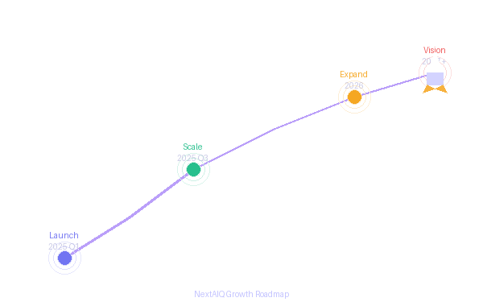
12
Next Steps & Collaboration
Start your institution's AI transformation journey today
Exploratory Meeting
Needs Assessment
Custom Proposal
Pilot Agreement
Schedule a 60-minute discovery call with your leadership team
Our team conducts a free infrastructure and curriculum audit
We deliver a tailored program proposal within 5 business days
Sign MOU and kick off a 30-student pilot at zero extra risk
Let's Connect
Schedule →
📧 edu@nextaiq.in
Start your institution's AI transformation journey today
📞 +91 98765 43210
🌐 www.nextaiq.in/edu
Transforming Education. Empowering Futures. · Powered by NextAIQ.

