Slide 1
Creating a Subscription Model in Scala Using Akka’s Distributed PubSub Library
Priya Mohan

Slide 2


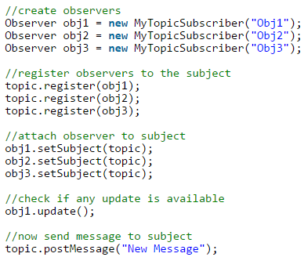

Problem
Can we create a simple subscription model where a user can choose to get information from a source at any time?
Java uses an Observer Pattern where an ‘observer’ is notified of any changes made to a topic once it has subscribed.

Slide 3
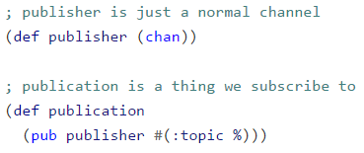
Problem
Can we create a simple subscription model where a user can choose to get information from a source at any time?
Java uses an Observer Pattern where an ‘observer’ is notified of any changes made to a topic once it has subscribed.
Clojure’s async library offers a pub/sub mechanism that focuses on the actual mechanism of a publisher as a transport instead of using a bus that links two models (publisher/subscriber) together.
Also allows the ‘content’ of published material to be derived, so a single publication can handle multiple subscriptions for many different topics.

Slide 4
Our Solution using Akka
Akka is a toolkit that can be used with Scala or Java that creates a helpful environment to allow for easier creation of concurrent and distributed applications.
Akka does this by using Actors, which are the basis for almost every other akka module that exists.
Breaks code down into separate actors that each belong to systems.

Slide 5
Build Tools
Akka is modular and therefore requires a lot of .JARs for each class you use
Eclipse stores all the .JARs in one area and builds them based on the program’s dependencies
We also have
application.conf file to tell akka which resources to use
.sbt file to tell akka which specific libraries we need

Slide 6
Akka Actors
Each actor has a state, where it can store and keep track of changes.
Each actor uses asynchronous messaging for communication.
Each actor uses behaviour to handle messages.
Our main focus is communication and handling messages.

Slide 7
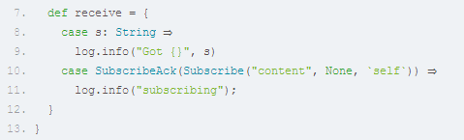
Communication and Message Handling
We use the ! operator to send messages to another actor
All actors implement a ‘receive’ function where the behaviour of that particular actor is described.
Receive is a PartialFunction [Any,Unit] so we cannot define an Actor that only receives messages of a specific Type (yet).

Slide 8
Steps
Create 2 actors = Publisher and Subscriber
The Publisher deals with sending messages (publishing) to the group
The Subscriber will listen for these messages

Slide 9
Subscriber
First we create a subscriber
The subscriber will automatically react to any Publisher update as its behaviour dictates

Slide 10
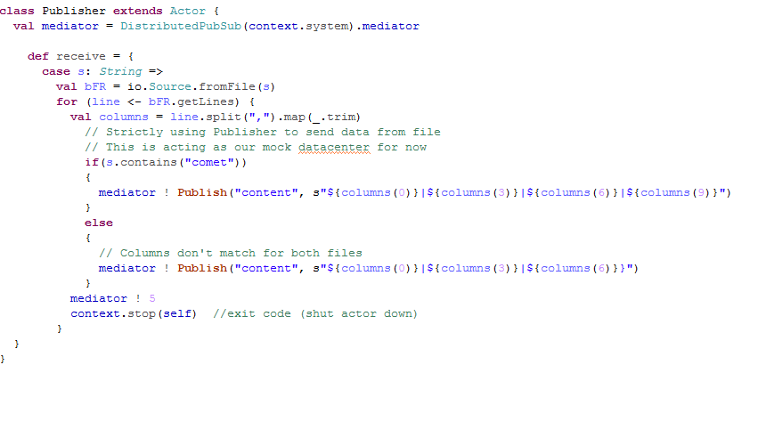
Publisher
Then we create a Publisher
The Publisher then handles messages any time the ! is used with the pub object.

Slide 11
Example & Codewalk
This program was built to model a simple subscriber system
Subscriber is given the option of subscribing to a certain topic
Publisher will then choose information from this topic to ‘publish’
The Subscriber will print these messages out
We are using a snapshot of NASA’s data for meteorites and comets for this example.
Codewalk …

Slide 12
References
Java Observer Model: http://www.journaldev.com/1739/observer-design-pattern-in-java-example-tutorial
Akka Actors: https://blog.codecentric.de/en/2015/08/introduction-to-akka-actors/
Distributed PubSub with Akka: http://doc.akka.io/docs/akka/2.4.3/scala/distributed-pub-sub.html#distributed-pub-sub-scala

