Slide 1

t_postman
@vaibhav
@ravishanker
@saurabh
@bishwjit

Slide 2
@t_postman will help to backup the textual content (eg: sms, notes, memo ...) to cloud.
For referal download and uses from (android devcies, desktops etc...) we are tracking it and provide rewards(extra coins). It will help to promote and have a larger user base.

Slide 3
> In case of accidental damage and loss of mobile device the content is safe in cloud and can be acceessible using the app.
> We are providing the hookup api to store and retrieve data, that end user can use to connect with other db and web services.

Slide 4
>> Technology used
---> cluseterpoint db as backend
---> android studio for app development
---> restful apis
---> branch.io for referral tracking

Slide 5
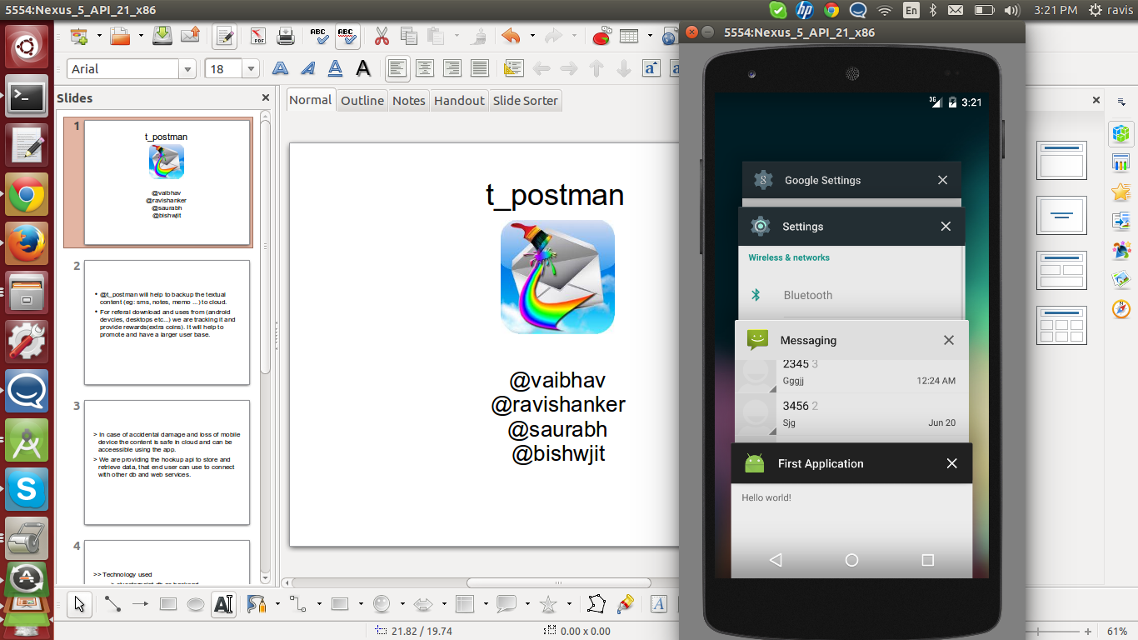

Slide 6
Scope
--------
Will parse the store data and provide and categorical retrival mechanism for all the textual data at a centralized point.

Slide 7
Thanks !!

