Slide 1
VUS RECLASSIFICATION FORECASTING
Which Uncertain Variants Resolve Next, and How Soon
Results from 149 real patients, 195,127 tracked ClinVar variants, and a global reclassification watchlist

Slide 2
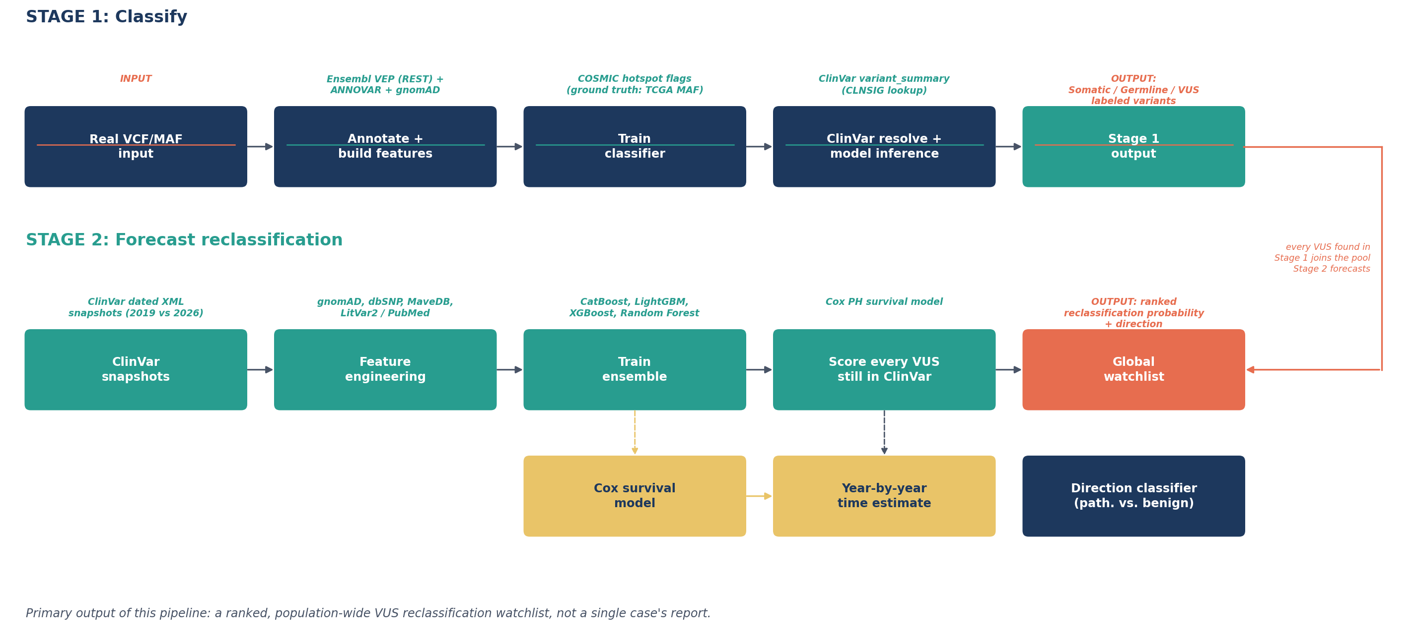
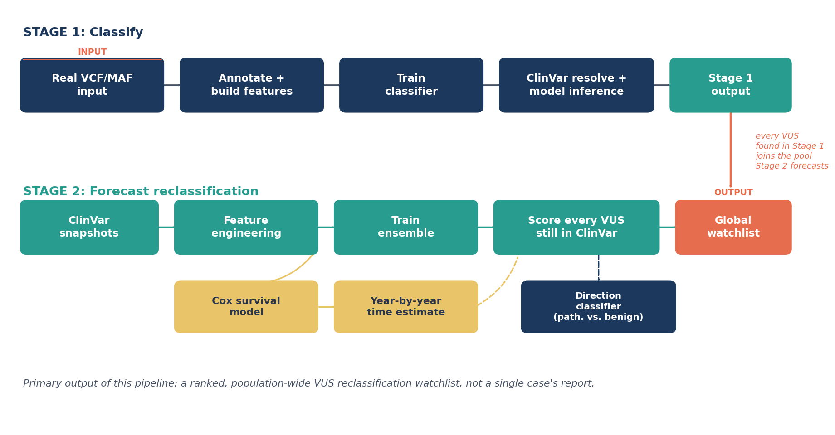
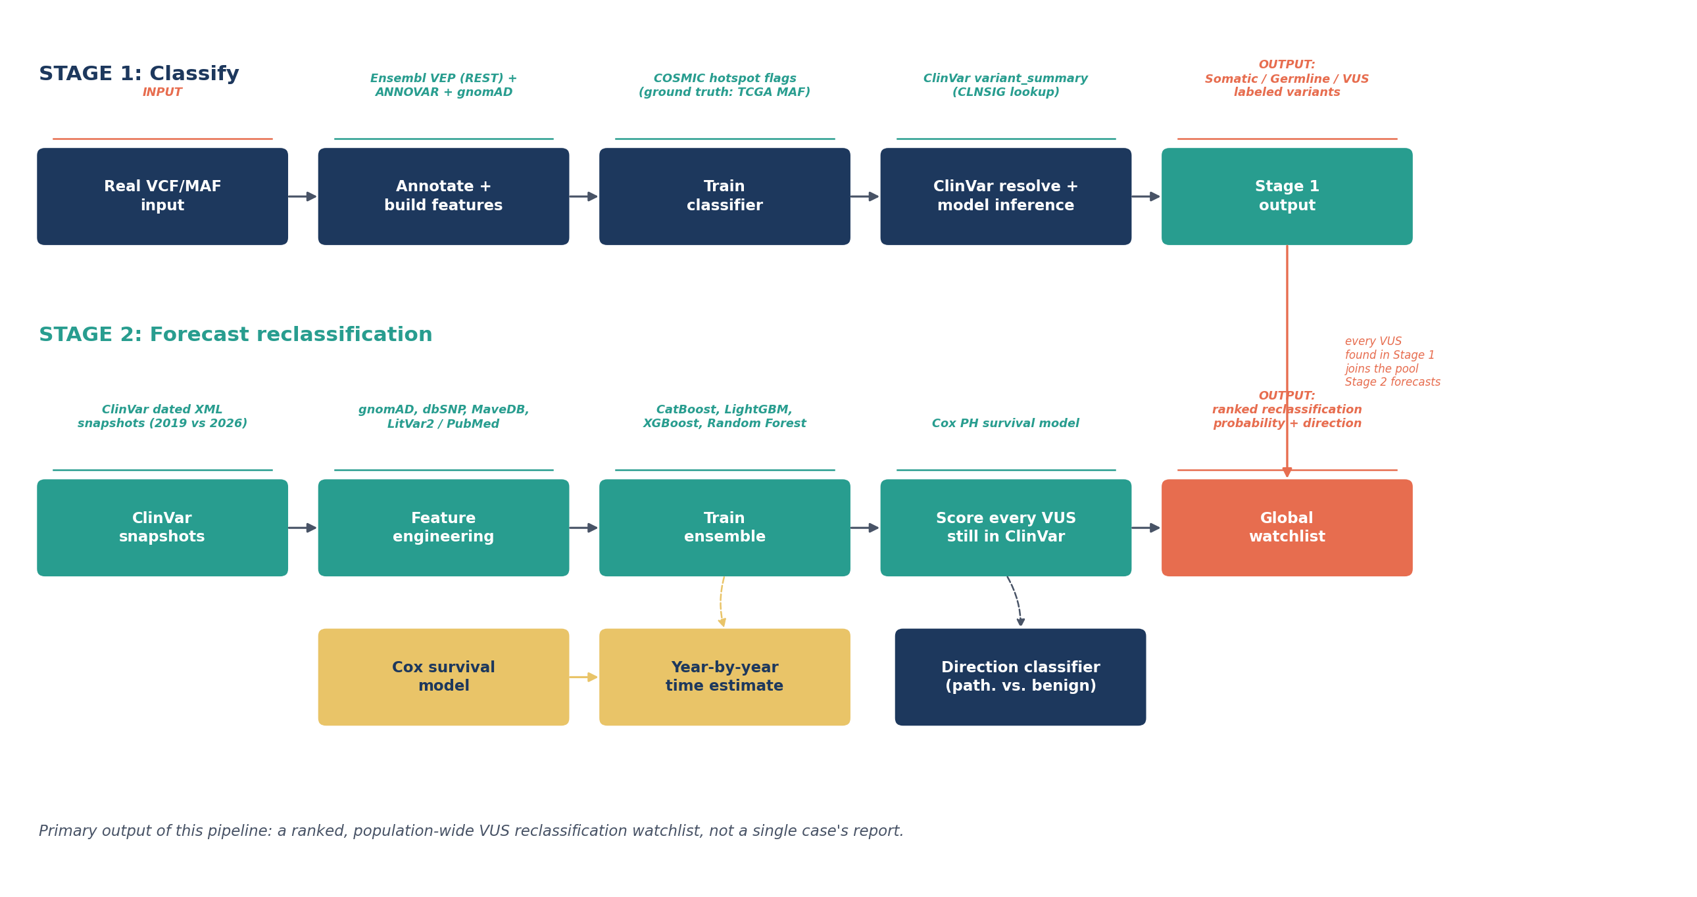
HOW THIS WAS BUILT
The End-to-End Pipeline
1

Slide 3
HOW THIS WAS BUILT
Two Models performing Two Jobs
Stage 1 sorts each variant into Germline or Somatic or VUS. Stage 2 takes every variant still classified as a VUS and forecasts how likely it is to be reclassified.
STAGE 1: GERMLINE VS. SOMATIC VS. VUS · XGBOOST
45,706
0.9218
training rows, 149 real patients
precision at production
STAGE 2: RECLASSIFICATION FORECAST · CATBOOST, COX, ENSEMBLE
0.432
0.849
0.760
0.946
PR-AUC · CatBoost model
ROC-AUC · CatBoost model
c-index · Cox timing model
ROC-AUC · ensemble direction
Three separate models, three separate jobs: CatBoost ranks how likely a VUS is to resolve at all, a Cox proportional-hazards model estimates roughly when, and a LightGBM, XGBoost, and RandomForest ensemble predicts which way it resolves once it does (pathogenic or benign). Each is scored honestly on its own held-out test set.
2

Slide 4
HOW THIS WAS BUILT
The Models Behind Each Number
Germline vs. somatic
XGBoost, tuned decision threshold (0.9218), production model
ClinVar resolves most variants directly; whatever's left as a VUS gets tagged Germline or Somatic by this model. The threshold was pushed to hit 90%+ precision.
Will a VUS resolve at all
Gradient-boosted trees, gene identity as a native categorical feature, production model
Letting the model learn gene-level structure directly, instead of hand-encoding it into a single number first, was the single biggest improvement in this model.
When it's likely to resolve
Cox proportional-hazards survival model, production model
A survival model, not a regression, because most VUS never resolve at all. Censoring has to be handled explicitly rather than treated as a missing label.
Which way it resolves
Tree Ensemble of LightGBM, XGBoost, and Random Forest, production model
Trained only on the variants that have already resolved: a smaller, cleaner problem than predicting resolution in the first place.
3

Slide 5
THE DATA
149 Real Patients, Seven Cancer Types
149
7
45,706
real patients
cancer types
training variants
34,853
10,853
212,782
somatic calls
germline calls
VUS tracked in ClinVar(for Stage II)
4

Slide 6
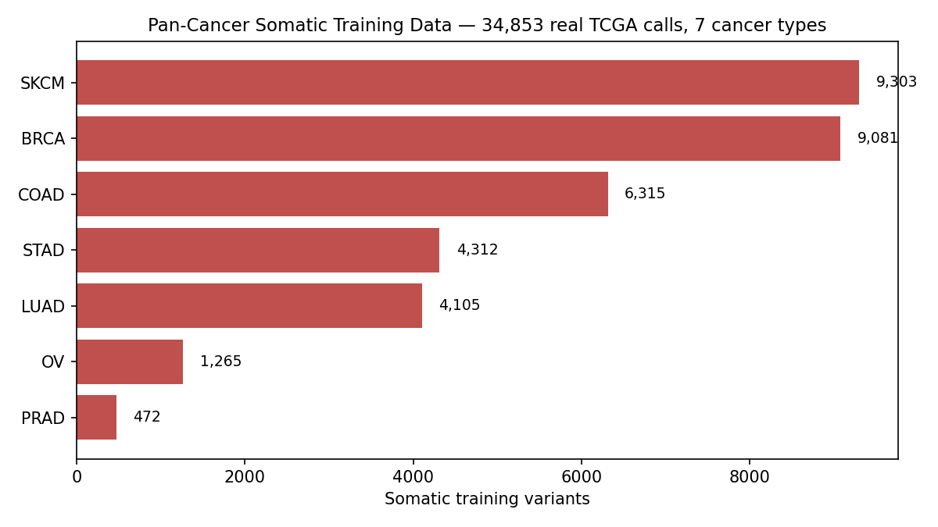
THE DATA
Somatic Variant Load, By Cancer Type
SKCM carries by far the heaviest somatic load of any cohort here, and that is a real, expected biological signal rather than a data quality problem: melanoma has one of the highest tumor mutational burdens of any common cancer because UV radiation drives a distinctive, high-volume mutational signature. This is exactly why Stage 1's training set spans seven cancer types instead of one, since a model trained only on a low-burden cohort like PRAD would badly underestimate variant counts elsewhere. The gap between SKCM and PRAD here (roughly 20x) sets the real scale this project's features had to generalize across.
5

Slide 7
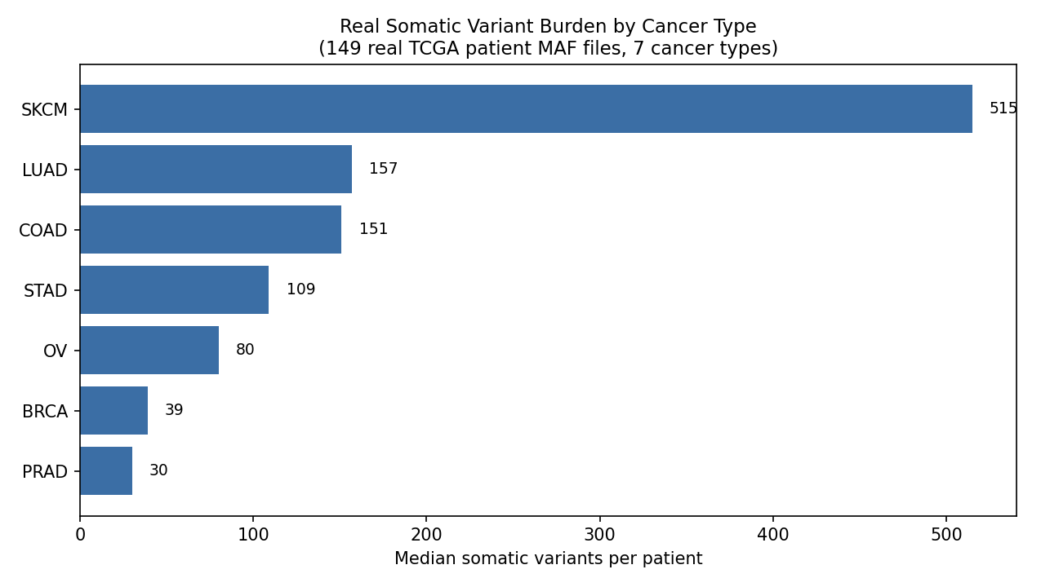
THE DATA
Mutation Burden Varies Sharply By Tumor Type
Burden varies within a cohort almost as much as it varies across cohorts, which is the real reason a single population-wide threshold for what counts as a heavily mutated tumor would be misleading. That spread is exactly what motivates checking for hypermutator outliers directly rather than assuming cancer type alone explains mutation count, which is covered on the next slide with a real patient case. It also means gene-level mutation counts later in this deck need to be read in the context of which cohort they came from, not compared blindly across cancer types.
6

Slide 8
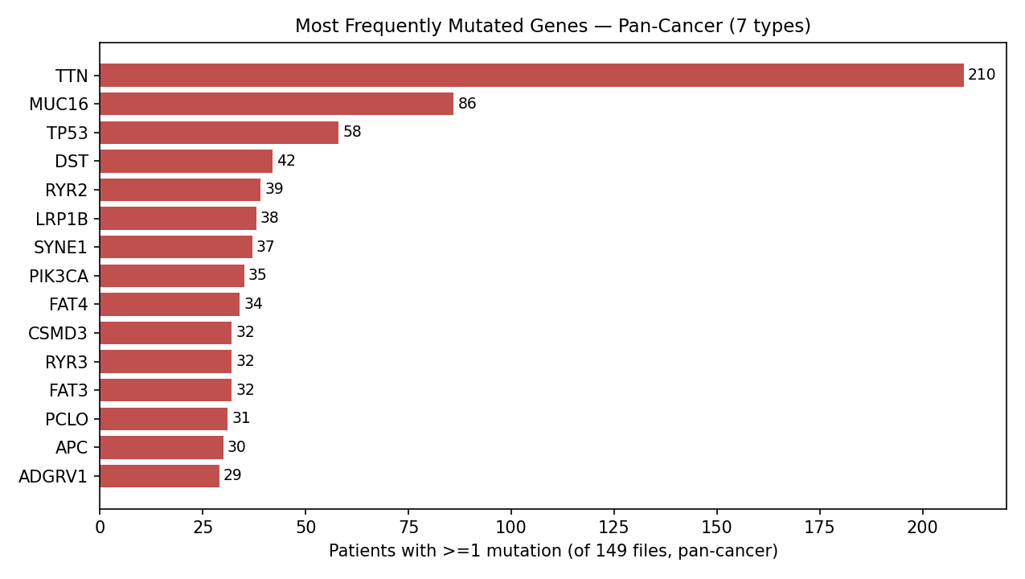
THE DATA
The Most Frequently Mutated Genes In This Cohort
BRCA1 and BRCA2 are not in this top 10, and that is not a withholding decision on this project's part: by raw somatic mutation count they rank 2,055th and 876th in this cohort, with only 4 and 6 mutations respectively across the whole dataset. Large genes like TTN and MUC16 dominate this list because they are simply bigger genomic targets for passenger mutations to land on, not because they carry more clinical significance. This is a well known confound in cancer genomics, and it is the reason Stage 2's models use gene-level historical resolution rate rather than raw mutation frequency as a feature, since frequency alone would systematically overweight large, clinically uninteresting genes.
7

Slide 9
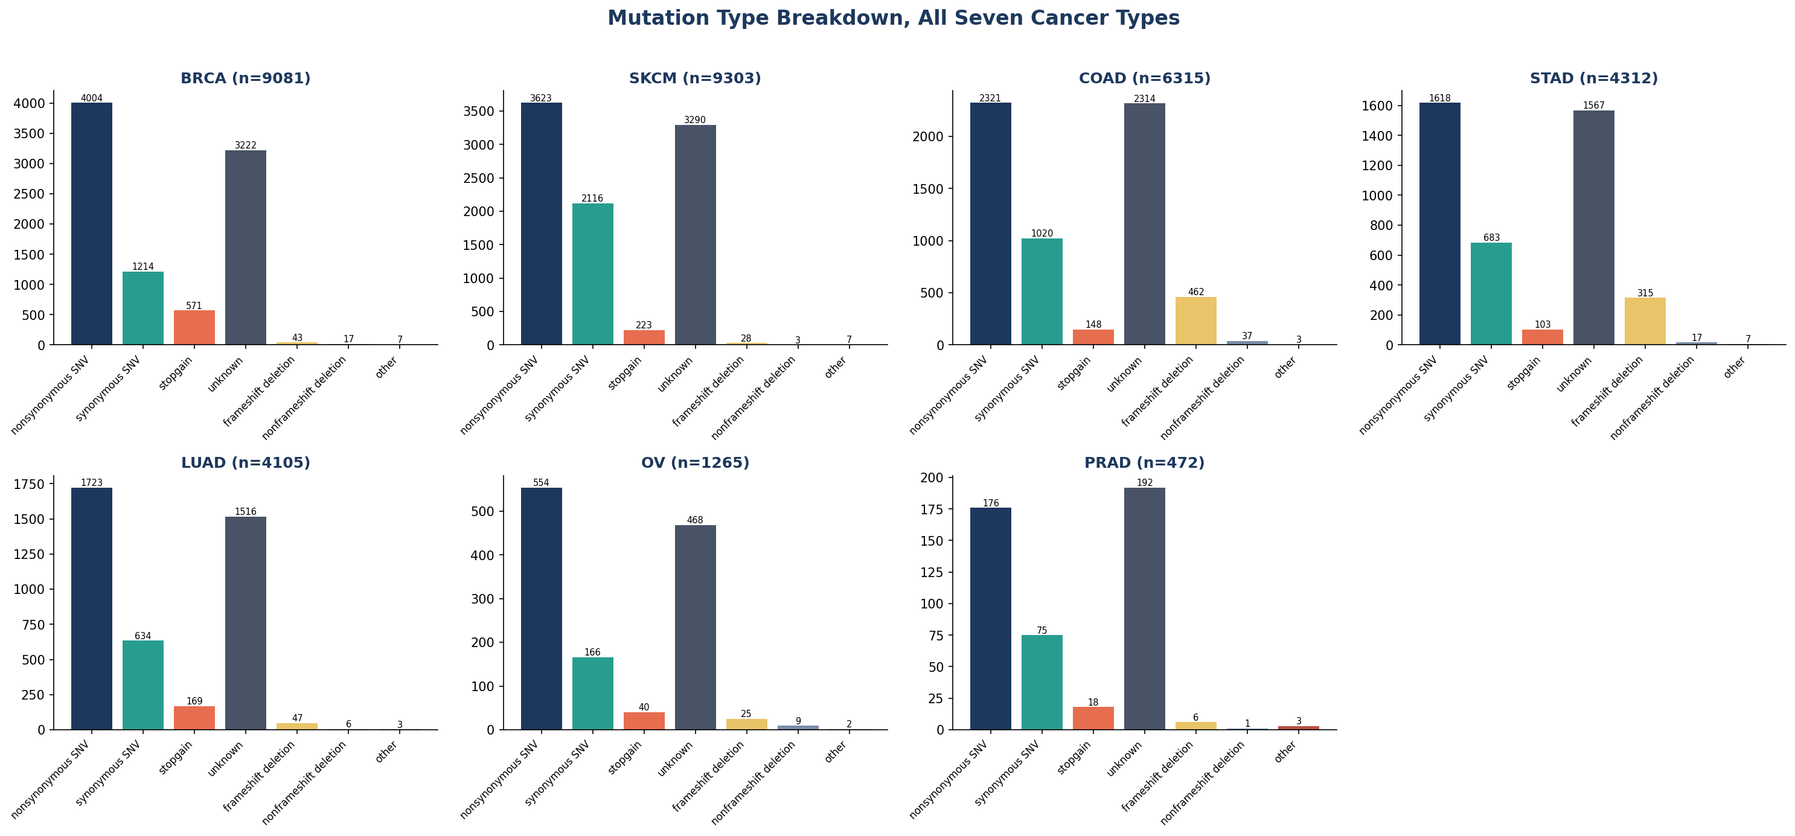
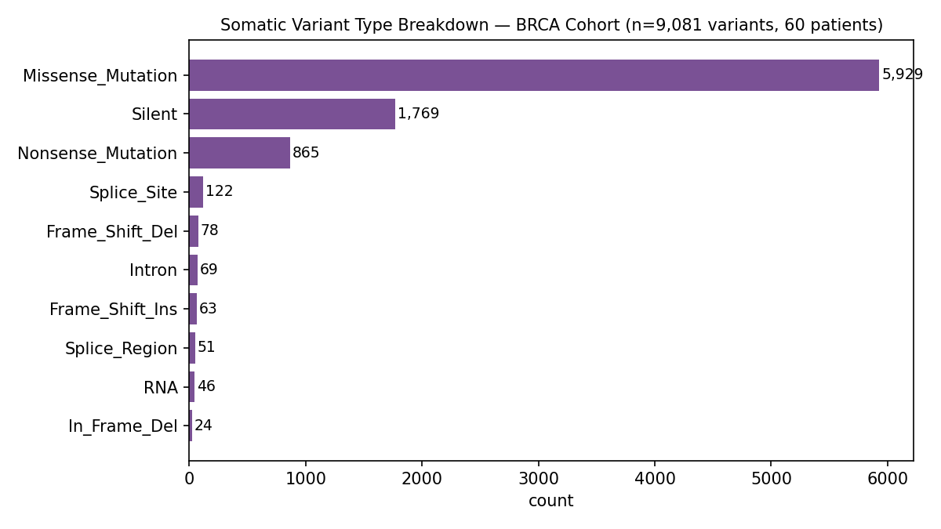
THE DATA
What Kind of Mutations These Are
Nonsynonymous SNVs dominate every one of the seven cohorts, which confirms the training labels reflect real coding-altering mutations rather than annotation noise or a pipeline bug that let synonymous variants leak through. The relative mix does shift by cohort: COAD and STAD show a noticeably higher frameshift-deletion share than BRCA or SKCM, consistent with the mismatch-repair-driven indel signatures known in colorectal and gastric cancers. The consistently small stopgain and startloss counts across cohorts also line up with the real biological expectation that most truncating events are individually rare compared to missense substitutions.
8

Slide 10
Hymermutated tumor outlier
One Tumor Had 96× the Normal Mutation Load
TCGA-AN-A046
BRCA · Stage IIA
68F · Alive
5,978
patient ID
diagnosis
clinical status
somatic variants (cohort median: 62)
WHY
This tumor carries mutations in POLE (2), MSH6 (1), MLH1 (1), and PMS2 (1): the genes that proofread and repair DNA during replication. Damage one of them and every subsequent cell division adds mutations no repair pathway catches. That is a hypermutator phenotype, and this is exactly why this tumor had so many more variations as compared to the median.
Most mutated genes overall in this tumor: TTN (38), DST (17), SYNE1 (11), RYR2 (10). These are large genes that pick up passenger mutations at a rate proportional to how hypermutated the tumor already is.
9

Slide 11
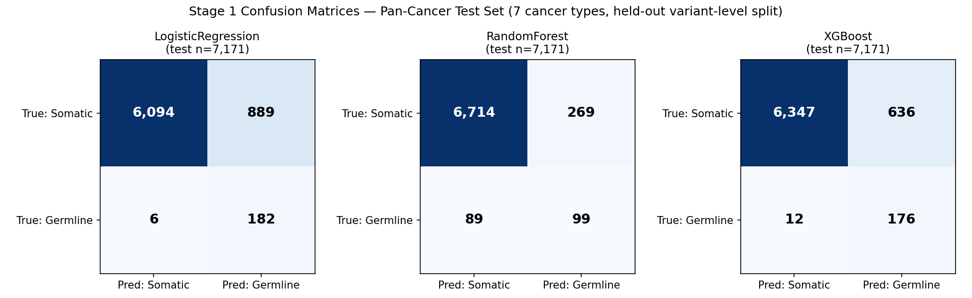
MODEL BEHAVIOR
What the Model Gets Right, and What It Doesn't
10

Slide 12
THE RECLASSIFICATION MODEL
How the Model Learns What 'Likely to Resolve' Means
Ground truth comes from comparing two ClinVar snapshots: everything that was a VUS in 2019, checked against what it became by 2026:
212,782
7.02%
195,127
VUS tracked across both snapshots
were reclassified within that window
kept usable GRCh38 coordinates for training
This is a historical, population-wide comparison. It is not a simulation, and it is not tied to any single patient's variant list. The model is trained once, on this label set, and then applied to score any VUS in ClinVar.
11

Slide 13
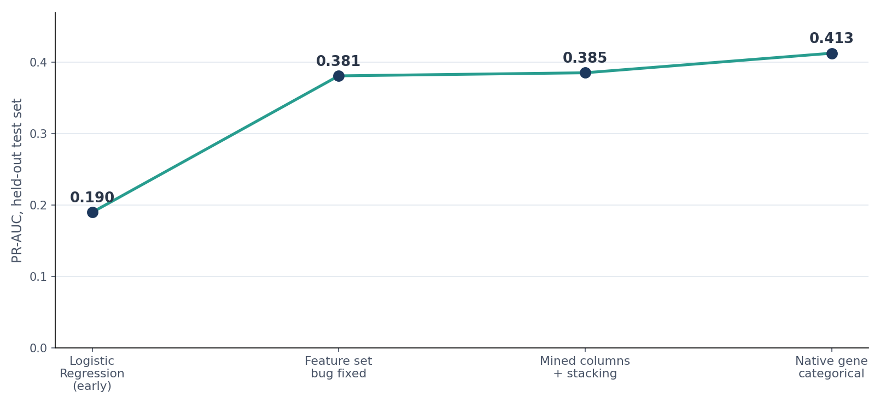
THE RECLASSIFICATION MODEL
What Actually Moved the Model, Step By Step
The last jump came from switching to a model that handles gene identity natively instead of hand-encoding it. That recovered signal the earlier approach was leaving on the table; it wasn't a bigger dataset.
12

Slide 14
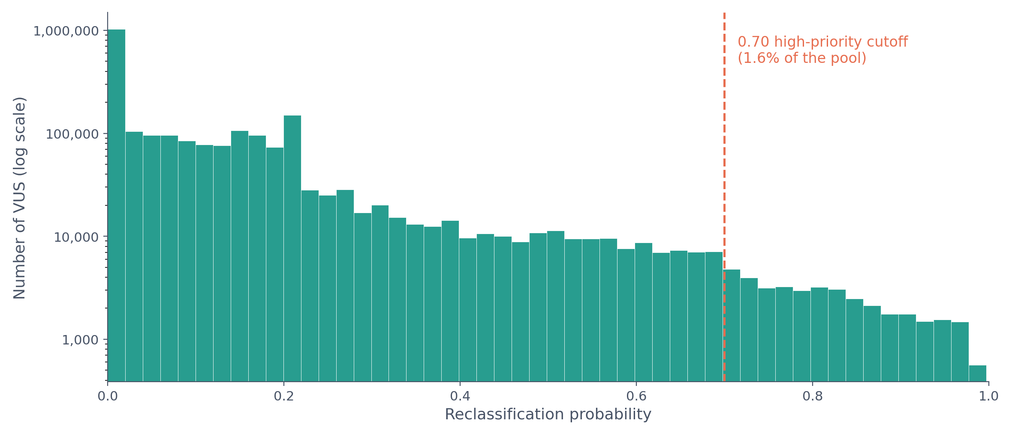
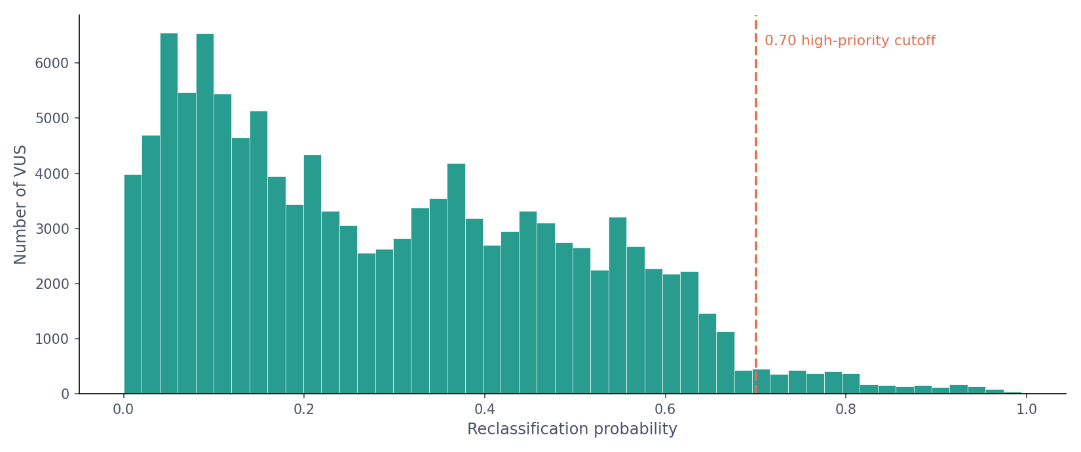
THE RECLASSIFICATION MODEL
How Scores Are Actually Distributed Across ClinVar
Most VUS cluster near the model's low-evidence baseline, now measured across the full 2,330,308-variant current ClinVar pool. The right-hand tail past 0.70 is the 1.6% high-priority pool covered later in this deck.
13

Slide 15
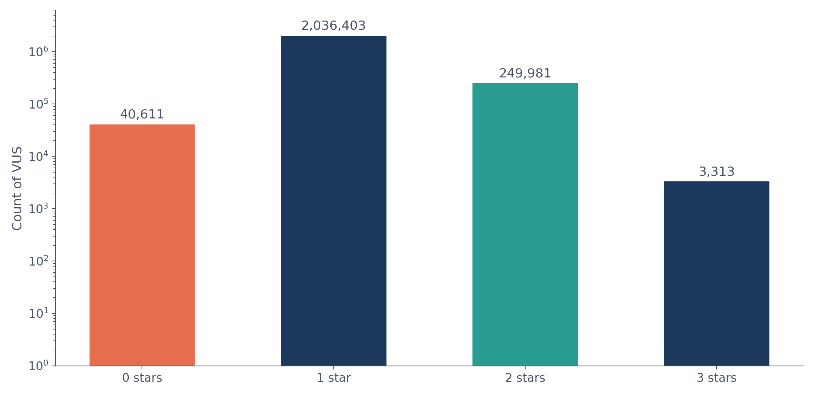
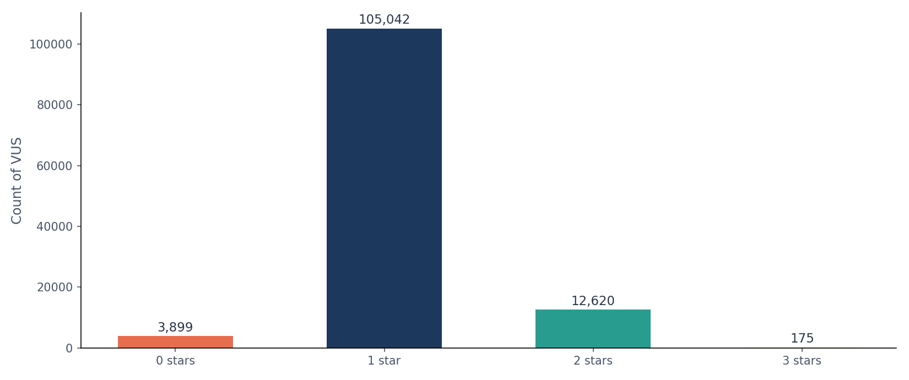
THE RECLASSIFICATION MODEL
The Evidence Landscape Behind Every VUS
87% of the watchlist sits at a single ClinVar star (one submitter, no conflicts).
ClinVar star ratings, plain terms: 0 stars means no assertion criteria provided or submitters actively conflict. 1 star means a single submitter with a clear interpretation and no conflicts, which is where most VUS sit. 2 stars means multiple submitters agree. 3 stars means an expert review panel signed off. More stars means more independently corroborated evidence behind the current call.
The distribution itself is the finding: 2,036,403 of 2,330,308 VUS (87.4%) rest on a single submitter, another 249,981 (10.7%) have just one independent second opinion, and only 3,313 (0.1%) carry full three-star expert-panel review. Almost none of this population has ever been independently cross-checked, which is exactly the evidence gap a probabilistic reclassification model is meant to help prioritize, not replace.
14

Slide 16
THE RECLASSIFICATION MODEL
What Evidence Is Actually Available, At Scale
1,740
44,022
of 2,330,308 VUS carry a real LitVar2 literature hit (0.07%)
of 2,330,308 VUS have real MaveDB functional-assay coverage (1.89%)
When either signal is present, it's unusually informative: TP53's functional-assay and literature coverage is why it shows up repeatedly as a strong example. Coverage looks thinner in percentage terms than it did on the smaller 2019-tracked cohort, because most of the pool now consists of newer ClinVar entries that simply haven't had time to accumulate citations or assay results yet. For the overwhelming majority of VUS, the model still has to work from weaker signals: gnomAD frequency, submission counts, and gene-level history.
15

Slide 17
THE RECLASSIFICATION MODEL
Once It Resolves, Which Way Does It Go?
A separate model, trained only on the 13,616 VUS that have already resolved (10,280 Benign, 3,336 Pathogenic), predicts the direction of resolution:
0.946
0.862
24.8%
ROC-AUC, held-out test set
PR-AUC, held-out test set
of all resolved variants turn out Pathogenic
Direction turns out to be an easier problem than resolution itself: once a variant has enough evidence to resolve at all, which way it goes is dominated by gene-level history. TP53 VUS, for example, score 93-97% pathogenic-if-resolved, consistent with TP53 being a well-established high-penetrance cancer gene.
16

Slide 18
AN HONEST LIMIT
By When? A Year-by-Year Answer, Not One Extrapolated Number
9.8%
90.2%
0.760
of the watchlist is expected to resolve within 10 years
still open past year 10, the majority outcome
c-index of the Cox model behind every one of these numbers
That 90.2% isn't a model shortfall. Only about 7% of all ClinVar variants have ever resolved historically, so a model predicting most VUS will still be open a decade out is just describing the real pace of the field.
17

Slide 19
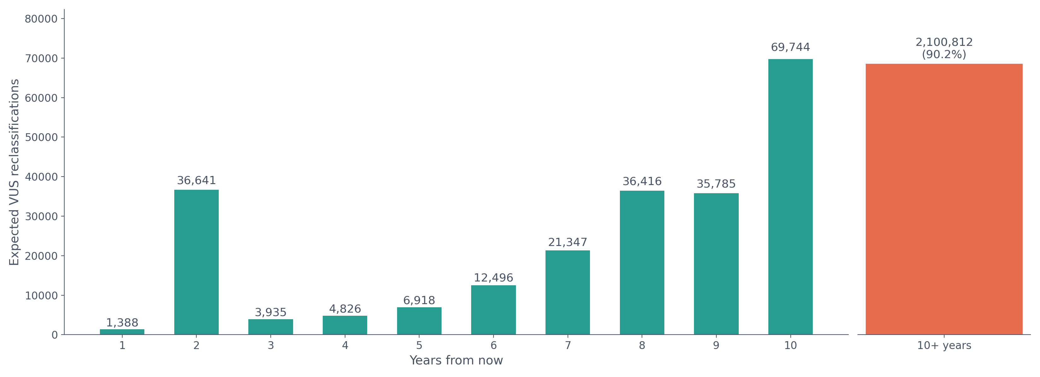
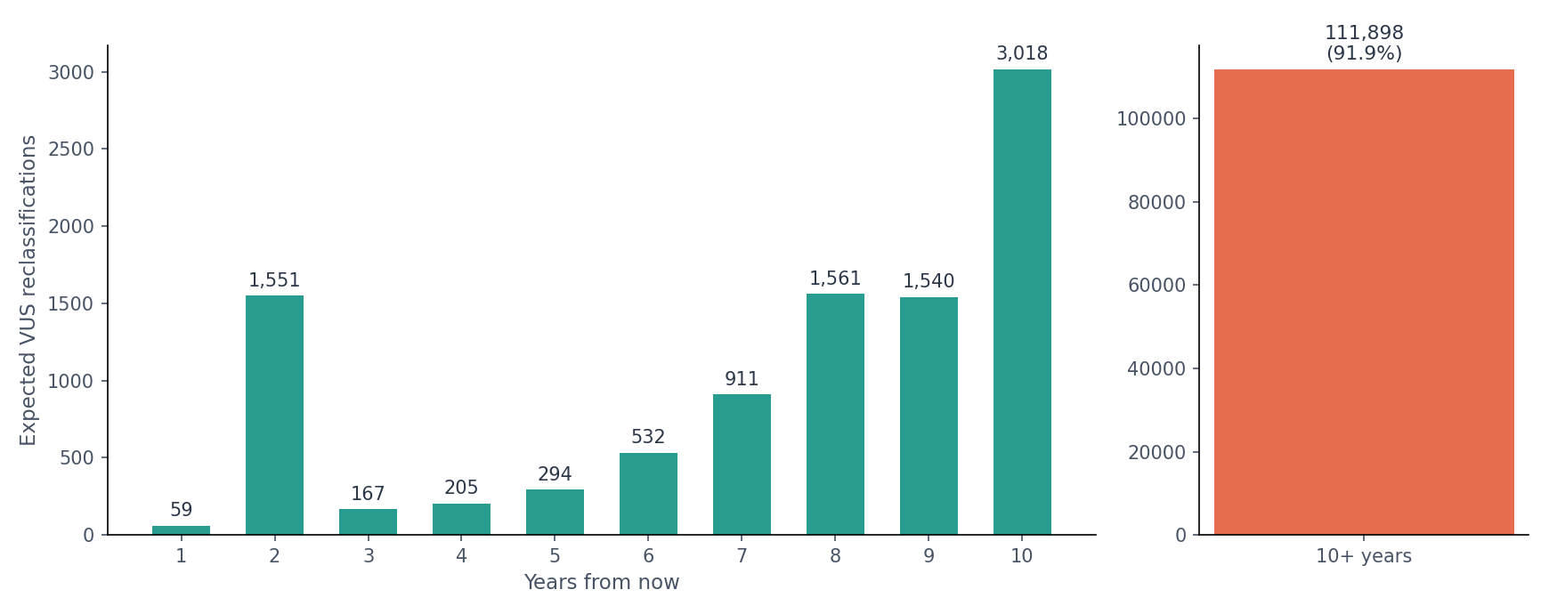
THE RECLASSIFICATION MODEL
Expected Reclassifications, Year By Year
18

Slide 20
PROOF THIS WORKS
A Real Case: Scored High in 2018, Resolved by 2026
0.968
Pathogenic
reclassification score assigned using only 2018-era ClinVar data
actual ClinVar classification by the 2026 snapshot
VariationID 376633 · TP53
The model flagged this variant as high-probability years(in training) years before it was reclassified
Missing gnomAD AF · MaveDB coverage present
19

Slide 21
PROOF THIS WORKS
One to Watch Right Now
0.971
Still "Conflicting"
reclassification score, current snapshot
current ClinVar status
VariationID 161517 · TP53
A near-identical feature profile to the resolved 376633 case: same gene, same missing gnomAD AF, same MaveDB coverage, but with even more literature support (794 LitVar2 hits vs. 274).
This is exactly the kind of variant the watchlist exists to surface: it looks statistically like a case that already resolved, but curators haven't reached consensus on it yet.
20

Slide 22
THE GLOBAL WATCHLIST
The Same Model, Applied to Every VUS in ClinVar
The model doesn't need case-specific submission history to run. Every feature is computable for any variant currently sitting in ClinVar, so it can rank the entire pool at once, as a standing watchlist.
2,330,308
37,167
12,014
VUS currently in ClinVar, scored
score ≥ 0.70 (1.6% of the pool)
of this cohort's own 12,550 mutated genes appear somewhere in the watchlist
21

Slide 23
THE GLOBAL WATCHLIST
Which Genes Dominate the High-Probability Pool
Counting genes among the 37,167 watchlist variants scoring ≥ 0.70:
SCN1A
1,006
MTOR
693
SCN2A
510
TTN
491
NF1
476
EHMT1
390
MECP2
360
GRIN2B
349
ATM
326
MSH2
316
22

Slide 24
THE GLOBAL WATCHLIST
Top 20 VUS Most Likely to Reclassify, By Cancer Type
Genes actually mutated in this cohort's tumors, cross-referenced against the global ClinVar watchlist and ranked by reclassification score. Cancer type reflects where the gene appears in this project's own training data. ClinVar itself carries no cancer-type label, so a gene mutated in more than one of the 7 cancer types is listed against all of them.
VariationID | Gene | Cancer type(s) in cohort | Score | Probability that it will be reclassified in the next two years
1510334 | NF1 | BRCA, LUAD, OV, SKCM | 0.997 | 3.7%
991919 | CDH23 | BRCA, COAD, LUAD, PRAD, SKCM | 0.996 | 3.0%
377085 | SLCO1B3 | SKCM, STAD | 0.995 | 2.9%
3072034 | RYR2 | All 7 cohort cancer types | 0.995 | 3.2%
2442731 | COL5A1 | BRCA, COAD, LUAD, SKCM | 0.994 | 3.0%
1397337 | POLE | BRCA, LUAD, SKCM, STAD | 0.994 | 3.4%
1895446 | NEFL | BRCA, STAD | 0.994 | 3.0%
1049656 | COL12A1 | BRCA, COAD, LUAD, SKCM, STAD | 0.994 | 1.5%
1185121 | MYO7A | BRCA, COAD, SKCM | 0.994 | 3.2%
1044100 | APC | All 7 cohort cancer types | 0.994 | 3.7%
Ranked 1 to 10 of 20
23

Slide 25
THE GLOBAL WATCHLIST
Top 20 VUS Most Likely to Reclassify, By Cancer Type
VariationID | Gene | Cancer type(s) in cohort | Score | Probability that it will be reclassified in the next two years
64893 | TSC2 | COAD, OV, PRAD, SKCM, STAD | 0.993 | 3.4%
2500065 | NEDD4L | SKCM | 0.993 | 1.6%
1519256 | MTOR | BRCA, COAD, OV | 0.993 | 4.5%
2128490 | MTOR | BRCA, COAD, OV | 0.993 | 4.5%
1017291 | MTOR | BRCA, COAD, OV | 0.993 | 4.5%
991092 | EYS | LUAD | 0.993 | 3.0%
3054827 | COL5A1 | BRCA, COAD, LUAD, SKCM | 0.993 | 2.9%
1393465 | APC | All 7 cohort cancer types | 0.993 | 3.7%
1034907 | POLE | BRCA, LUAD, SKCM, STAD | 0.992 | 3.4%
3069490 | MYH7 | COAD, LUAD, OV, SKCM | 0.992 | 3.3%
Several genes in this list, including APC, POLE, MTOR, NF1, and TSC2, are well-established cancer genes with known clinical relevance. Others, like the collagen genes COL5A1 and COL12A1 or the hearing- and cardiac-linked genes MYO7A, CDH23, RYR2, and MYH7, carry high-confidence resolution signal in the model without a familiar cancer role, which is itself a useful finding: statistical resolution signal and clinical familiarity are not the same thing.
24

Slide 26
THE GLOBAL WATCHLIST
Which Genes Historically Resolve Fastest
Gene-level resolution rate is the single biggest lever in the model. Leaderboard restricted to genes with ≥ 2 historical ClinVar submissions, so the rate reflects real submission volume rather than a one-off:
PNPLA8
11.4%
MICOS13
11.4%
MSH2
7.0%
RIPPLY2
6.6%
NECTIN4
6.6%
NTHL1
6.6%
STAG2
6.6%
TBX2
6.6%
UBA5
6.6%
ARL3
6.6%
Baseline resolution rate across all of ClinVar: 7.0%. TP53 sits at 20.4%, well above baseline but outside this top 10, which is dominated by lower-submission-volume genes with unusually consistent early curator agreement.
25

Slide 27
WHAT THIS MEANS
How This Changes VUS Reporting
Today
Every VUS is reported with equal uncertainty, regardless of how likely it is to resolve soon.
With this model
Each VUS in ClinVar carries a ranked probability, so any report drawing on it can flag which variants deserve closer attention.
For curators
The 37,167-variant high-probability pool is a real, prioritized review queue instead of 2,330,308 undifferentiated variants.
For patients
A variant in a gene with a real, historically-high resolution rate is a fundamentally different conversation than one sitting at the model's flat baseline.
26

Slide 28
RESULTS
What the Numbers Actually Say
Variant origin
Precision ≥ 0.90 across 45,706 rows, 149 real patients.
Strong enough to trust in a real pipeline. This stage is essentially solved for the data it was trained on.
Will it resolve
PR-AUC 0.432, ROC-AUC 0.849, against a population base rate under 10%.
Meaningful signal on a hard, imbalanced problem, though short of the 0.50-0.60 range this project originally aimed for.
When it resolves
c-index 0.760, with a year-by-year breakdown instead of one point estimate.
The most conservative result by design: 90.2% of the watchlist is expected to still be unresolved past year 10, and the model says so rather than guessing further out.
Which way it resolves
ROC-AUC 0.946, PR-AUC 0.862, the strongest result in the project.
Once a variant has enough evidence to resolve, gene identity alone predicts the outcome well. That's a genuinely easier problem than resolution itself.
27

Slide 29
GLOBAL VUS WATCHLIST
Two Watchlist Deliverables, Ready to Share
Every VUS the model has scored, delivered as two linked spreadsheets: the full model output for all the VUS in ClinVar, and a short, global watchlist for VUS’s likely to be reclassified in the next five years
FULL MODEL OUTPUT
TOP CANDIDATES, NEXT 5 YEARS
Global VUS Watchlist
Watchlist: Likely Within 5 Years
All 2,330,308 VUS currently open in ClinVar, every model column: overall reclassification likelihood, all ten yearly resolution probabilities, predicted direction, and the driver features behind each score. Ranked by likelihood, descending.
The relative top tier of the watchlist by 5-year resolution probability (8,655 variants, just above the real 99th percentile). Gene name and score only.
Open in Google Drive
Open in Google Drive
28

Slide 30
LIVE DEMO
See the Model Run, Live
The full Stage 1 and Stage 2 pipeline is deployed as a working web app: upload a MAF or VCF file and get real predictions back from the actual trained models behind this deck, not a mockup.
WEB APP
HOW IT WORKS
Upload a MAF or VCF file and get real Stage 1 and Stage 2 predictions back, generated by the same trained models used throughout this deck.
Each variant is sorted into germline, somatic, or VUS. Every VUS is then scored for reclassification probability, expected timing, and predicted direction.
Open the Live App
29

Slide 31
Thank You!
Prakhar Shah
prs016@ucsd.edu
https://www.linkedin.com/in/prakhar-shah-842b48293

