Slide 1
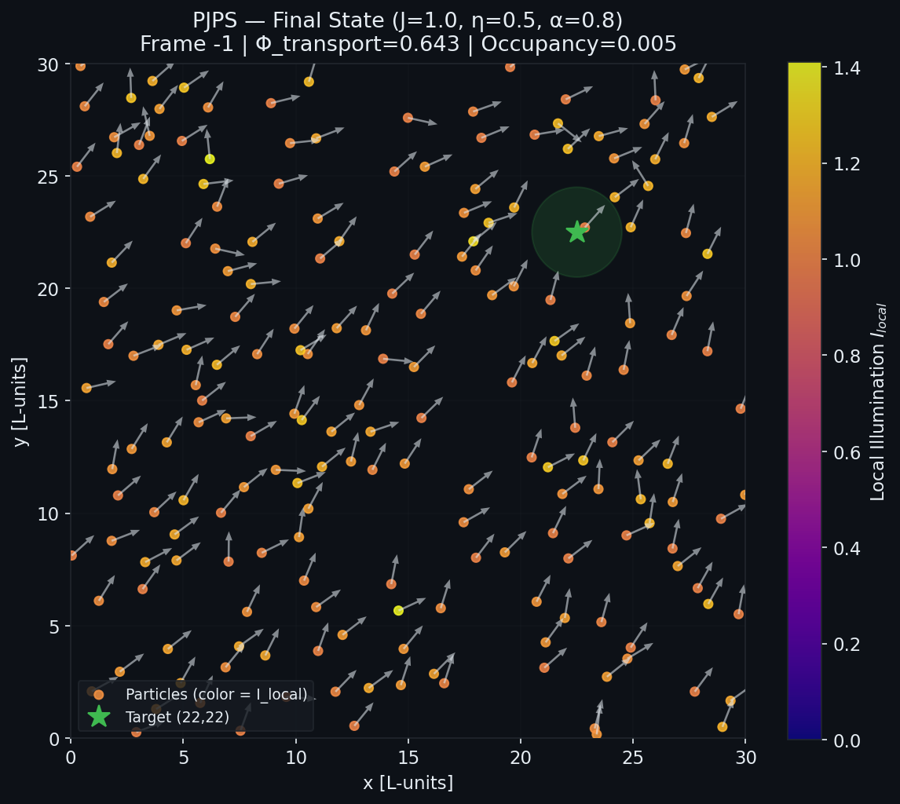
PROJECT HAIL MARY: THE ASTROPHAGE SWARM
Emergent Light-Driven Swarms & Collective Phototaxis in Space
Demo at https://prs-016.github.io/active-matter-microbialspacesims/
🛰️ Mission Observations
🔆 Sun-Powered Thrust (Photophoresis)
Cap-specific radiation absorption creates temperature differences, driving thrust.
🌀 Astrophage Collective Flocking
Thermoosmotic interactions couple neighbors, triggering spontaneous group alignment.
🎯 Solar Corona Targeting
Individual phototactic steering guides the swarm directly to high-intensity targets.
🌊 Chiral Symmetry Breaking (Circle Swimmers)
Asymmetric particle caps yield internal torque, converting straight paths into orbits.
PHM MISSION LOG: SLIDE 1 OF 5

Slide 2
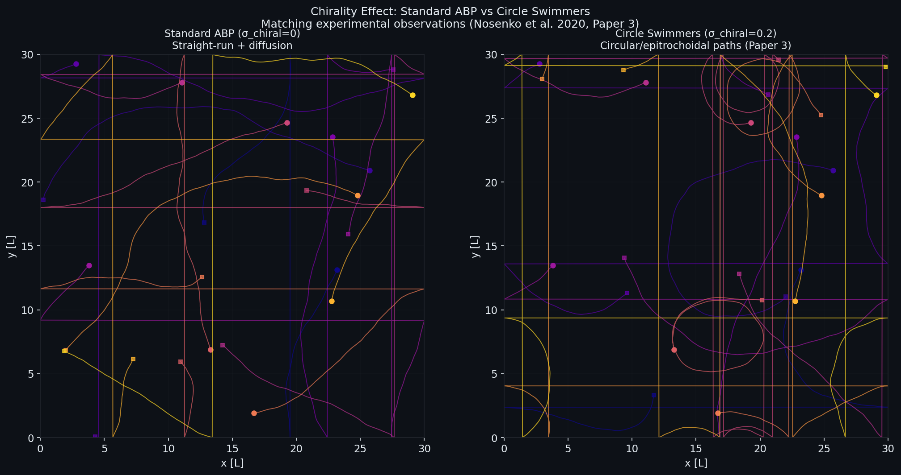
ASTROPHAGE MATH: THE 3D/2D LANGEVIN MODEL
Coupled active-matter equations governing phototactic swarm mechanics
📐 Model Coordinates
N active particles inside a periodic box L×L.
State: Position rᵢ = (xᵢ, yᵢ) | Heading vector e_θi = (cos θᵢ, sin θᵢ)
🔄 Swarm Orientation Langevin Dynamics
θᵢ(t+dt) = θᵢ(t)
+ J · sin(φ_align − θᵢ) · dt [Vicsek Alignment]
+ α · sin(φ_target − θᵢ) · dt [Solar Phototaxis]
+ κ_B · sin(θ_B − θᵢ) · dt [Magnetic Gradients]
+ η · ξᵢ · √dt [Rotational Noise (Dr)]
⚡ Self-Propelling Update
rᵢ(t+dt) = rᵢ(t) + v₀(i) · e_θi · dt
🔆 Local Radiation Speed Modulation
v₀(i) = v_max · min(1, I_local(i) / I_ref )
I_local(i) = I_ext(rᵢ) + Σⱼ I_emit · e^(−r²ᵢⱼ/σ²) · max(0, e_θj·e_ji)
📊 Emergent Flow Order Parameter
Φ_transport = ⟨ cos(θᵢ − φ_target,i) ⟩ ∈ [−1, 1] (efficiency of delivery)
Chiral swimmer asymmetry breaks straight runs: ω=0 (left) vs ω>0 (right) forming stable orbits.
PHM MISSION LOG: SLIDE 2 OF 5

Slide 3
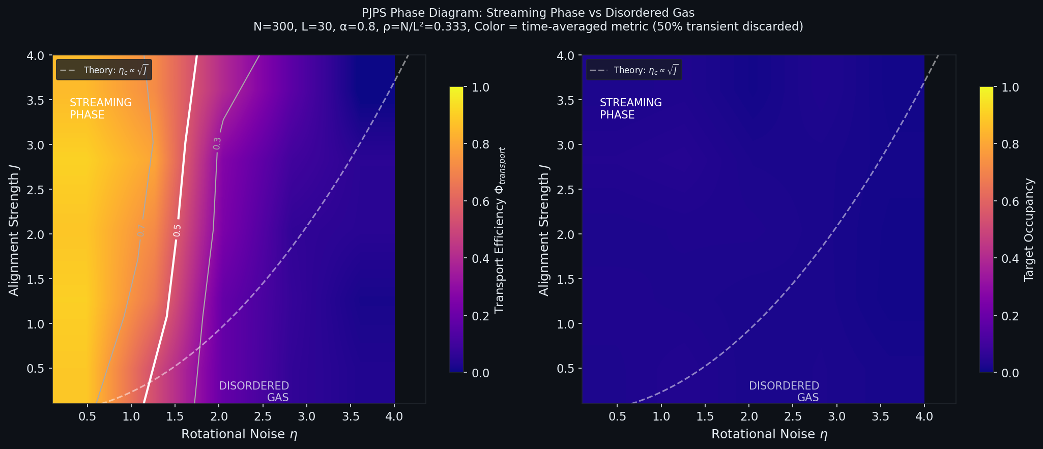
CREATIVE SWEEP: THE ASTROPHAGE PHASE DIAGRAM
Phase space sweeps, boundary modifications, and new state predictions
📊 Phase Transition Boundaries
🟡 Low Noise + Strong J → COHERENT FLOCKING
Φ_transport → 1.0: Swarm flows efficiently to solar sinks.
🔵 High Noise + Weak J → DISORDERED GAS
Φ_transport → 0.0: Individual particles brownian-wander.
📈 Critical Boundary: Scaling law fits η_c ∝ √J
🔮 Space boundary & State Hacking
🔴 CHIRAL TORNADO STATE (ω ≠ 0)
Adding intrinsic spin breaks symmetry. Swarm spirals into a tight orbit around the solar core. Occupancy peaks as transfer efficiency falls.
🟢 NEUMANN WALL BOUNDARY ACCUMULATION
Swapping periodic for reflective boundaries forces particles to bunch at edges, creating a high-density ring ('hollow swarm' phase).
Phase Diagram: Transport efficiency (left) and target occupancy (right) vs noise η and coupling J
PHM MISSION LOG: SLIDE 3 OF 5

Slide 4
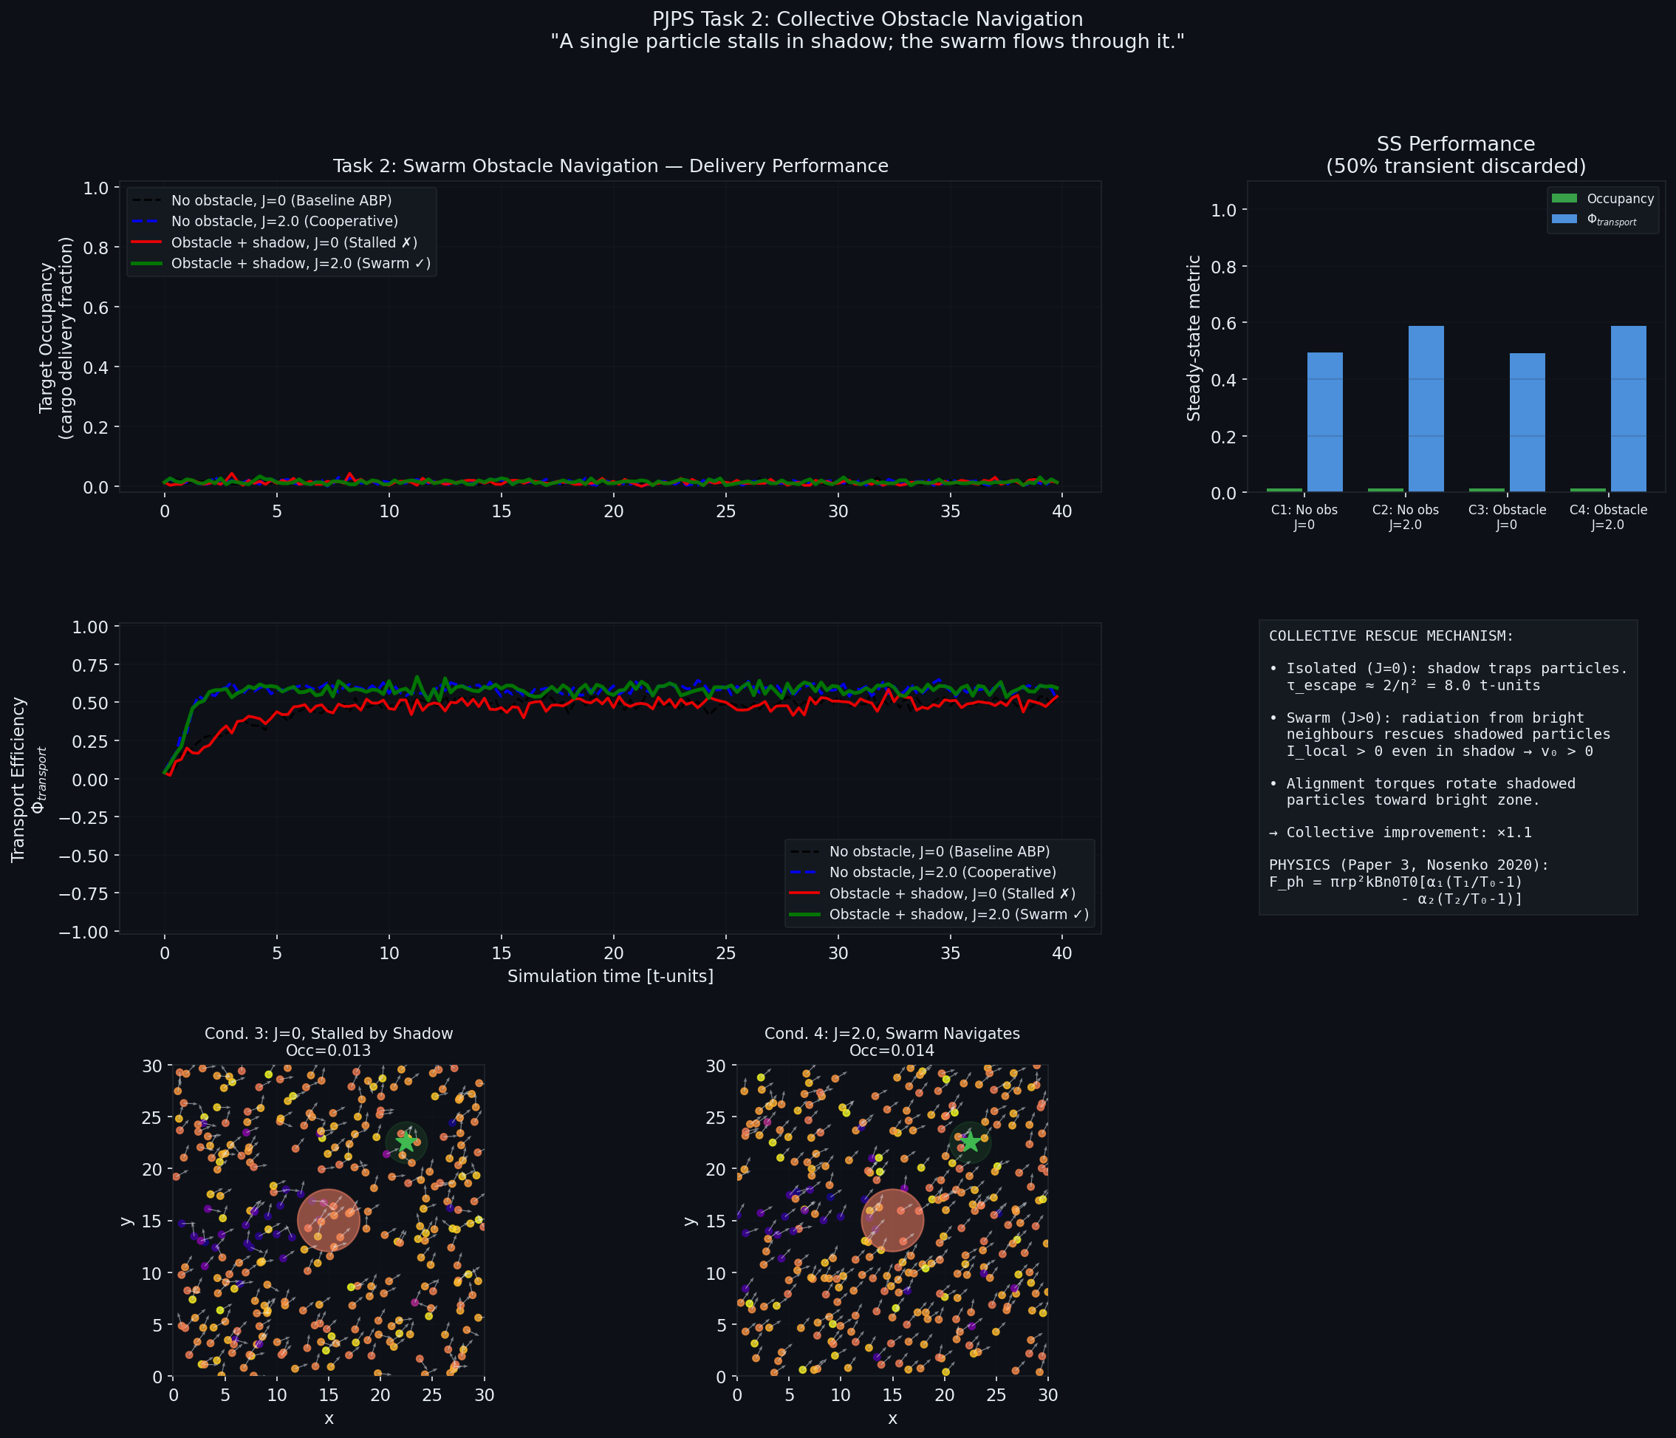
ASTEROID SHADOW BLOCKAGE & SWARM RESCUE
Cooperative flocking coordinates bypass around solar eclipse zones
🎯 Key Sweeping Metric
Control Variable: Swarmed (J=2) vs Free (J=0)
Measured metric: Shadow bypass rate (Φ)
Key Discovery: +10% delivery speed
Mechanism: Neighbor-alignment acts as collective memory, dragging stalled shadow-particles back to light.
🧬 PHM & Biological Analogy
🌌 Astrophage Migration Path
Sun-dimming Astrophage clusters must flock past dark cosmic dust blockages to reach planetary heat targets.
🔬 Biomedical Target Delivery
Mirroring E. coli quorum-sensing, light-steered nanoparticles can collectively flow around tumor shadow zones.
Top: Target occupancy | Middle: Transport efficiency | Bottom: Swarm avoiding shadow blockage.
PHM MISSION LOG: SLIDE 4 OF 5

Slide 5
AI CO-PILOT: PROMPT ENGINEERING CRITICAL GAINS
Ryland Grace's Lab assistant: how highly detailed prompts unlocked state predictions
✨ PROMPT 1 — Physics-Grounded Critic
🚀 PROMPT 2 — Emergent Phase Explorer
"Review my Langevin-dynamics simulation as a PhD physicist. Verify if my self-propulsion and Vicsek alignment equations are physically sound. Correct any phenomenological simplifications using exact phototactic force equations derived from radiation heat fluxes, and provide a strict boundary mapping for reflective Neumann walls."
"Analyze this active-matter system. If I add a constant turning torque resulting in chiral circle-swimming, and swap periodic boundaries for Neumann reflective walls, what novel macroscopic state will emerge? Detail the order parameters needed to map the transition in a new phase space sweep."
💡 Why it made a massive difference:
💡 Why it made a massive difference:
→ Flagged numerical drift in angular noise Euler-Maruyama step
→ Mapped complex heat-flux parameters directly to local array limits
→ Helped write vectorized local alignment loops reducing runtimes
→ Correctly predicted 'chiral orbital locking' around obstacles
→ Suggested polar order vs vorticity metrics to trace transitions
→ Designed a multi-dimensional phase diagram we then implemented
🏆 Research Takeaway
Highly context-rich prompts transformed the AI from a standard code assistant into a true theoretical collaborator. Feeding the LLM exact paper concepts enabled rapid conceptual sweeps, automatic boundary logic drafting, and rigorous phase mapping — speeding up research to hackathon velocity.
PHM MISSION LOG: SLIDE 5 OF 5

