Slide 1
Mutual Fund Analytics
End-to-End Data Engineering and Analytics Capstone Project
TECH STACK
Python
Pandas
NumPy
Scikit-learn
Power BI
GitHub
Transforming Raw Data into Investment Intelligence Prepared By – PRATEEK RAJ

Slide 2



Problem Statement
Need for Analysis
Investor Challenges
Data-Driven Decisions
Over 10,000+ mutual fund schemes exist in India
Investors struggle to identify schemes suited to their goals
No unified platform provides comprehensive fund intelligence
Overwhelming volume of data with no structured insights
Opaque expense ratios erode long-term returns silently
Risk assessment and fund comparison remain complex
Rule-based analytics eliminate emotional bias
Quantitative scoring enables consistent fund selection
Transparent metrics empower informed investment choices

Slide 3
Project Objectives
01
Data Ingestion
02
Data Validation
Collect and load AMFI scheme data, historical NAV, AUM, SIP inflow and benchmark indices into a structured pipeline.
Apply automated checks for missing values, duplicates, outliers and schema integrity across all datasets.
03
Data Cleaning
04
Exploratory Analysis
Standardise formats, impute missing fields, remove noise and engineer meaningful derived features.
Uncover patterns in fund categories, expense ratios, risk grades and return distributions via statistical profiling.
05
Dashboard Development
06
Recommendation Engine
Build interactive Power BI dashboards covering performance, investor behaviour, portfolio and recommendations.
Develop a multi-parameter, rule-based engine to surface top-rated, low-cost funds aligned with investor profiles.

Slide 4
Project Architecture
Raw Data
Validation
Cleaning
EDA
SQLite Database Power BI Dashboard
Rec. Engine
AMFI, NAV, AUM, SIP, Index feeds
Schema checks, null & duplicate detection
Imputation, normalisation, feature engineering
Statistical profiling & pattern discovery
Aggregation, KPI computation, export
Rule-based fund scoring & ranking
Pipeline Design Principles
Modular Python scripts for each stage ensure independent testing and maintenance.
Pandas and NumPy form the core processing layer for speed and flexibility.
Data quality gates prevent corrupted records from propagating downstream.
Power BI consumes the clean, aggregated output for real-time visual exploration.
The recommendation engine acts as the final intelligence layer on the processed data.

Slide 5
Datasets Used
Dataset | Source | Key Fields | Description
AMFI Schemes | AMFI India | Scheme Name, Category, AMC, Rating, Expense Ratio | Master list of all registered mutual fund schemes in India
Historical NAV | AMFI / MFD | Date, NAV, Scheme Code, Returns | Daily net asset values for performance trend analysis
AUM Data | AMFI Reports | AUM (₹ Crore), Fund House, Quarter | Assets Under Management by fund house and category
SIP Inflows | AMFI Monthly | Month, Inflow (₹ Crore), Accounts, Folios | Monthly SIP contribution trends showing investor behaviour
Portfolio Holdings | Scheme Disclosures | Stock, Sector, Allocation %, Holding Value | Underlying securities held by each fund scheme
Benchmark Indices | NSE / BSE / CRISIL | Index Level, Returns, Date, Index Name | Market benchmarks for fund alpha and relative performance

Slide 6
Exploratory Data Analysis
Key EDA Dimensions
Fund Category Distribution
Fund Category Distribution
Equity, Debt, Hybrid, ELSS, Index breakdown across all schemes
Fund House Distribution
AMC-wise scheme count and AUM concentration analysis
Expense Ratio Analysis
Range: 0.1%–2.5%; correlation with performance outcomes
Risk Grade Analysis
Low, Moderate, High risk segmentation by fund type
Risk Grade Distribution
Rating Distribution
1- to 5-star Morningstar rating spread across categories

Slide 7
Performance Analysis
Avg. 3-Year Return by Category (%)
Illustrative NAV Trend (Equity vs Hybrid)
Key Observations
Small and Mid-Cap funds delivered superior returns over 3 years; Debt funds showed lower but stable yields.
Equity funds consistently outperform benchmarks over long horizons despite short-term volatility.
ELSS combines tax benefits with competitive equity-level returns, making it an optimal choice for salaried investors.

Slide 8
Recommendation Engine
How It Works — Rule-Based Multi-Parameter Scoring
Category
Risk Grade
Expense Ratio
Morningstar Rating
Matches investor risk appetite: Equity, Hybrid or Debt.
Filters Low / Moderate / High / Very High rated funds.
Penalises high-cost funds; prefer < 1.0% TER.
Prioritises 4-star and 5-star rated schemes.
Methodology
Advantages
User selects a preferred risk category.
Engine filters the schemes matching the selected risk profile.
Funds are ranked using Sharpe Ratio as the primary metric.
Top-performing schemes are returned with supporting return metrics.
Fully transparent — no black-box algorithm
Easily tunable parameters for different investor profiles
Scalable to 10,000+ schemes without performance loss
Foundation for ML upgrade (collaborative filtering, XGBoost)

Slide 9
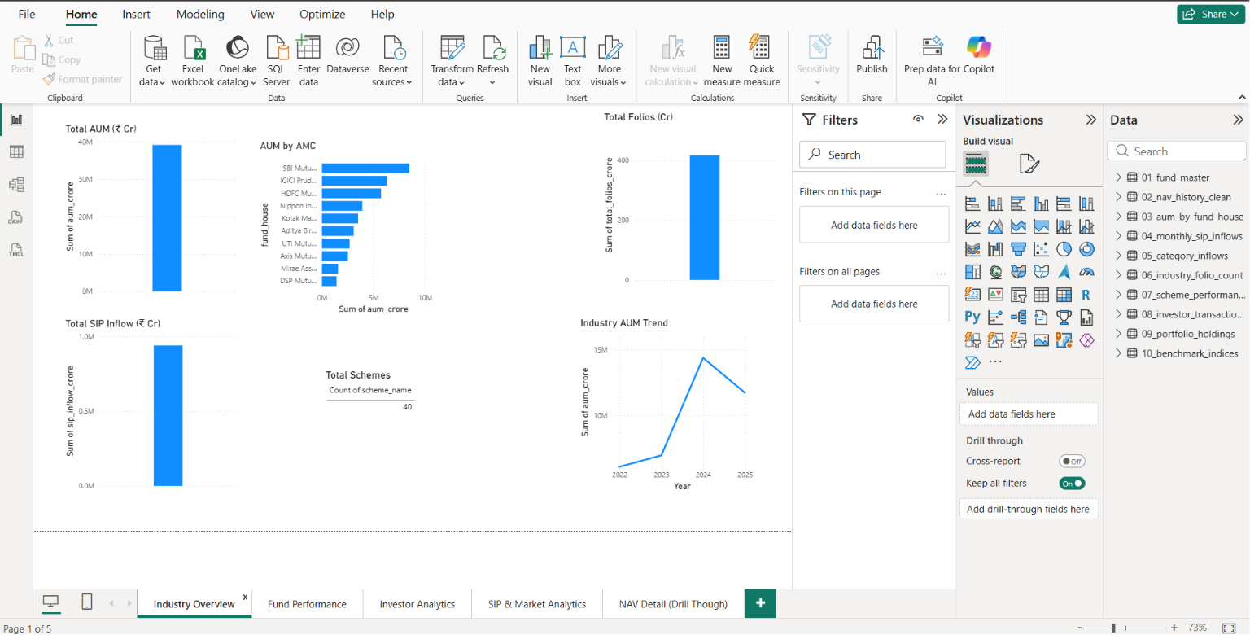
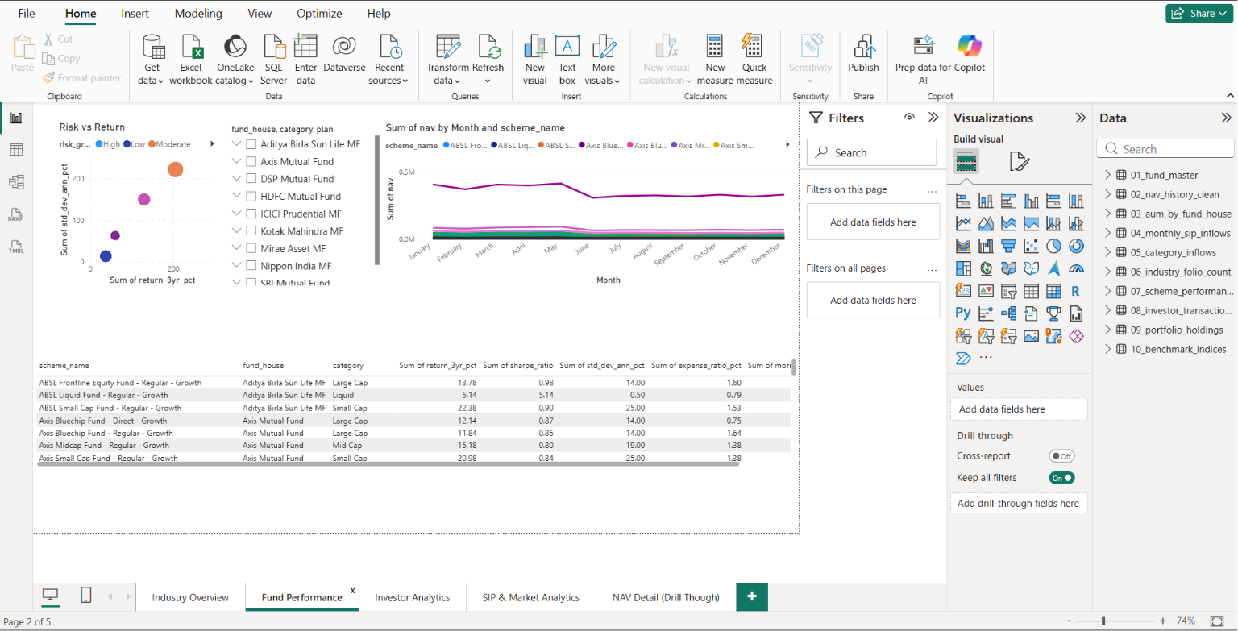
Power BI Dashboard — Executive Overview
10,482
44
1.08%
3.4 ★
48.6L
Total Funds
Tracked
Fund Houses
(AMCs)
Avg. Expense
Ratio
Avg. Morningstar
Rating
Total AUM
(₹ Crore)
[ Power BI Executive Dashboard Screenshot ]
Insert dashboard screenshot here — Executive Overview page

Slide 10
Power BI Dashboard — Pages Overview
Fund Performance Dashboard
Investor Behaviour Dashboard
Top 10 funds by 1Y, 3Y and 5Y returns
Category-level return comparison bar charts
Expense ratio vs. return scatter analysis
Alpha and Sharpe ratio heatmap by fund house
Monthly SIP inflow trend (₹ Crore)
Folio count growth over rolling 12 months
Redemption vs. purchase ratio analysis
Category-wise net inflow waterfall chart
Portfolio Dashboard
Recommendation Dashboard
Sector allocation breakdown by fund
Top 10 holdings across selected schemes
Overlap analysis between portfolio funds
Concentration risk indicator per scheme
Interactive filter pane (category, risk, TER)
Ranked fund table with score breakdown
Side-by-side scheme comparison panel
Watchlist and export to CSV functionality

Slide 11
Key Findings & Analytical Conclusions
01
Equity Funds Dominate
02
High-Rated Funds Show Consistency
Equity schemes constitute ~38% of all registered schemes and account for over 55% of total industry AUM, reflecting strong long-term investor confidence.
4-star and 5-star Morningstar-rated funds demonstrated superior risk-adjusted returns with lower standard deviation over a 3-year window.
03
Expense Ratio Affects Performance
04
Top Fund Houses Outperform
Funds with TER below 1.0% consistently outperformed high-cost peers in the same category, highlighting the compounding impact of fees on net returns.
SBI MF, HDFC MF, and Mirae Asset emerged as consistently top-performing AMCs across equity categories with strong alpha generation.
05
SIP Inflows Signal Retail Growth
06
Sector Concentration Risk Identified
Monthly SIP contributions crossed ₹19,000 Crore, indicating a structural shift toward disciplined, long-term retail investing in India.
Portfolio analysis revealed heavy allocation to Banking and IT across funds — signalling hidden concentration risk for seemingly diversified investors.

Slide 12
Conclusion & Future Scope
Project Summary
Future Enhancements
Built a production-ready data pipeline from raw AMFI data to actionable insights
Delivered 4 interactive Power BI dashboards covering performance, behaviour and portfolio
Designed a rule-based recommendation engine serving investor-profile-specific fund picks
Demonstrated end-to-end data engineering competency using industry-standard tools
ML Recommendation — collaborative filtering and XGBoost scoring
Streamlit Deployment — public-facing web app for real-time fund search
Real-Time API Integration — live NAV data via NSE/BSE APIs
Portfolio Optimisation — Markowitz mean-variance & Sharpe ratio
Predictive Analytics — NAV forecasting with LSTM / Prophet models
Thank You
Mutual Fund Analytics | End-to-End Data Engineering and Analytics Capstone Project
Built with Python · Pandas · NumPy · Scikit-learn · Power BI · GitHub

