Slide 1

Statistic Model to Analyze Student’s Performance
Xuchuan Zheng, Sungki Park, Prashant Sharma

Slide 2

Introduction
Academic success is very important for bright future.
A good school and good teacher are important
But is there anything else ?
Does the social and demographic factors has any impact on student’s grade ?
Children of educated parent perform better in school ?
Spending time with friends can decrease the grade ?

Slide 3
Dataset
The data was collected from 2 Portuguese schools for 2 subjects: Math and Portuguese.
There are 649 rows and 33 variables.
It records information like family size, parent’s education, parent’s occupation, travel time to school, romantic relations, final grade in class and many more.
The dependent variable is final grade (G3).
Most of the information is available as ordinal data.

Slide 4
Variable Name | Description | Scale | Type
studytime | weekly study time | (Numeric: 1 - <2 hours, 2 - 2 to 5 hours, 3 - 5 to 10 hours, or 4 - >10 hours | Qualitative
failures | number of past class failures | numeric: n if 1<=n<3, else 4 | Qualitative
schoolsup | extra educational support | binary: yes or no | Qualitative
higher | wants to take higher education | binary: yes or no | Qualitative
health | current health status | numeric: from 1 - very bad to 5 - very good | Qualitative
romantic | with a romantic relationship | binary: yes or no | Qualitative
G3 | final grade | numeric: from 0 to 20, output target | Quantitative
Some of the variables from our dataset

Slide 5
Methodology
Build full additive model.
Use forward selection procedure to find significant variables.
Compare Full model with Final Additive model.
Check for interaction between variables and higher order terms.
Check usability of final model using ANOVA Test.
Provide final model.
Verify assumptions for multi-linear regression model.

Slide 6

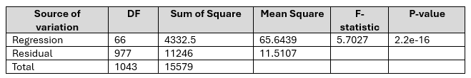
Full Additive Model
ANOVA Test (Null Model vs. Full Model)
P-value 2.2e-16 < α=0.05
Clearly reject the null hypothesis.
At least one of student performance variables must be related to Final grade (G3).

Slide 7

Individual T-test to find significant variables
Use Forward selection procedure (33 variables)
8 Variables are significant.
Failures
Study Time
School Support
Daily Alcohol Consumption
Health
Romantic
Family Size
Going out with Friends
Final Grade

Slide 8
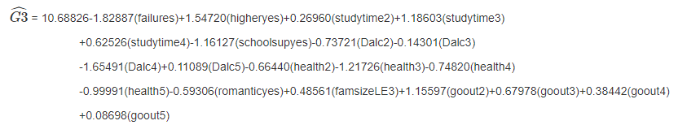
Individual T-test to find significant variables - Cont.
The best additive model is
 | Variables
Positive | Student Desire to go for higher study, Study Time, Family Size, Goin out with Friends
Negative | Past Course Failure, School Support, Alcohol Consumption, Current Health Status, Romantic Relationship

Slide 9

Compare Full Model with the Best Additive Model
Comparison of Adjusted R2 and RSE
0.0257
Adjusted R square has decreased, but it is better to have less Adjusted R square than over-fitting the model.
We chose the best Additive Model.

Slide 10
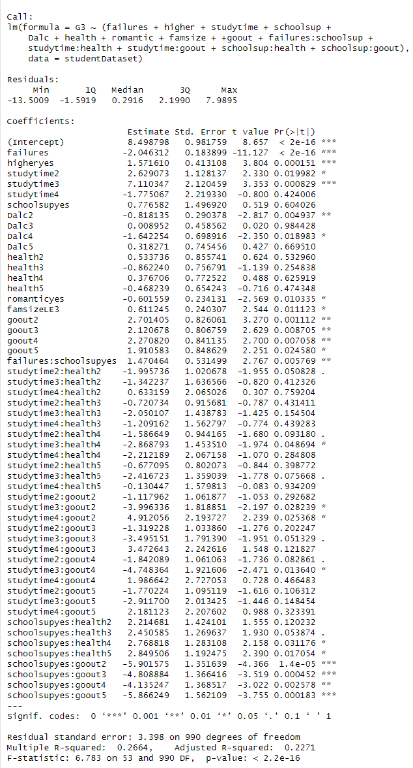
Interaction Model
Use the best additive model.
All the interaction terms are significant

Slide 11
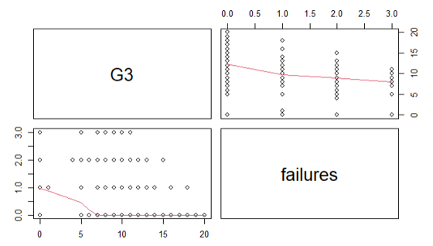
Higher Order Model
Failures variable – Quantitative variable.
Pairs Plot
No clear visual indication that we should add higher order term for our variable.
However, we still try adding the higher order term

Slide 12

Higher Order Model - Cont.
Comparison of Adjusted R2 and RSE (Interaction Model vs Higher Order Model)
Adjusted R2 increased from 0.22271 to 0.2384.
RSE decreased from 3.398 to 3.373
We selected our Higher Order Model.

Slide 13
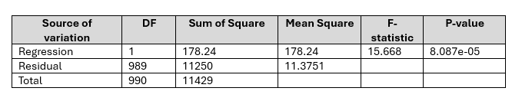
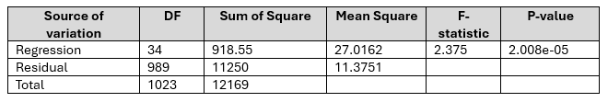
Usability of our final model
ANOVA (Interaction Model vs Higher Order Model)
-P-value 8.087e-05 < α=0.05
- Reject the null hypothesis
Higher Order Model is Better.
ANOVA (Best additive model vs Higher Order Model)
-P-value 2.008e-05 < α=0.05
- Reject the null hypothesis
Higher Order Model is Better

Slide 14
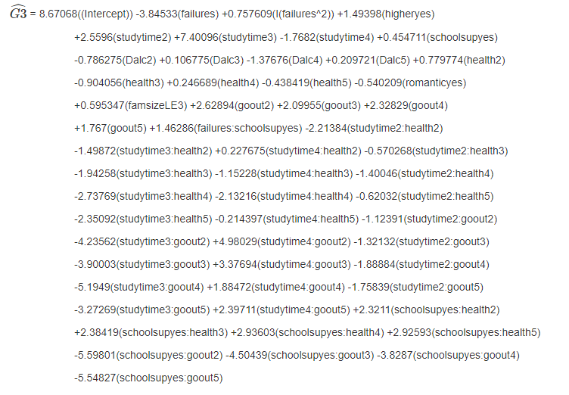
Final Model

Slide 15
Assumption Verification
Linearity Assumption
Equal Variance Assumption
Normality Assumption
Independence Assumption
Multi-Collinearity
Outliers

Slide 17
Conclusion
Some variables has positive impact like desire to go for higher education, spending time with friends, extra school support.
Variables like alcohol consumption, romantic relation, number of past failures has negative impact.
Adjusted R² is 23.84% which is not high, but our model met all the assumptions.
But it confirmed that social and demographic variables do play role in student’s academic performance.

Slide 18
References
Kolmogorov–Smirnov test. (n.d.). Retrieved from Wikipedia: https://en.wikipedia.org/wiki/Kolmogorov–Smirnov_test#:~:text=Various%20studies%20have%20found%20that,samples%20with%20many%20identical%20values
Student Performance. (n.d.). Retrieved from UC Irvine Machine Learning Repository: https://archive.ics.uci.edu/dataset/320/student+performance

Slide 19
Thank you

