Slide 1
IE-2086 Decision models
Final Project Presentation
Vehicle Performance Optimization
Sabbella Prasanna

Slide 2
Introduction
A bicycle that has 7 different gears.
Four riders to substitute.
Each rider has different forces and power values.
Rider covers less distance on gear n than on gear n+1.
Rider depletes less energy per unit time while on gear n than on gear n+1.
Determine how much time a rider must spend on a gear to achieve overall maximum distance.

Slide 3
Stage
Rider 1
Rider 2
Rider 3
Rider 4
1-7
8-14
15-21
22-28
Each gear change corresponds to a stage.
7 stages occur during the tenure of every rider. 28 in total.
For simplicity, we model this sequential problem for individual riders (7 stages).

Slide 4
Constant and deterministic values
Force capacity: Maximum impact force by a normal human = 2000 N
Only a fraction of it is used during pedaling.
F = 488 N and fraction force ff = (488/2000) = 0.244
Mass of the rider m = 73 kgs
Rider power decreases after each stage by a known power depletion factor pdf = 0.05.
Power during stage 1 P₁ = 400 watt
Power of rider on gear j = P₁ – (P₁ * pdf * (j-1)) for j = 2 to 7
cog_radius_{j} = { j=1:0.068, j=2:0.046, j=3:0.042, j=4:0.038, j=5:0.034, j=6:0.03, j=7:0.026 }

Slide 5
Constant and deterministic values
On every gear j the rider initially spends a specific amount of time *t_{j} under constant acceleration *a_{j} before he reaches to a final constant speed and travels a distance *d_{j} during this time.
Though the rider can practically skip this time and change to next gear, these values are assumed to be non-zero for the sake of avoiding complications in the modeling of this project.
*t_{j} = f ( F , cog_radius_{j} , m , P_{j} )
*d_{j} = f ( F , cog_radius_{j} , m , P_{j} )
*a_{j} = f ( F , cog_radius_{j} , m , P_{j} )
Stage or gear - j | accelerating time (s) – (*tj) | distance travelled during accelerating time (m) – (*dj)
1 | 6.738888 | 16.10185
2 | 5.954503 | 36.95961
3 | 0.932611 | 7.311164
4 | 1.379133 | 11.47019
5 | 2.12807 | 19.08346
6 | 3.462291 | 34.22947
7 | 6.027885 | 67.78453

Slide 6
State variables
The speed/velocity of the vehicle associated with a specific gear can be calculated using basic engineering mechanics knowledge given the deterministic values and speed during previous gear.
Apart from *t_{j} rider spends t_{j} amount of time riding on stage j and covers d_{j} amount of distance in addition to *d_{j} .
V_{j} = Vehicle velocity achieved by rider on gear j (stage j)
t_{j} = The amount of time that rider spends on gear j (stage j)

Slide 7
Decision variables
Each shift in gear is considered as a stage. The decision variable would be whether to shift a gear at a given point in time.
x = 0 no gear change happens
x = 1 gear change happens

Slide 8
Exogenous variables
The amount of time the rider can last on any gear is limited by an equation.
As the rider moves to higher gears this time will reduce by a certain amount (TDF = Time Depletion Factor) which is random.
TDF_{j+1} is not known during stage j.

Slide 9
Transition function
Initial velocity during stage n+1 is the final velocity of stage n
V_{j+1} = f (F , cog_radius_{j+x} , m, P_{j+x} , V_{j}) = V_{j} + *a_{j+1} * *t_{j+1}
t_{j+1} = f ( ff , t_{j} , TDF_{j+1} )

Slide 10
Transition function
However, t_{j} for every j is limited by an equation.
t₁ ≤ ((1.2/(ff - 0.15)^{0.618}) - 1.21)*2*60
t_{j} ≤ t₁ - t₁ * TDF_{j} for j = 2 to 7
“ The harder the muscle fibers contract, the more the interlaced arterioles and capillaries are compressed and the more the blood flow and oxygen supplies are restricted, the faster the muscle fatigues. ”
Niebel’s Methods, Standards, and Work Design - Thirteenth Edition
Andris Freivalds and Benjamin W. Niebel

Slide 11
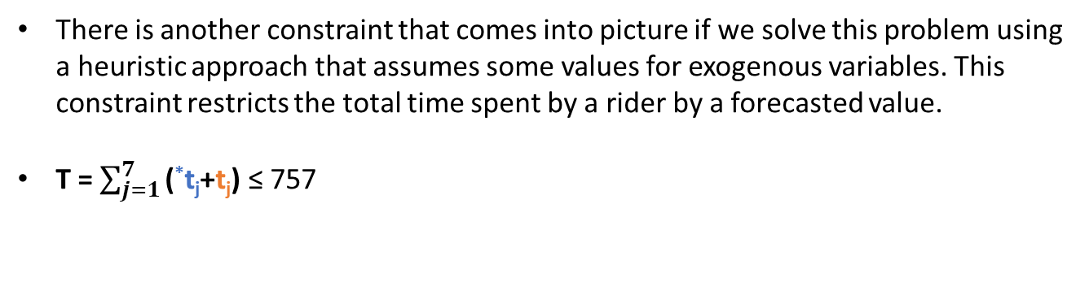
Transition function
There is another constraint that comes into picture if we solve this problem using a heuristic approach that assumes some values for exogenous variables. This constraint restricts the total time spent by a rider by a forecasted value.
T = $\sum_{j=1}^{7}{\text{(}\text{∗}\text{t}\text{j}\text{+}\text{t}\text{j}\text{)}}$ ≤ 757

Slide 12
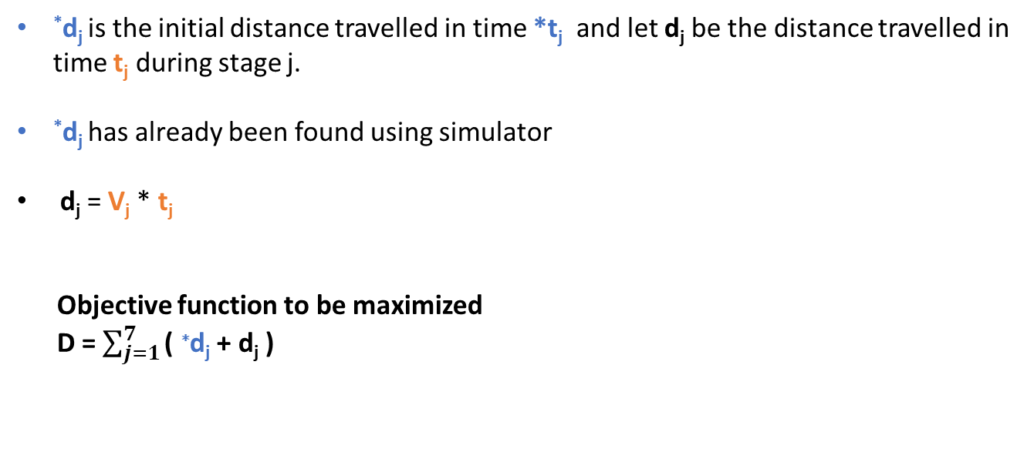
Objective function
*d_{j} is the initial distance travelled in time *t_{j} and let d_{j} be the distance travelled in time t_{j} during stage j.
*d_{j} has already been found using simulator
d_{j} = V_{j} * t_{j}
Objective function to be maximized
D = $\sum_{j=1}^{7}{\text{( }\text{∗}\text{d}\text{j}\text{ + }\text{d}\text{j}\text{ )}}$

Slide 13
Quick summary
The following graph shows the values of times and distances during every stage.
V_{j}
Stage 1
Stage 2
Stage 3
Stage 4
Stage 5
Stage 6
Stage 7
D
d₆
V₃
*d₆
T
*t₁
t₁

Slide 14
Solution
Three ways of policy approach.
Risk-averse heuristic
Greedy heuristic
Heuristic by fixing the exogenous variables

Slide 15
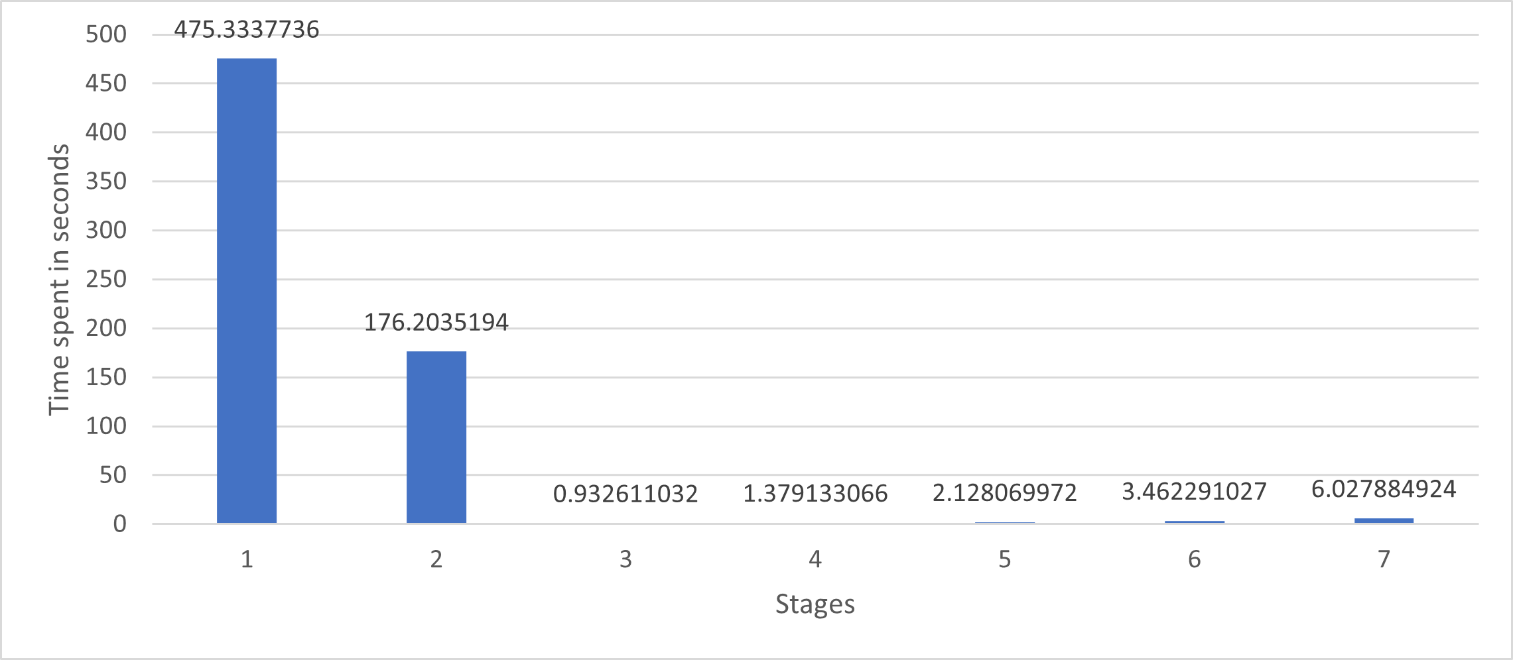
Risk-averse approach (Solved using Gurobi)
The rider is not willing to take risk and tries to avoid higher gears in a fear of receiving a higher TDF_{j}
Shifts from a gear only when the time exceeds the limit on that gear
Stage 1
Stage 2
Stage 3
Stage 4
Stage 5
Stage 6
Stage 7
D = 3732 m

Slide 16
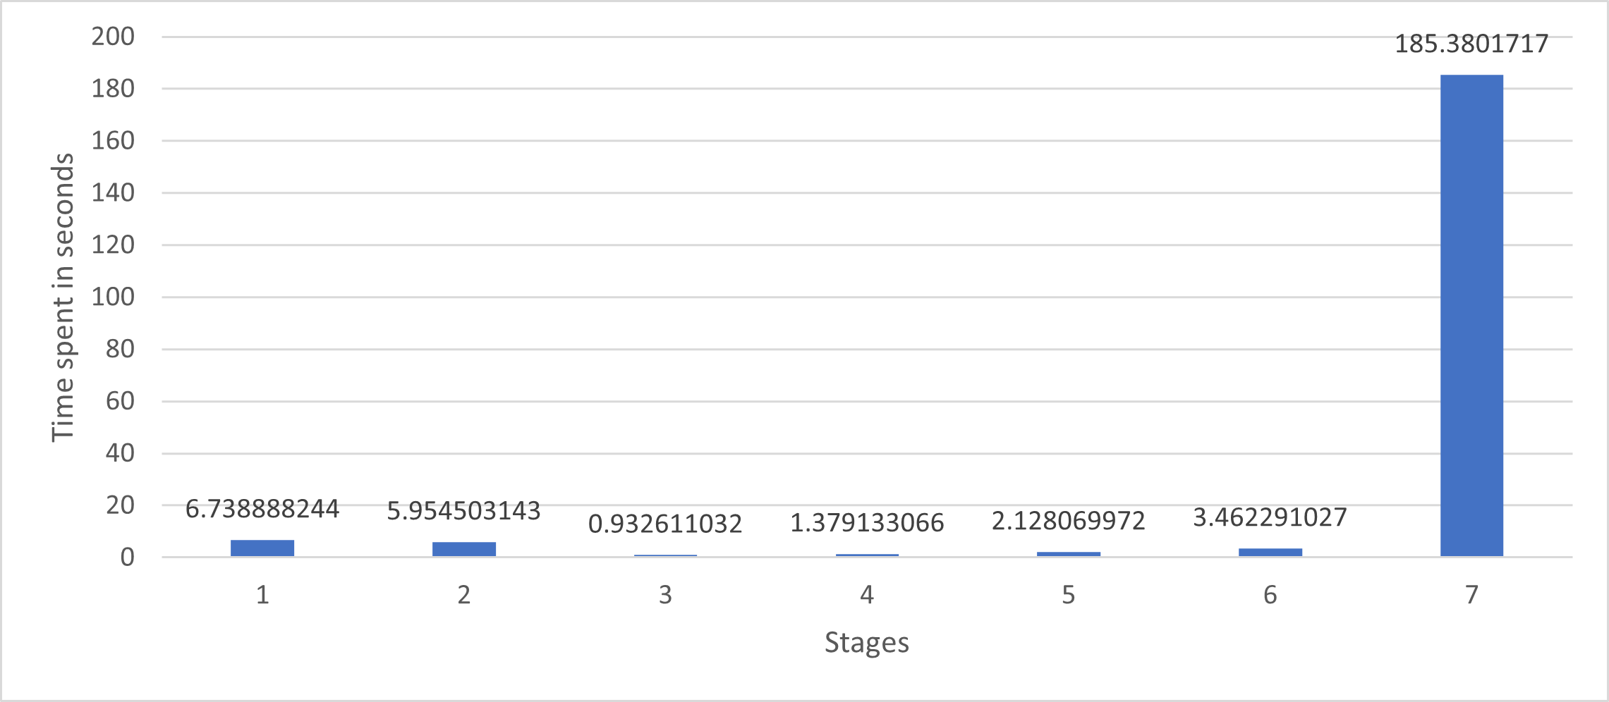
Greedy approach (Solved using Gurobi)
The rider rides on the highest gear possible as he knows that the velocity is maximum.
The rider takes comfort in high speed and hopes that he will cover more distance though the TDF_{j} is higher (i.e. he does not last long).
Stage 1
Stage 2
Stage 3
Stage 4
Stage 5
Stage 6
Stage 7
D = 2356 m

Slide 17
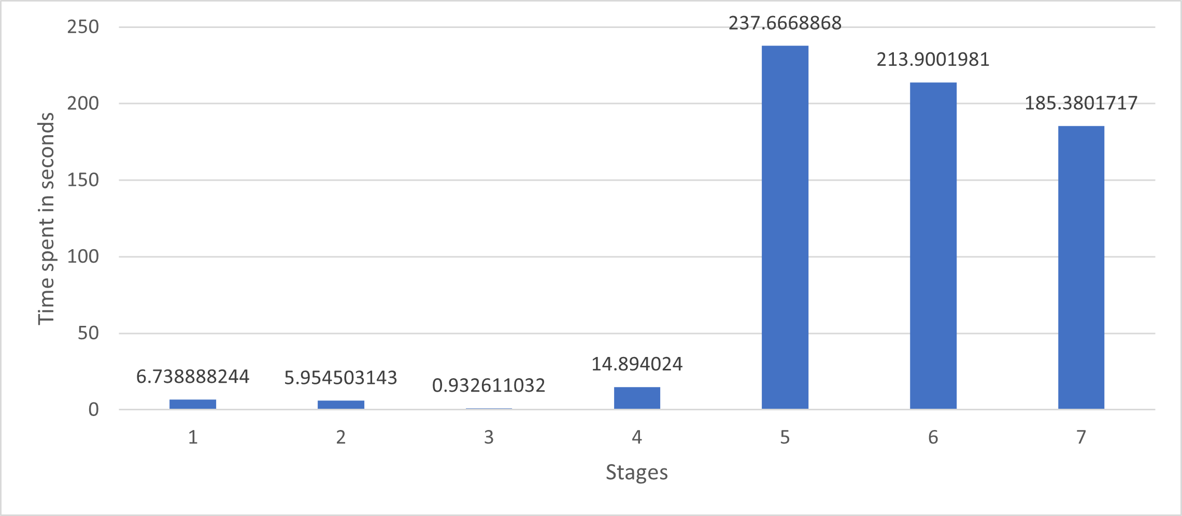
Fixing random variables
The rider now has the full knowledge of TDF_{j}.
Chooses gears wisely.
Stage 1
Stage 2
Stage 3
Stage 4
Stage 5
Stage 6
Stage 7
D = 6867 m

Slide 18
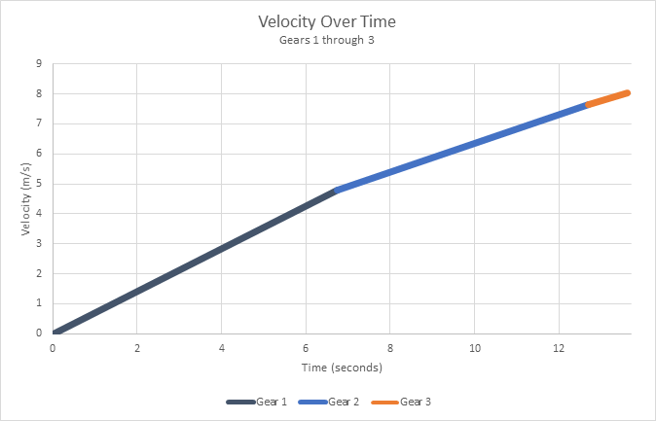
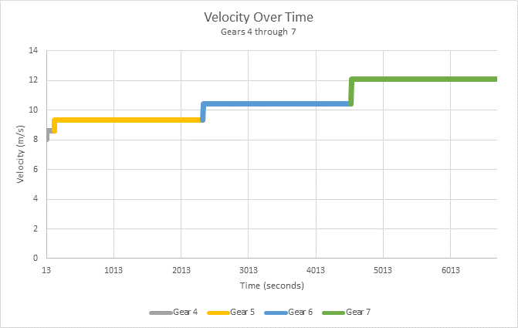
Plots for rider 1

Slide 19
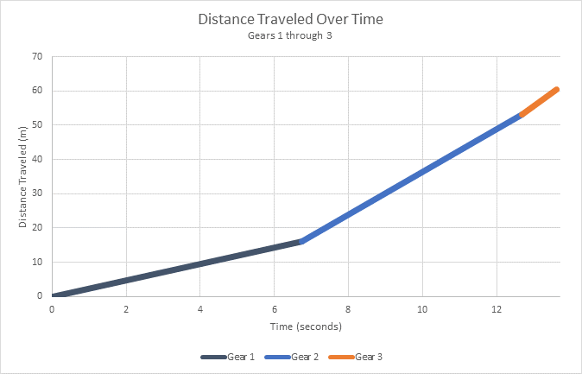
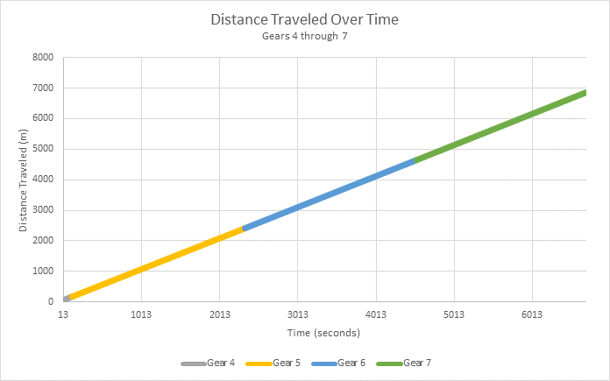
Plots for rider 1

Slide 20
Thank you

