Slide 1
TaskTracker

Slide 2
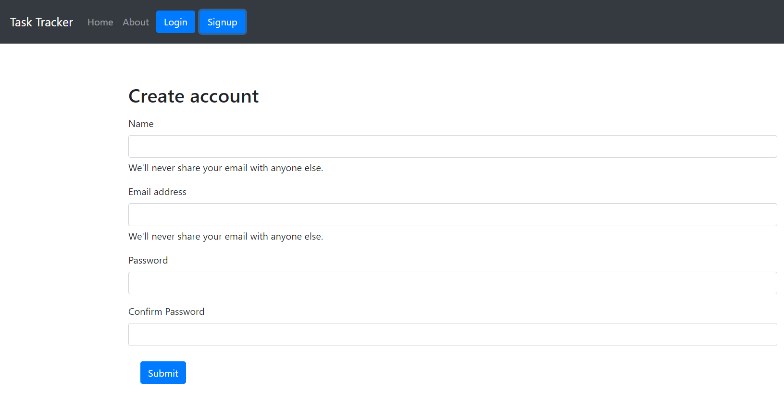
This is the signup page where the user is supposed to signup . When the valid details are provided the new user will be created.

Slide 3
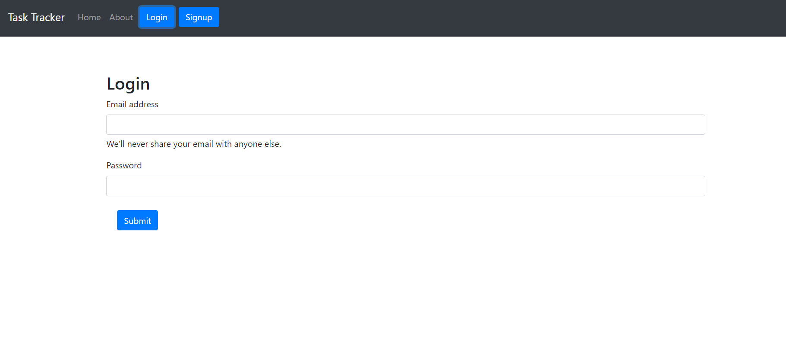
This is the login page . When the user is logged in based on the user the respective tasks are being rendered.

Slide 4
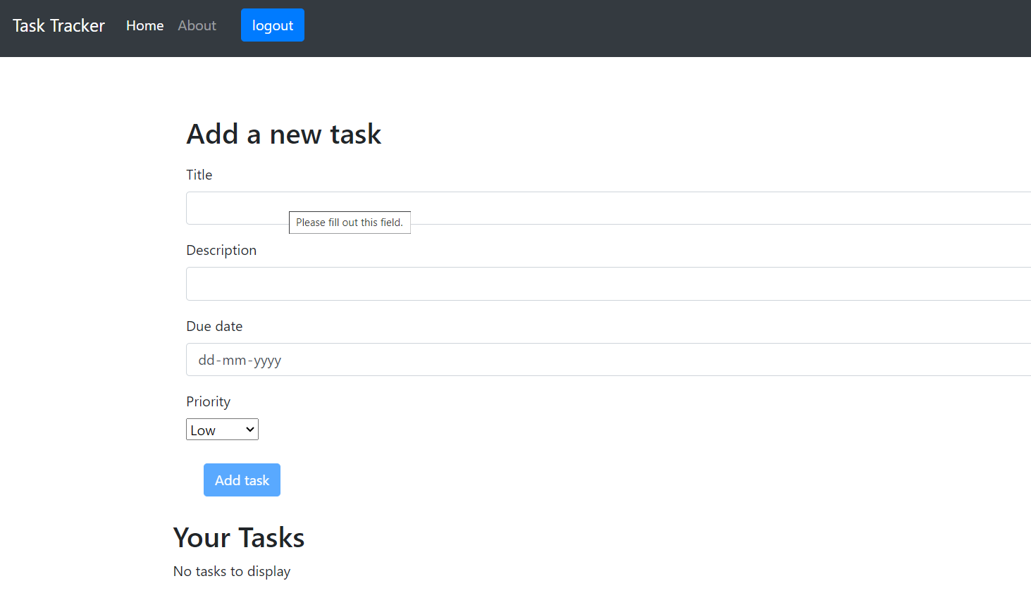
The tasks of the user will be rendered in the your tasks section . We can add a new task by entering the details and clicking on the add task button. Here the due date selected should be greater than present date otherwise we will not be able to add the task.

Slide 5
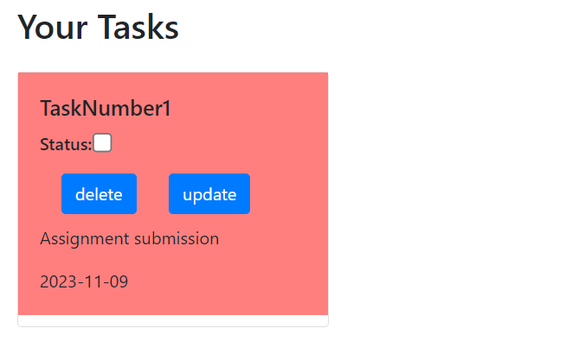
Here we had added a new task . There are three types of priorities . high-red color background , medium-green color background,low-blue color background. We can delete the task by clicking on the delete button. If the task is not yet completed then we can update the task by clicking on the update button and chaging the details as per requirements.

Slide 6
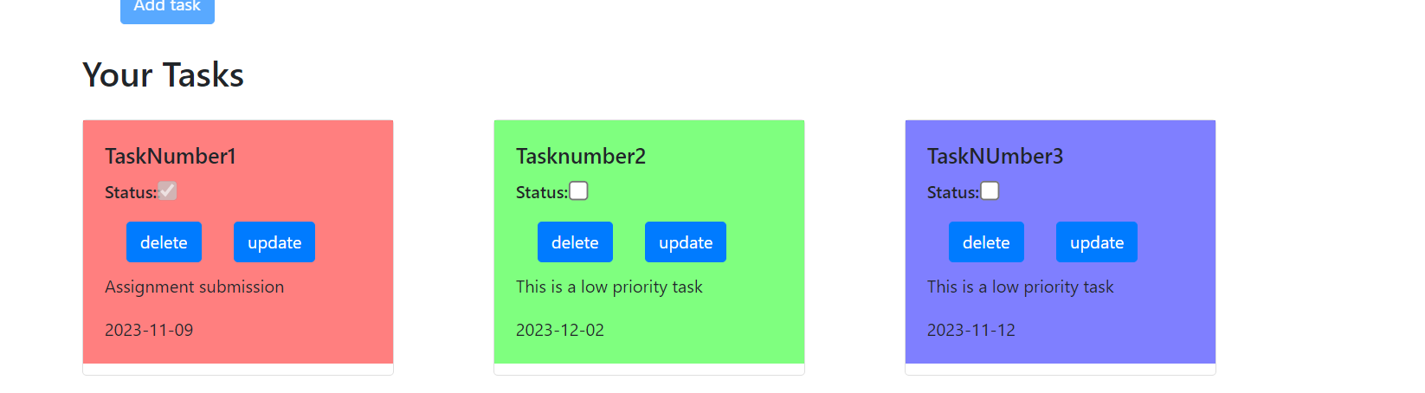
Here we can see all the different types of prioritised tasks.

Slide 7
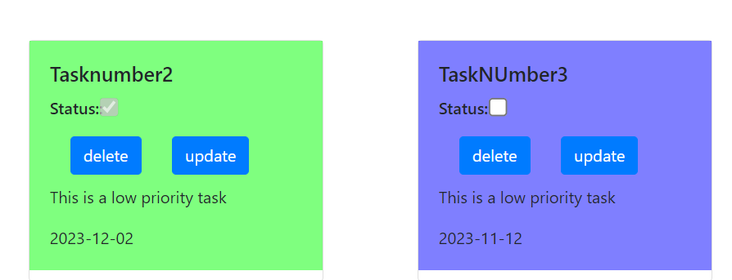
The first task is already completed hence the status box is disabled . The second task is not yet marked as completed . Hence the tick box is not set.

Slide 8
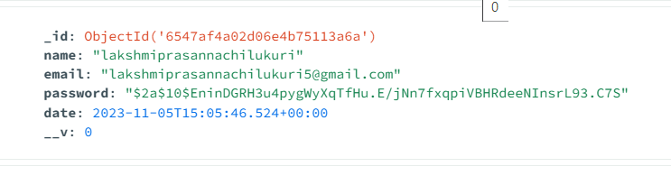
User details is stored in the mongodb as follows.

Slide 9
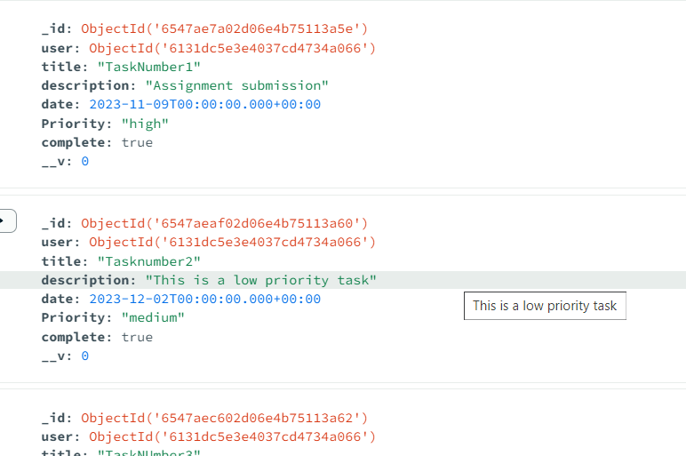
Tasks are stored in the below way in the mongodb

