Slide 1

Exploring Snowflake Stages:
Internal and External Data Movement Strategies

Slide 2

Introduction to Snowflake Stages
Types of Stages - Internal/External
Load data using Snowflake internal Stage
Load data using Snowflake External Stage (Azure)
Use Case and Benefits
python library for Snowflake data ingestion: snowflake-connector-python
AGENDA

Slide 3
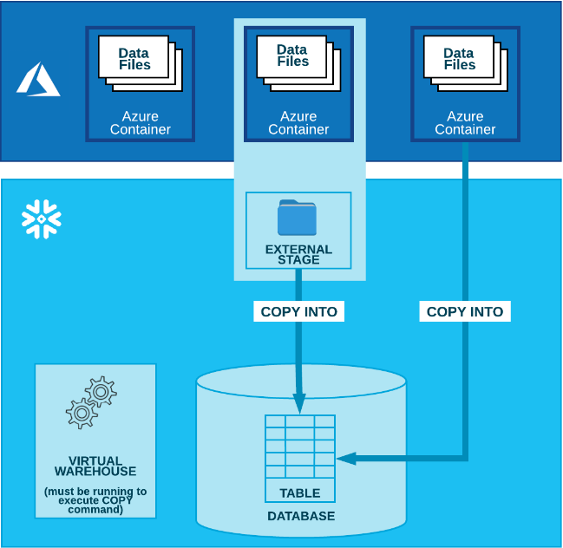
Introduction to Snowflake Stages
Snowflake stages are essential components within the Snowflake cloud data platform that facilitate seamless data movement between external storage systems and Snowflake's powerful analytical environment. Acting as virtual bridges, these stages enable efficient data loading and unloading operations without the need for data duplication. By seamlessly connecting Snowflake with cloud storage solutions like Azure, AWS, or Google Cloud, stages empower data engineers and analysts to effortlessly access, process, and analyze data in Snowflake, optimizing data workflows for modern analytics and insights.

Slide 4
Snowflake currently supports loading from blob storage only. Snowflake supports the following types of storage accounts:
Blob storage
Data Lake Storage Gen2
General-purpose v1
General-purpose v2
Snowflake does not support Data Lake Storage Gen1.
External stages serve as the bridge connecting Snowflake and Azure, enabling us to load data into Snowflake directly from Azure cloud storage. These stages act as pointers, directing Snowflake to data stored in Azure Blob Storage. This means we can work with our data without the need to duplicate it within Snowflake's storage.
Note: If a hierarchical namespace is enabled on Data Lake Storage Gen2, Snowflake doesn’t support the purge of files with the COPY command.

Slide 5
Types of Stages Snowflake supports two main types of stages: Internal Stages and External Stages. Each of these types serves specific purposes when it comes to data loading, unloading, and storage in Snowflake.
Internal stages Managed storage locations provided by Snowflake within its own infrastructure. They are typically used for temporary storage of data files during data loading, unloading, and transformation operations within the Snowflake environment. Here are some key points about internal stages:
Purpose: Internal stages are primarily used for temporary storage of data during ETL processes and other data movement operations.
Managed by Snowflake: Internal stages are created and managed by Snowflake, making them convenient for use in Snowflake-specific workflows.
Usage Scenario: You might use internal stages to hold intermediate results or temporary data files during data transformations or data movement between Snowflake tables.
Access Control: Access to internal stages can be controlled using Snowflake's access controls and permissions.
External stages, provide a way to interact with cloud-based object storage services such as Amazon S3, Azure Blob Storage, or Google Cloud Storage. These stages allow Snowflake to access data stored externally without physically copying it into Snowflake's storage. Here are some key points about external stages:
Purpose: External stages enable seamless data movement between cloud storage systems and Snowflake, without the need for data duplication.
Pointer to Data: External stages serve as pointers to files in cloud storage, allowing Snowflake to read from or write to those files without moving the data into Snowflake.
Accessing External Data: External stages are crucial for loading data into Snowflake from external sources or exporting data from Snowflake to external storage.
Access Control: Access to external stages can be controlled through Snowflake's authentication mechanisms and cloud provider access controls.

Slide 6
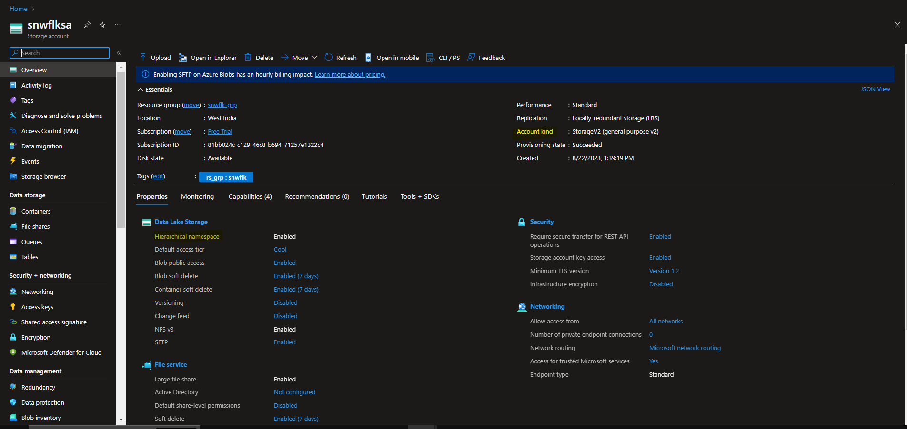

Slide 7
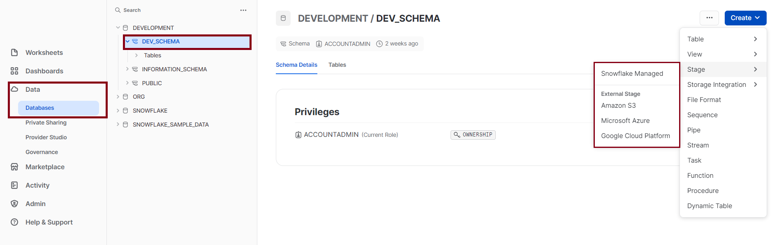

Slide 8
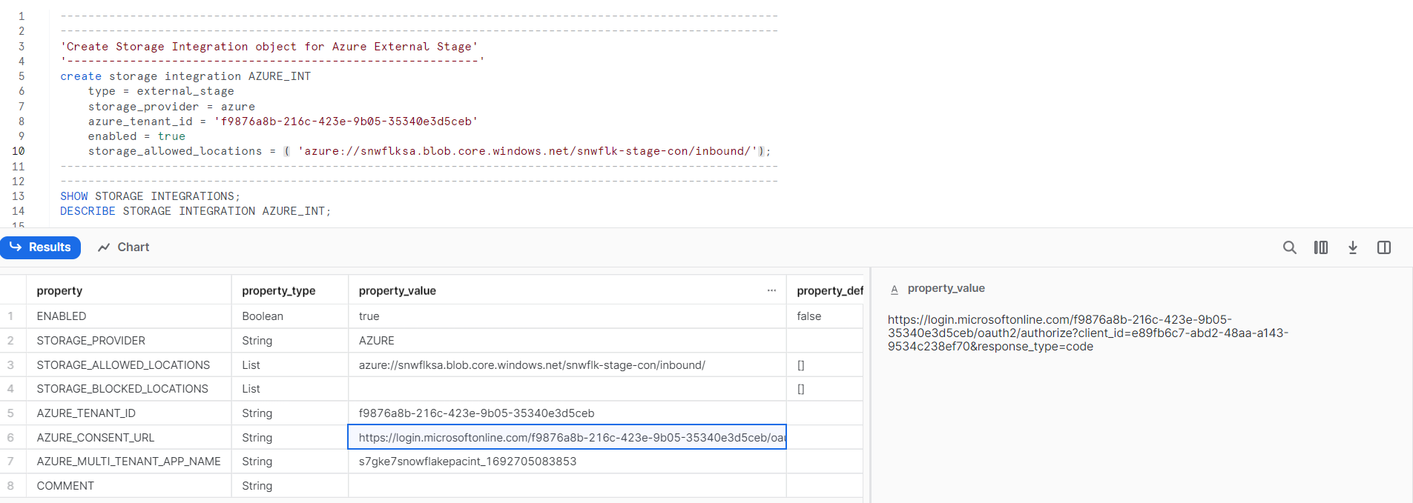
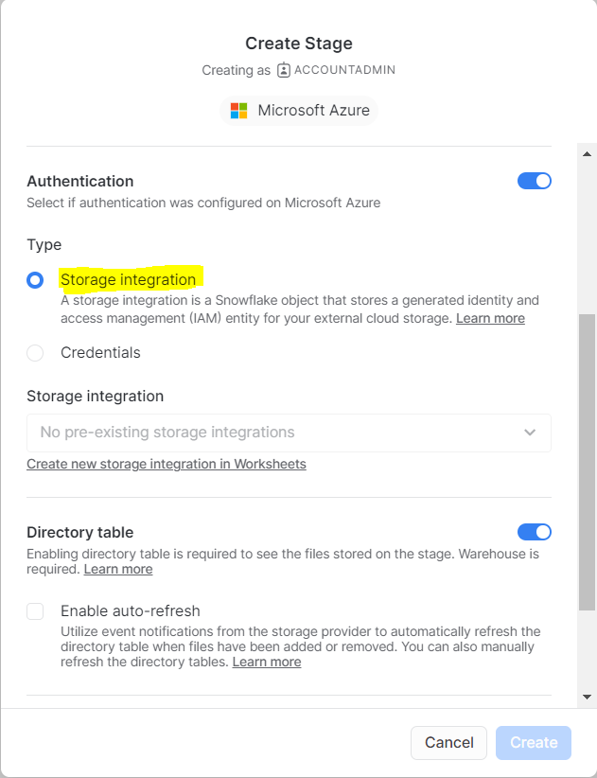
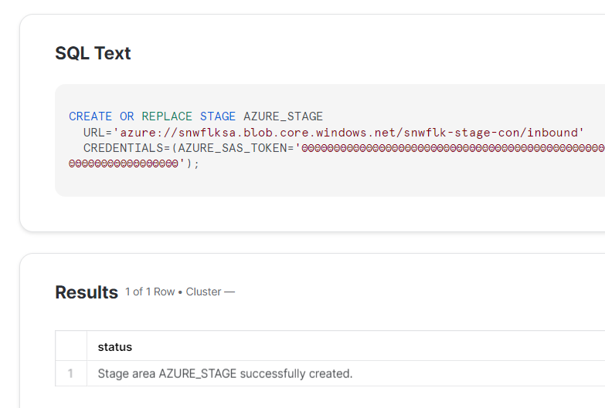
Configuring an Azure Container for Loading Data
OPTION-1
OPTION-2

Slide 9
Configuring an Azure Container for Loading Data
Option-1
Configure a storage integration object to delegate authentication responsibility for external cloud storage to an Azure service principal. A service principal is an identity created for use with services such as Snowflake to access Azure resources.
Snowflake highly recommends this option, which avoids the need to supply a SAS token when creating stages or loading data.
Accessing Azure blob storage in government regions using a storage integration is limited to Snowflake accounts hosted on Azure in the same government region. Accessing your blob storage from an account hosted outside of the government region using direct credentials is supported.
Option-2
Configure a storage integration object to delegate authentication responsibility for external cloud storage to an Azure service principal. A service principal is an identity created for use with services such as Snowflake to access Azure resources.
Snowflake highly recommends this option, which avoids the need to supply a SAS token when creating stages or loading data.
Accessing Azure blob storage in government regions using a storage integration is limited to Snowflake accounts hosted on Azure in the same government region. Accessing your blob storage from an account hosted outside of the government region using direct credentials is supported.

Slide 10
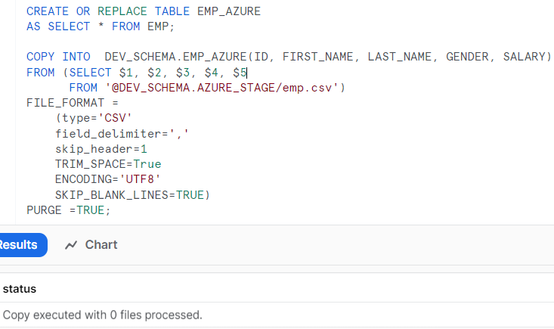
Copy executed with 0 files processed.
Snowflake employs an efficient mechanism to track the state of data files within an external stage during data loading operations. When you execute a COPY INTO statement to load data from an external stage into a Snowflake table, Snowflake performs a few checks to optimize the loading process. One of these checks is based on the concept of Snowflake's internal metadata, such as the metadata about the files and their state in the external stage.
File Metadata Tracking: When you initially load a file using COPY INTO, Snowflake records metadata about the file, such as its size, modification timestamp, and other relevant attributes.
Subsequent Load: When you repeat the same COPY INTO statement with the same file in the external stage, Snowflake compares the file's metadata to the previously recorded metadata.
Unchanged Metadata: If Snowflake detects that the metadata of the file hasn't changed since the last load, it understands that the file content remains unchanged.
Optimization: Since the file content is the same and no modifications have occurred, Snowflake optimizes the loading process by skipping the actual loading step. This results in the message "Copy executed with 0 files processed."
1. File Size Change: When you replace a character 'a' with character 'b' in a text file, the file's size could potentially change, depending on the encoding used. If the characters 'a' and 'b' have different byte representations in the file's encoding, then changing one character to another could cause the file's byte count to change. Snowflake's metadata tracking includes file size, so if the size changes, Snowflake is likely to recognize this as a modification.
2. File Encoding: File encoding plays a significant role in how characters are stored in a file. Different encodings represent characters using varying numbers of bytes. For instance, changing a single character could alter the number of bytes used to represent it in the file. This, in turn, impacts the file's size. If the encoding change results in a different byte count, Snowflake may identify the file as modified based on the altered file size in its metadata.

Slide 11
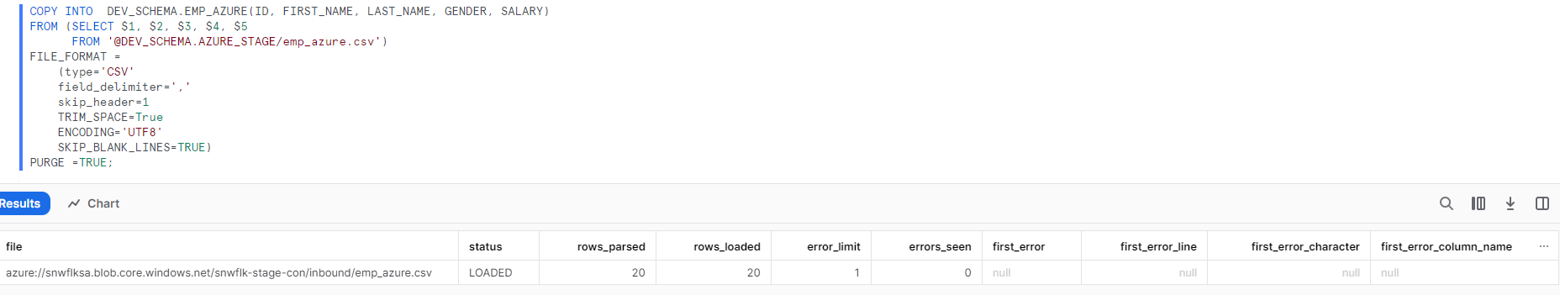
The COPY INTO command Snowflake is a powerful SQL statement that enables you to efficiently load data into Snowflake tables from various external data sources. It's a central component of Snowflake's data loading capabilities and is designed to handle large-scale data movement. The COPY INTO command can perform several tasks related to data loading and processing:
Data Loading: The primary purpose of the COPY INTO command is to load data from external files into Snowflake tables. It supports various file formats, including CSV, JSON, Parquet, Avro, and more. The command efficiently reads data from files, performs necessary transformations, and loads the data into the specified target table.
Supported Data Sources: You can load data from various external sources, including cloud-based storage services like Amazon S3, Azure Blob Storage, and Google Cloud Storage. This allows you to seamlessly integrate data stored in these sources with your Snowflake environment.
Data Transformation: The COPY INTO command can apply data transformations during the loading process, such as data type conversion, data mapping, and basic data cleaning. This helps ensure data integrity and compatibility with the target table's schema.
Parallel Loading:
The command supports parallel loading, which means that it can distribute the data loading process across multiple Snowflake clusters, enhancing loading performance for large datasets.
File Format Flexibility: Depending on the specified file format, the COPY INTO command can handle different types of data, such as structured (CSV), semi-structured (JSON), and columnar (Parquet) formats.
Skip Headers and Trailers: If your data files contain headers or trailers that you want to skip during the loading process, the COPY INTO command allows you to specify the number of header and trailer lines to skip.

Slide 12
snowflake-connector-python - pandas_tools.py
The pandas_tools.py module in the snowflake-connector-python library provides functionality for integrating Snowflake
with the popular Python data manipulation library, Pandas. It's designed to simplify and streamline the process of loading data
from Pandas DataFrames into Snowflake tables using the COPY INTO statement.
This module acts as a bridge between Pandas and Snowflake's data loading capabilities.
https://github.com/snowflakedb/snowflake-connector-python/blob/main/src/snowflake/connector/pandas_tools.py

