Slide 1
Limitations of traditional warehouses
Traditional data warehouses rely on static partitioning of large tables to achieve acceptable performance and enable better scaling.
In these systems, a partition is a unit of management that is manipulated independently using specialized DDL and syntax;
however, static partitioning has several well-known limitations, such as maintenance overhead and data skew, which can result in disproportionately-sized partitions.
Micro-partitions
The Snowflake Data Platform implements a powerful and unique form of partitioning, called micro-partitioning, that delivers all the advantages of static partitioning without the known limitations, as well as providing additional significant benefits.
In Snowflake, all data in tables is automatically divided into micro-partitions, which are contiguous units of storage.
Each micro-partition contains between 50 MB and 500 MB of uncompressed data, but in practice, the data is always stored compressed.
This compression is applied automatically during the data loading phase, and Snowflake uses a combination of compression algorithms to optimize the storage efficiency.
Groups of rows in tables are mapped into individual micro-partitions, organized in a columnar fashion. This size and structure allows for extremely granular pruning of very large tables, which can be comprised of millions, or even hundreds of millions, of micro-partitions.
Snowflake stores metadata about all rows stored in a micro-partition, including: -> The range of values for each of the columns in the micro-partition.
-> The number of distinct values. -> Additional properties used for both optimization and efficient query processing.

Slide 2
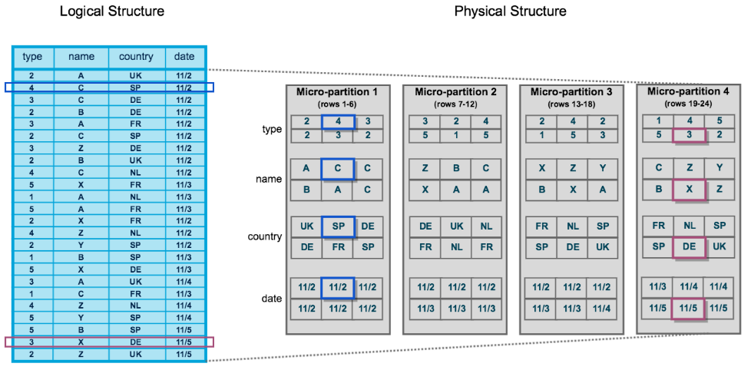
The table consists of 24 rows stored across 4 micro-partitions, with the rows divided equally between each micro-partition.
Within each micro-partition, the data is sorted and stored by column, which enables Snowflake to perform the following actions for queries on the table:
First, prune micro-partitions that are not needed for the query.
Then, prune by column within the remaining micro-partitions.
Query pruning in Snowflake refers to the optimization technique used to reduce the amount of data that needs to be scanned and processed during query execution. By analyzing the metadata associated with micro-partitions and leveraging the clustering information, Snowflake can skip unnecessary data blocks and access only the relevant data, resulting in faster query response times and more efficient resource utilization.
Clustering Typically, data stored in tables is sorted/ordered along natural dimensions. This “clustering” is a key factor in queries because table data that is not sorted or is only partially sorted may impact query performance, particularly on very large tables.
In Snowflake, as data is inserted/loaded into a table, clustering metadata is collected and recorded for each micro-partition created during the process. Snowflake then leverages this clustering information to avoid unnecessary scanning of micro-partitions during querying, significantly accelerating the performance of queries that reference these columns.

Slide 3


Benefits of Micro-partitioning
In contrast to traditional static partitioning, Snowflake micro-partitions are derived automatically; they don’t need to be explicitly defined up-front or maintained by users.
Snowflake applies a combination of different compression techniques, including run-length encoding, dictionary encoding, and bit packing, depending on the data's characteristics and column types.
This approach optimizes the compression ratio, leading to a smaller storage footprint for the data. The compression process occurs during the data loading phase, and Snowflake transparently handles the compression and decompression tasks as needed.
When querying data, Snowflake automatically decompresses only the necessary data to perform the required calculations or retrieve the requested information. This "on-the-fly" decompression ensures that query performance remains efficient, as only the relevant data is decompressed during query execution.
As the name suggests, micro-partitions are small in size (50 to 500 MB, before compression), which enables extremely efficient DML and fine-grained pruning for faster queries.
As the name suggests, micro-partitions are small in size (50 to 500 MB, before compression), which enables extremely efficient DML and fine-grained pruning for faster queries.
Columns are stored independently within micro-partitions, often referred to as columnar storage. This enables efficient scanning of individual columns; only the columns referenced by a query are scanned.
Columns are also compressed individually within micro-partitions. Snowflake automatically determines the most efficient compression algorithm for the columns in each micro-partition.

Slide 4






Caching in Snowflake
Stats
Query Results
Data
Long Term centralized Storage – “Remote”
Metadata Cache
Results Cache
Warehouse
SSD cache
“Local”
Metadata caching stores frequently accessed metadata in memory to optimize query planning and optimization. Metadata includes information about the database schema, table structure, and statistics about the data distribution. Storing this information in memory reduces the need to repeatedly access disk storage during query planning and execution, leading to faster query compilation and better optimization.
Result caching stores the results of a previously executed query in the query result cache, which is a memory-based cache within Snowflake. When the same query is executed again, Snowflake checks if the query and its parameters (e.g., input values, filter conditions) match a cached result. If a match is found, Snowflake can use the cached result instead of re-executing the query, providing faster response times.
The warehouse SSD cache, also known as the local cache, is a cache at the warehouse level. It utilizes solid-state drives (SSDs) to cache data blocks from cloud storage that are frequently accessed by queries running on a specific warehouse. This local caching reduces the need to fetch frequently accessed data blocks from cloud storage, leading to lower latency and faster query processing. The warehouse SSD cache is specific to each warehouse, and cached data is not shared across warehouses.

Slide 5
Query Results are reused if all the following conditions are met:
The new query syntactically matches the previous executed query.
The table data contributing to the query result has not changed.
The persisted result for the previous query is still available.
The query does not include functions that must be evaluated at execution time, e.g., current_timestamp(), UUID_STRING(), etc. however current_date() is an exception.
The micro-partitions for tables involved in query have not changed (reclustered or consolidated )

Slide 6
Types of tables in Snowflake:
Permanent Tables
Temporary Tables
Transient Tables
Stores non-permanent data.
Exists only within session they were created.
Not visible to other users or sessions.
Do not support some std. features like cloning.
Once the session ends, data stored in tables is purged and cannot be recovered either by user or by Snowflake.
Can create temporary & permanent table with the same name and within same schema. (temp table takes precedence)
Persist until explicitly dropped.
Similar to permanent tables, except that they don’t have a fail-safe period.
Specifically designed for data that doesn’t need same level of data protection and recovery as provided by permanent tables.
Contribute to overall storage charges that Snowflake bills, similar to permanent tables, but do not include fail-safe costs.
Can create transient databases and schema as well.
All tables created in transient schema, as well as all schemas created in transient db are transient.
Default table type when creating any table.
Created for longer period.
Level of data protection and recovery mechanisms are implemented.
High time travel retention in comparison to transient and temporary tables.
Have a fail-safe period of 7 days.

Slide 7
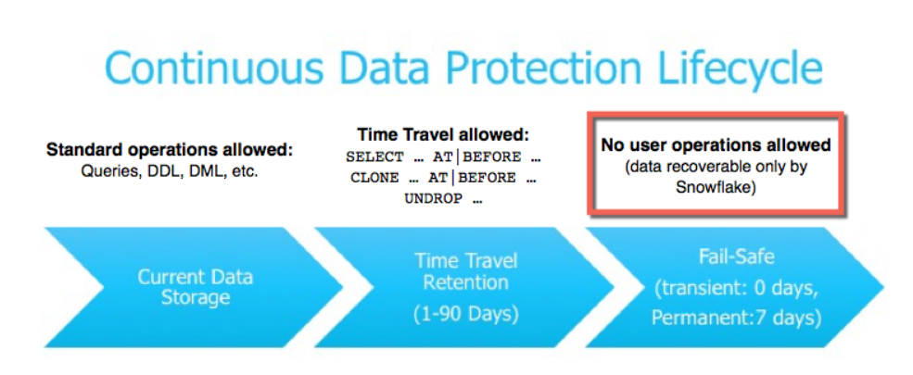
Time Travel in Snowflake
Day5
inserted 5 records
Day12
Deleted 1 record
Timeline →
Day1
created table
inserted 3 records
Day10
Updated 6 records
Time Travel allows you to query data at different points in time within the retention period. This can be particularly useful for auditing, debugging, and recovering from accidental data changes.
Run queries on data that has been updated or deleted in the past.
Create clones of entire tables, schemas, and databases at or before specific points in the past.
Restore tables, schemas, and databases that have been dropped.

Slide 8
Time Travel : Data retention period
Specifies the number of days for which historical data is preserved. (Can set for Permanent table up to 90 days, 1 day for transient and temporary)
Std. retention period is 1 day (24 hours) and is automatically enabled for all snowflake accounts.
For Snowflake Std. edition:
the retention period can be set to 0 or unset back to default 1 at account and objects level.
For Snowflake enterprise edition (and higher):
-- For transient objects, the retention period can be set to 0, or unset back to default 1 at account and objects level. Same is true for Temporary tables.
-- For permanent objects, the retention period can be set up to 90 days.
Only ACCOUNTADMIN role can set DATA_RETENTION_TIME_IN_DAYS value.
Once the defined period ahs elapsed, the data is moved into Snowflake Fail-Safe.

Slide 9
Fail Safe in Snowflake
Fail-safe provides a (non-configurable) 7-day period during which historical data may be recoverable by Snowflake.
This period starts immediately after the Time Travel retention period ends. (however, note that a long-running Time Travel query will delay moving any data and objects (tables, schemas, and databases) in the account into Fail-safe, until the query completes.
Fail-safe is a data recovery service that is provided on a best effort basis and is intended only for use when all other recovery options have been attempted.
Fail-safe is not provided as a means for accessing historical data after the Time Travel retention period has ended.
It is for use only by Snowflake to recover data that may have been lost or damaged due to extreme operational failures.
Data recovery through Fail-safe may take from several hours to several days to complete.

