Slide 1
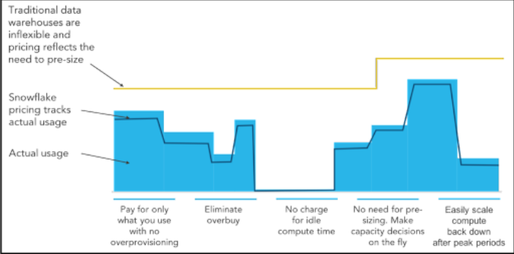
Snowflake
Snowflake pricing is based on a pay-as-you-go model, offering a cloud-based data platform that allows businesses to efficiently store, analyze, and process large volumes of data. The pricing structure includes:
serverless features,
storage costs,
and compute costs for virtual warehouses
which are billed per second of usage.
Data storage costs are determined by the volume of data stored each month, and data transfer costs apply when moving data in and out of Snowflake or between different regions and cloud providers.
To optimize costs, users can right-size virtual warehouses, implement auto-suspending features, and utilize data compression, partitioning, and clustering techniques.
Monitoring credit consumption is crucial, and Snowflake provides various ACCOUNT_USAGE views to track credit utilization accurately.

Slide 2
Serverless Features Snowflake Offers the following additional features that use snowflake managed compute resources and consume snowflake credits when they are used.
Snowpipe | Database Replication | Materialized Views Maintenance | Automatic Clustering | Search Optimization Service
Is an automated service that rapidly ingests streaming data | Seamlessly replicates data across regions and cloud platforms. | Automatically syncs materialized views with underlying tables. | Maintains optional clustering state using defined cluster keys. | Greatly speed up point lookup queries in massive tables.
Requires no virtual warehouse. | Requires no virtual warehouse. | Requires no virtual warehouse. | Applies to tables and materialized views. | Pair SOS with smaller virtual warehouses to lower costs.
Uses Snowflake managed compute resources, which are paid for with Snowflake credits and are billed per second, plus incurs a fixed Snowflake credit charge per file. | Uses Snowflake managed compute resources, which are paid for with Snowflake credits and are billed per second, plus incurs a standard storage and data transfers costs. | Uses Snowflake managed compute resources, which are paid for with Snowflake credits and are billed per second. | Uses Snowflake managed compute resources, which are paid for with Snowflake credits and are billed per second. | Uses Snowflake managed compute resources, which are paid for with Snowflake credits and are billed per second.

Slide 3
Snowflake- Storage cost (On-demand/pre purchased)
Snowflake is a cloud-based data warehousing platform that separates storage and compute resources, allowing you to scale each independently. This separation provides flexibility and cost-effectiveness, as you only pay for the storage you use, and the compute resources you need for processing data.
There are two main types of storage cost options in Snowflake:
On-Demand Storage:
With on-demand storage, you pay for the storage you use on a pay-as-you-go basis.
The pricing is usually based on the amount of data stored in your Snowflake account per month. This means that if your data volume fluctuates or you have a smaller amount of data, on-demand storage can be a suitable choice.
Pre-Purchased Storage (Snowflake On-Demand Capacity):
Pre-purchased storage, also known as Snowflake On-Demand Capacity, involves committing to a specific amount of storage in advance for a fixed duration, typically in terms of months or years.
By pre-purchasing storage, you can often get a discount compared to the on-demand storage pricing. This option is beneficial if you have predictable data storage requirements and want to save on costs in the long run.
When choosing between on-demand and pre-purchased storage, consider the following factors:
Data Volume: If your data volume varies significantly over time or if you have a smaller amount of data, on-demand storage might be more cost-effective.
Predictable Workloads: If you have a consistent and predictable data storage pattern, pre-purchasing storage can lead to cost savings.
Budget: Consider your budget and cost requirements. Pre-purchased storage might require a larger upfront investment, while on-demand storage can be more flexible in terms of payment.

Slide 4

Snowflake – choose storage type wisely
https://www.snowflake.com/pricing/pricing-guide/
Assumptions | Actual consumption | Cost per TB | Total cost per month
100 GB of storage would be required per month. Selected pre-purchased storage plan. | 20GB | $23/TB | 0.1 * 23 = $2.3
10GB of storage would be required per month. Selected on-demand storage plan. | 20 GB | $40/TB | 0.02 * 40 = $0.8
User1
User2
Assumptions | Actual consumption | Cost per TB | Total cost per month
100 GB of storage would be required per month. Selected pre-purchased storage plan. | 90GB | $23/TB | 0.1 * 23 = $2.3
10GB of storage would be required per month. Selected on-demand storage plan. | 90 GB | $40/TB | 0.09 * 40 = $3.6
User1
User2

Slide 5
Virtual Warehouse/Compute cost
Snowflake supports a wide range of virtual warehouse sizes: X-Small, Small, Medium, Large, X-Large, 2X-Large, 3X-Large, and 4X-Large.
The size of the virtual warehouse determines how fast queries will run. When a virtual warehouse is not running (that is, when it is set to sleep mode), it does not consume any Snowflake credits.
The different sizes of virtual warehouses consume Snowflake credits at the following rates, billed by the second with a one-minute minimum.
 | XS | S | M | L | XL | 2XL | 3XL | 4XL | 5XL 6XL
Std. | 1 | 2 | 4 | 8 | 16 | 32 | 64 | 128 | 256 512
Snowpark-Optimized | NA | NA | 6 | 12 | 24 | 48 | 96 | 192 | 384 786

Slide 6
Data Transfer
Customers who wish to move or copy their data between regions or clouds will incur data transfer charges. Features such as External Tables, External Functions and Data Lake Export may incur data transfer charges.

Slide 7
Pricing Example-1
Customer Information
The customer has purchased the Snowflake Capacity Standard Service with Premier Support.
The customer is in the United States.
They load data into Snowflake every night.
There are 8 users who access the database during business hours.
Data Loading Requirements
The customer performs data loading daily.
They use a "Small Standard Virtual Warehouse" for the data loading task, which consumes 2 credits per hour.
The loading window is 2.5 hours each night.
To calculate the credits required per month for data loading:
2 credits/hour * 2.5 hours/day * 31 days/month = 155 credits per month.
User Requirements
There are 8 users who access the Snowflake database.
The users work from 8 AM to 6 PM, which is a total of 10 hours per day.
They use a "Medium Virtual Warehouse" for their work, which consumes 4 credits per hour.
To calculate the credits required per month for user access:
4 credits/hour * 10 hours/day * 20 days/month = 800 credits per month.
Total Credits Required
To get the total credits required per month, add the credits required for data loading and user access:
Total credits required per month = 800 credits (users) + 155 credits (data loading) = 955 credits per month.
Storage Requirements
The customer stores an average of 4 TB of compressed data in Snowflake.
Snowflake provides a pricing model based on storage usage at a rate of $23 per TB per month.
To calculate the data storage price per year:
4 TB * $23/TB/month * 12 months = $1,104 per year.
Virtual Warehouse Cost
The cost of using the virtual warehouse is calculated based on the total credits required per month.
The cost per credit is $2, but there is also a 5% sample discount applied (0.95).
To calculate the virtual warehouse cost per year:
955 credits per month * $2/credit * 0.95 * 12 months = $21,774 per year.
Total Price
The total price per year is the sum of the data storage price and the virtual warehouse cost:
Total Price per year = $1,104 (data storage) + $21,774 (virtual warehouse) = $22,878.
So, the customer will be paying a total price of $22,878 per year for the Snowflake Capacity Standard Service with Premier Support in the United States, considering the data loading frequency, user access, and storage requirements as outlined in the example.

