Slide 1
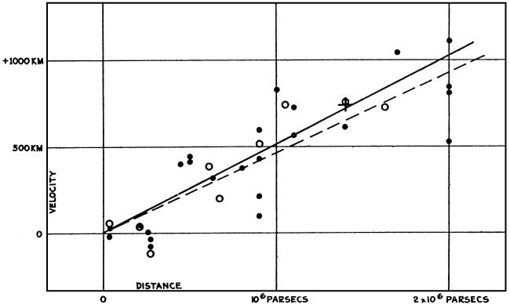
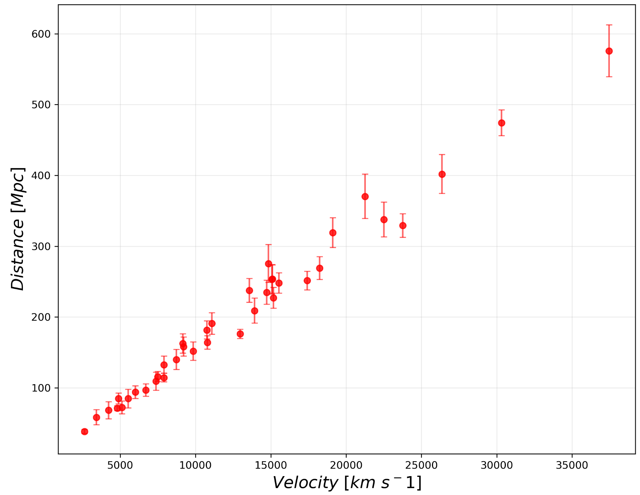
LAB 1: Hubble Time - Jorge Casas, Pablo Drake
Today, we have data from high-redshift SN (reference), allowing us to compute H₀ and its related Hubble time. Through this calculation, we will answer the question of what is the age of our Universe?
Hubble, E. P. (1929) Proc. Natl. Acad. Sci. USA 15, 168–173.
Filippenko, A. V. & Riess, A. G., 1998, Physics Reports, 307, 31
Edwin Hubble (1929) plot of distant galaxies and redshifted recessional velocities. The first estimate of the Hubble Constant, H₀, was imprecise due to uncertainty inf distance to sampled galaxies.
Type 1A Supernova sampling offers a more precise approach to measure the distance using these events as “standard candles” for the distance modulus to recalculate the Hubble Constant, H₀.

Slide 2
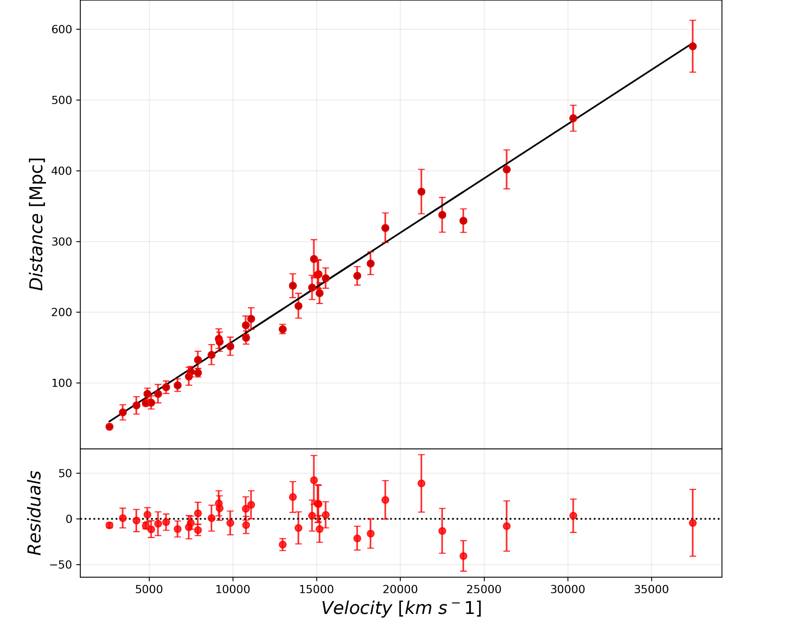
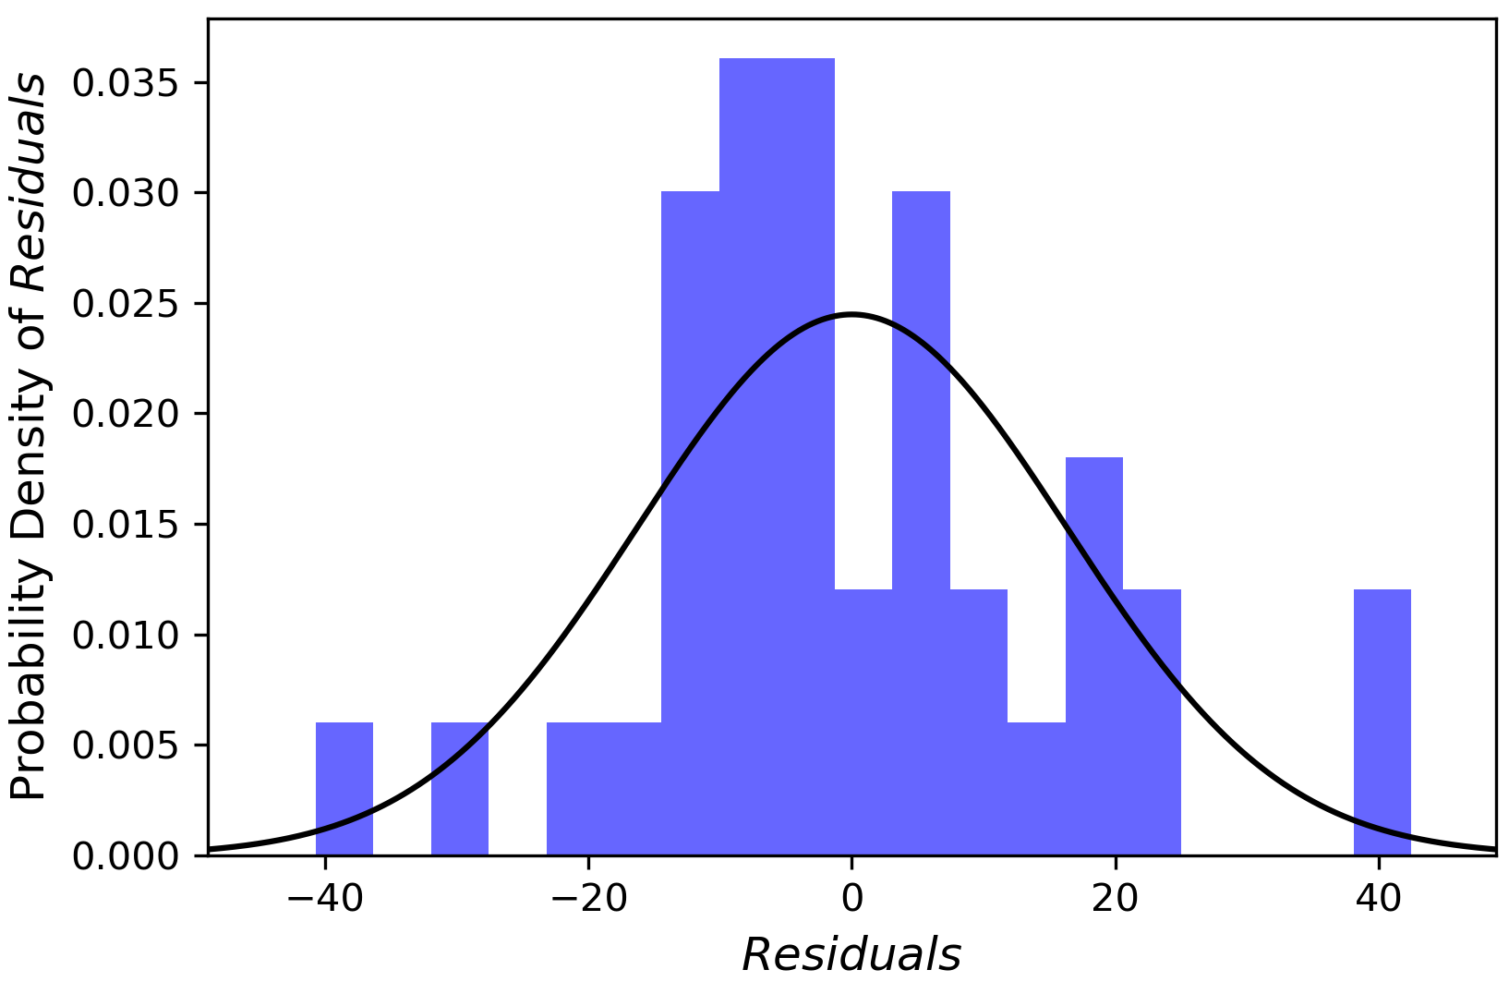
The relationship between distance and velocity seems linear. Furthermore, Hubble’s calculation presupposes this linearity (by assuming a constantly expanding Universe)
Using the error data provided by Filippenko, A. V. & Riess, A. G., 1998, we have carried out a weighted linear fit using np.polyfit
We have also solved the normal equation as a way to check the resulting gradient and y-intercept parameters
Lastly, we completed a bootstrapping approach, with 1000 samples. An error term was added to each sampled point in each bootstrap sample, determined by randomly sampling from a Normal distribution with standard deviation equal to the measurement uncertainty of the respective sampled point.

Slide 3
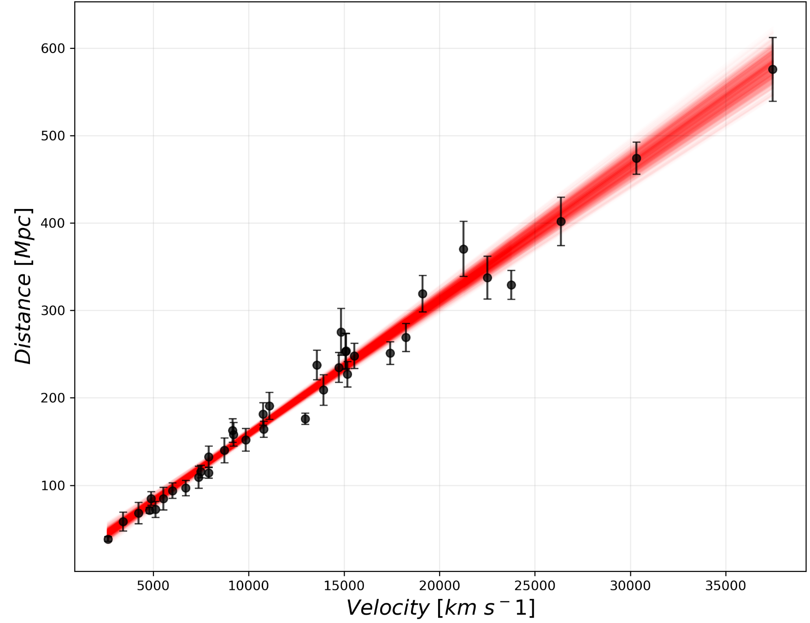
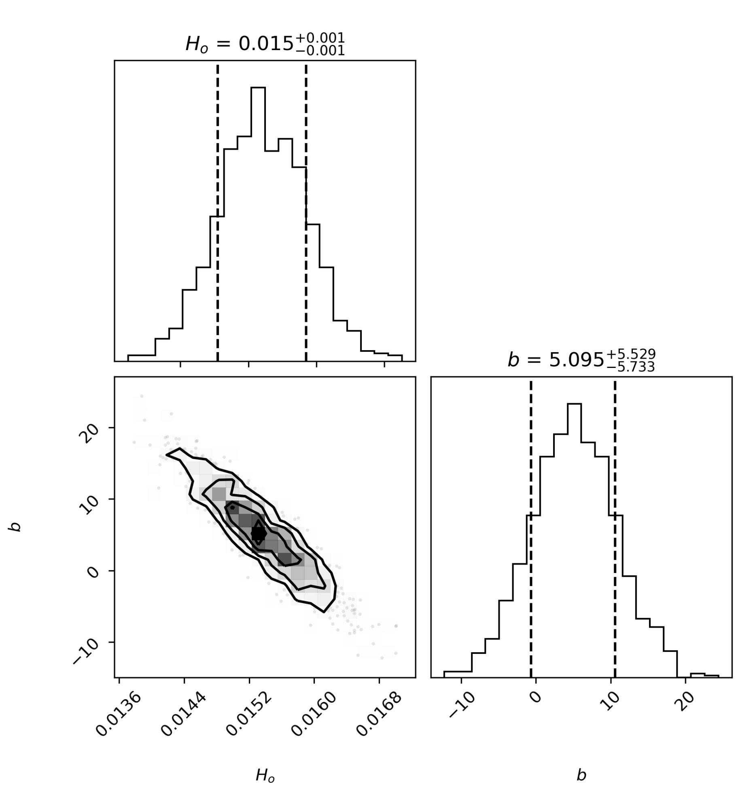
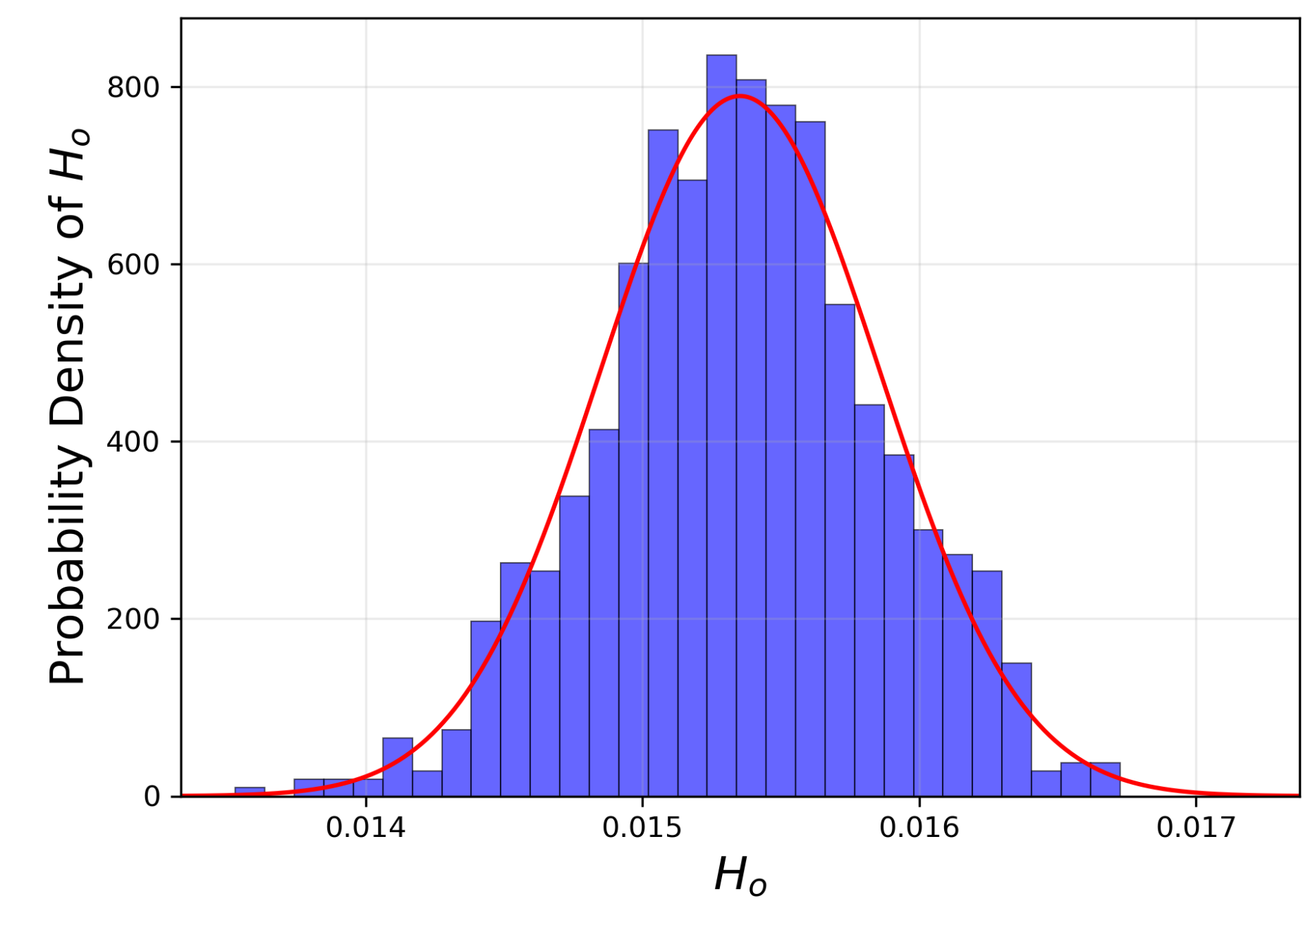
From the linear fit, we find:
Linear model slope, H_{o}⁻¹: (1.54 ± 0.03) x 10⁻² [Mpc s km⁻¹]
Age of the universe: 14.90 ± 0.28 [Gyr]
From the bootstrap approach, we find a similar best-fit gradient, with a slightly larger uncertainty, as can be seen in the lower right-hand histogram.
Similarly, we can check the correlation between gradient and right intercept of the bootstrap approach in the corresponding corner plot.

