Slide 1
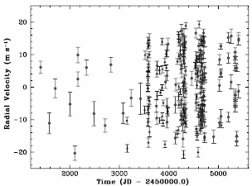
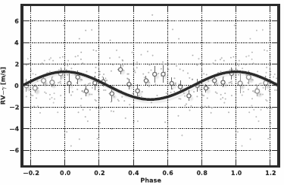
LAB 4: Model Sel. - Jorge Casas, Pablo Drake
In this lab, we were tasked with validating models using four different model techniques, ultimately concluding that the significance of Vogt’s planet's detection is smaller than the original 4.7σ discovery.
Credit: S. Vogt et al., 2010
Credit: T.Forveille et al., 2018
Steven Vogt discovered Gliese 581 g, an Earth-like exoplanet, which sparked conversations about the possibility of life on it. However, a new study using more data disproved its existence. Our presentation aims to determine the significance of the detection of G581 g based on Vogt's original dataset.
We will use four models to analyze Vogt's data. These models use an equation that adds up the amplitudes, periods, and phases of all the planets. We will calculate values for K, P, and q based on Vogt's results and use them to minimize the χ² value of the models.

Slide 2
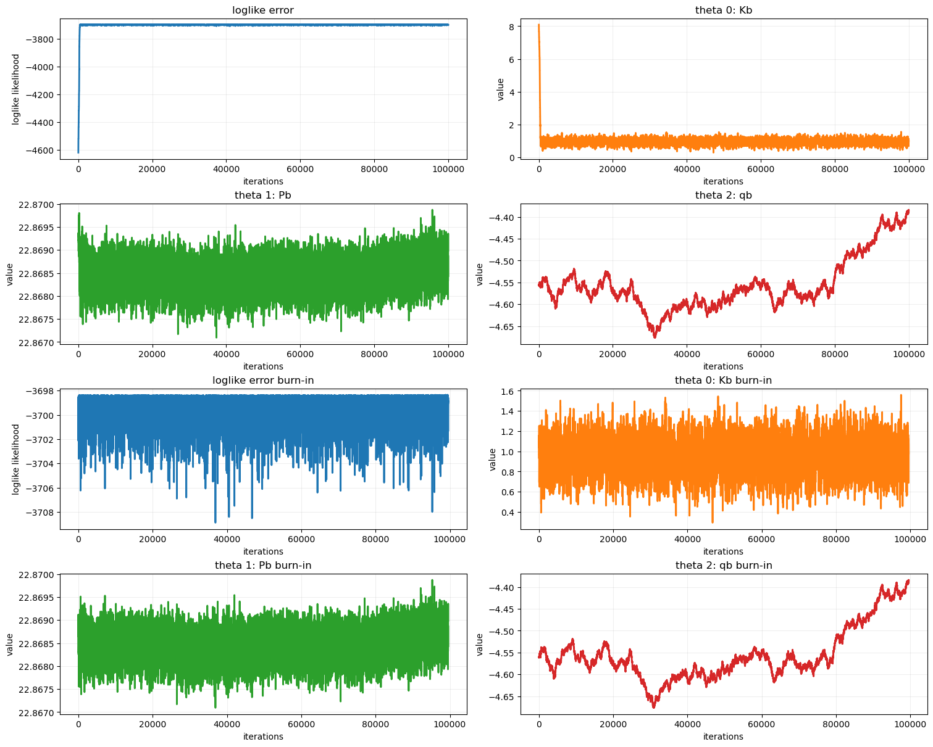
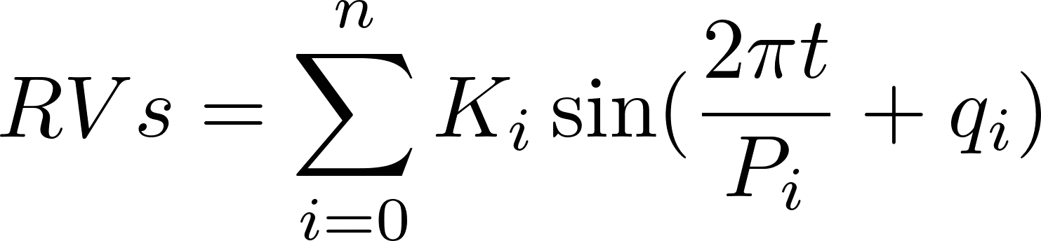
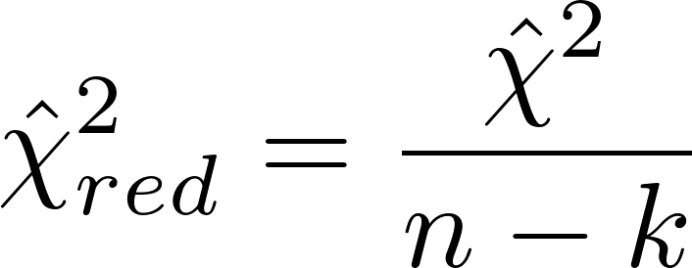
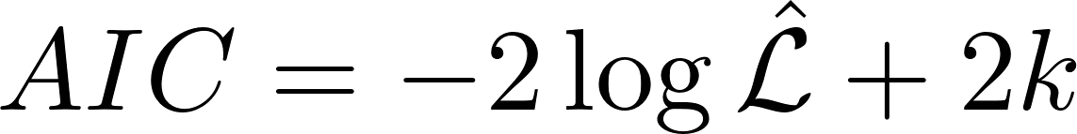
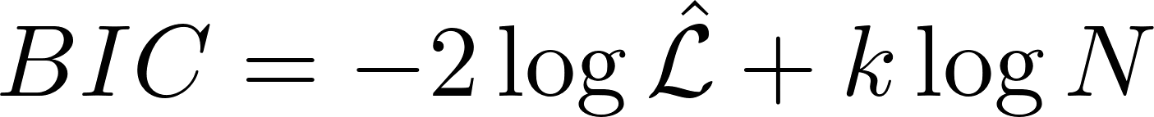
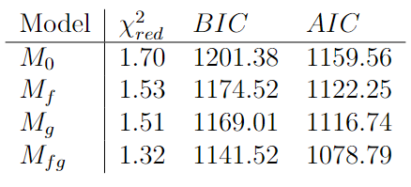
Once the four models have been computed, we calculate several model comparison metrics Eq. (2), Eq. (3), Eq. (4) to obtain a first estimation of the best-fitting model.
(1)
(2)
(3)
(4)
An MCMC algorithm was also used to independently validate the Vogt’s results for the first planet using model Eq. (1) through loglike minimization. Interestingly, the MCMC does not converge on Vogt’s with the following being the proposed values:
Kb: 0.96 Pb: 22.87 qb: -4.57
Note: The phase parameter never converged to a normally dist. value.

Slide 3
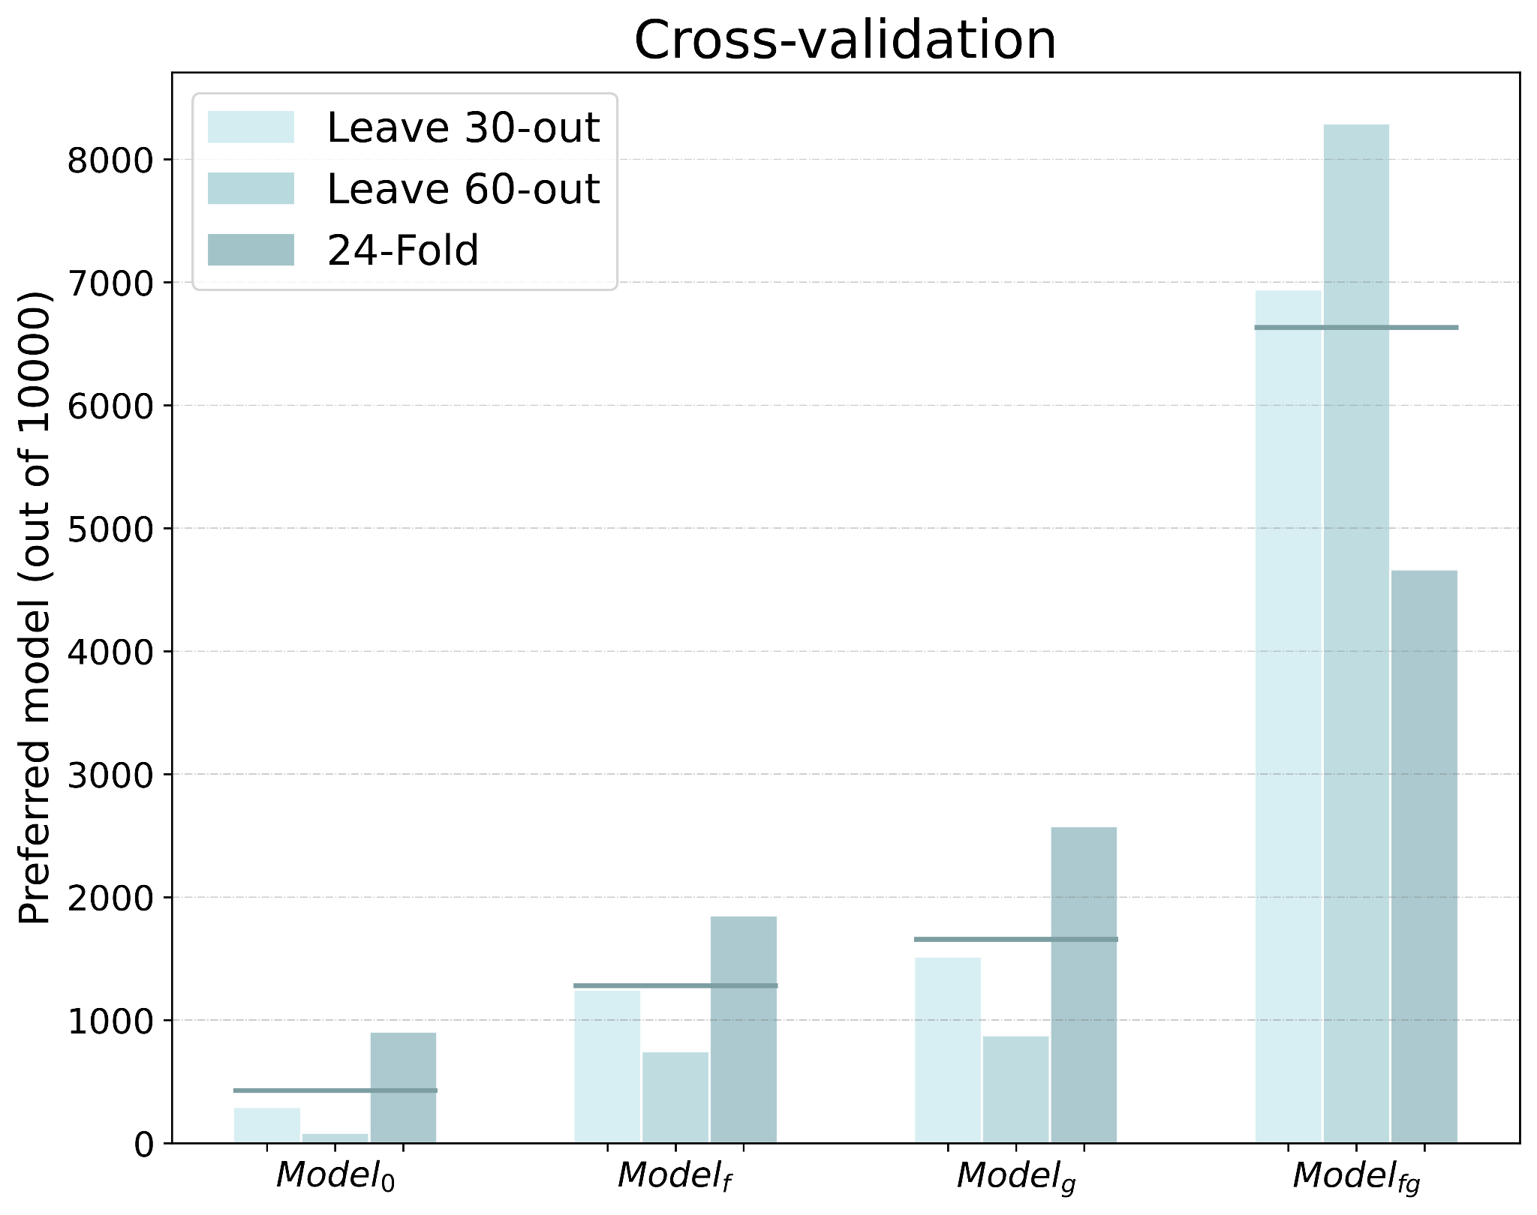
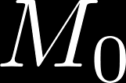
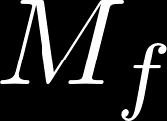
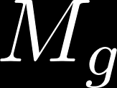
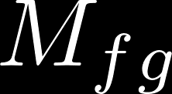
We will also test the performance of our models using three cross-validation techniques, including:
M0 μ: 428.67 Mf μ: 1281.33
Mg μ: 1657.0 Mfg μ: 6633.0
K-folding training allows for the partitioning of data into k equally sized parts and using each fold as a validation set, while the remaining k-1 folds are used to train the model. The 24-fold technique is the most exhaustive and homogeneous.
Although the Mfg model appears to be the best, and is the best in just under 70% of cases, with models Mf & Mg being above 5% and M0 being under 5%. This implies that the significance of the existence of planet G581 g is much lower than the previously claimed 4.7σ.

