Slide 1
COMPARATIVE ANALYSIS OF VARIOUS ALGORITHMS FOR FAKE NEWS DETECTION
by
Prithwiraj Samanta and Satya Kumari
Under the guidance of
Dr. Rashmi Panda
Department of Computer Science and Engineering
INDIAN INSTITUTE OF INFORMATION TECHNOLOGY, RANCHI
(An Institution of National importance under act of Parliament)
(Ranchi - 834010), Jharkhand

Slide 2
Introduction
Fake news intends to convince the reader to believe false information.
Published fake news used to increase readership or as part of psychological warfare.
Fake news detection is the task of detecting forms of news consisting of deliberate disinformation or hoaxes.
One can prevent lot of negative impact on the society caused by fake news.
Deep Learning approach has been used in our work for this problem

Slide 3
Literature Survey
Author | Algorithm | Accuracy
Zhou et al.[1] | Not Applicable | Not Applicable
Abedalla et al.[2] | Attention Layer with CNN + LSTM | Accuracy of 0.71
Fawaid et al.[3] | Fine Tuned BERT | Accuracy of 0.90
Ajao et al.[4] | RNN | Accuracy of 0.82
Manzoor et al.[5] | Random Forest Classifier | Accuracy of 0.65

Slide 4
Literature Survey
Author | Algorithm | Metric(Best)
Zhao et al.[6] | Combination of Clustering and Classifiers on Clusters | Accuracy of 0.33
Ahmed et al.[7] | Passive Aggressive Classifier | Accuracy of 0.93
Umer et al.[8] | CNN + LSTM (with PCA & MSWD) | Accuracy of 0.97
Dong et al.[9] | DSTL | F1-Score of 0.58
Salur et al.[ 10] | CNN + LSTM in Parallel | F1-Score of 0.89

Slide 5
Motivation
We came across various algorithms during our research.
The best performer was CNN + LSTM model. We decided to work further on this model and try to improve its performance.
During our work we also came across Attention and Transformer based models which are emerging slowly.
We tried to perform a comparative analysis of CNN + LSTM, Attention, and Transformer models.

Slide 6
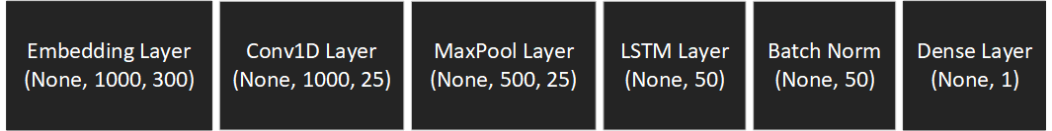
Methodology
RNNs can keep track of arbitrary long-term dependencies in the input sequences.
When training a RNN using back-propagation, the long-term gradients which are back-propagated can "vanish" or "explode“.
It is because of the computations involved in the process, which use finite-precision numbers.
LSTM units partially solve the vanishing gradient problem, because LSTM units allow gradients to also flow unchanged.

Slide 7
Methodology
A common LSTM unit is composed of a cell, an input gate, an output gate and a forget gate.
CNNs are regularized versions of multilayer perceptron. Multilayer perceptron usually mean fully connected networks.
CNNs take advantage of the hierarchical pattern in data.
It assemble patterns of increasing complexity using smaller and simpler patterns embossed in their filters.

Slide 8
Methodology
CNN layers used for feature extraction on input data combined with LSTMs to support sequence prediction.
Attention is a mechanism combined in the RNN allowing it to focus on certain parts of the input sequence when predicting a certain part of the output sequence, enabling easier learning and of higher quality.
Combination of attention mechanisms enabled improved performance in many tasks making it an integral part of modern RNN networks.
Attention mechanisms let a model draw from the state at any preceding point along the sequence.

Slide 9
Methodology
The attention layer can access all previous states and weights them according to a learned measure of relevancy, providing relevant information about far-away tokens.
Transformers use an attention mechanism without an RNN, processing all tokens at the same time and calculating attention weights between them in successive layers.

Slide 10
Implementation
Pre-processing
The text data which is available to us for using in the fake news detection is full of noisy information and present in format that can’t be directly used by our algorithms.
The data pre-processing is to transform the data into a useable form.
The pre-processing started with removing the null values present in the dataset. The entire row in which any column is null has been dropped.

Slide 11
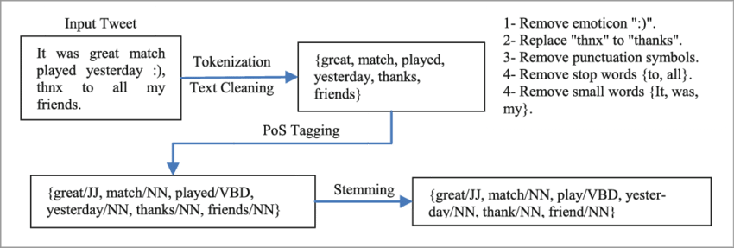
Implementation

Slide 12
Implementation
The contractions has been expanded(short forms and shorthand's) used in the english text using contractions library of python.
The text has been converted into lowercase, and split into word list.
All form of punctuation and stop words from the processed word list has been removed.
All special characters and numbers has been removed from the processed word list.
All non-English words has been from the word list, and then finally convert word list back into text.

Slide 13
Implementation
TF-IDF vectorizer has been used to extract the features from the corpus(processed text) and convert it to word vector.
A separate form of dataset has been created using tokenizer instead of vectorizer.
Stemming has been used to generate another form of formatted data. using a python library, Port Stemmer.
One-hot encoder has been used to encode the words, and then generate the embedding matrix.
At last, we save the 3 format using pickle library of python. We have generated all the format used by common ML and DL algorithms.

Slide 14
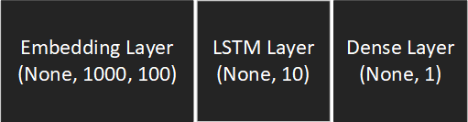
Implementation
Model-1
It is a simple LSTM model with 100 features. We observe that its validation accuracy is 86% though we have the training accuracy 2-3% higher.
There is a good amount of oscillation in the accuracy during training and there is steep change in curve at few points.
We found that simple LSTM model requires a large number of features to converge.

Slide 15
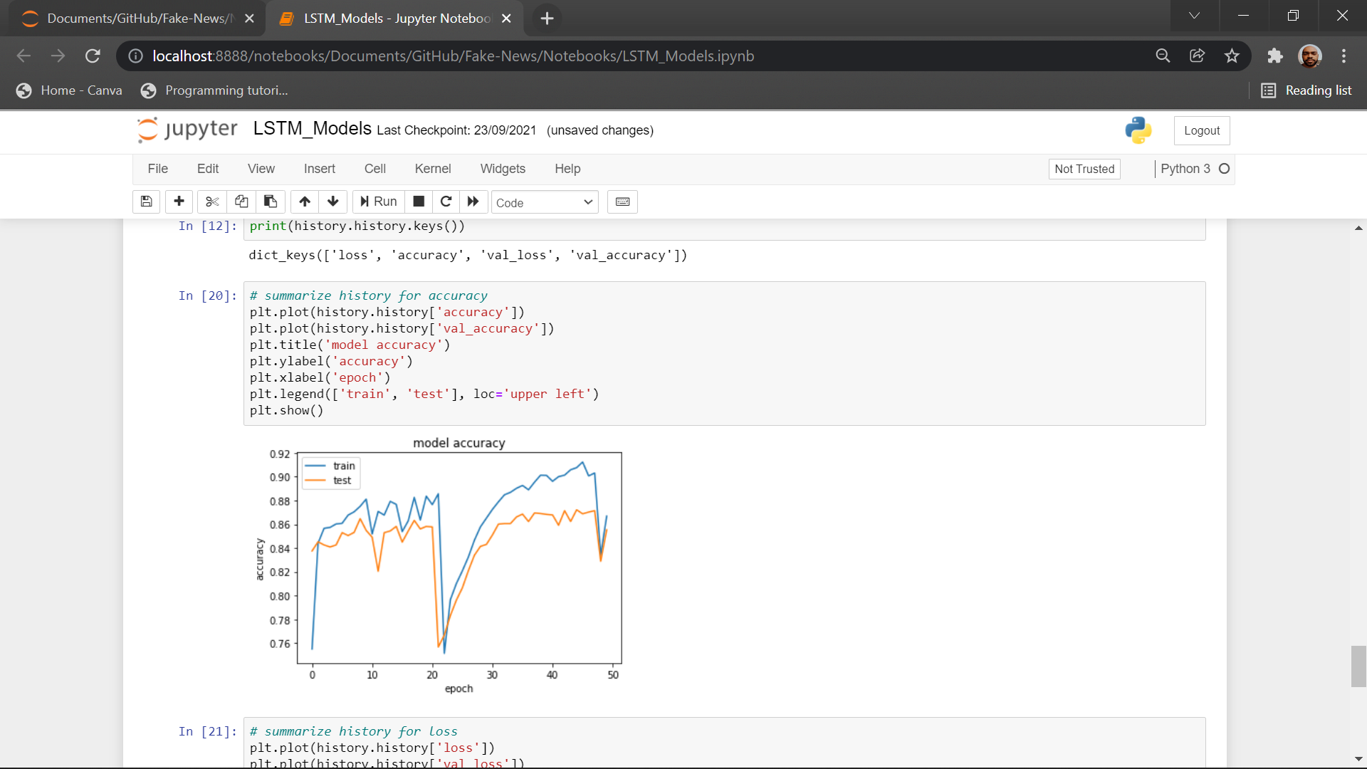
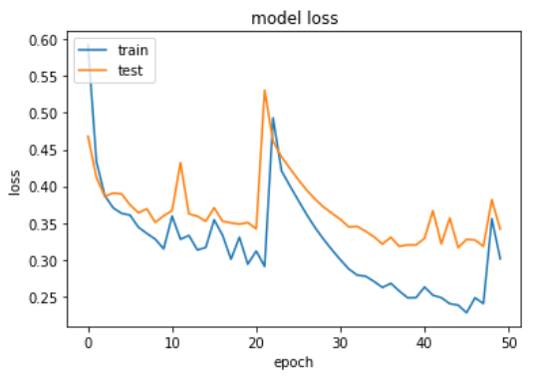
Implementation
Model-1

Slide 16
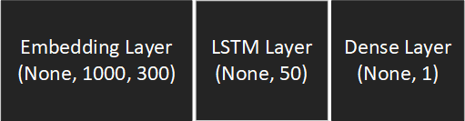
Implementation
Model-2
This is an upgrade of previous model with a greater number of features and neurons.
It has a significant increase in the accuracy but takes a large amount of computation power due to large network.
It proves our previous deduction that simple LSTM models requires a large number features for getting good results.

Slide 17
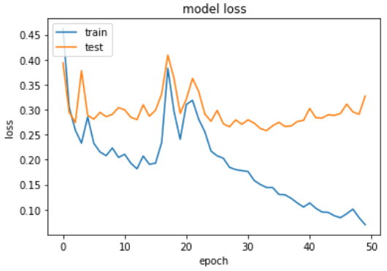
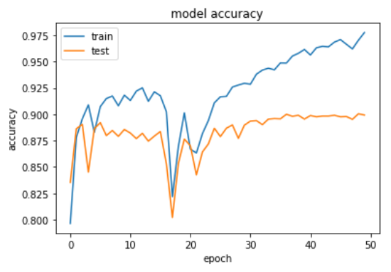
Implementation
Model-2

Slide 18
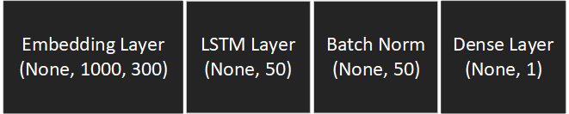
Implementation
Model-3
It is an upgrade of previous model with additional batch normalization layer.
On adding batch normalization, it has boosted the overall accuracy of the previous model.
It is a technique for training very deep neural networks that normalizes the contributions to a layer for every mini-batch.
This has the impact of settling the learning process and drastically decreasing the number of training epochs required to train deep neural networks.

Slide 19
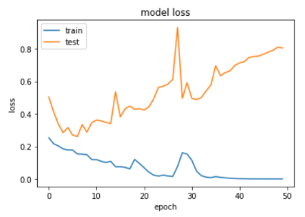
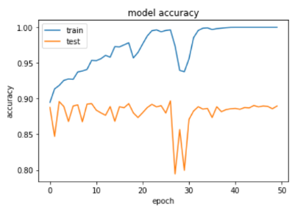
Implementation
Model-3

Slide 20
Implementation
Model-4
It is an upgrade of previous model with additional CNN network.
CNN input the is used for detecting the features and then more refined details is passed to LSTM boosting its accuracy to 91%.
Though we have used batch normalization it is not required that will observe in our final model.

Slide 21
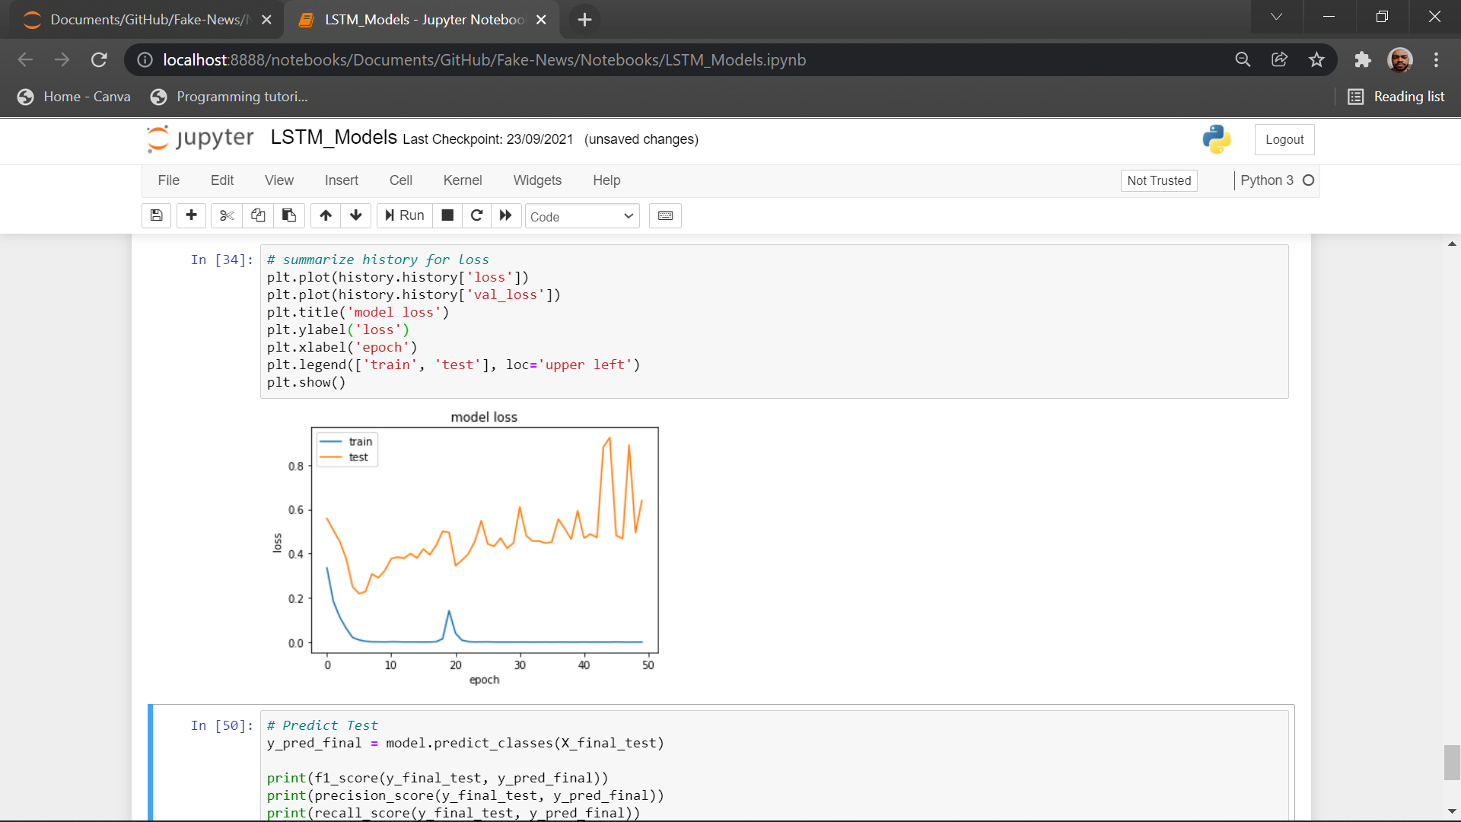
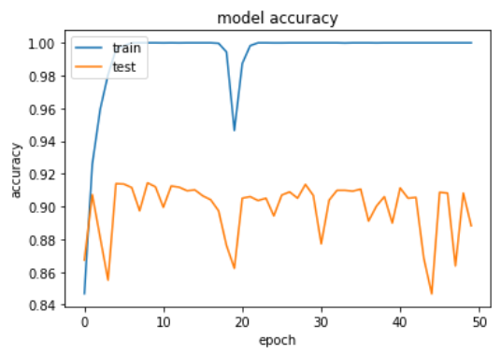
Implementation
Model-4

Slide 22
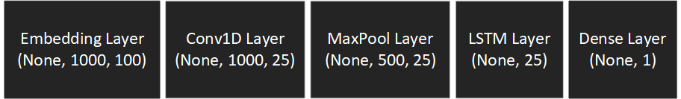
Implementation
Model-5
It is a downgrade of previous model with decrease in number of neurons and features and removal of batch normalization.
We can observe that our final model uses much less computing power and features for same accuracy(as of only LSTM Models).
Batch normalization is not required as the efficiency remains almost same even on removal of it.

Slide 23
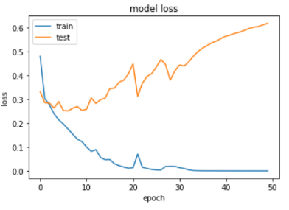
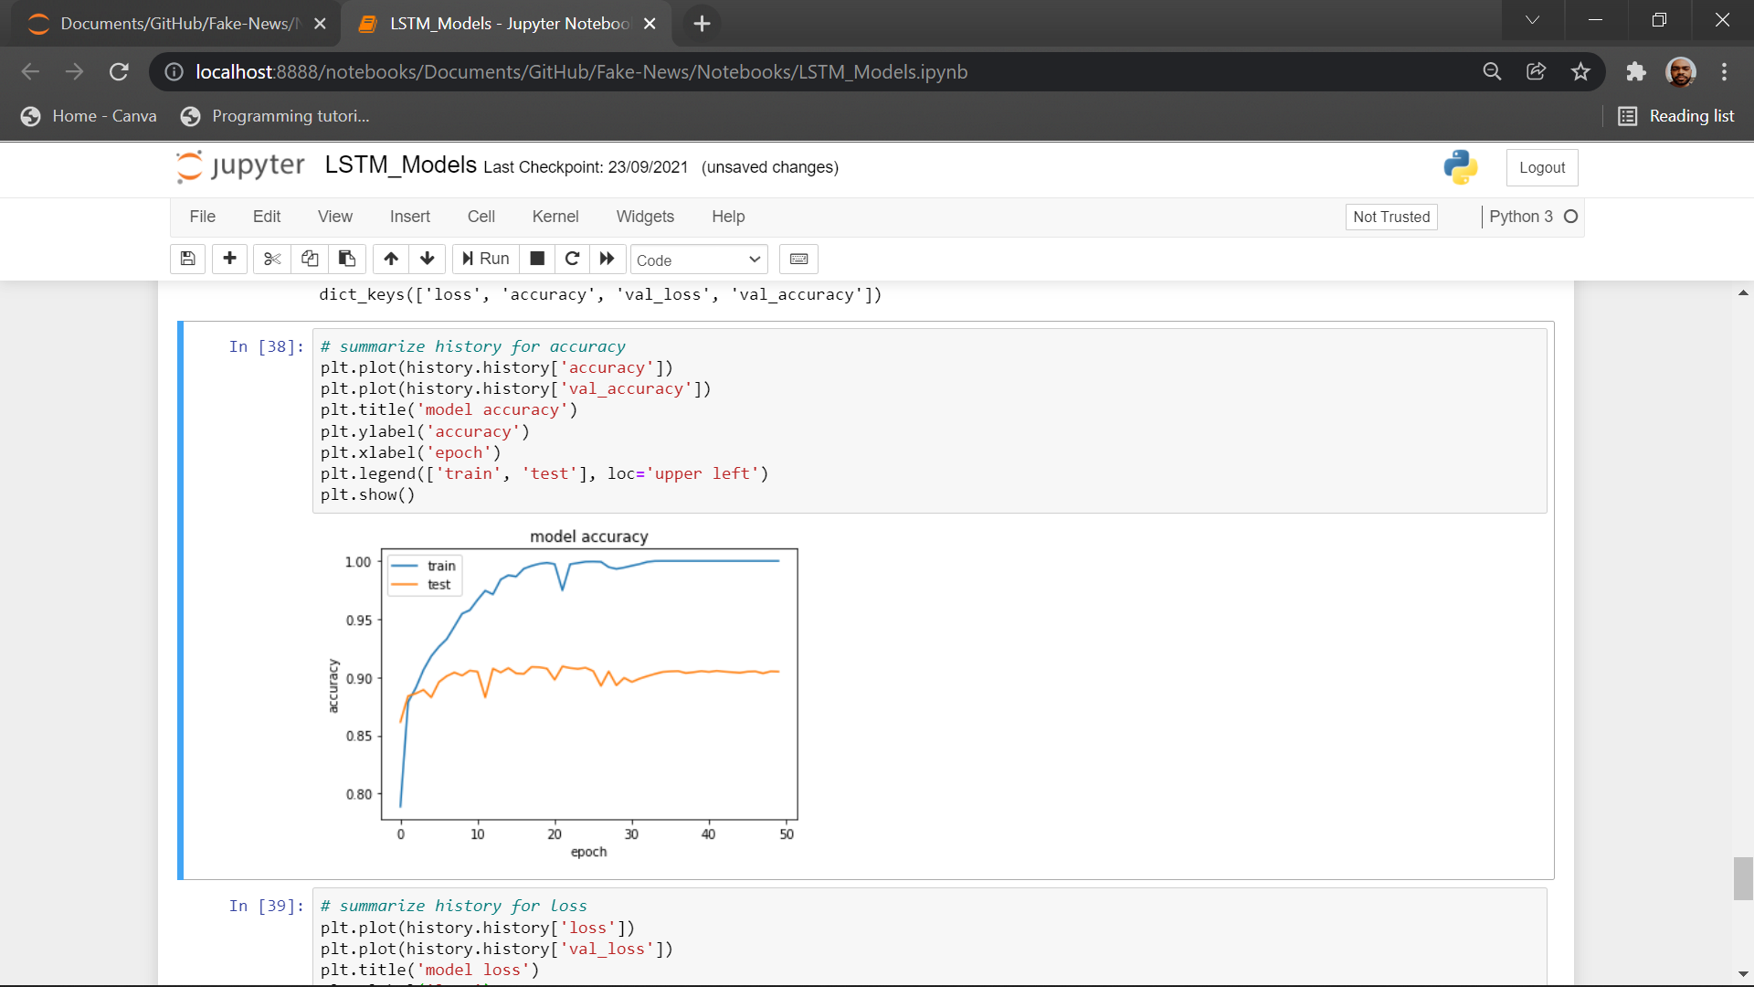
Implementation
Model-5

Slide 24
Implementation
Model-6
The model with attention layer gets a significant improvement on accuracy.
The attention layer decides efficiently about the data model needs to focus more on.
The model is more complex as it uses a greater number of layers than previous ones, but the computational cost for attention layer is less than recurrent layers.
Embedding Layer
(None,700,100)
Conv1DLayer
(None,700,64)
MaxPool layer
(None,350,64)
LSTM
(None,350,128)
Attention
(None,128)
Dense Layer
(None,1)

Slide 25
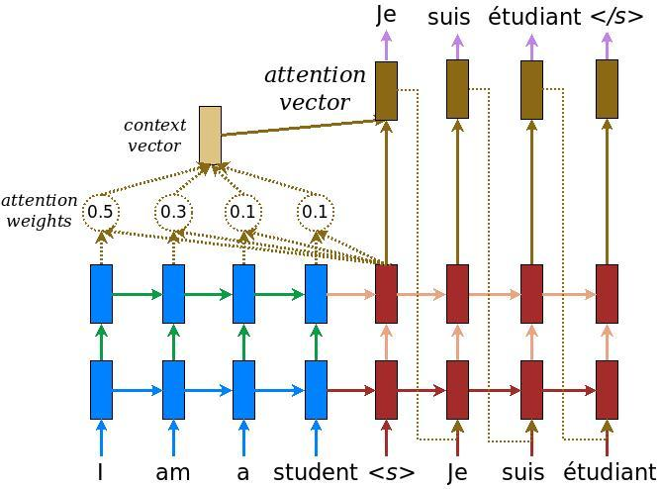
Implementation
Model-6

Slide 26
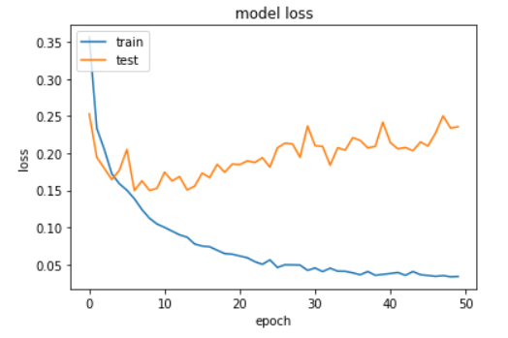
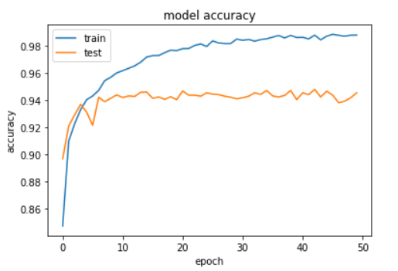
Implementation
Model-6

Slide 27
Implementation
Model-7
Use of XLM-RoBERTa has boosted the accuracy significantly.
XLM models specialize in finding hidden sentiments in the texts which led to the best result.
The model used is a transformer model and takes more RAM and computational cost.

Slide 28
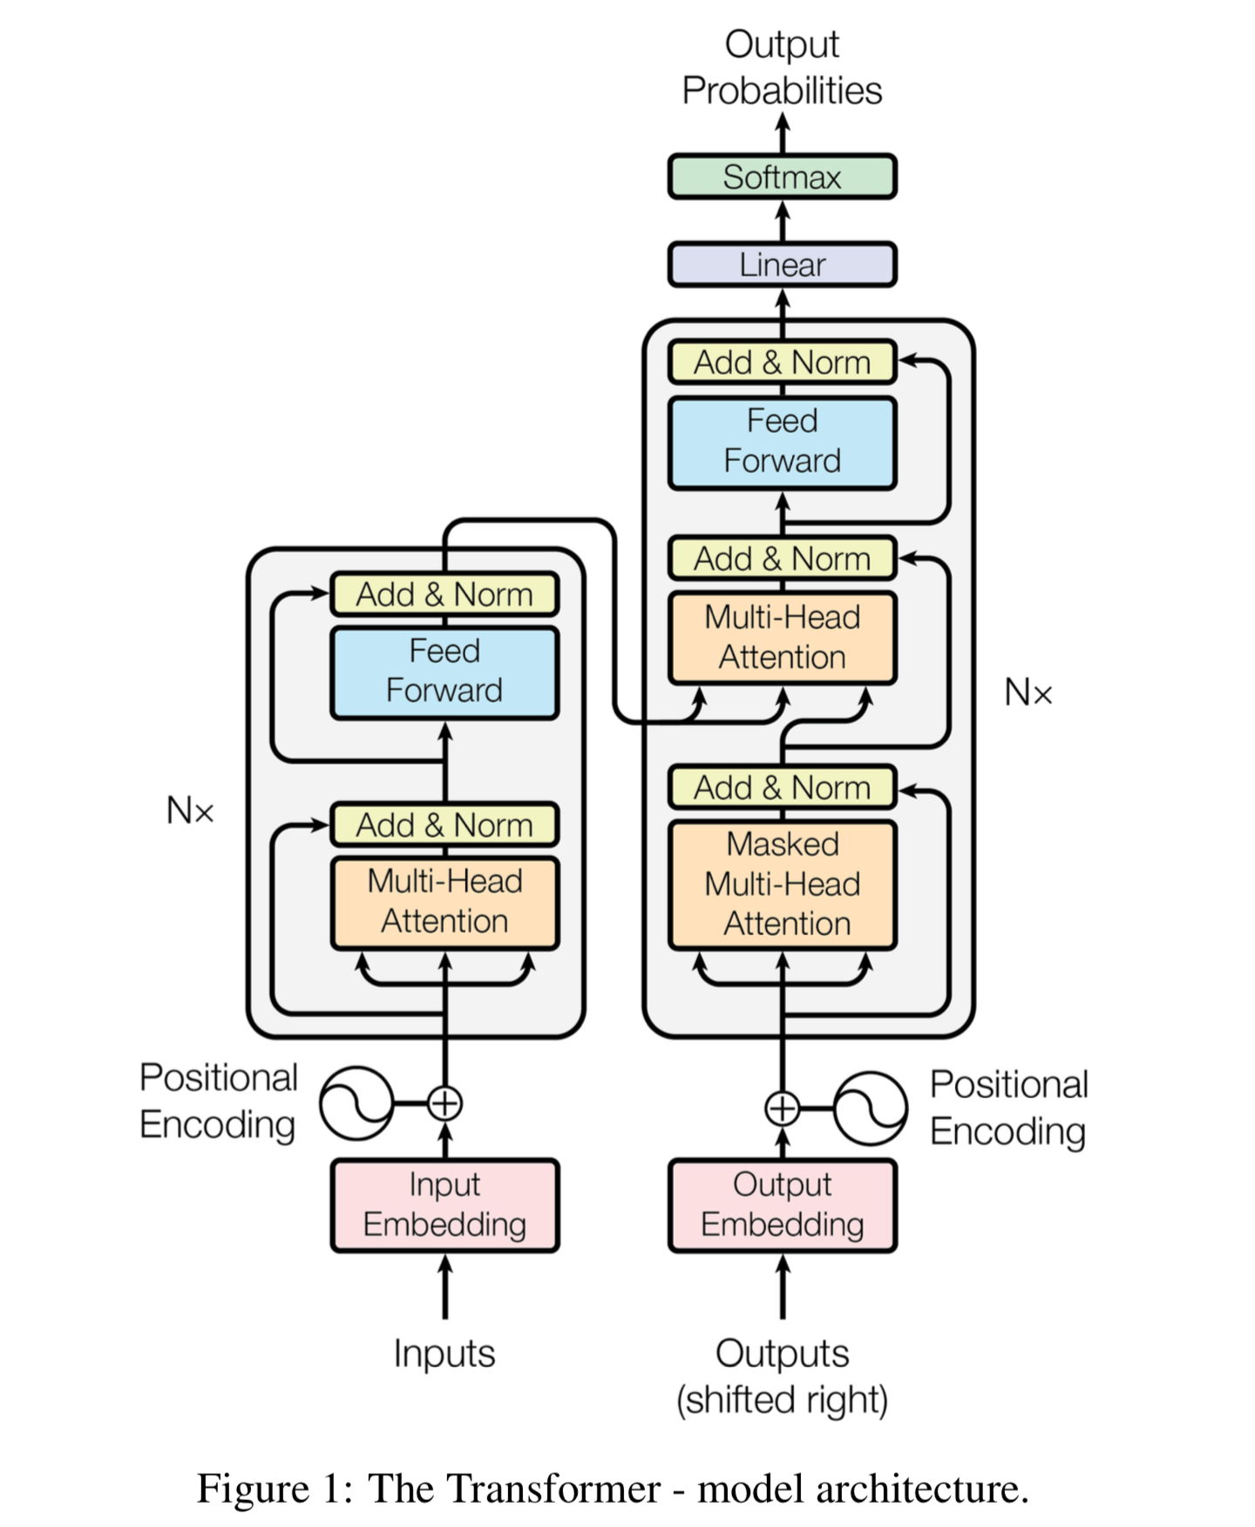
Implementation
Model-7

Slide 29
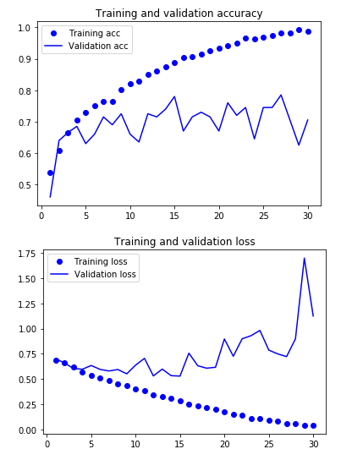
Implementation
Model-7

Slide 30
Result and Analysis
Model | Val. Acc. | Train Acc. | Val. Loss | Train Loss | Test Acc. | Time/Epoch
LSTM only(Model-1) (100 features) | 86% | 88% | 0.30 | 0.35 | 84% | 10s
LSTM only(Model-2) (300 features) | 89% | 94% | 0.12 | 0.26 | 86% | 20s
LSTM only(Model-3) (300 features)(Batch Normalization) | 89% | 98% | 0.50 | 0.10 | 88% | 25s
LSTM + CNN (Model-4) (300 features) (Batch Normalization) | 91% | 99% | 0.50 | 0.05 | 90% | 22s
LSTM + CNN (Model-5) (100 features) | 90% | 99% | 0.45 | 0.05 | 89% | 8s
LSTM + Attention (Model-6) (100 features) | 94% | 99% | 0.20 | 0.04 | 94% | Trained on TPU
XLM-RoBERTa (Model-7) (100 features) | 98% | 99% | 0.16 | 0.02 | 99% | Trained on TPU

Slide 31
Conclusion
In our study we started with simple LSTM models and tested their performance which was proportional to the number of features and the size of network. But still it produced maximum accuracy up to 86%.
We observed that LSTM + CNN models are capable of producing accuracy up to 89% with much smaller network compared to simple LSTM model.
We used RNN + Attention model and found that it has accuracy of about 94%.

Slide 32
Conclusion
While studying attention model further we found that attention model is itself sufficient to give the result.
Then we switched to transformer models which has accuracy up to 99%. In our study we have able to find out how gradually we progressed from LSTM models to transformer models.
Our study will help the future researcher to understand the how these models are derived from its predecessor models and what improved its performance from its predecessor.

Slide 33
Future Work
We are planning to work on detecting fake news shown in form of videos.
We will be using our knowledge of text-based fake news detection and speech to text conversion.
We may develop algorithm to identify the fake speaker in the video and then warn the users against him/her.
We will also work on will contain data pipeline to automate the entire process of fetching data and converting it to required form.

Slide 34
References
[1] Xinyi Zhou and Reza Zafarani. 2020. A Survey of Fake News: Fundamental Theories. https://doi.org/10.1145/3395046
[2] Ayat Abedalla, Aisha AI-Sadi, and Malak Abdullah. 2019. A Closer Look at Fake News Detection. https://doi.org/10.1145/3369114.3369149
[3] Jibran Fawaid, Asiyah Awalina, and Rifky Yunus Krishnabayu . 2021. Indonesia’s Fake News Detection using Transformer Network https://doi.org/10.1145/3479645.3479666
[4] Oluwaseun Ajao, Deepayan Bhowmik, and Shahrzad Zargari. 2018. Fake News Identification on Twitter with Hybrid CNN and RNN Models. https:// doi.org/10.1145/3217804.3217917
[5] S. I. Manzoor, J. Singla and Nikita, "Fake News Detection Using Machine Learning approaches. https://doi.org/10.1109/ICOEI.2019.8862770

Slide 35
References
[6] Zhao, Zhe & Resnick, Paul & Mei, Qiaozhu. (2015). Enquiring Minds: Early Detection of Rumours in social media from Enquiry Posts. 1395-1405. https://doi.org/10.1145/2736277.2741637
[7] Sa, Ahmed & hinkelmann, knut & Corradini, Flavio. (2020). Development of Fake News Model using Machine Learning through Natural Language Processing.
[8] M. Umer, Z. Imtiaz, S. Ullah, A. Mehmood, G. S. Choi and B. -W. On, "Fake News Stance Detection Using Deep Learning Architecture (CNN-LSTM https://doi.org/10.1109/ACCESS.2020.3019735
[9] arXiv:1906.05659 [cs.CL]
[10] M. U. Salur and I. Aydin, "A Novel Hybrid Deep Learning Model for Sentiment Classification. https://doi.org/ 10.1109/ACCESS.2020.2982538

