Slide 1
CF INVENTORY EXPLORER
How to Use — Calculated Field lineage, governance
and tenant replication
One JSON in · Six tabs · Runs entirely in your browser
Author: Prasanna Krishna Reddy Ch
Notes:
Where Data Discovery helps you design new calculated fields, this tool helps you understand, govern and replicate the ones you already have.

Slide 2
OVERVIEW
Five things you can do that Workday cannot
Trace a CF’s full lineage — what it is built from, and every CF built on it, until the chain goes blank
See the blast radius before changing a hub CF
Find dead weight: unused CFs, Do-Not-Use exposure, duplicate definitions
Discover which reports, condition rules and integrations actually consume a CF
Generate a dependency-safe Replication Kit to rebuild a CF in another tenant
A real tenant, at a glance
28,658
14
3,393
212
9,946
Calculated Fields
Levels deep (longest chain)
Safe-delete candidates
Flagged Do Not Use
Distinct consumers
Every number is computed live from the JSON you attach — nothing is hardcoded.
Notes:
These figures come from a real Master CF DDR export and illustrate the scale the tool is built for.

Slide 3
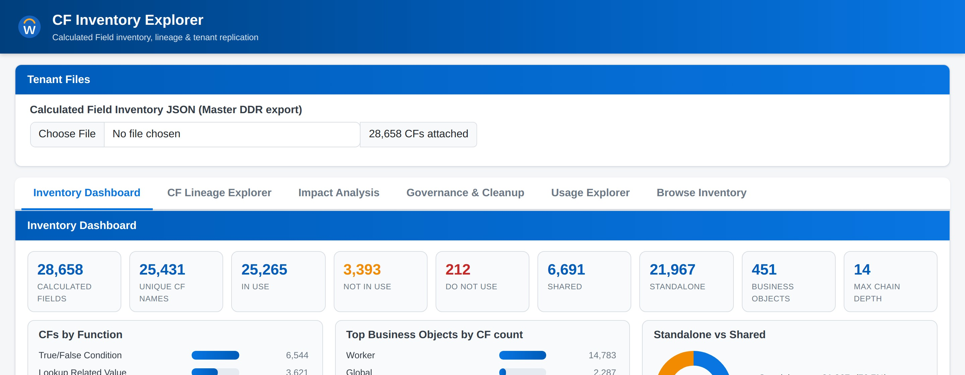
BEFORE YOU START
One file: the Master CF DDR export
What the tool reads
Include the Reference ID column
CF name, Business Object, Function, Field Type
Standard fields used (and any DNU fields among them)
In Use / Do Not Use / Shared flags, description
Where Used — CFs built on this CF (the chain)
Where Used — reports, rules, integrations …
Reference IDs are unique per calculated field, so chains resolve exactly — even when two CFs share a name on different Business Objects.
Without them the tool falls back to name matching, which silently loses branches.
Attach the file once — every tab then works instantly (index build is ~0.2 s on 28,658 CFs).
Notes:
Missing fields degrade gracefully rather than breaking the tool.

Slide 4
THE SIX TABS
Where to go for what
Inventory Dashboard
CF Lineage Explorer
1
2
The tenant at a glance: functions, BOs, in-use, shared, chain depth
One CF: its definition, what it is built from, everything built on it
Impact Analysis
Governance & Cleanup
3
4
What breaks if I change this CF? The full downstream blast radius
Safe-delete candidates, DNU exposure, replication blockers, duplicates
Usage Explorer
Browse Inventory
5
6
Which reports / rules / integrations consume which CFs
Filterable catalogue — the quick answer machine
Notes:
Tabs are independent — switching never reloads the file or loses state.

Slide 5
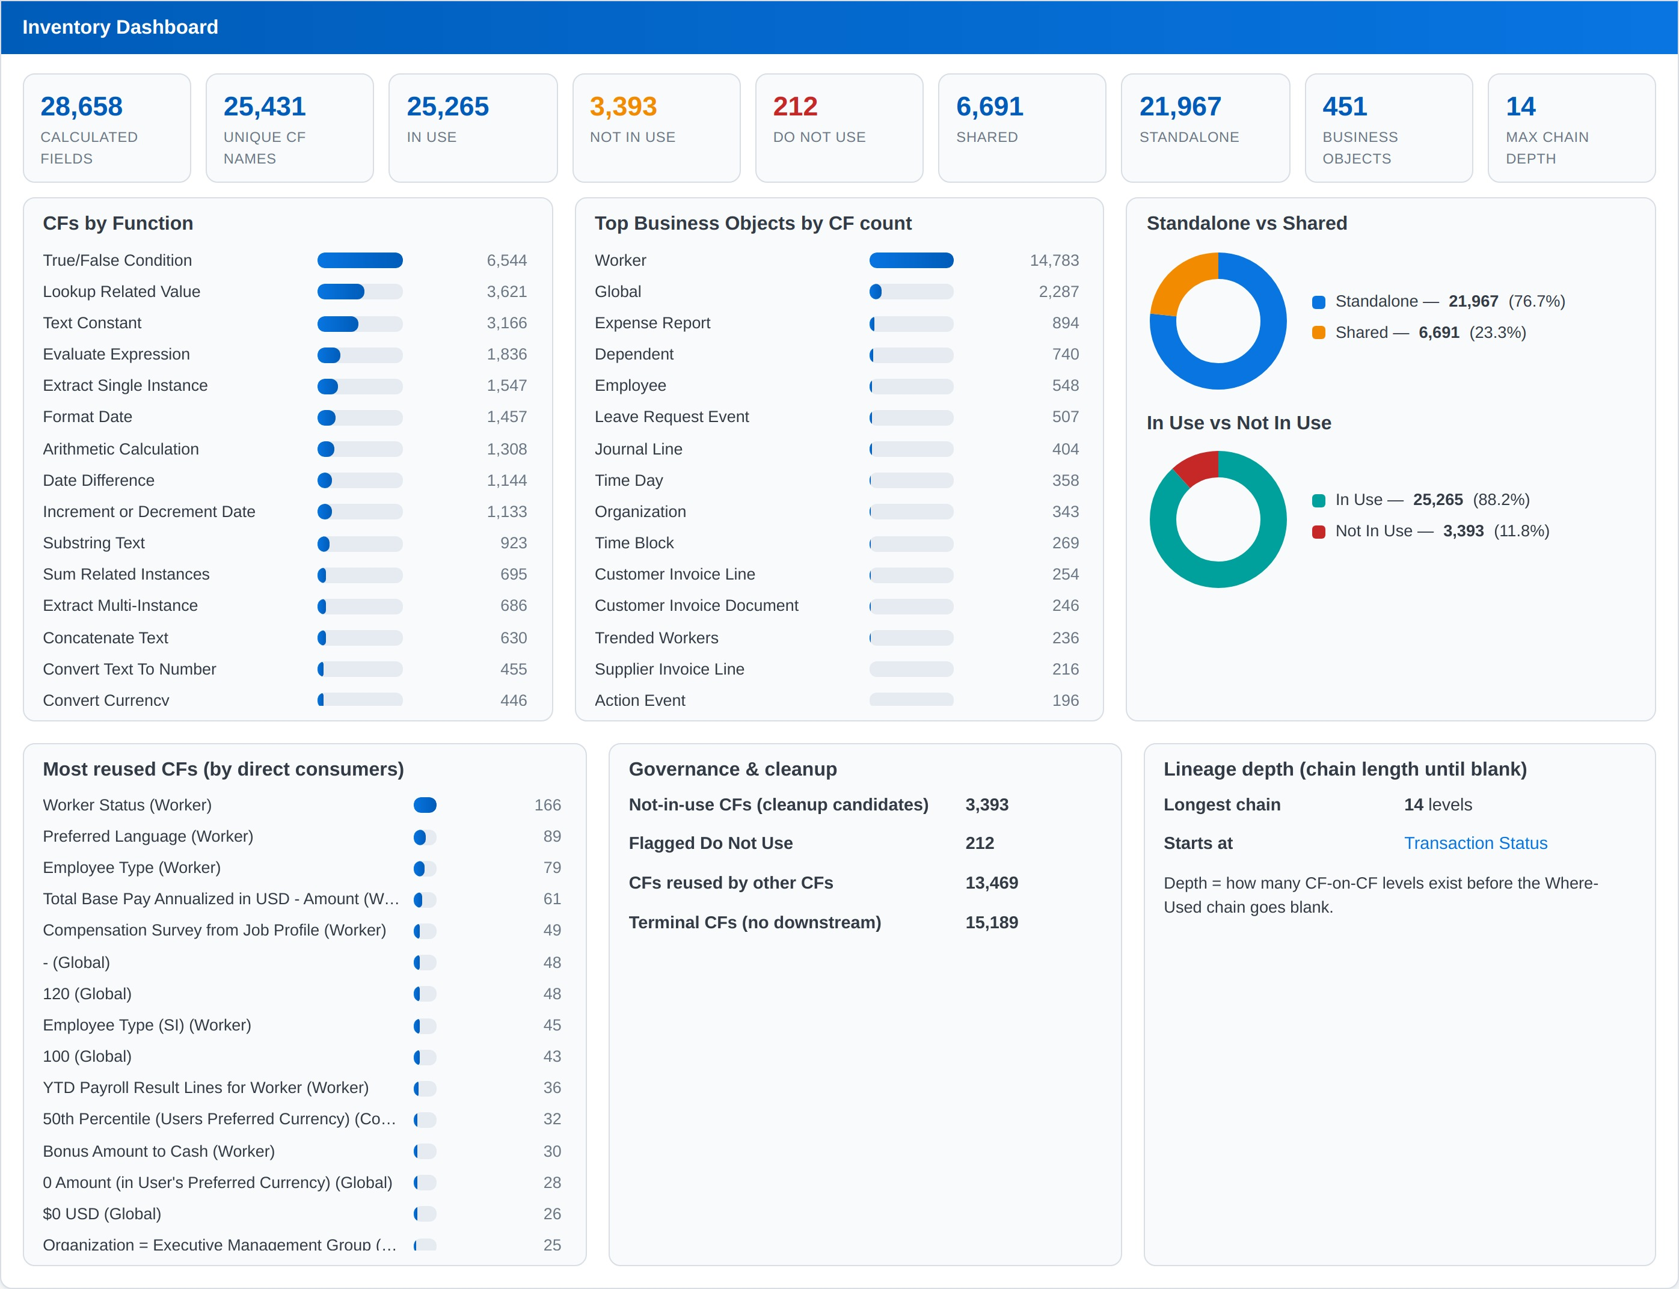
TAB 1
Inventory Dashboard
Read it for
Function mix across all 34 CF functions
Which Business Objects carry the CF load
In-use vs unused, shared vs standalone
Most reused CFs — your hubs
Longest CF-on-CF chain in the tenant
Start here on an unfamiliar tenant. The hubs you see at the top of “Most reused” are the CFs you must never change casually.
Notes:
The dashboard computes on file attach — no button to press.

Slide 6
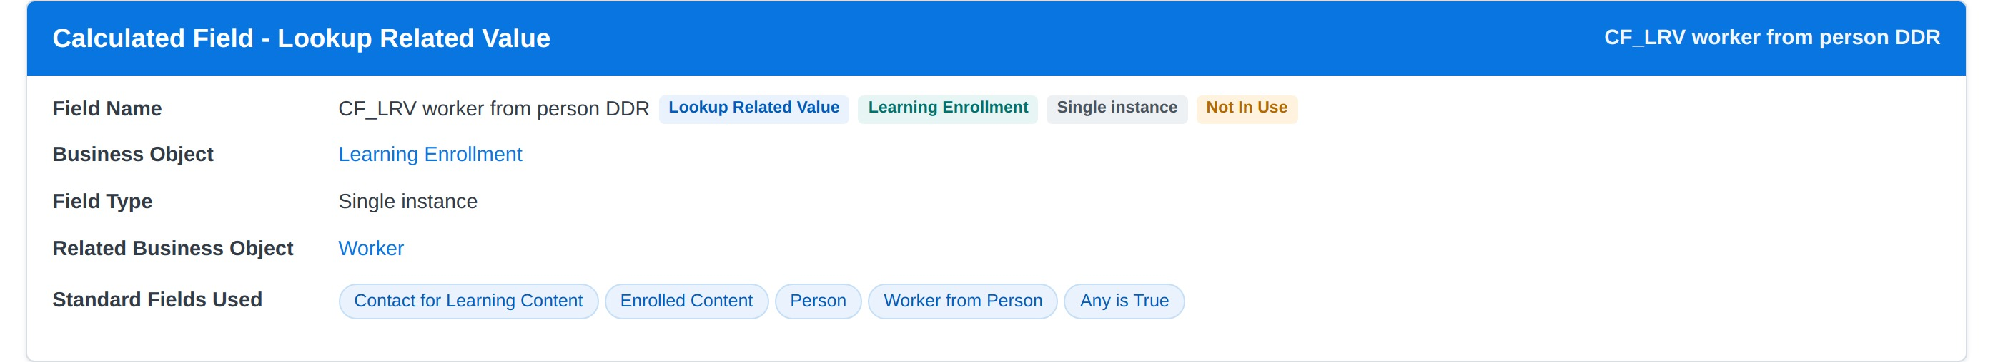
TAB 2
CF Lineage Explorer — the CF itself
Search a CF by name (autocomplete shows its Business Object and function), then click Explore.
The detail card gives you the definition, the standard fields it references, and — crucially — the Used In list: the reports and rules that would break if it changed.
Badges tell the story at a glance
Function · Business Object · Field Type · Shared · Do Not Use · Not In Use — duplicate names each get their own card, resolved by Reference ID.
Notes:
Each record is rendered in the Workday CF page style, so it reads like the tenant.

Slide 7
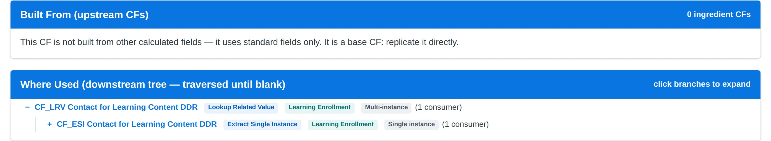
TAB 2
Where Used — the downstream tree
Click any branch to expand its consumers, level by level, until nodes are marked “Terminal — chain ends here”. That is your blank Where-Used: the end of the chain.
Built From
The ingredient CFs this one is made of — the upstream direction
Where Used
Every CF built on this one — expanded on demand, until terminal
Circular references
Detected and flagged rather than looping forever
Notes:
This is the flow the tool was built around: follow the chain until Where-Used goes blank.

Slide 8
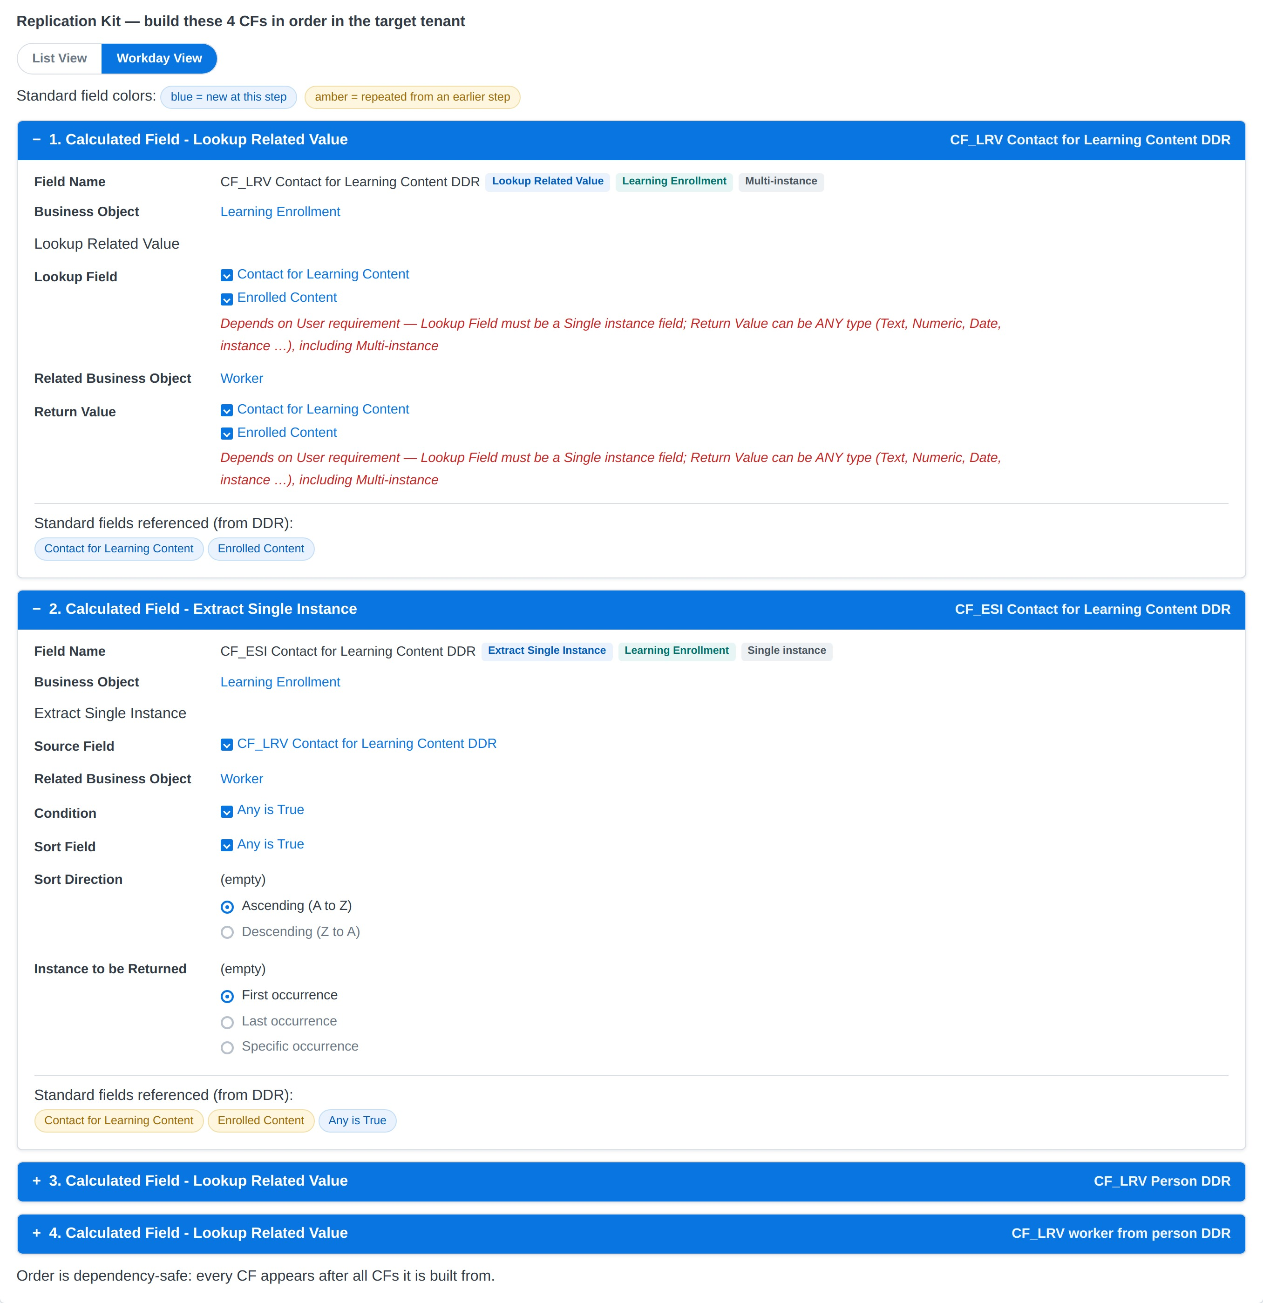
TAB 2
Replication Kit — rebuild a CF in another tenant
Dependency-safe build order
Every CF appears after everything it is built from — work top to bottom in the target tenant.
Two views
List View — compact steps
Workday View — collapsible CF pages, click + to expand
Blue chip = field is new at this step
Amber chip = repeated from an earlier step (inherited from an ingredient CF — already accounted for)
Caution: a scaffold, not a specification
Each function’s design varies with the requirement — the cards will not always be a 100% match. Red “Depends on User requirement” means the export cannot prove it; the tool refuses to guess.
Notes:
The kit is the practical migration artefact: a numbered checklist with each CF rendered as its Workday form.

Slide 9
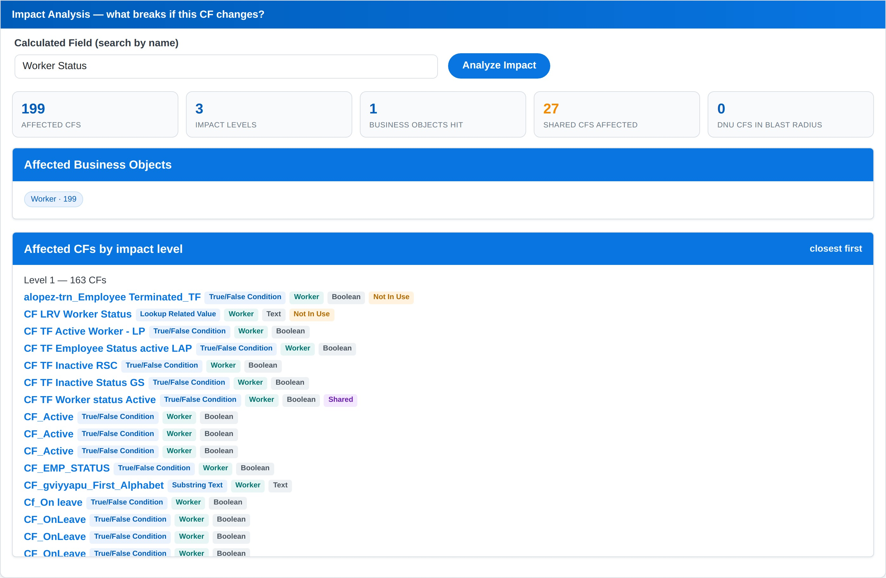
TAB 3
Impact Analysis — what breaks if I change this?
Run this before touching any hub CF. It walks the complete recursive downstream closure and reports affected CFs, impact levels, Business Objects hit, shared CFs, and any Do-Not-Use CFs sitting in the blast radius — then lists every affected CF, closest first.
Notes:
Example: Worker Status affects 199 CFs across 3 levels.

Slide 10
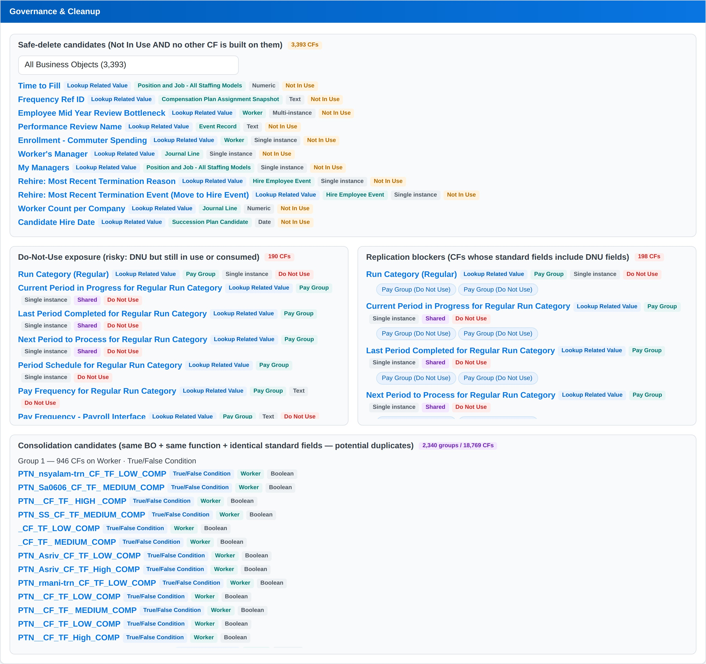
TAB 4
Governance & Cleanup
Safe-delete candidates
Not in use AND nothing is built on them. Filter by Business Object.
Do-Not-Use exposure
Flagged DNU but still in use or still consumed — contradictions worth fixing.
Replication blockers
CFs whose standard fields include DNU fields — these fail in a clean tenant.
Consolidation candidates
Same BO + function + identical field set. Review candidates, not proven duplicates.
Computes on first open — no button to press.
Notes:
Consolidation is a review list: the export has no condition logic, so identical field sets can still differ in conditions.

Slide 11
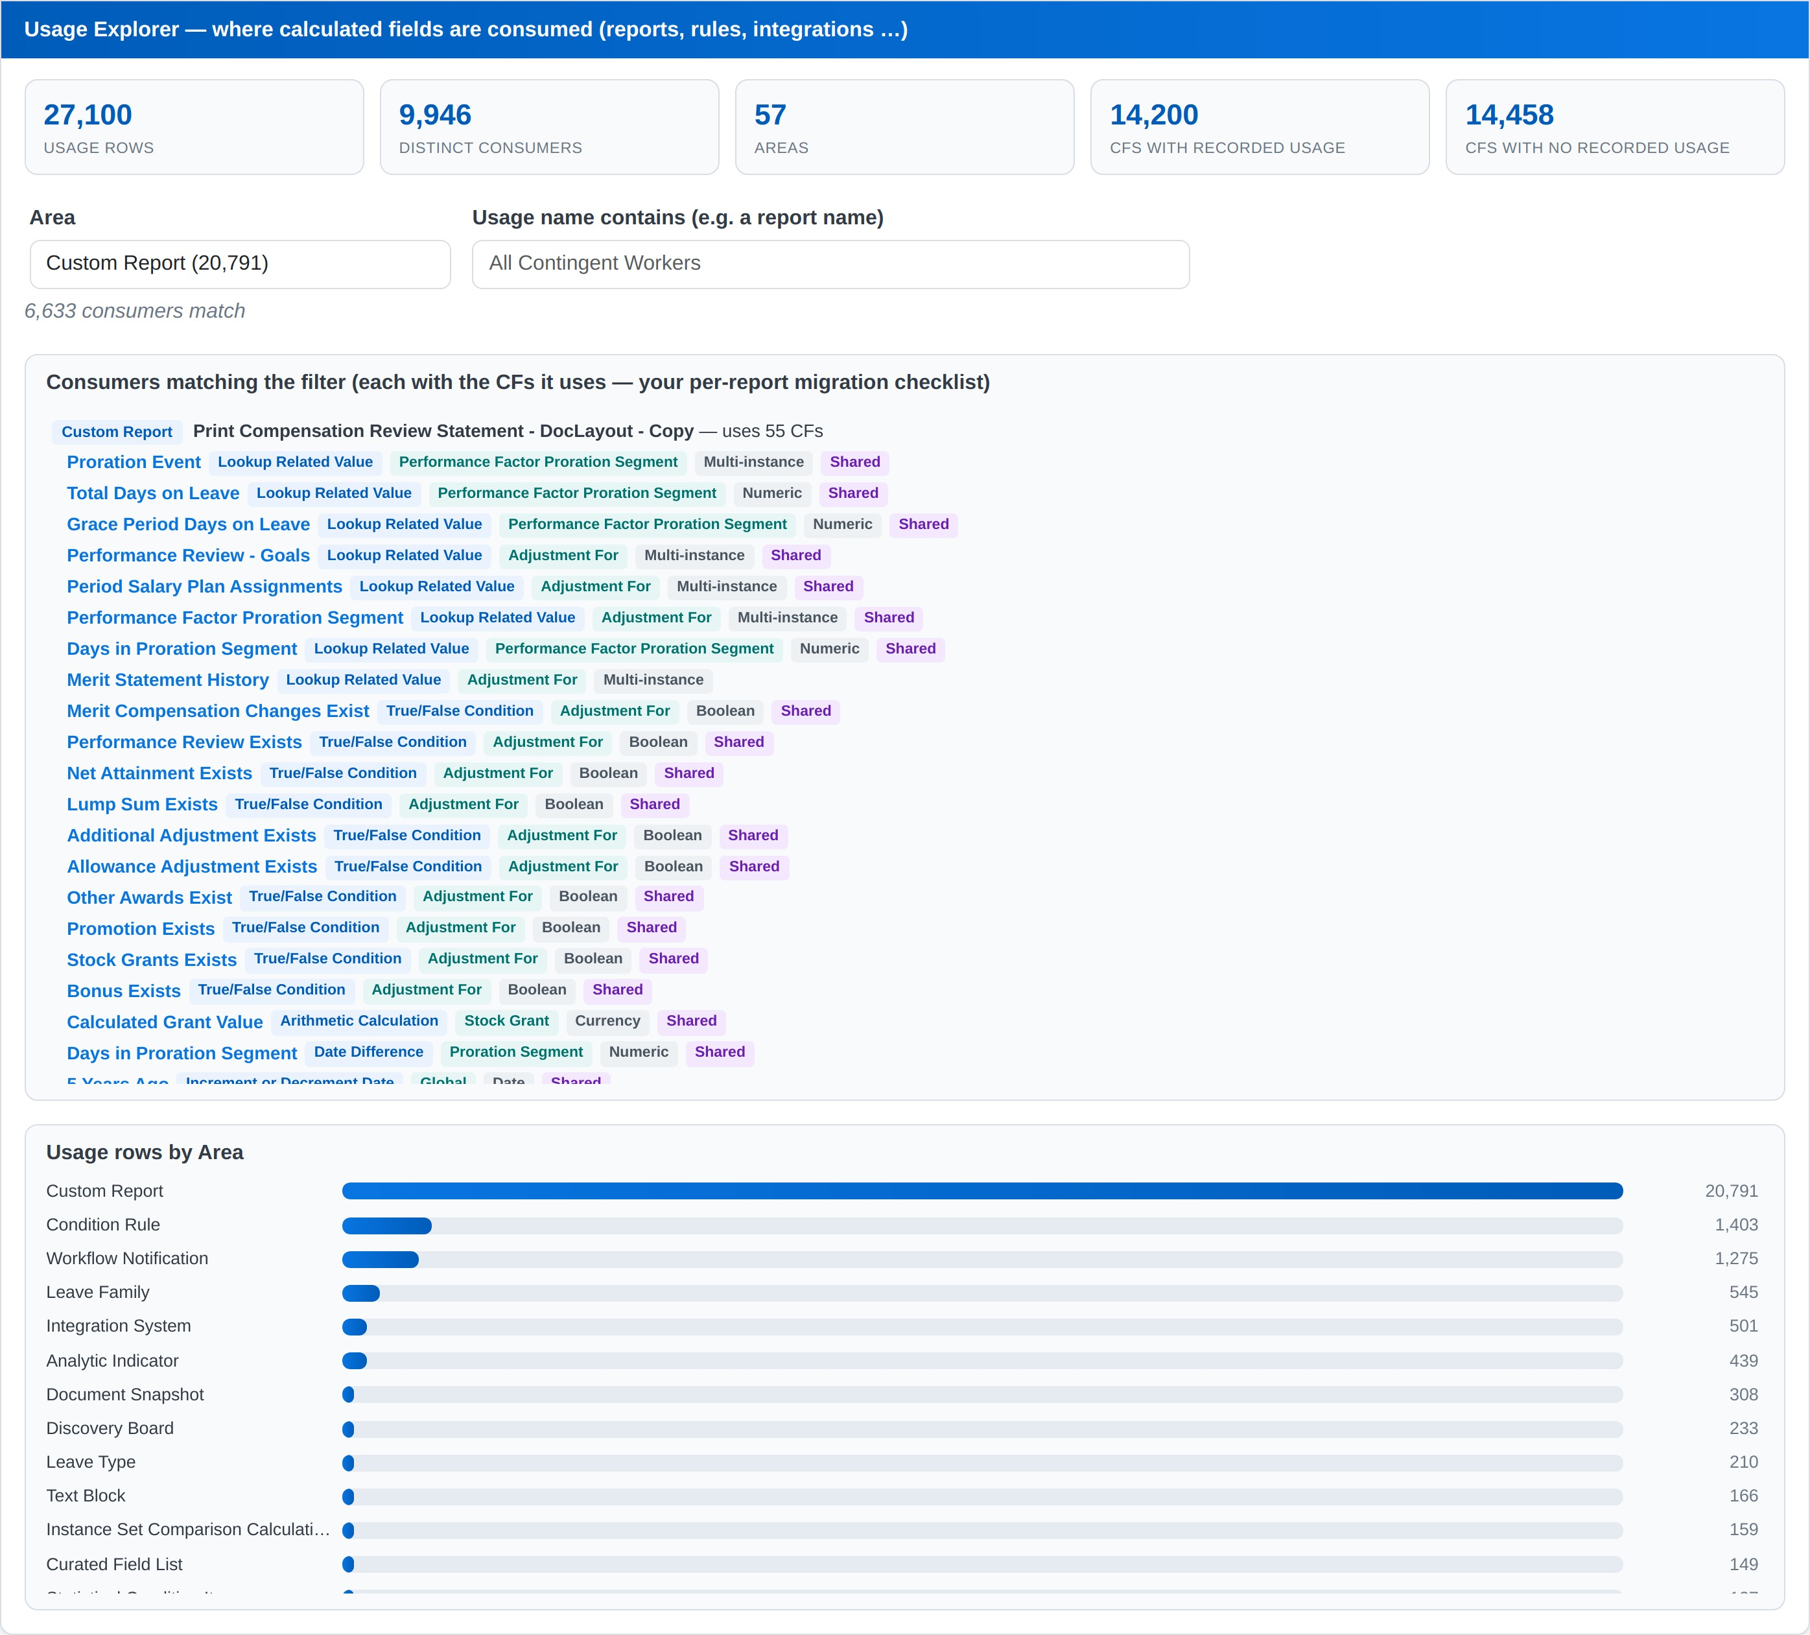
TAB 5
Usage Explorer — per-report migration checklist
Filter by Area (Custom Report, Condition Rule, Workflow Notification, Integration System, Discovery Board …) and search a report name. Each consumer expands to show exactly which CFs it uses — every one clickable straight into Lineage.
Notes:
This is how you scope a report migration: find the report, list its CFs, build a Replication Kit for each.

Slide 12
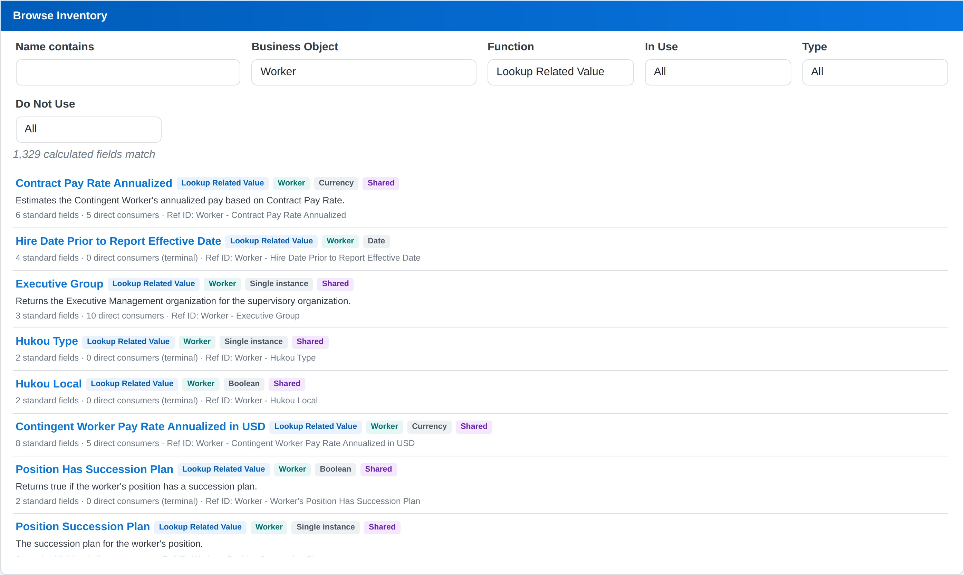
TAB 6
Browse Inventory — the quick answer machine
Filter by name, Business Object, function, In Use, Shared/Standalone and Do Not Use. Each row shows the description, standard-field count, direct-consumer count (with a terminal marker) and the Reference ID — click any name to jump into Lineage.
Notes:
Use it to answer questions like "how many unused CFs sit on Worker?" in seconds.

Slide 13
HOW THE CARDS ARE FILLED IN
Proven facts in blue. Judgment calls in red.
1
The previous CF fills the Source / Lookup Field
That is how Workday chains work — each CF consumes the one before it.
2
Boolean CFs and “Any is True” fields go to Condition
Never to Source or Return. For ESI they also fill the Sort Field.
3
Return Value is the CF’s own new field
Its standard fields minus everything inherited from its ingredients — the blue chips.
4
LRV Lookup must be Single instance
A Multi-instance field can only be a Return Value. Return Value itself may be any type.
5
What cannot be proven stays red
Operators, formats, thresholds, ambiguous pairs: shown with the governing rule, never guessed.
6
Always review before you build
Function designs vary by requirement. The kit is a scaffold that removes the guesswork — it is not a 100% match to the CF you must create.
Full detail: CF-Inventory-Explorer_User_Guide.md · Author: Prasanna Krishna Reddy Ch
Notes:
A wrong slot assignment silently breaks a build in the target tenant; a red line costs ten seconds of judgment. That trade-off drives the whole design.

