Slide 1
PRASANNA M
NMID: DA399B9D34973FE8CED49232A34041C9
Course : Generative AI for Engineering (E2324)
Madras Institute of Technology Campus, Anna University
Enhancing Graduate Admissions Prediction: A Transparent Approach with Support Vector Regression
Final Project :

Slide 2
PROJECT TITLE
Enhancing Graduate Admissions Prediction: A Transparent Approach with Support Vector Regression

Slide 3


AGENDA
Objective:
Develop a predictive model using Support Vector Regression (SVR) to estimate admission probabilities for prospective graduate students applying to different university classes.
Approach:
Utilize SVR to capture complex relationships between input features and admission probabilities.
Incorporate diverse input features including GRE scores, TOEFL scores, institutional class rankings, ratings for subjective components, and CGPA.
Outcome:
Empower prospective students with personalized insights for informed decision-making.
Enhance transparency and fairness in admissions.
Foster collaboration with stakeholders to ensure the model remains relevant and responsive to end users' needs.

Slide 4

PROBLEM STATEMENT
In the complex landscape of graduate admissions, this project aims to develop a predictive model using Support Vector Regression (SVR) to estimate the probability of admission to different university classes. Leveraging input features such as GRE and TOEFL scores, institutional class rankings, ratings for subjective components like statements of purpose and letters of recommendation, and CGPA, the model seeks to provide a comprehensive understanding of admission probabilities. By offering transparency and insights into the holistic evaluation process, the project aims to empower prospective students to make informed decisions and shed light on the role of institutional prestige and subjective evaluations in shaping admission outcomes.

Slide 5

PROJECT OVERVIEW
Objective: Develop an innovative approach to predict graduate admissions probabilities for prospective students applying to different university classes.
Challenges: Traditional admission models often rely solely on quantitative metrics, providing limited insight into the holistic evaluation process undertaken by universities.
Approach: Incorporate additional input features such as ratings for subjective components (statements of purpose, letters of recommendation) and institutional class rankings.
Modeling Technique: Utilize Support Vector Regression (SVR) algorithm to build a predictive model that estimates the probability of admission based on diverse input features.
User Interface: Develop a user-friendly interface for self-assessment, enabling prospective students to gauge their admission likelihood and make informed decisions about where to apply.

Slide 6
PROJECT OVERVIEW - CONT
Objectives:
Evaluate the role of subjective components in admissions decisions.
Identify underrepresented applicant groups and assess institutional class ranking impact.
Compare predictive models and conduct longitudinal analysis of admission trends.
Impact:
Enhance fairness, transparency, and accessibility in the graduate admissions process, providing valuable insights and guidance for prospective students navigating the higher education landscape.

Slide 7

WHO ARE THE END USERS?
1. Prospective Graduate Students:
Objective: Seeking clarity and guidance regarding admission chances.
Usage: Input academic credentials to receive personalized admission probability estimates.
Benefit: Make informed decisions about where to apply, enhancing overall admissions experience.
2. University Admissions Committees:
Objective: Understand factors influencing admission decisions.
Usage: Gain insights from application data and predictive model outputs.
Benefit: Refine evaluation criteria for fairer and more transparent admissions processes.

Slide 8
WHO ARE THE END USERS? - CONT
3. Academic Advisors:
Objective: Provide tailored guidance to students.
Usage: Utilize predicted admission probabilities to offer personalized advice.
Benefit: Assist students in making strategic decisions about their academic futures.
4. Policymakers:
Objective: Promote diversity, equity, and transparency in admissions.
Usage: Leverage findings to inform policy decisions.
Benefit: Develop initiatives that enhance inclusivity and fairness in higher education.

Slide 9
YOUR SOLUTION AND ITS VALUE PROPOSITION
Develop a predictive model using Support Vector Regression (SVR) to estimate admission probabilities for prospective graduate students.
Value Proposition:
Personalized Insights: Empower prospective students to make informed decisions about where to apply based on their unique academic credentials and institutional preferences.
Transparency and Fairness: Enhance transparency in the admissions process by providing clear and interpretable insights into admission probabilities, promoting fairness and equity.
Holistic Evaluation: Capture the holistic nature of admissions decisions by incorporating subjective components such as statements of purpose and letters of recommendation, along with traditional metrics.
User-Friendly Interface: Offer a user-friendly interface for easy input of academic credentials and seamless access to personalized admission probability estimates.

Slide 10

THE WOW IN YOUR SOLUTION
This project innovates upon existing admission prediction models by introducing additional input features, including ratings for statements of purpose and letters of recommendation, and employing a Support Vector Regression (SVR) approach to estimate the probability of admission to different university classes. Unlike traditional models that only classify admission outcomes, this approach provides a nuanced understanding of admission probabilities, empowering prospective students with more transparent and actionable insights into their chances of acceptance.
10

Slide 11
MODELLING
Support Vector Regression (SVR):
Utilize SVR, a powerful machine learning technique for regression tasks, to build the predictive model.
SVR is well-suited for capturing complex relationships between input features and admission probabilities, particularly in cases of non-linear data.
Input Features:
Incorporate a diverse set of input features including:
Quantitative metrics: GRE scores, TOEFL scores, and CGPA.
Qualitative ratings: Statements of purpose and letters of recommendation.
Institutional class rankings.
These features provide a comprehensive overview of applicants' academic credentials and subjective evaluations.
Data Preprocessing:
Handle missing values, scale numerical features, and encode categorical variables as necessary to prepare the data for modeling.
Explore techniques for feature selection and dimensionality reduction to improve model performance and interpretability.
11

Slide 12
MODELLING
Model Training and Tuning:
Train the SVR model using the preprocessed data, optimizing hyperparameters to maximize prediction accuracy.
Utilize cross-validation techniques to assess model performance and ensure robustness.
Evaluation Metrics:
Evaluate model performance using appropriate regression metrics such as Mean Squared Error (MSE), R-squared (R²), and Mean Absolute Error (MAE).
Compare the SVR-based model against baseline models and alternative machine learning approaches to assess relative performance.
12

Slide 13
RESULTS
Improved Decision-Making for Prospective Students: By providing personalized admission probability estimates, the project empowers prospective graduate students to make informed decisions about where to apply. This can lead to more strategic application strategies and increased likelihood of acceptance at desired institutions.
Enhanced Transparency and Fairness in Admissions: The project sheds light on the holistic nature of admissions decisions by incorporating subjective evaluations and institutional prestige into the prediction model. This promotes transparency and fairness in the admissions process, ensuring that all applicants are evaluated comprehensively and equitably.
Identification of Underrepresented Applicant Groups: Analysis of admission probabilities across demographic and socioeconomic categories can help identify underrepresented applicant groups. This information can inform targeted interventions and policies aimed at promoting diversity and equity in graduate admissions.
Insights for Admissions Committees and Academic Advisors: The predictive model provides valuable insights for admissions committees and academic advisors, enabling them to better understand factors influencing admission decisions and offer tailored guidance to prospective students.
13

Slide 14
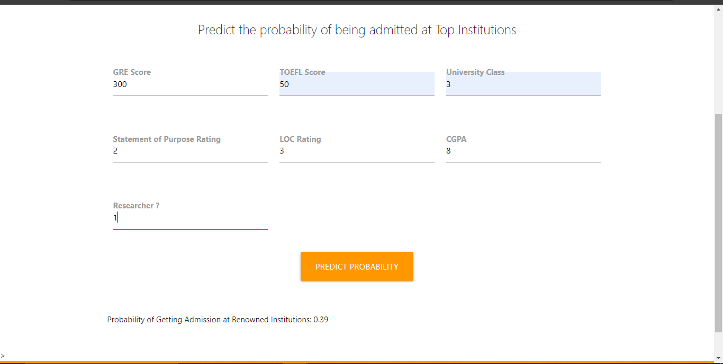
RESULTS - CONT
PREDICTED PROBABILITY OF GETTING ADMISSION IN PARTICULAR
UNIVERSITY CLASS
14

Slide 15
THANK YOU

