Slide 1
Template Usage + Style Guide
October 2025 (UPDATED)

Slide 2
Agenda
Template Usage Guide
Style Guide
Light vs Dark Template
Getting Started
Guides
Using Type Tools
Image Formatting
Theme Layouts
Theme Colors
Importing External Slides
GSheet Charts
Spell Check
4
5
6
7
8
9
10
11
12
13
Logo
Typography
Type Sizing
Color Palette
Photography
Highlights
Iconography
Resources
14
15
16
17
18
19
20
21
‹#›

Slide 3
Template Usage Guide
‹#›

Slide 4
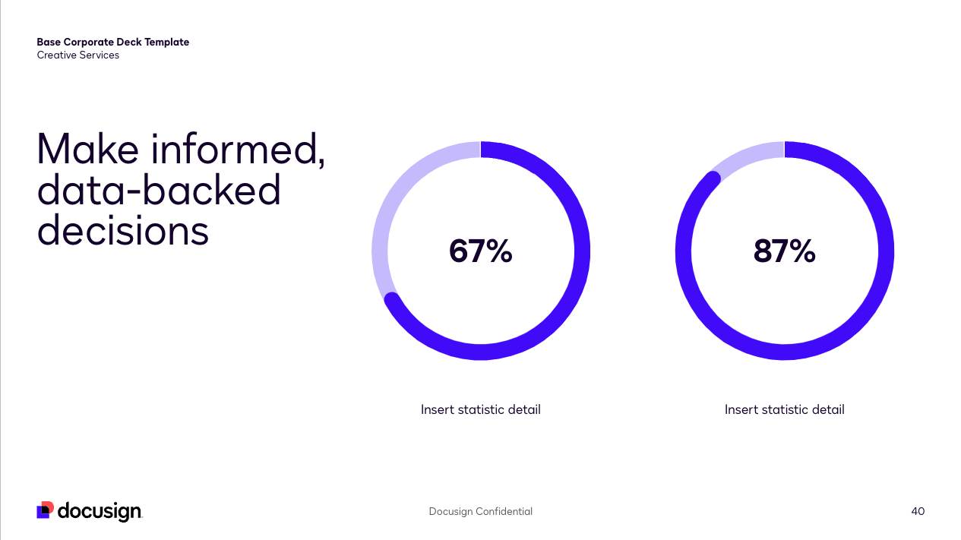
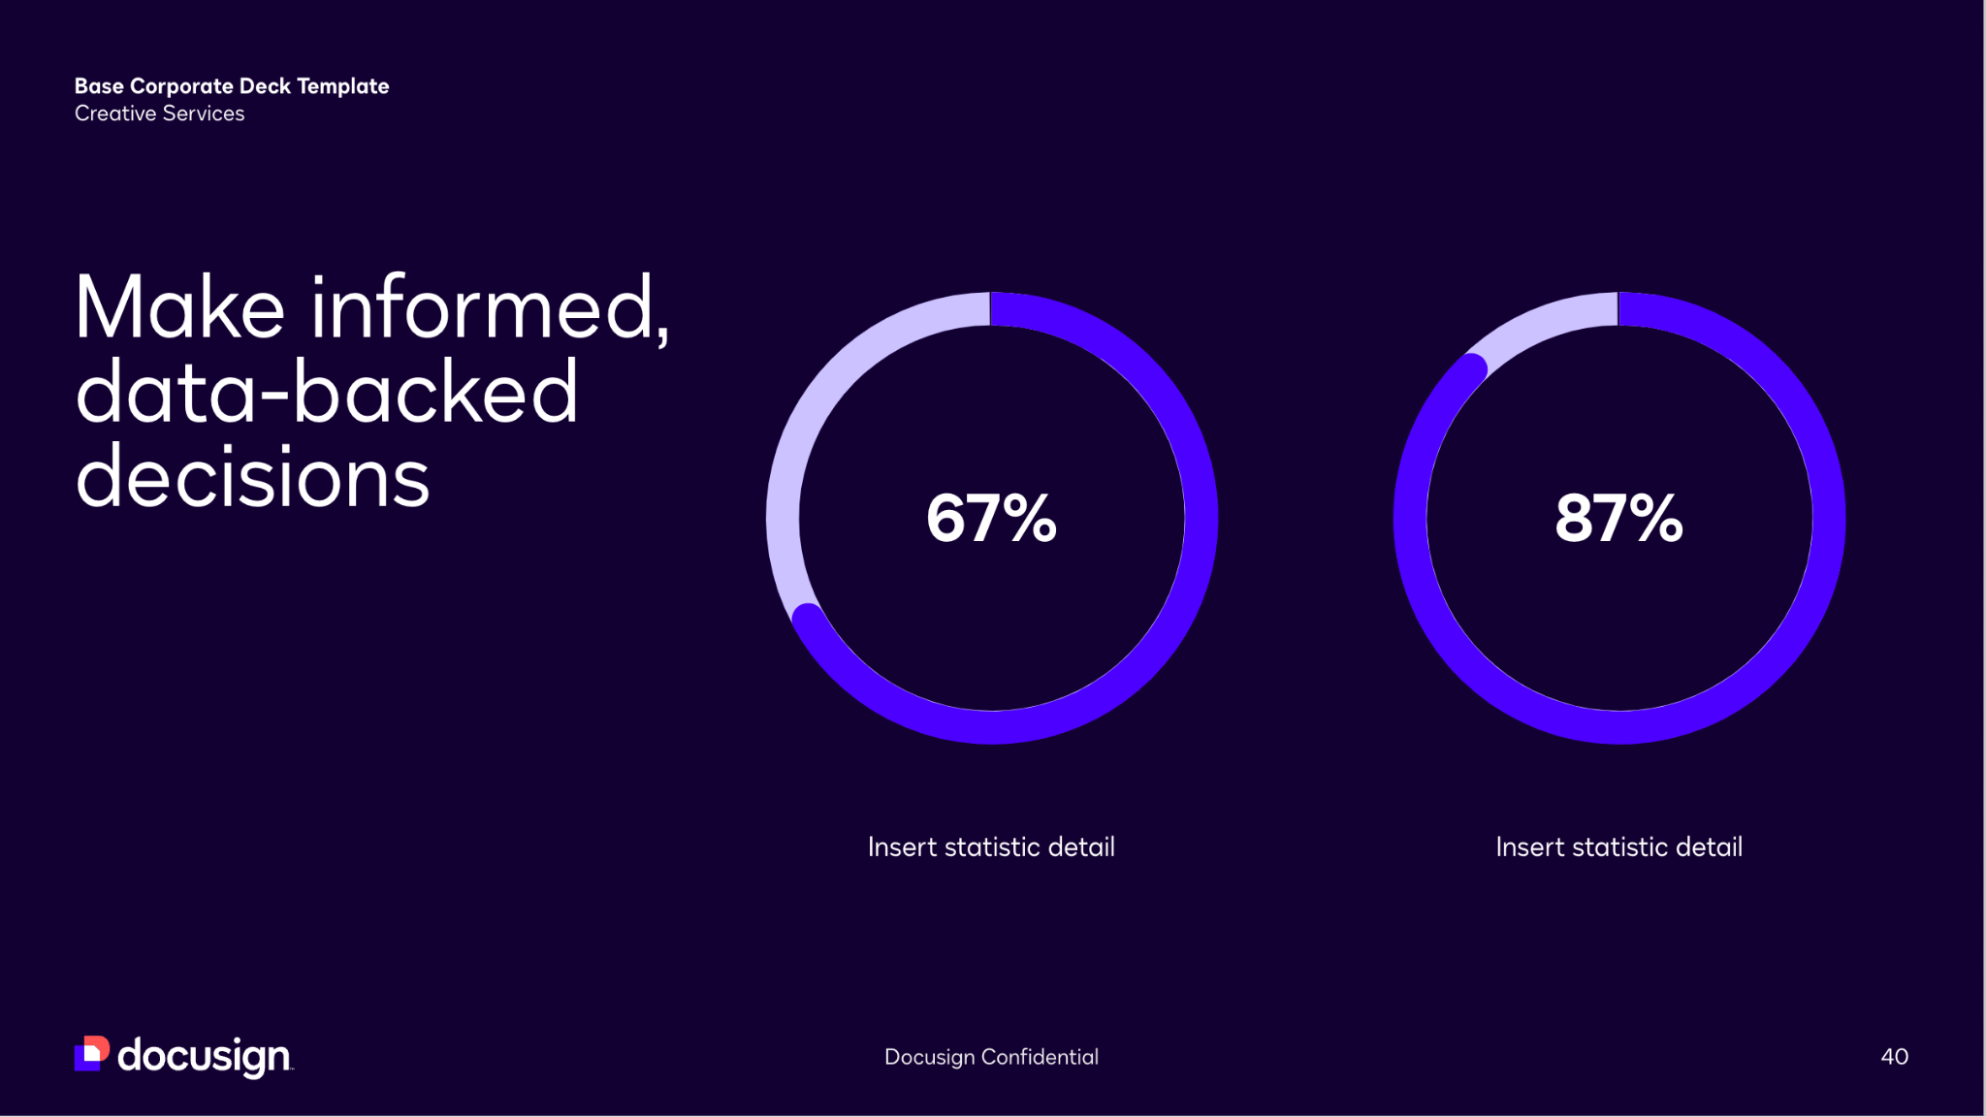
When to use light vs dark template
Light and bright
Light themes are clean, professional, and inviting. They work great for smaller, well-lit presentation settings such as virtual meetings, classrooms, meeting rooms, and webinars.
Dark and impactful
Unlike its light counterpart, black is a low-energy color and works especially well for (but not limited to) large presentation screens. Dark backgrounds are dramatic and confident – this can pack a powerful punch in keynote and executive-level presentations.
Our template comes in both light and dark versions. Although there are a myriad of reasons into which version might be better suited it boils down to your presentation setting and audience. We’ll address general use-cases and which template may work best for your presentation purposes.
‹#›

Slide 5
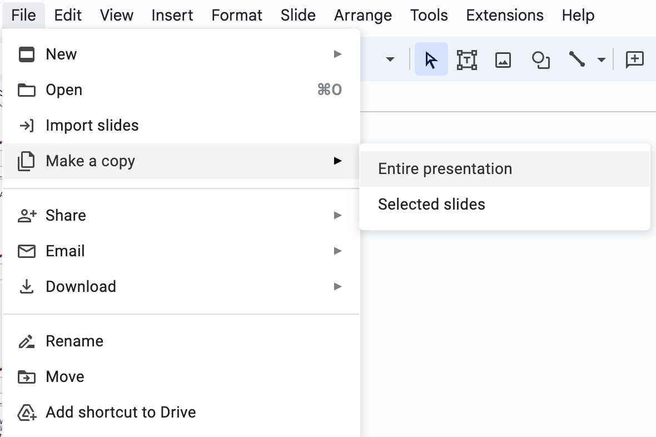
Getting started
Make your own copy
Go to File > Make a copy to create a duplicate of this template that you can edit.
Customize the deck slides
This deck is designed to create engaging presentations. Fit the content to your presentation needs. Please keep the slide content short and digestible.
‹#›

Slide 6
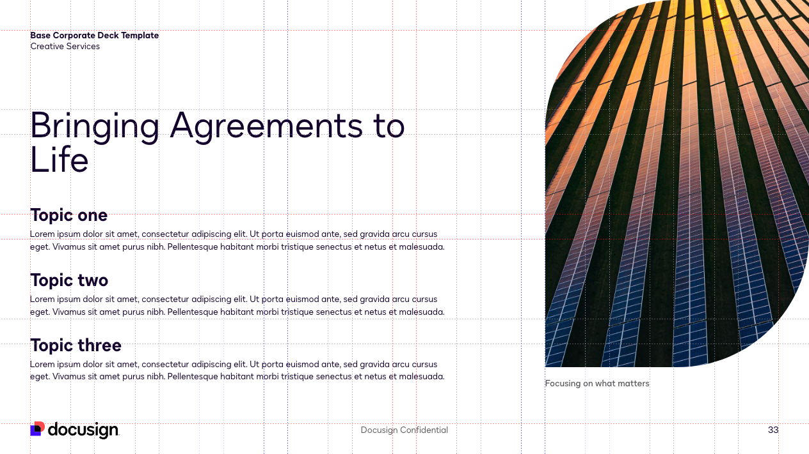
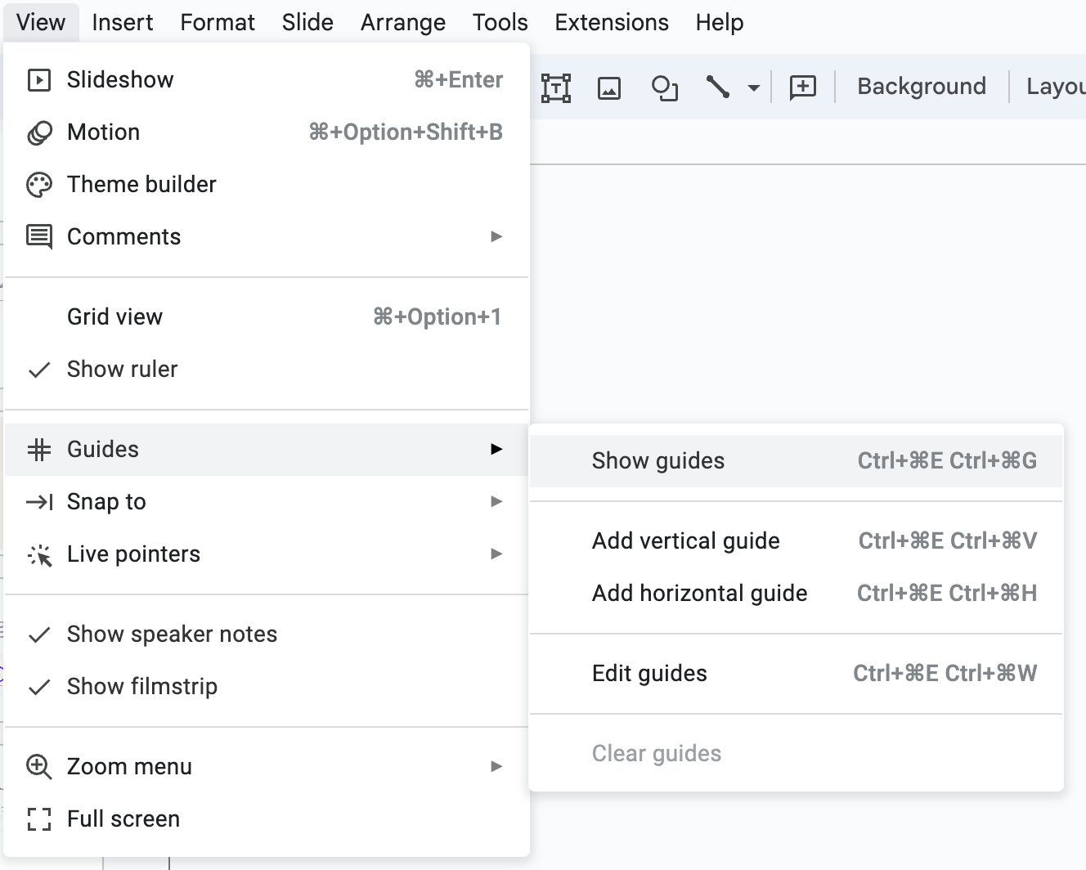
Guides
We’ve color coded the guides to help distinguish various content segments:
Red guides – section half
Blue guides – section thirds
Grey guides – section quarters
NOTE: Please refrain from placing copy/important details outside the red margins
‹#›

Slide 7
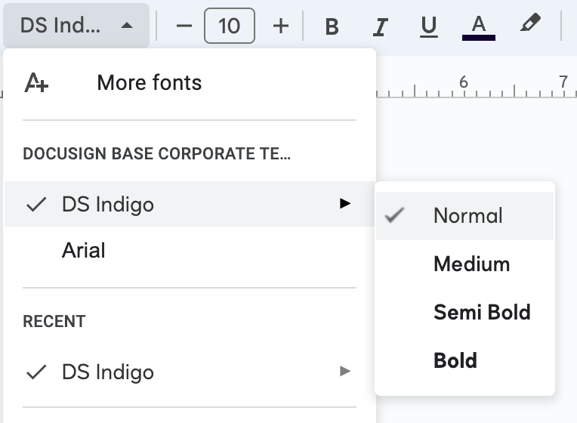
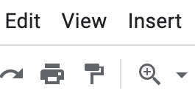
Using the type tools
Using our font
Our typeface is DS Indigo. If you do not have this font type, you can download the font package here.
Using the arrow next to DS Indigo in the font list you can access the different weights. These are the text weights that are used specifically throughout this template: normal, semi bold, bold.
Pro tip: You can duplicate the formatting of any existing text using the paint roller icon. Select the text you want to copy the formatting of > click the paint roller icon > then select the text you want to mirror the formatting on to.
‹#›

Slide 8
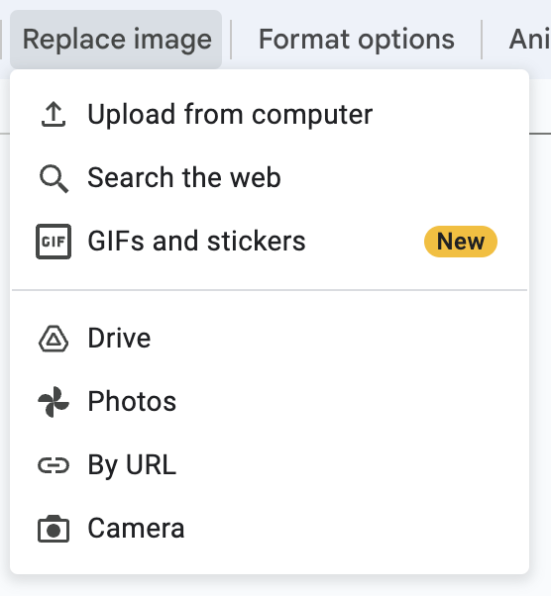


Image formatting
Swap an existing photo
Select the existing image, click ‘Replace image’ and choose your
new image.
You may need to reposition or resize your image within the container. Double click on the image, now you can move and resize the photo within the container.
‹#›

Slide 9
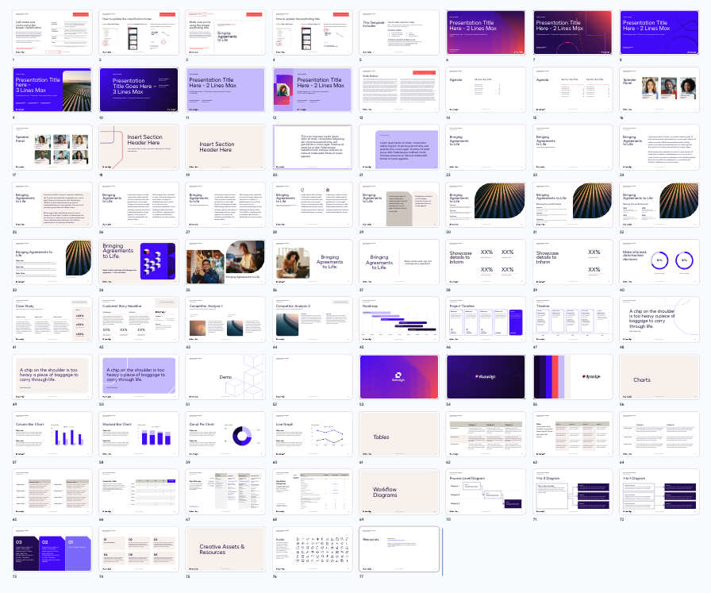
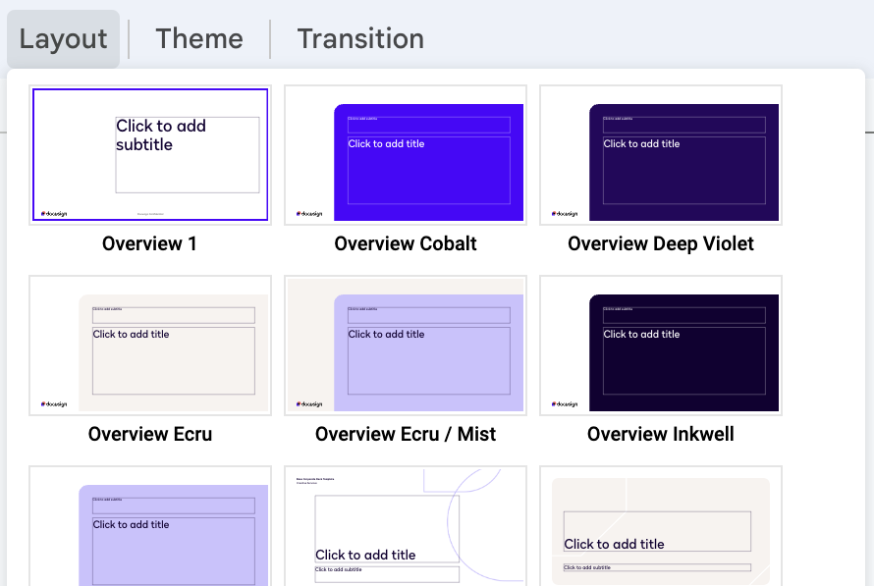
Theme layouts
Choosing a layout
Our corporate deck template contains 60+ layout options – offering a wide selection of content and narrative solutions.
‹#›

Slide 10
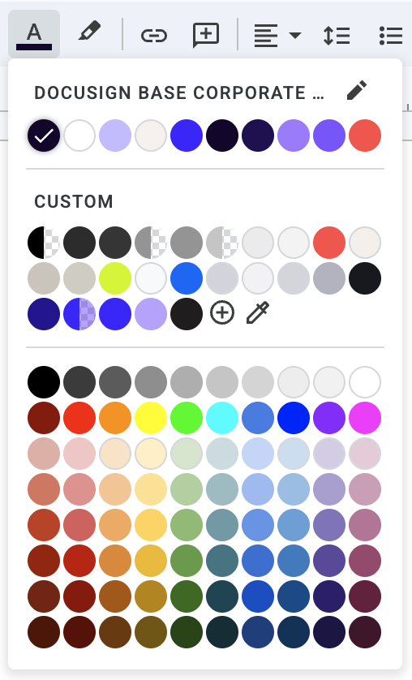
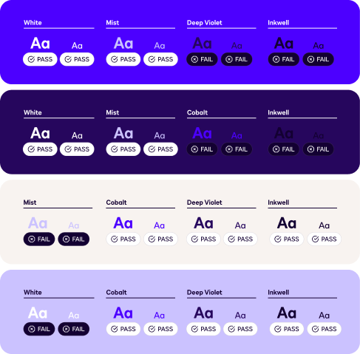
Theme colors
Docusign uses a vibrant range of colors to help increase energy and highlight key information.
The type and background combinations must meet a 4.5:1 minimum contrast ratio to help ensure people of all abilities can access and understand our communications.
Pro tip: Use one to two colors max per section or throughout your presentation. This will help maintain a clean and consistent flow without presenting a rainbow colored deck.
‹#›

Slide 11
Importing external slides
Copy slide objects over
Do not copy and paste slides. Doing so will create unwanted themes and styles. Instead:
Select and copy pieces of content to bring over or ”Paste without formatting” is your best option to bring text over clean
This will help keep all new decks moving forward consistent
Don’t copy entire slides over
‹#›

Slide 12
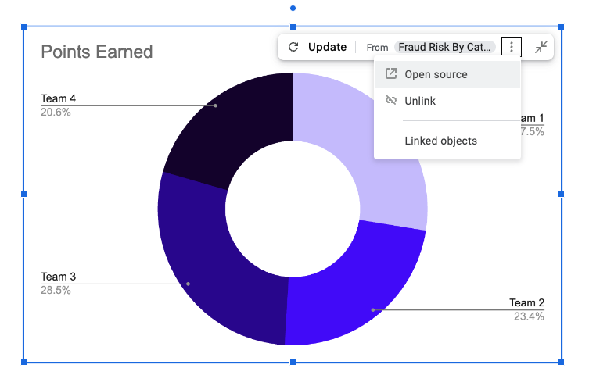
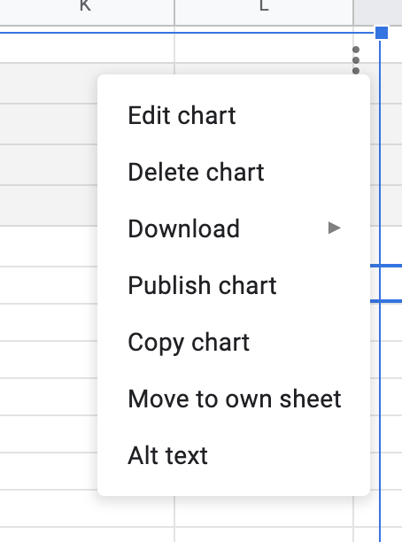
How to use GSheet charts
1. Open Source
Click on the graph, in the top right corner click the down arrow and select ‘Open Source’
2. Make a copy
This will open GSheets. Go to File > Make a copy of the document before editing the data.
3. Copy chart
When you’re finished editing, click on the 3 dots in the top right corner of the chart and select ‘Copy chart’. Then return to Google Slides paste it into your slide.
‹#›

Slide 13
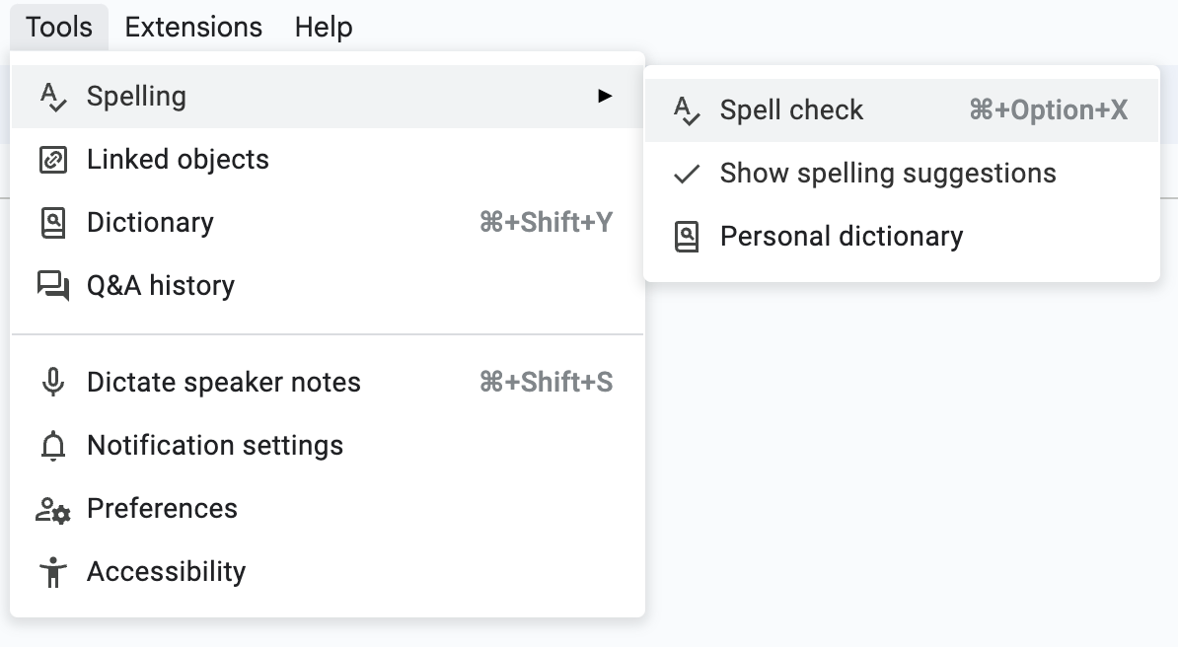
Spell check
Remember to run spell check in the toolbar. It’s always good practice to check your work and ensure we deliver clean and accurate presentations.
‹#›

Slide 14
Style Guide
‹#›

Slide 15
Logo
Main logos
Co-branding lockups
The face of Docusign
Our logo conveys trust, confidence and connection. Use the wordmark wisely. That means wherever you place it, make sure the materials are current and best reflect Docusign as it is today. All countries and languages must use the logo in this exact format.
‹#›

Slide 16
Typography
DS Indigo
Normal
AaBbCcDdEeFfGgHhIiJjKkLlMmNn
OoPpQqRrSsTtUuVvWwXxYyZz
1234567890
Medium
AaBbCcDdEeFfGgHhIiJjKkLlMmNn
OoPpQqRrSsTtUuVvWwXxYyZz
1234567890
Semi Bold
AaBbCcDdEeFfGgHhIiJjKkLlMmNn
OoPpQqRrSsTtUuVvWwXxYyZz
1234567890
Bold
AaBbCcDdEeFfGgHhIiJjKkLlMmNn
OoPpQqRrSsTtUuVvWwXxYyZz
1234567890
Headlines and Titles:
DS Indigo Normal
Subheadlines:
DS Indigo Semibold or Normal
Body Text:
DS Indigo Medium or Normal
Our type family
We use DS Indigo for every brand touchpoint: a custom typeface created just for Docusign. A happy medium between classic grotesque and geometric sans, DS Indigo feels modern and digital—but not stuffy. We designed the typeface to feel at home in both our marketing and product experiences.
‹#›

Slide 17
Type sizing
Type ramp sequence: Generated from 10-point body copy.
Body copy
Subhead / H2
Header / H1
Headline
8
10
12
16
26
42
52
We’ve created a type ramp by multiplying the body copy number by a common ratio. In these examples, we’ve used the golden ratio (1.618) to scale type.
Font sizes 8pt and 12pt should be used for detail pages, descriptors and footers.
In this template deck, font sizes beyond 42pt will not be needed.
Font size 52pt is only used for title and section header slides.
Pro tip: For dynamic contrasts, skip a number in the sequence.
‹#›

Slide 18
Color palette
Docusign Cobalt is iconic.
It is the primary color of our brand and reflects our brand archetype and ethos. Inkwell, Deep Violet, White and Mist are our secondary colors and their use is heavily paired with Cobalt. Our brand red, Poppy, is used sparingly as an accent color to bring energy and attention to elements on a layout.
‹#›

Slide 19


Photography
Connection
We strive to show collaboration and connection. Docusign brings people together in agreement.
Natural
Use imagery with story and soul — real people in real environments.
Inspirational
Our imagery should reinforce an optimistic point of view. It should never be dark or overly serious in tone.
Approved usage:
Our photographic outlook should capture real moments of dynamic connection — people coming together, physically and digitally, to come to agreements that shape their businesses and lives for the better. This outlook should stylistically echo the rest of our brand design system: bold, clean, and optimistic; animated, dynamic, and full of life and energy.
Misuse of photography:
‹#›

Slide 20
Icons
Our icons quickly identify and represent features, functionality, or content. Icons are meant to be simple, visual elements that are recognized and understood immediately.
Use icons when images, graphics, and/or plain text just won’t cut it.
‹#›

Slide 21
Resources
Access our full brand style guide for additional creative support and guidance.
https://brand.docusign.com/
Still need help? If you have questions that are not covered in this Guide, or if you can't find what you need on the Brand website mentioned above, send us a message, and we'll reply as soon as we can.
‹#›

