Slide 1

MAULANA AZAD NATIONAL INSTITUTE OF TECHNOLOGY
BHOPAL
DEPARTMENT OF COMPUTER SCIENCE AND ENGINEERING
PROJECT ON
Monitoring of Wind Turbine Power Curve
Submitted by –
PRIYANSHI SOMANI 131112228
RAGHAV MAHAJAN 131112217
SHUBHAM GARG 131112213
ASHISH BAGHEL 131112011
Under the Guidance of-
Dr. Rajesh Wadhvani
Session 2016-17

Slide 2
Contents
Wind Power Curve
Wind Turbine Performance Monitoring
Wind Power Curve Profile
Architecture
Statistical Process Control for Process Monitoring
Outlier Analysis
Mahalanobis Distance
Conclusion

Slide 3
Introduction to Wind Power Curve
A wind power curve is a graphical representation of the turbine electric power output as a function of the hub-height wind speed.
A monitoring approach is proposed to monitor the wind power generation performance through analyzing the variation of wind power curves rather than individual data points.
To monitor the variations of wind power curve profiles over time, multivariate approach is applied.

Slide 4
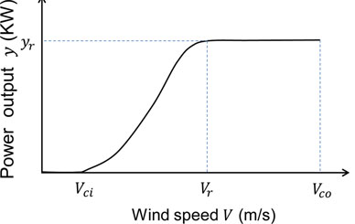
Operating Characteristics
V_{ci} is the cut-in wind speed,
V_{co} is the cut-out wind speed,
V_{r} is the rated wind speed,
y_{r} is the corresponding rated
power output.

Slide 5
When v<v_{ci} and v>v_{co}, wind turbines do not produce power,and the power curve monitoring is not needed in this scenario.
When v_{r} ≤ v ≤ v_{co}, the wind power is rated at P_{max.}To monitor turbine conditions, we can simply apply line P = P_{max .}
When v_{ci} ≤ v < v_{r}, the shape and curvature of the power curve of a healthy wind turbine are variable over time .To monitor the quality of power curves in such a scenario, profiles are developed

Slide 6
Wind Turbine Performance Monitoring
Wind turbine monitoring can be done in two ways: condition-based and performance-based.
Condition monitoring requires installation of additional equipment/sensors to continuously monitor relevant parameters in real time.
Performance monitoring utilizes historical data for prediction of turbine performance. Since performance monitoring relies on the existing data, there is no additional cost to the wind farm operators.

Slide 7
Wind Power Curve Profile
4LP and 5LP based power curve models are applied to generate power curve profiles by fitting into the subdata sets.
Power curve profiles are composed of power curve model parameters that depict power curve characteristics.
The Four & Five Parameters Logistic Regression (4PL & 5PL), nonlinear regression model is commonly used for curve-fitting analysis in bioassays.

Slide 8
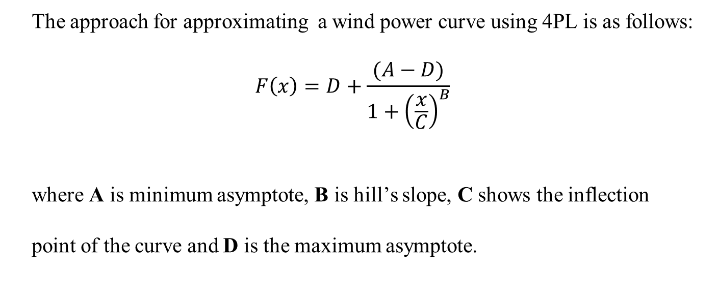
4PL Profile
The approach for approximating a wind power curve using 4PL is as follows:
$$F\left(x\right)=D+\frac{(A−D)}{1+{\left(\frac{x}{C}\right)}^{B}}$$
where A is minimum asymptote, B is hill’s slope, C shows the inflection
point of the curve and D is the maximum asymptote.

Slide 9
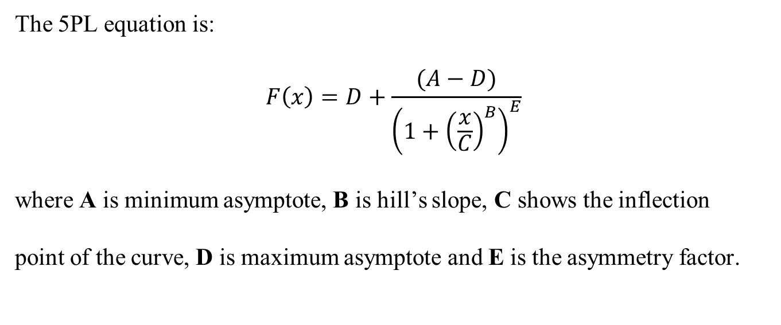
5PL Profile
The 5PL equation is:
$$F\left(x\right)=D+\frac{(A−D)}{{\left(1+{\left(\frac{x}{C}\right)}^{B}\right)}^{E}}$$
where A is minimum asymptote, B is hill’s slope, C shows the inflection
point of the curve, D is maximum asymptote and E is the asymmetry factor.

Slide 10
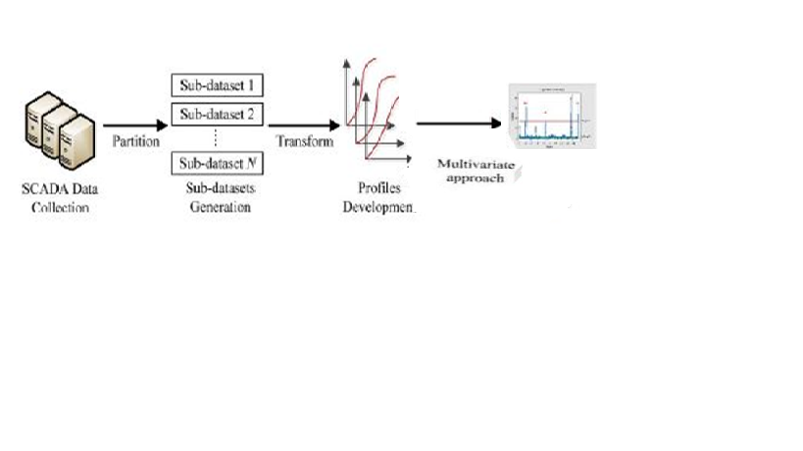
Architecture

Slide 11
Statiscal Process Control for Performance Monitoring
The objective of SPC is to monitor the performance of a process over time to verify that it remains in a state-of-statistical-control. It is done using two approaches:
Univariate Approach
Multivariate Approach
Univariate Approach can only handle single parameter dependency and hence fails to monitor when multiple parameters are taken into consideration. Thus multivariate approach is used to monitor the performance as it efficiently handles behaviour of one variable with respect to others.

Slide 12
Outlier Analysis
The outliers describe the abnormal data behaviour, i.e. data which are deviating from the natural data variability. The cut-off value or threshold which divides anomalous and non-anomalous data numerically is often the basis for important decisions. The standard method for multivariate outlier detection is robust estimation of the parameters in the Mahalanobis distance and the comparison with a critical value of the chi square distribution.

Slide 13
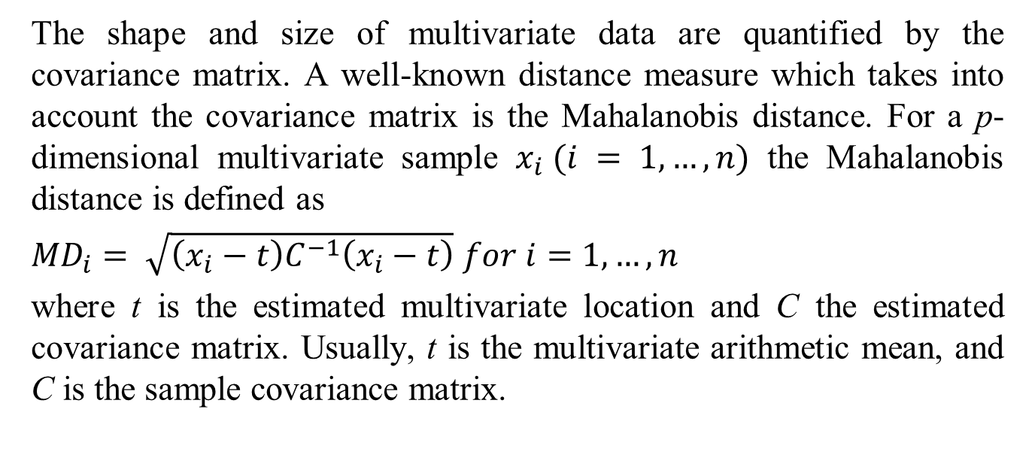
Mahalanobis distance
The shape and size of multivariate data are quantified by the covariance matrix. A well-known distance measure which takes into account the covariance matrix is the Mahalanobis distance. For a p-dimensional multivariate sample $x_{i} (i = 1,…,n)$ the Mahalanobis distance is defined as
${MD}_{i}= \sqrt{\left(x_{i}−t\right)C^{−1}\left(x_{i}−t\right)}$ $for i=1,…,n$
where t is the estimated multivariate location and C the estimated covariance matrix. Usually, t is the multivariate arithmetic mean, and C is the sample covariance matrix.

Slide 14
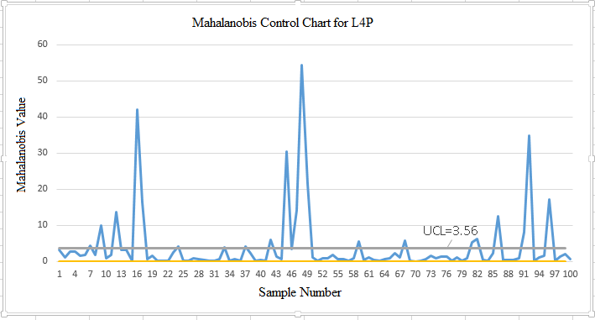
.
Mahalanobis Control Chart for L4P

Slide 15
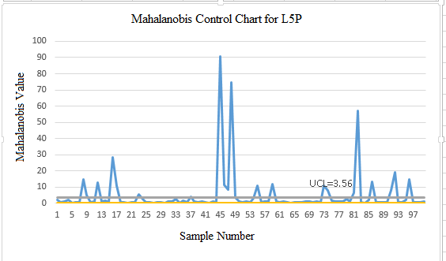
.
Mahalanobis Control Chart for L5P

Slide 16
Results
Outliers in L4P Profile
12,16,17,24,33,37,42,45,47,48,49,59,68,81,82,86,91,92,96
Outliers in L5P profile
8, 9,12,16,17,23,37,45,46,47,48,49,55,59,73,74,81,82,86,91,92,96
.

Slide 17
Conclusion
4LP and 5LP are applied on 100 sub-datasets and using mahalanobis distance outliers in these profiles were detected for monitoring purpose.
The proposed approach could be implemented for monitoring of wind turbine power curve. It could accurately detect faults but not as timely as point-based condition monitoring methods.
It is because a certain amount of time is required to build new power curve profiles.

Slide 18
Future Work
Future research will investigate a mechanism to partition data sets with the completion of the power curve information to enhance the monitoring power of the proposed approach.
In addition, the relationship between the wind power and multiple parameters will be considered in the monitoring.

Slide 19
References
[1] Huan Long, Long Wang, Zijun Zhang, Member, IEEE, Zhe Song, and Jia Xu “Data-Driven Wind Turbine Power Generation Performance Monitoring”
[2] Paul G. Gottschalk, John R. Dunn “The five parameter logistic: A characterization and comparison with four parameter logistic”
[3] L. Kang and S. Albin, “On-line monitoring when the process yields a linear profile,” J. Qual. Technol., vol. 32, no. 4, pp. 418–426, Oct. 2000.
[4] Kusiak, H. Zheng, and Z. Song, “On-line monitoring of power curves, ”Renew. Energy, vol. 34, no. 6, pp. 1487–1493, Mar. 2009.
[5] D. Montgomery, Introduction to Statistical Quality Control. NewYork, NY, USA: Wiley, 2008.

Slide 20
THANK YOU
Presented by
Priyanshi Somani 131112228
Raghav Mahajan 131112217
Shubham Garg 131112213
Ashish Baghel 131112011

