Slide 1
Sparse Matrix
In computer programming, a matrix can be defined with a 2-dimensional array. Any array with 'm' columns and 'n' rows represent a m X n matrix. There may be a situation in which a matrix contains more number of ZERO values than NON-ZERO values. Such matrix is known as sparse matrix.
A sparse matrix can be represented by using TWO representations, those are as follows...
1.Triplet Representation (Array Representation)
2.Linked Representation

Slide 2
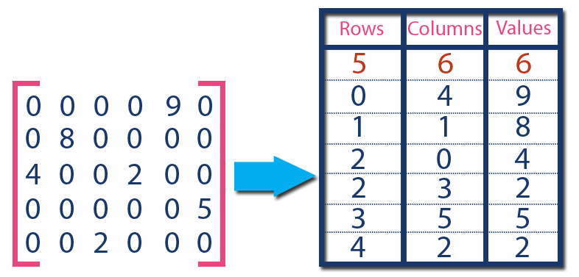
Triplet Representation (Array Representation)
In above example matrix, there are only 6 non-zero elements ( those are 9, 8, 4, 2, 5 & 2) and matrix size is 5 X 6. We represent this matrix as shown in the above image. Here the first row in the right side table is filled with values 5, 6 & 6 which indicates that it is a sparse matrix with 5 rows, 6 columns & 6 non-zero values. The second row is filled with 0, 4, & 9 which indicates the non-zero value 9 is at the 0th-row 4th column in the Sparse matrix. In the same way, the remaining non-zero values also follow a similar pattern.

Slide 3
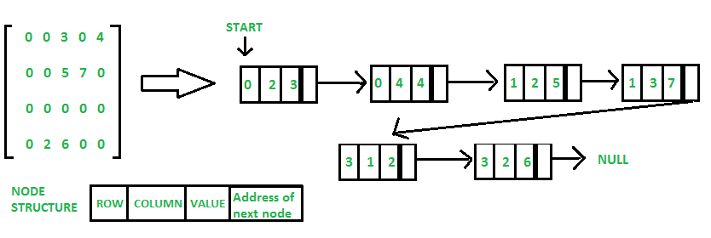
Sparse matrix representation using linked list

