Slide 1
What is hystrix?
Hystrix is a library developed by Netflix and is part of Spring via the Spring Cloud Netflix project. Hystrix is a fault tolerance library and is used as strategy against failures (at different levels) in a service-layer.
Hystrix is a latency and fault tolerance library designed to isolate points of access to remote systems, services and 3rd party libraries, stop cascading failure and enable resilience in complex distributed systems where failure is inevitable.

Slide 2
Why do we use Hystrix?
Hystrix can be used in situations where your application depends on remote services. In case one or more remote services are down you can handle the situation by using a circuit breaker in your application.
Circuit breaker is a design pattern used in modern software development. It is used to detect failures and encapsulates the logic of preventing a failure from constantly recurring, during maintenance, temporary external system failure or unexpected system difficulties.
Ex- Failsafe, Hystrix, Javaslang , Vert.x

Slide 3
fallback method
Hystrix is watching methods for failing calls to related services. If there is such a failing method, it will open the circuit, which means, it forwards the call to a fallback method. In case the services is restored it will close the circuit and the applications acts as expected again.
SWITCH…….

Slide 4
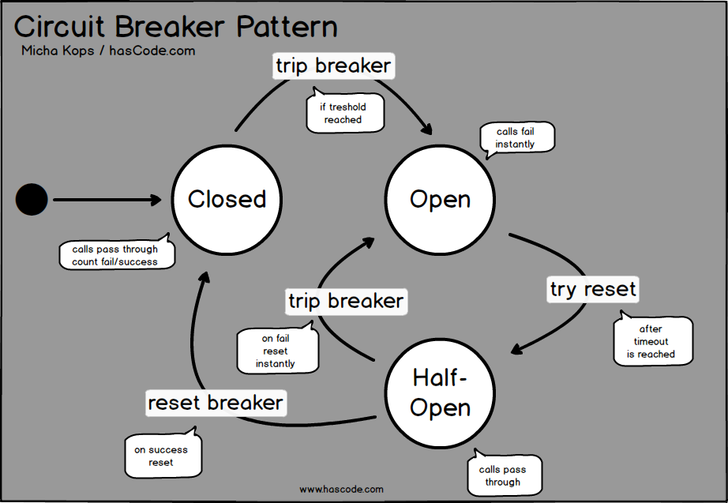

Slide 5
references
http://www.baeldung.com/spring-cloud-netflix-hystrix
https://www.hascode.com/2017/02/resilient-architecture-circuit-breakers-for-java-hystrix-vert-x-javaslang-and-failsafe-examples/
https://howtodoinjava.com/spring/spring-cloud/spring-hystrix-circuit-breaker-tutorial/

