Slide 1
Working with Node.js
Dr. Saritha R C

Slide 2
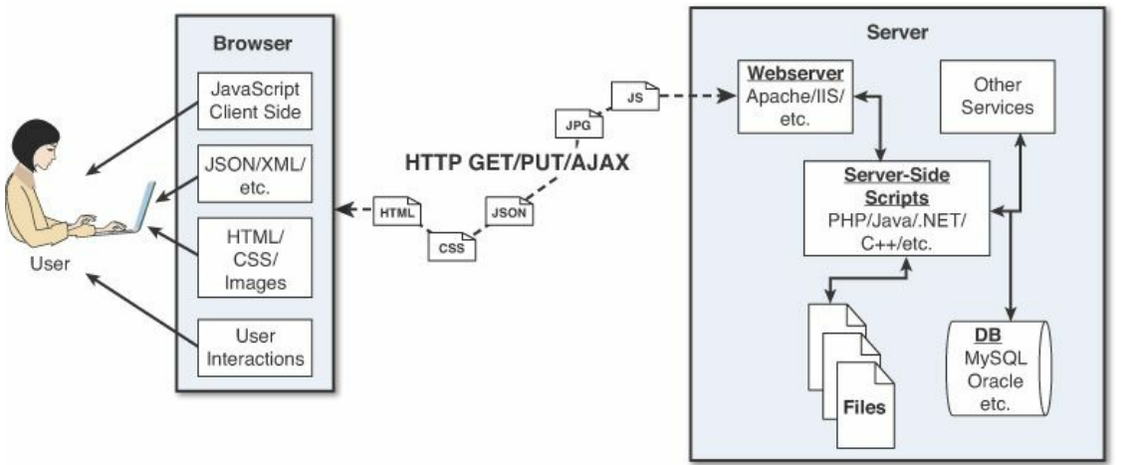
Introduction to Node.js
Figure : Components of basic website/web application

Slide 3
Introduction to Node.js
The browser plays three roles in the web framework:
Provide communication to and from the webserver
Interpret the data from the server and render it into the view that the user actually sees
Handle user interaction through the keyboard, mouse, touchscreen, or other input device and take the appropriate action
Browser-to-webserver communication consists of a series of requests, using the HTTP and HTTPS protocols
Hypertext Transfer Protocol (HTTP) is used to define communication between the browser and the webserver.
HTTPS adds an additional security layer, SSL/TLS, to ensure secure connections by requiring the webserver to provide a certificate to the browser.

Slide 4
Introduction to Node.js
There are three main types of requests that a browser will make to a webserver
GET: The GET request is typically used to retrieve data from the server, such as .html files, images, or JSON data.
POST: POST requests are used when sending data to the server, such as adding an item to a shopping cart or submitting a web form.
Asynchronous JavaScript and XML (AJAX) is actually just a GET or POST request that is done directly by JavaScript running in the browser. Despite the name, an AJAX request can receive XML, JSON, or raw data in the response.
The most common types of data the browser uses to render the final user view as well as define the webpage behavior:
HTML files:
CSS files
Client-side scripts added functionality to a webpage, manipulate the DOM to change the look of the webpage
Media files are rendered as part of webpage
Data such as XML, JSON, or raw text can be provided by the webserver as a response to an AJAX request
HTTP headers

Slide 5
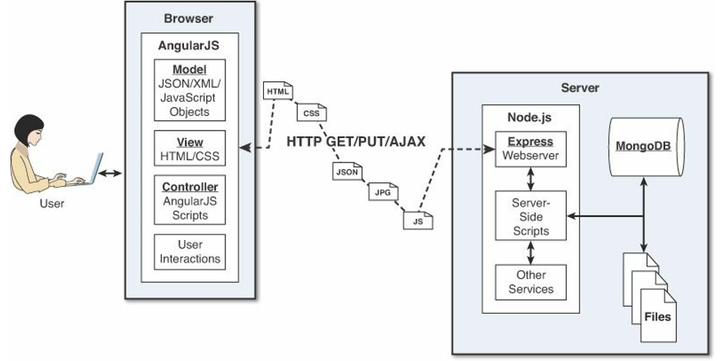
Introduction to Node.js
Figure: Web framework using node.js, express.js,mongodb and angularjs

Slide 6
Introduction to Node.js
Node.js® is a JavaScript runtime environment built on Chrome's V8 JavaScript engine.
Node.js was developed in 2009 by Ryan Dahl as an answer to the frustration caused by concurrency issues, especially when dealing with web services
Build powerful , fast & scalable web applications
website/application framework and server-side solution for JS
Uses an eventdriven
Node.js is a very modular platform, which means much of the functionality that you will use is provided by external modules rather than being inherently built into the platform
Node.js is written in JavaScript, developers can easily navigate back and forth between client and server code
Node.js
V8 Javascript Runtime

Slide 7
Introduction to Node.js
Node.js can be used for a wide variety of purposes. Because it is based on V8 and has highly optimized code to handle HTTP traffic, the most common use is as a webserver.
Websocket server like a chat server
fast file upload server
Ad server
network server
However, Node.js can also be used for a variety of other web services, such as:
Web services APIs such as REST
Real-time multiplayer games
Backend web services such as cross-domain, server-side requests
Web-based applications especially Single page applications
Multiple-client communication such as IM
Disadvantages: It is not advisable to use Node.js for CPU intensive applications.

Slide 8
Node.js VS Apache
Introduction to Node.js
It's fast
It can handle tons of concurrent requests
It's written in JavaScript (which means you can use the same code server side and client side)
Platform | Number of request per second
PHP ( via Apache) | 3187,27
Static ( via Apache ) | 2966,51
Node.js | 5569,30

Slide 9
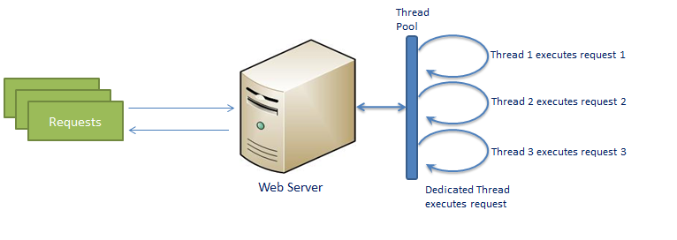
Traditional web server model
Introduction to Node.js

Slide 10
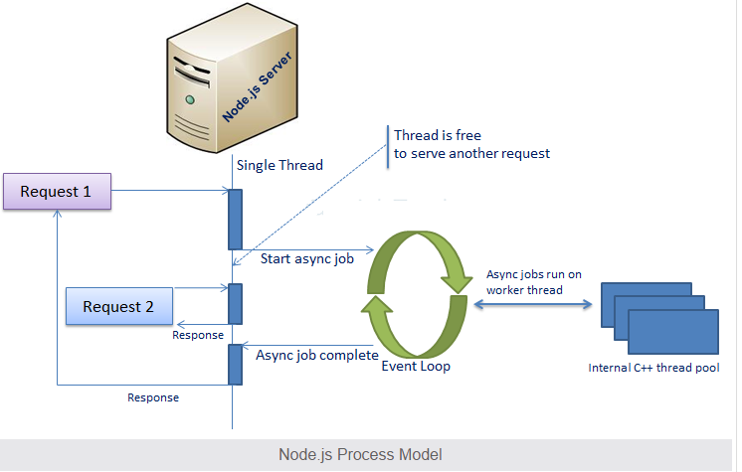
Node.js process model Node.js runs in a single process and the application code runs in a single thread and thereby needs less resources than other platforms.
Introduction to Node.js

Slide 11
All the user requests to your web application will be handled by a single thread and all the I/O work or long running job is performed asynchronously for a particular request. An event loop is constantly watching for the events to be raised for an asynchronous job and executing callback function when the job completes. Internally, Node.js uses libev for the event loop which in turn uses internal C++ thread pool to provide asynchronous I/O
Introduction to Node.js

Slide 12
Threads VS Event-driven
Introduction to Node.js
Threads | Asynchronous Event-driven
Lock application / request with listener-workers threads | only one thread, which repeatedly fetches an event
Using incoming-request model | Using queue and then processes it
multithreaded server might block the request which might involve multiple events | manually saves state and then goes on to process the next event
Using context switching | no contention and no context switches
Using multithreading environments where listener and workers threads are used frequently to take an incoming-request lock | Using asynchronous I/O facilities (callbacks, not poll/select or O_NONBLOCK) environments

Slide 13
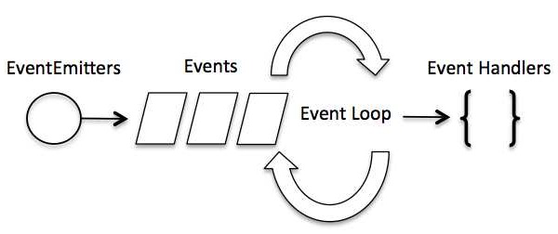
Introduction to Node.js
Servers do nothing but I/O -Scripts waiting on I/O requests degrades performance
To avoid blocking, Node makes use of the event driven nature of JS by attaching callbacks to I/O requests
As soon as Node starts its server, it simply initiates its variables, declares functions and then simply waits for the event to occur.
In an event-driven application, there is generally a main loop that listens for events, and then triggers a callback function when one of those events are detected.

Slide 14
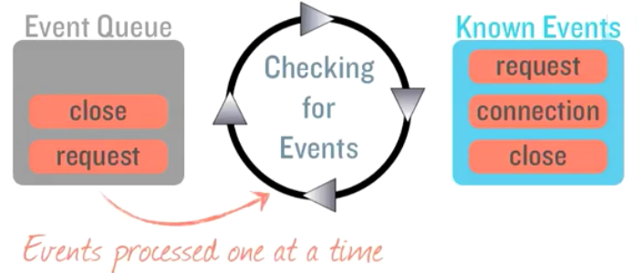
Introduction to Node.js
Event Loop

Slide 15
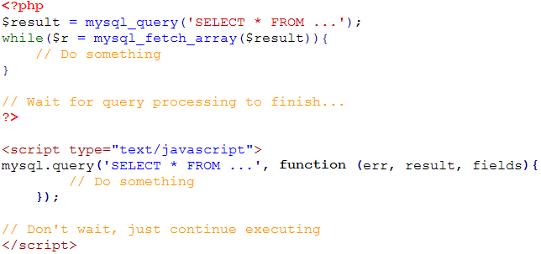
I/O Example
Introduction to Node.js

Slide 16
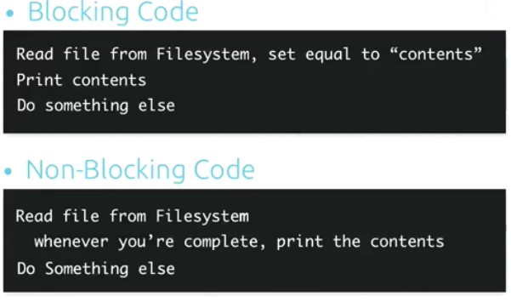
Introduction to Node.js

Slide 17
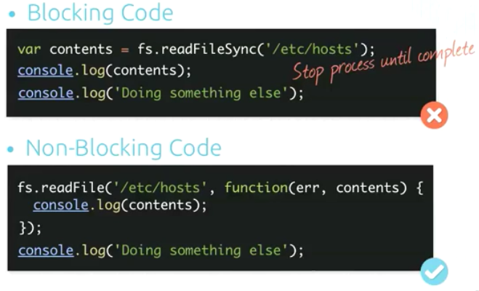
Introduction to Node.js

Slide 18
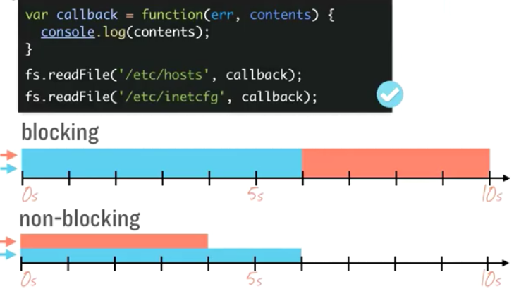
Introduction to Node.js

Slide 19
Consistancy
Introduction to Node.js
Use of JS on both the client and server-side should remove need to “context switch”
Client-side JS makes heavy use of the DOM, no access to files/databases
Server-side JS deals mostly in files/databases, no DOM
Concurrency: The Event Loop
Instead of threads Node uses an event loop
Alleviates overhead of context switching

Slide 20
Introduction to Node.js
Node.js uses an asynchronous event-driven model
Node.js is non-blocking I/O model that makes it lightweight and efficient.
Node.js package ecosystem npm is the largest ecosystem of open source libraries in the world.
Node is designed to build scalable network applications.
Runs over the command line
Designed for high concurrency to handle many connections without threads or new processes
Node is free from worries of dead-locking process
Uses the CommonJS framework which is closer to a real OO language
Never blocks, not even for I/O
No Buffering Node.js applications never buffer any data. These applications simply output the data in chunks.
License : Node.js is released under the MIT license.

Slide 21
Introduction to Node.js
Node Package Manager
Node Package Manager (NPM) is a command line tool that installs, updates or uninstalls Node.js packages in your application. It is also an online repository for open-source Node.js packages. It allows you to download, install and manage third party modules. Node Package Manager (NPM) provides two main functionalities:
Online repositories for node.js packages/modules which are searchable on search.nodejs.org
Easy to specify and link dependencies
Modules get installed into node_modules folder
Command line utility to install Node.js packages, do version management and dependency management of Node.js packages
NPM comes bundled with Node.js installables after v0.6.3 version. Latest version is 3.1.0.

Slide 22
Introduction to Node.js
Popular Modules are
Express – web development framework
Connect – extensible HTTP server framework
Socket.io – server side component for websockets
Pug / Jade – Template engine inspired by HAML
Mongo / Mongoose – wrappers to interact with MongoDB
Nodemon – simple monitor script and automatically restart your node application if any file changes in the directory.
Nodemailer – enables e-mail sending from node.js applications.
Passport - authentication middleware for verifying usernamr]=e and password using OAuth or OpenID
Coffee –script – Coffeescript compiler
Redis – Redis Client Library

Slide 23
Introduction to Node.js
To verify current version of NPM
$ npm --version
2.7.1
Just use Installing Modules using NPM There is a simple syntax to install any Node.js module:
$ npm install <Module Name>
For example, following is the command to install a famous Node.js web framework module called express:
$ npm install express
Now you can use this module in your js file as following:
var express = require('express');
NPM installs any dependency in the local mode. Here local mode refers to the package installation in node_modules directory lying in the folder where Node application is present. you can use npm ls command to list down all the locally installed modules.You can use the following command to check all the modules installed globally:
$ npm ls -g

Slide 24
Introduction to Node.js
Uninstalling a Module
Use the following command to uninstall a Node.js module.
$ npm uninstall express
Updating a Module
Update package.json and change the version of the dependency to be updated and run the following command.
$ npm update express
Search a Module
Search a package name using NPM.
$ npm search express

Slide 25
Introduction to Node.js
Package.json is present in the root directory of any Node application/module .
Tells npm how your package is structured and what to do to install it.
used to define the properties of a package as follows.
name - name of the package
version - version of the package
description - description of the package
homepage - homepage of the package
author - author of the package
contributors - name of the contributors to the package
dependencies - list of dependencies. NPM automatically installs all the dependencies mentioned here in the node_module folder of the package.
repository - repository type and URL of the package
main - entry point of the package
keywords - keywords

Slide 26
Introduction to Node.js
Package.json is as follows:
{
"name": "NodejsConsoleApp",
"version": "0.0.0",
"description": "NodejsConsoleApp“,
"main": "app.js",
"author":
{
"name": "Dev",
"email": ""
},
“licence”: “CDAC”,
"dependencies":
{ "express": "^4.13.3" }
}

Slide 27
Introduction to Node.js
Creating a module requires package.json to be generated.
Let's generate package.json using NPM, which will generate the basic skeleton of the package.json
$ npm init
........
Press ^C at any time to quit.
name: (webmaster)
We need to provide all the required information about your module. Once package.json is generated, use the following command to register yourself with NPM repository site using a valid email address.
$ npm adduser
Username: cdac
Password:
Email: (this IS public) cdac@gmail.com
It is time now to publish your module:
$ npm publish

Slide 28
Lets write some code

Slide 29
Introduction to Node.js
Node.js Console:
Node.js comes with virtual environment called REPL (aka Node shell). REPL stands for Read Eval Print Loop and it represents a computer environment like a Windows console or Unix/Linux shell where a command is entered and the system responds with an output in an interactive mode.
Node.js or Node comes bundled with a REPL environment. It performs the following tasks:
● Read - Reads user's input, parses the input into JavaScript data-structure, and stores in memory.
● Eval - Takes and evaluates the data structure.
● Print - Prints the result.
● Loop - Loops the above command until the user presses ctrl-c twice.
Starting REPL
$ node
>
Simple expression evaluation:
> 1 + ( 2 * 3 ) - 4
3

Slide 30
Introduction to Node.js
You can make use variables to store values and print later like any conventional script. If var keyword is not used, then the value is stored in the variable and printed. Whereas if var keyword is used, then the value is stored but not printed. You can print variables using console.log().
$ node
> x = 10
10
> var y = 10
undefined
> x + y
20
> console.log("Hello World")
Hello World
undefined

Slide 31
Introduction to Node.js
Multiline Expression
> var x = 0
undefined
> do {
... x++;
... console.log("x: " + x);
... } while ( x < 5 );
save the node session commands to a file
> .save mylog.js
To load the .js file into command shell
>.load mylog.js
Stopping REPL:
use ctrl-c twice to come out of Node.js REPL

Slide 32
Introduction to Node.js
Node.js Basics:
Node.js supports JavaScript. So, JavaScript syntax on Node.js is similar to the browser's JavaScript syntax.
Primitive Types:
Node.js includes following primitive types:
String
Number
Boolean
Undefined
Null
RegExp
Everything else is an object in Node.js.

Slide 33
Introduction to Node.js
Loose Typing:
JavaScript in Node.js supports loose typing like the browser's JavaScript. Use var keyword to declare a variable of any type.
Object Literal:
Object literal syntax is same as browser's JavaScript.
Example: Object
var obj = { authorName: ‘Saritha', language: 'Node.js' }
Functions:
Functions are first class citizens in Node's JavaScript, similar to the browser's JavaScript. A function can have attributes and properties also. It can be treated like a class in JavaScript.
Example: Function
function Display(x) {
console.log(x);
}
Display(100);

Slide 34
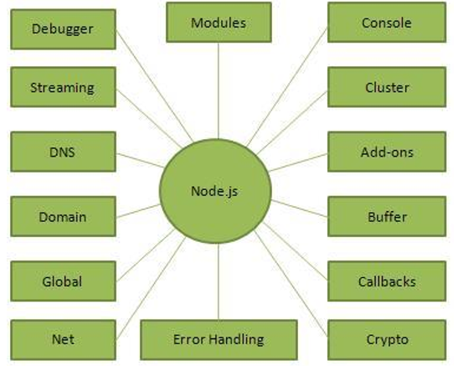
Introduction to Node.js
Figure : Parts of Node.js

Slide 35
Introduction to Node.js
Node.js Module:
Module in Node.js is a simple or complex functionality organized in single or multiple JavaScript files which can be reused throughout the Node.js application.
Each module in Node.js has its own context, so it cannot interfere with other modules or pollute global scope. Also, each module can be placed in a separate .js file under a separate folder.
Node.js implements CommonJS modules standard. CommonJS is a group of volunteers who define JavaScript standards for web server, desktop, and console application.
Module Types:
Node.js includes three types of modules:
Core Modules
Local Modules
Third Party Modules

Slide 36
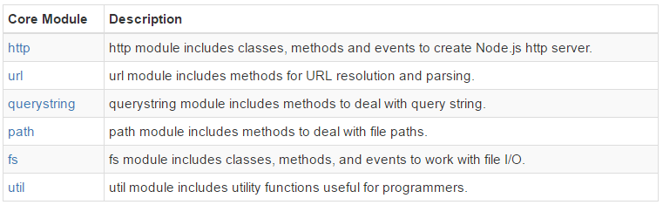
Introduction to Node.js
Node.js Core Modules:
Node.js is a light weight framework. The core modules include bare minimum functionalities of Node.js. These core modules are compiled into its binary distribution and load automatically when Node.js process starts. However, you need to import the core module first in order to use it in your application.
The following table lists some of the important core modules in Node.js.

Slide 37
Introduction to Node.js
Loading Core Modules:
In order to use Node.js core or NPM modules, you first need to import it using require() function as shown below.
var module = require('module_name');
As per above syntax, specify the module name in the require() function.
The require() function will return an object, function, property or any other JavaScript type, depending on what the specified module returns.
Ex:
var http = require('http');
var server = http.createServer(function(req, res)
{
//write code here
});
server.listen(5000);

Slide 38
Introduction to Node.js
A Node.js web application consists of the following three important components:
1. Import required modules: We use the require directive to load Node.js modules.
2. Create server: A server which will listen to client's requests similar to Apache HTTP Server.
3. Read request and return response: The server created in an earlier step will read the HTTP request made by the client which can be a browser or a console and return the response.

Slide 39
Introduction to Node.js
Creating Node.js Application
Step 1 - Import Required Module We use the require directive to load the http module and store the returned HTTP instance into an http variable as follows:
var http = require("http");
Step 2: Create Server The created http instance and call http.createServer() method to create a server instance and then we bind it at port 8081 using the listen method associated with the server instance.
http.createServer(function (request, response) {
// Send the HTTP header with HTTP Status: 200 : OK and Content Type: text/plain
response.writeHead(200, {'Content-Type': 'text/plain'});
// Send the response body as "Hello World"
response.end('Hello World\n');
}).listen(8081);
// Console will print the message
console.log('Server running at http://127.0.0.1:8081/');

Slide 40
Introduction to Node.js
Step 3: Testing Request & Response combine step 1 and 2 together in a file called main.js and start our HTTP server as shown below:
Now execute the main.js to start the server as follows:
$ node main.js
+
Verify the Output. Server has started displaying the following message in the console.
Server running at http://127.0.0.1:8081/
Make a Request to the Node.js Server in windows
Open http://127.0.0.1:8081/ in any browser and observe the following result.
you can use the command-line program curl, which most Mac and Linux machines have pre-installed.
curl -i http:// 127.0.0.1:8081

Slide 41
Introduction to Node.js
The querystring module provides us with the following methods. 1. querystring.stringify() 2. querystring.parse() 1. syntax: querystring.stringify(obj, [seperator], [assignment]) This function will serialize your object to a query string. In this method you have to pass the object which is mandatory and then you can override the default separator ('&') and assignmnet('=') characters.
For Example, querystring.stringify({firstName: 'A', secondName: 'B'}) will return 'firstName=A&secondName=B'

Slide 42
Introduction to Node.js
The querystring module provides us with the following methods. 1. querystring.stringify() 2. querystring.parse() 2. querystring.parse(str, [seperator], [assignment], [options]) This is the opposite of stringify, it deserialize the query string to an object. Like stringify it also has optional parameters as seperator and assignment which you can override. Using options you can limit the number of keys which can be processed in your querystring. For Example, querystring.parse('firstName=A&secondName=B') will return {firstName: 'A', secondName: 'B'}

Slide 43
Introduction to Node.js
Node.js File System:
Node.js includes fs module to access physical file system. The fs module is responsible for all the asynchronous or synchronous file I/O operations.
Reading File: Use fs.readFile() method to read the physical file asynchronously.
Method Signature: fs.readFile(fileName [,options], callback)
Parameters:
filename: Full path and name of the file as a string.
options: The options parameter can be an object or string which can include encoding and flag. The default encoding is utf8 and default flag is "r".
callback: A function with two parameters err and fd. This will get called when readFile operation completes.
var fs = require('fs');
fs.readFile('TestFile.txt', function (err, data) {
if (err) throw err;
console.log(data);
});

Slide 44
Introduction to Node.js
Node.js path module:
Node.js path module is used for handling and transforming file paths. This module can be imported using the following syntax.
var path = require("path");
S.No.Method & Description
1 path.normalize(p) Normalize a string path, taking care of '..' and '.' parts.
2 path.join([path1][, path2][, ...]) Join all the arguments together and normalize the resulting path.
3 path.resolve([from ...], to) Resolves to an absolute path.
4 path.isAbsolute(path) Determines whether the path is an absolute path. An absolute path will always resolve to the same location, regardless of the working directory.
path.relative(from, to) Solve the relative path from from to to.
path.dirname(p) Return the directory name of a path. Similar to the Unix dirname command
path.basename(p[, ext]) Return the last portion of a path. Similar to the Unix basename command.
path.extname(p) Return the extension of the path, from the last '.' to end of string in the last portion of the path. If there is no '.' in the last portion of the path or the first character of it is '.', then it returns an empty string.
path.parse(pathString) Returns an object from a path string.
path.format(pathObject) Returns a path string from an object, the opposite of path.parse above.

Slide 45
Introduction to Node.js
Properties
S.No. Property Description
path.sep The platform-specific file separator. '\\' or '/'.
path.delimiter The platform-specific path delimiter, ; or ':'.
path.posix Provide access to aforementioned path methods but always interact in a posix compatible way.
path.win32 Provide access to aforementioned path methods but always interact in a win32 compatible way.
// Normalization
console.log('normalization : ' + path.normalize('/test/test1//2slashes/1slash/tab/..'));
// Join
console.log('joint path : ' + path.join('/test', 'test1', '2slashes/1slash', 'tab', '..'));
// Resolve
console.log('resolve : ' + path.resolve('main.js'));
// extName
console.log('ext name : ' + path.extname('main.js'));

Slide 46
Introduction to Node.js
Global objects
The node.js global objects are global in nature and available in all modules.
__dirname
__filename
Console
Process
Buffer
setImmediate
setInterval
setTimeout
clearIntermediate
clearInterval
clearTimeOut

Slide 47
Introduction to Node.js
Buffer:
Pure JavaScript is Unicode friendly, but it is not so for binary data. While dealing with TCP streams or the file system, it's necessary to handle octet streams. Node.js includes an additional data type called Buffer (not available in browser's JavaScript). Buffer is mainly used to store binary data, while reading from a file or receiving packets over the network and necessary for handling octet streams.
Buffer is a global class. It can by accessed without importing its module.
Creating Buffers
Node Buffer can be constructed in a variety of ways.
Method 1 : Following is the syntax to create an uninitiated Buffer of 10 octets −
var buf = new Buffer(10);
Method 2 :Following is the syntax to create a Buffer from a given array −
var buf = new Buffer([10, 20, 30, 40, 50]);
Method 3 : Following is the syntax to create a Buffer from a given string and optionally encoding type −
var buf = new Buffer("Simply Easy Learning", "utf-8");

Slide 48
Introduction to Node.js
Writing to Buffers
buf.write(string[, offset][, length][, encoding])
This method returns the number of octets written
Reading from Buffers
buf.toString([encoding][, start][, end])
Convert Buffer to JSON
buf.toJSON()

Slide 49
Introduction to Node.js
process object:
Each Node.js script runs in a process. It includes process object to get all the information about the current process of Node.js application.
The following example shows how to get process information in REPL using process object.
process.execPath 'C:\\Program Files\\nodejs\\node.exe' > process.pid 1652 > process.cwd() 'C:\\‘
Similarly we have process.arch, process.platform, process.version, process.uptime, process.kill(pid[,signal])

Slide 50
Introduction to Node.js
Defaults to local:
Node's JavaScript is different from browser's JavaScript when it comes to global scope. In the browser's JavaScript, variables declared without var keyword become global. In Node.js, everything becomes local by default.
Access Global Scope:
In a browser, global scope is the window object. In Node.js, global object represents the global scope.
To add something in global scope, you need to export it using export or module.export.
The same way, import modules/object using require() function to access it from the global scope.
For example, to export an object in Node.js, use exports.name = object.

Slide 51
Introduction to Node.js
Node.js Local Module:
Local modules are modules created locally in your Node.js application.
These modules include different functionalities of your application in separate files and folders. You can also package it and distribute it via NPM, so that Node.js community can use it.
For example, if you need to connect to MongoDB and fetch data then you can create a module for it, which can be reused in your application.
Writing Simple Module:
Let's write simple logging module which logs the information, warning or error to the console.
In Node.js, module should be placed in a separate JavaScript file. So, create a Log.js file and write the following code in it.

Slide 52
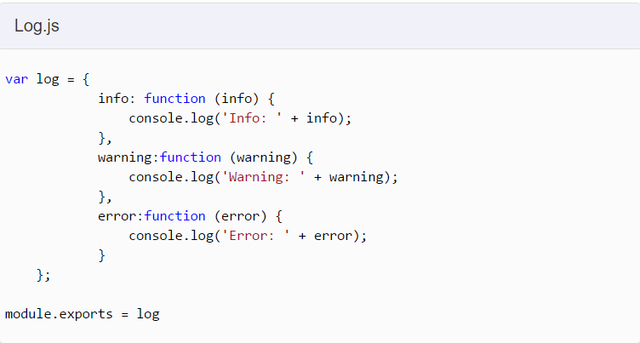
Introduction to Node.js
we have created an object with three functions - info(), warning() and error() and assigned this object to module.exports.
The module.exports is a special object which is included in every JS file in the Node.js application by default.
Use module.exports or exports to expose a function, object or variable as a module in Node.js.

Slide 53
Introduction to Node.js
Loading Local Module:
To use local modules in your application, you need to load it using require() function in the same way as core module. However, you need to specify the path of JavaScript file of the module. Let us consider app.js is using the module.
var myLogModule = require('./Log.js');
myLogModule.info('Node.js started');
So now you can use logging module as an object and call any of its function using dot notation e.g myLogModule.info() or myLogModule.warning() or myLogModule.error()
Run the above example using command prompt (in Windows) as shown below.
C:\> node app.js Info: Node.js started

Slide 54
Introduction to Node.js
Expose different types as a module using module.exports.
The module.exports or exports is a special object which is included in every JS file in the Node.js application by default.
module is a variable that represents current module and exports is an object that will be exposed as a module.
Export Literals:
exports is an object. So it exposes whatever you assigned to it as a module.
Ex : Message.js
module.exports = 'Hello world';
//or exports = 'Hello world';
import this message module and use it in app.js as shown below.
var msg = require('./Messages.js');
console.log(msg);

Slide 55
Introduction to Node.js
Export Object:
exports is an object. So, you can attach properties or methods to it.
Message.js
module.exports.SimpleMessage = 'Hello world'; // or exports.SimpleMessage = 'Hello world';
module.exports.log = function (msg) {
console.log(msg);
};
module.exports = { firstName: 'James', lastName: 'Bond' }
In app.js import the above module as follows:
var person = require('./Message.js');
console.log(person.SimpleMessage);
console.log(person.log(“Welcome Students”);
console.log(person.firstName + ' ' + person.lastName);

Slide 56
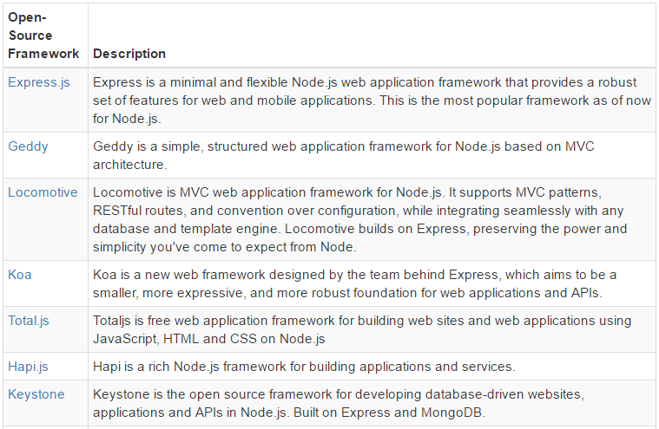
Introduction to Node.js
Frameworks for Node.js
There are various third party open-source frameworks available in Node Package Manager which makes Node.js application development faster and easy. The following table lists frameworks for Node.js.

Slide 57
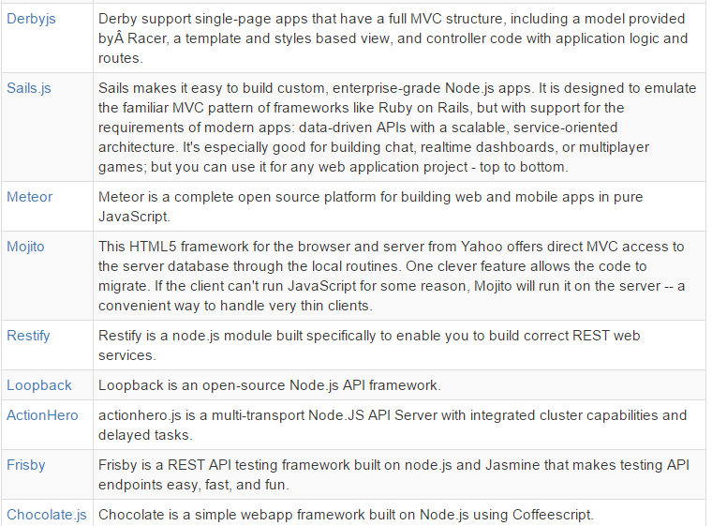
Introduction to Node.js

Slide 58
Introduction to Node.js
Event-Driven Programming
Node.js uses events heavily and it is also one of the reasons why Node.js is pretty fast compared to other similar technologies.
As soon as Node starts its server, it simply initiates its variables, declares functions and then simply waits for the event to occur.
In an event-driven application, there is generally a main loop that listens for events, and then triggers a callback function when one of those events is detected.

Slide 59
Introduction to Node.js
Event-Driven Programming
Events look quite similar to callbacks, the difference lies in the fact that callback functions are called when an asynchronous function returns its result, whereas event handling works on the observer pattern. The functions that listen to events act as Observers.
Whenever an event gets fired, its listener function starts executing.
Node.js has multiple in-built events available through events module and EventEmitter class which are used to bind events
// Import events module
var events = require('events');
// Create an eventEmitter object
var eventEmitter = new events.EventEmitter();
// Bind event and even handler as follows
eventEmitter.on('eventName', eventHandler);
// Fire an event
eventEmitter.emit('eventName');

Slide 60
Introduction to Node.js
Use fs.readFileSync() method to read file synchronously as shown below.
Example: Reading File Synchronously
var fs = require('fs');
var data = fs.readFileSync('dummyfile.txt', 'utf8');
console.log(data);
Writing File: Use fs.writeFile() method to write data to a file. If file already exists then it overwrites the existing content otherwise it creates a new file and writes data into it.
Method Signature: fs.writeFile(filename, data[, options], callback)
Parameters:
filename: Full path and name of the file as a string.
Data: The content to be written in a file.
options: The options parameter can be an object or string which can include encoding, mode and flag. The default encoding is utf8 and default flag is "r".
callback: A function with two parameters err and fd. This will get called when write operation completes.

Slide 61
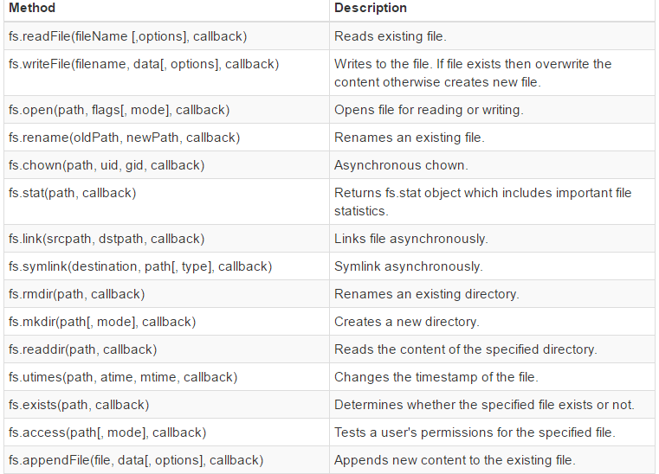
Introduction to Node.js
Important method of fs module:

Slide 62
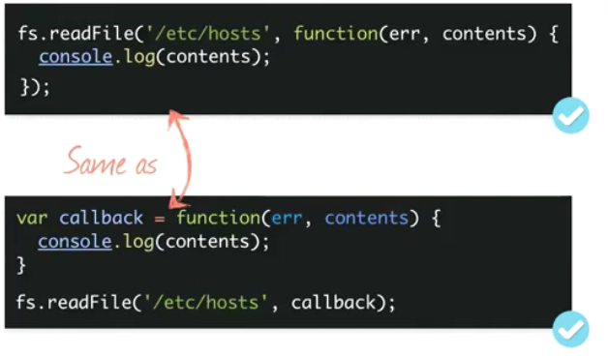
Introduction to Node.js

Slide 63
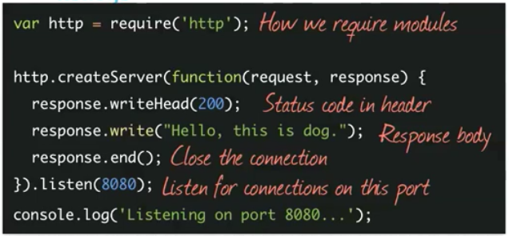
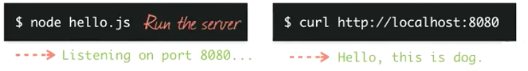
Introduction to Node.js

Slide 64
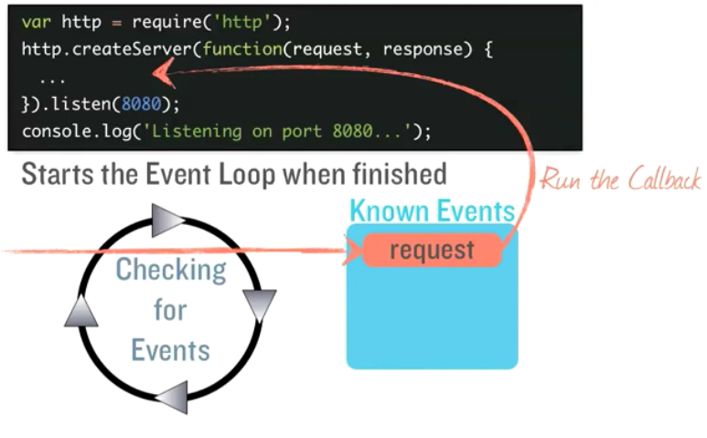
Introduction to Node.js

