Slide 1
HEART DISEASE
PREDICTION
USING MACHINE
LEARNING
A Mini Project by
Pratik Mulchandani 60004160065
Mudra Nagda 60004160067
Abigail Pereira 60004160076
Guide: Prof. Kriti Srivastava

Slide 2
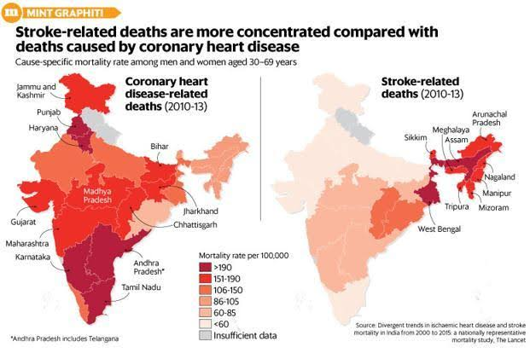
Deaths in India due to Heart Disease

Slide 3
Aim
In today’s fast-paced world, there has been a large increase in the number of ailments, especially those related to the cardiovascular system. It is estimated that 90% of heart-related diseases are preventable. There are many risk factors for heart diseases that we will take a closer look at.
The main objective of this study is to build a model that can predict the heart disease occurrence, based on a combination of features (risk factors) describing the disease. Different machine learning algorithms will be implemented and statistically compared using metrics such as accuracy.

Slide 4
Literature Review
Name: Heart Disease Prediction Using Data Mining
Authors: Ajad Patel, Sonali Gandhi, Swetha Shetty, Prof. Bhanu Tekwani
Publication: International Research Journal of Engineering and Technology (IRJET)
Date: 2017
Proposed Methods: Naive Bayes and Weighted Association Rule Mining (WARM)

Slide 5
Disadvantages
Naive Bayes:
Makes the conditional independence assumption
Weighted Association Rule Mining (WARM):
Finding appropriate parameter setting difficult
May result in generation of irrelevant rules
Sometimes rules are incomprehensible
Our Conclusion: the Associative Classifier in conjunction with Naïve Bayes used in this paper does not produce very accurate results
Notes:
-Ask support and conf from user
-lot of rules generated : irrelevamt
-too many variables in rules
Solutions to this limit no of variables : workaround

Slide 6
Literature Review
Name: A Heart Disease Prediction Model using Logistic Regression
Authors: K. Sandhya Rani, M. Sai Manoj, G. Suguna Mani
Publication: International Journal of Trend in Scientific Research and Development (IJTSRD)
Date: 2018
Proposed Methods: Logistic Regression

Slide 7
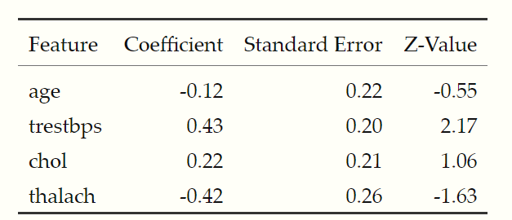
Disadvantages
Uses the Cleveland Heart Disease Database (303 samples 14 attributes) which contains correlated attributes.
The above table indicates that older people are less likely to suffer from a heart disease which seems illogical.
We need to be extra careful while choosing features that will be used in the logistic regression model.
Our Conclusion: the Logistic Regression model used in this paper is not as accurate as more complex Machine Learning algorithms such as Random Forests and SVM.
Notes:
Correlated
Log reg w age etc separately
Age ^ heart dis decr
So dont incl age
Keep checking w all features to get correct

Slide 8
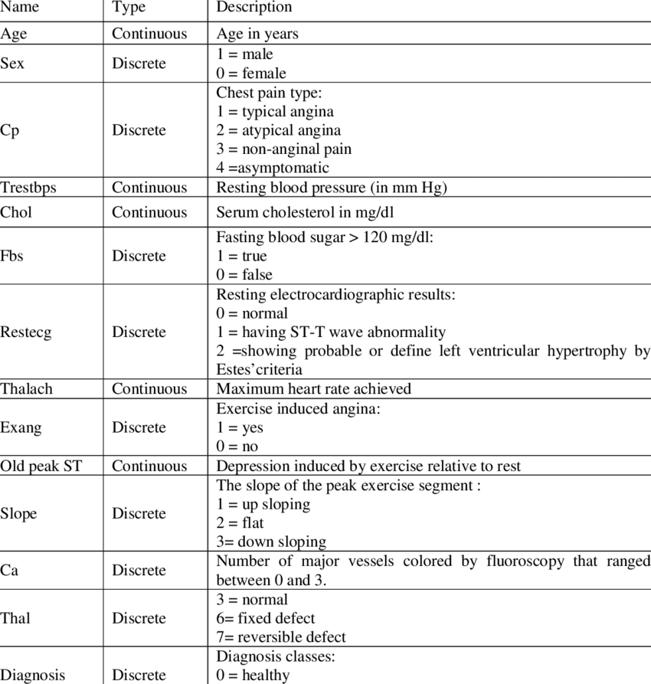
Dataset: UC Irvine Machine Learning Repository
Input features: 14
Target feature: Diagnosis (whether the person has been diagnosed with heart disease or not)

Slide 9
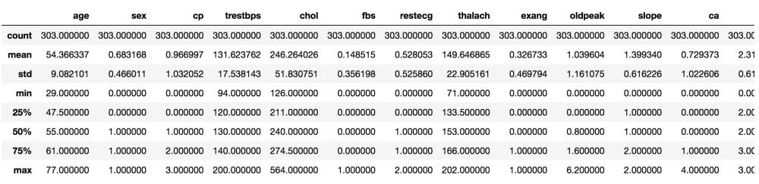
Description of the dataset

Slide 10
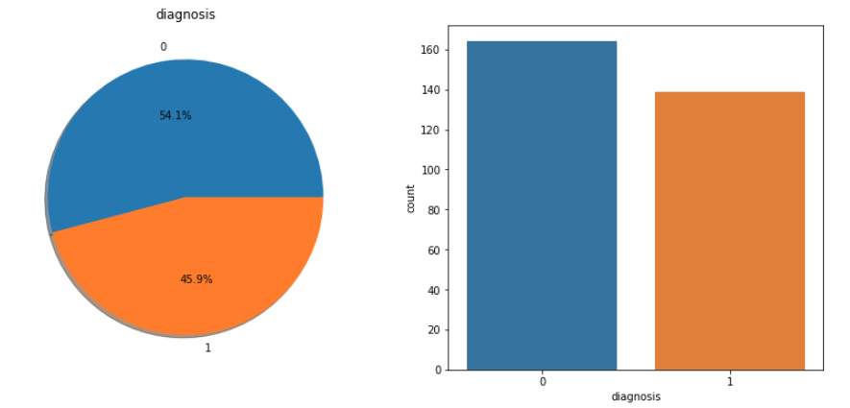
Dataset should be approximately balanced.
An extremely imbalanced dataset can render the whole model training useless and thus, will be of no use.
The plot indicates that the classes are almost balanced.
Distribution of target value

Slide 11
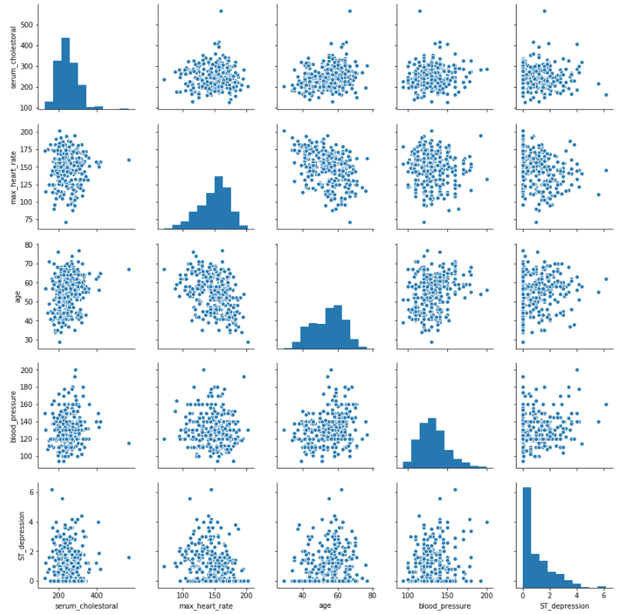
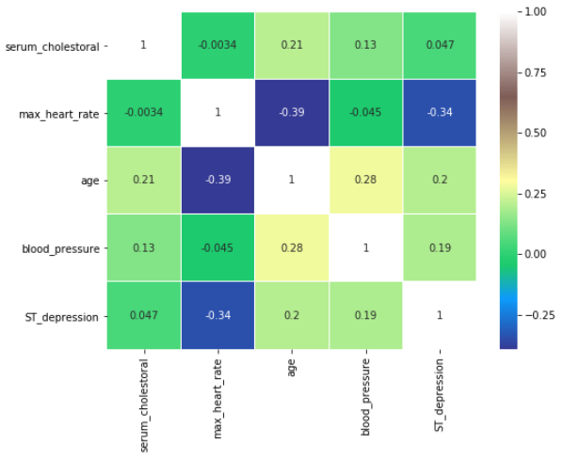
Pair plots and correlation matrix of all numeric features
One can observe that there is no single feature that has a very high correlation with another. Also, some of the features have a negative correlation with the target value and some have positive.

Slide 12
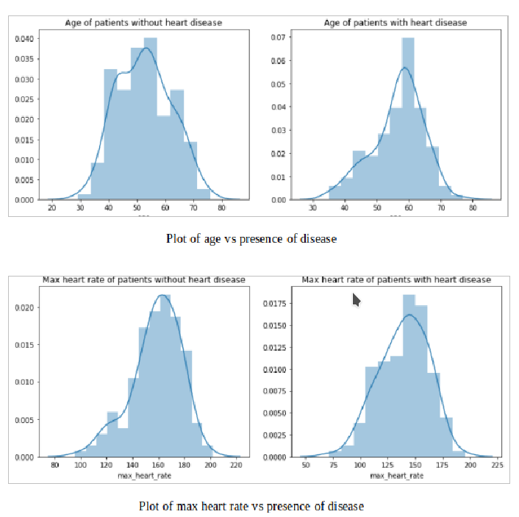

Slide 13
Pre-processing
Replace missing values with the mode of the remaining values.
Target Value has 5 values-
0 Disease absent
1-4 Indicating severity of disease present
Replace 1-4 with 1 to indicate disease present
.

Slide 14
Model Analysis
In this project, we have used several Machine Learning algorithms such as:
K-Nearest Neighbors (KNN)
Decision Trees
Logistic Regression
Gaussian Naive Bayes
Support Vector Machines (SVM)
Random Forests
The data was split into training and testing data sets using a 70-30 percent ratio. We then fed this cleaned training data to different machine learning algorithms and compared their predictions on the testing data. While doing so, we ensured the selection of optimum paths for KNN and Decision Trees in order to maximize the accuracy.
Notes:
K = 5, Dec tree depth = 6, no. of estimators in random forest=110, svc linear kernel

Slide 15
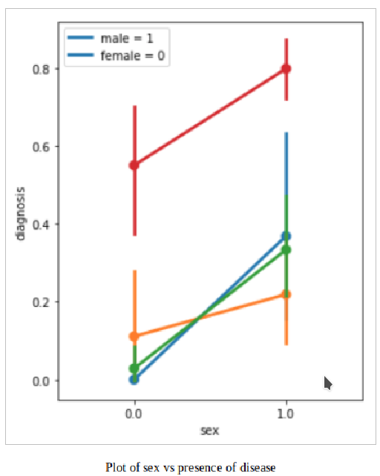
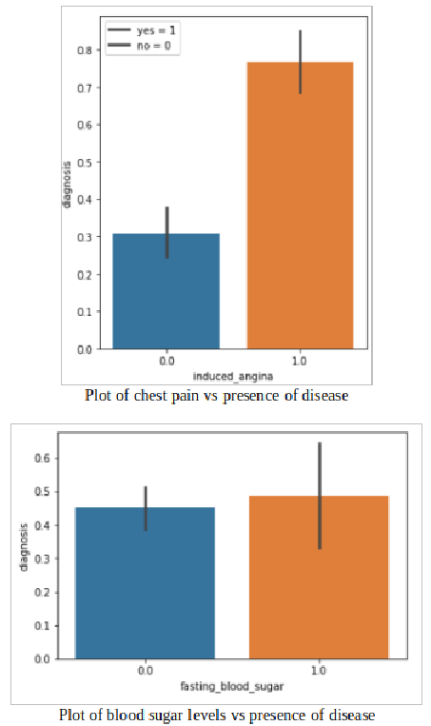

Slide 16
Results
 | Accuracy | Misclassification | Sensitivity | Specificity | Precision | Recall | FScore
KNN | 0.868 | 0.132 | 0.821 | 0.904 | 0.865 | 0.821 | 0.842
Decision Trees | 0.791 | 0.209 | 0.641 | 0.904 | 0.833 | 0.641 | 0.725
Logistic Regression | 0.857 | 0.143 | 0.795 | 0.904 | 0.861 | 0.795 | 0.827
Gaussian Naive Bayes | 0.868 | 0.132 | 0.821 | 0.903 | 0.865 | 0.821 | 0.842
SVM | 0.879 | 0.121 | 0.821 | 0.923 | 0.889 | 0.821 | 0.853
Random Forests | 0.890 | 0.109 | 0.846 | 0.923 | 0.892 | 0.846 | 0.868

Slide 17
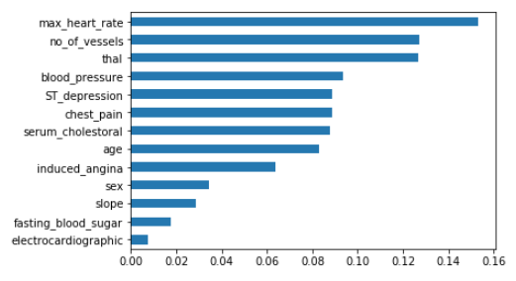
Significance of features according to the chosen model (Random Forests)

Slide 18
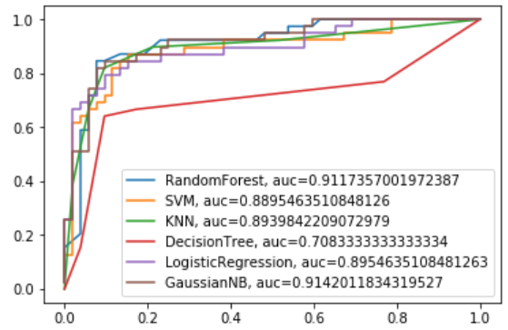
ROC Curve

Slide 19
Conclusion
The evolution in healthcare facilities has vastly improved the scope of disease prediction applications.
This project explores the use of machine learning algorithms such as KNN, SVM, Decision Trees, Logistic Regression, Naïve Bayes and Random Forests in order to predict heart disease.
The dataset used is from the UCI repository and contains numerical, as well as categorical data. This data is a set of 14 attributes, collected from 303 individuals who may or may not suffer from heart disease.
From the comparison of the various algorithms, Random forest classifiers are providing us with a maximum accuracy of 89.01%.
In the future, a larger dataset and more advanced algorithms may be used to improve the predictions even further. We hope to enhance this project in the future through further study and analysis.

Slide 20
Future Scope
In the future, a larger dataset and more advanced algorithms like Multilayer Neural Networks may be used to improve the predictions even further.
We hope to enhance this project in the future through further study and analysis.
Thank you!

