Slide 1
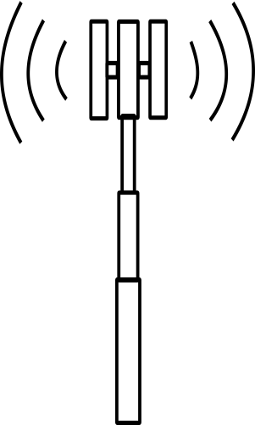
Testing Narrowband –Internet of Things
Narrow Band Internet of Things (NB-IoT) was introduced by 3GPP in release-13 as a platform to serve as a base for Internet of Things(IoT) infrastructure.
NB-IoT can be considered as a part of low power wireless network (LPWN) technology, which serves the concept of connecting small wireless devices, by using existing LTE network or GSM network. To meet the MTC application requirements for data rate, latency, and battery life, 3GPP introduced several functionalities in NB-IOT.
Low data rate
DL – 17.0 kbps
UL – 25.0 kbps
LTE+NB-IoT Cell
LTE Cell Edge
+20dB gain
NB-IoT Cell Edge
Enhanced network coverage Cover devices in poor coverage | Coverage enhancement
 | Channel Repetitions
 | Multi-Subframe
Low data rate Comply with IoT standards | Control Plane CIoT Optimization
 | User Plane CIoT Optimization
High Capacity ~50K devices per cell | Cross Subframe Scheduling
 | DL-Gaps
 | UL-Gaps
Re-use existing Cellular infrastructure LTE and GSM | LTE-Inband Mode
 | LTE-Guardband Mode
 | Standalone Mode
Power Saving Battery life up to 10yrs | eDRX
Key NB-IoT services validated in lab environment for Tier-1 Test & Measurement(TEM) equipment manufacturers

