Slide 1
Proteomic analysis indicates activation of reactive oxygen species signaling during seed germination and seedlings growth in Hordeum vulgare (Barley)
Seo Hyun Lee^{1#}, Ravi Gupta^{1#}, Yu Ji Kim¹, Cheol Woo Min¹, So Wun Kim¹, Woo Duck Seo², Sun Tae Kim^{1*}
¹Department of Plant Bioscience, Life and Industry Convergence Research Institue, Pusan National University, Miryang 627-706, Republic of Korea
²Division of Crop Foundation, National Institute of Crop Science, Rural Development Administration, Jeollabuk-do 565-851, Republic of Korea

Slide 2
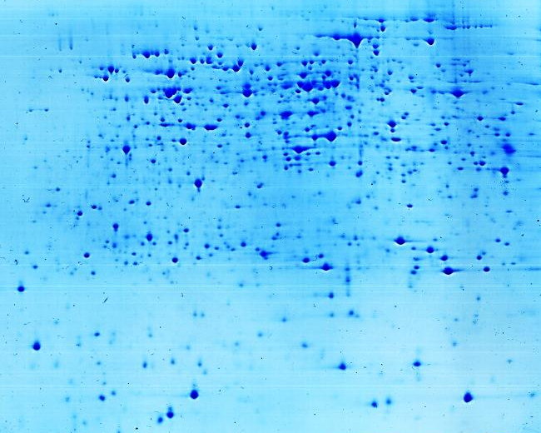
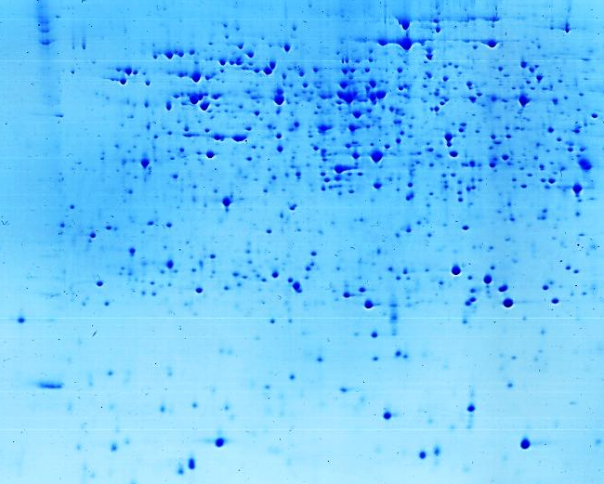
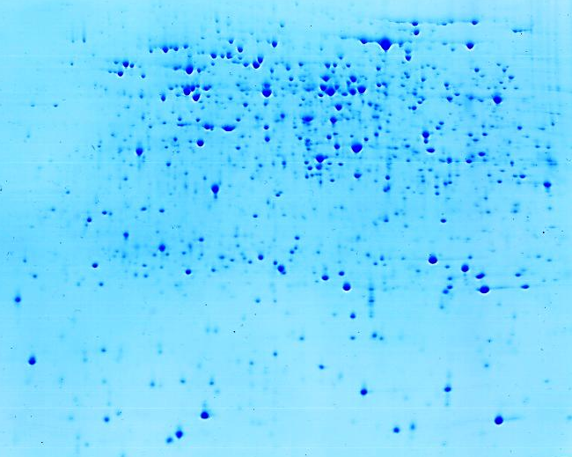
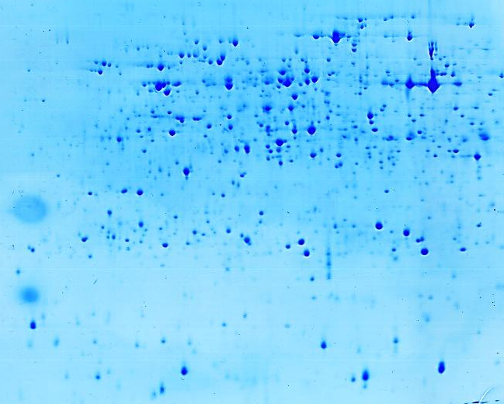
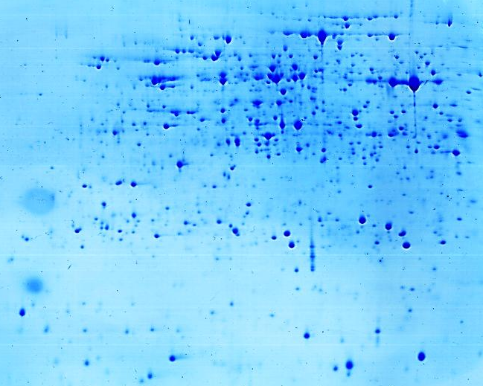
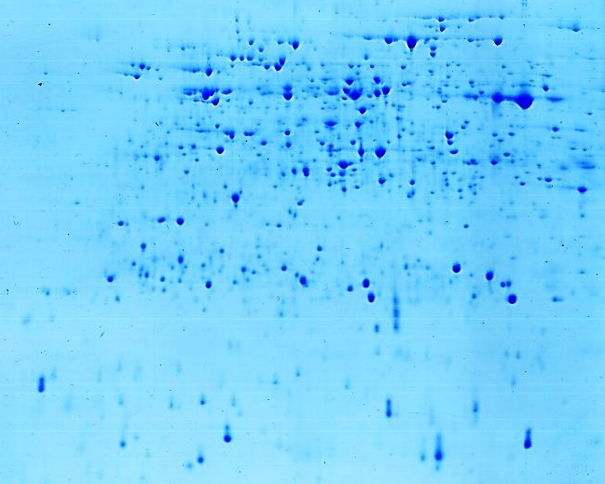
4
pI
7
4
pI
7
4
pI
7
100 -
D1-1
D1-2
D1-3
70 -
55 -
40 -
35 -
25 -
15 -
100 -
D2-1
D2-2
D2-3
70 -
55 -
40 -
35 -
25 -
15 -
Figure S1

Slide 3
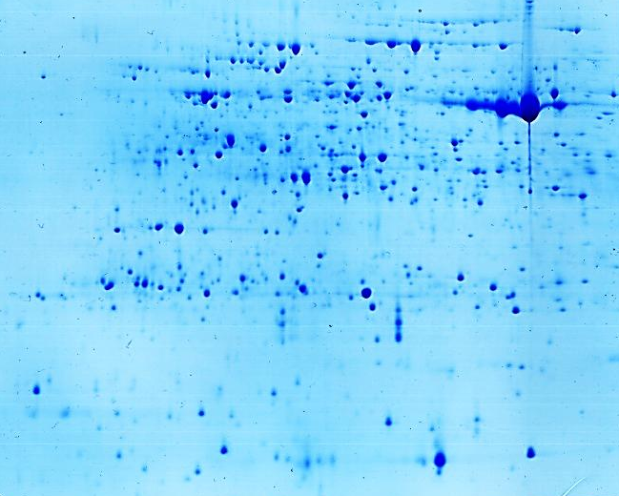
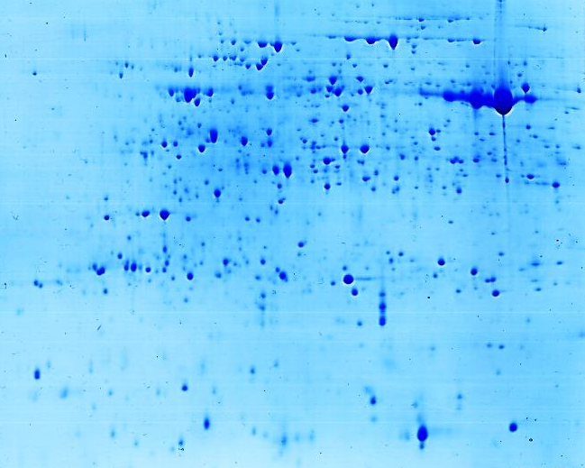
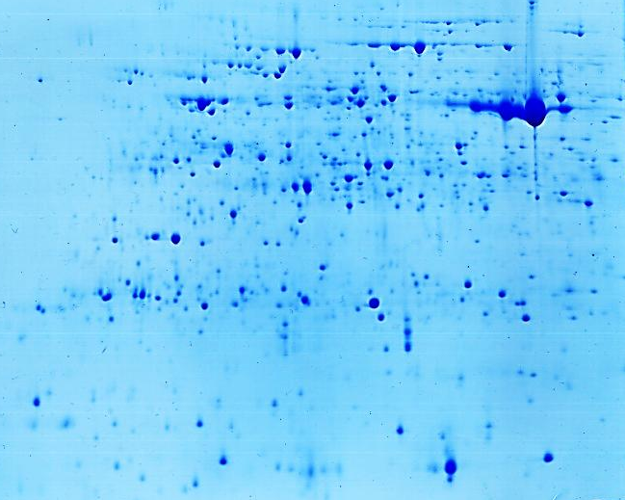
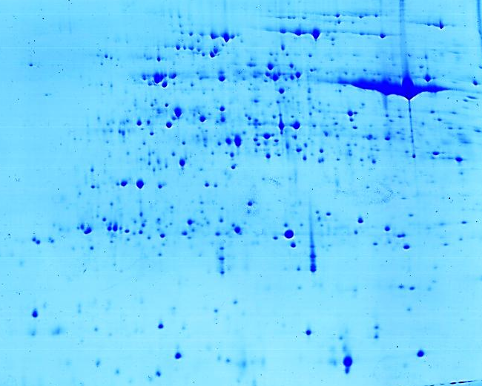
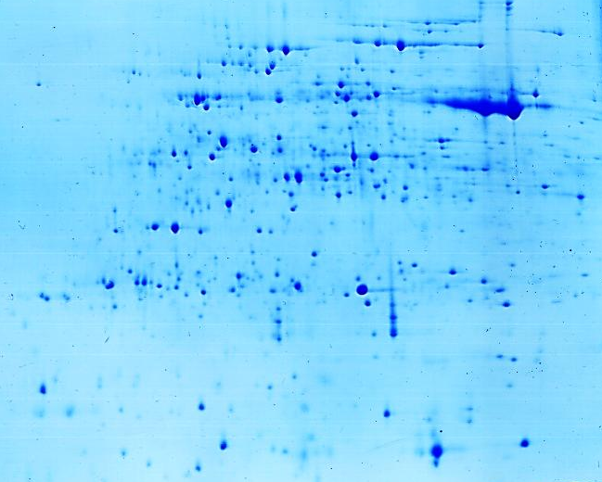
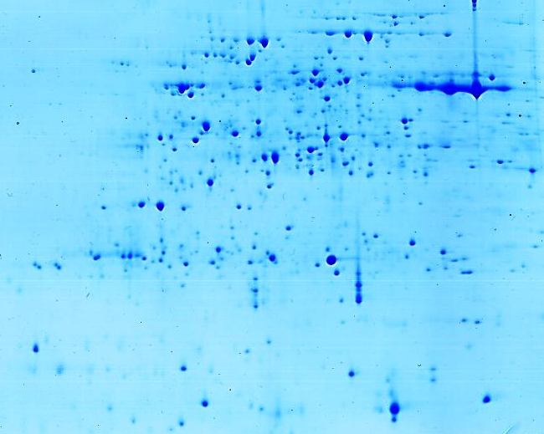
4
pI
7
4
pI
7
4
pI
7
100 -
D3-1
D3-2
D3-3
70 -
55 -
40 -
35 -
25 -
15 -
100 -
D4-1
D4-2
D4-3
70 -
55 -
40 -
35 -
25 -
15 -
Figure S1

Slide 4
Figure S1. Two-DE gel maps from three biological replicate samples at each germination stages.

