Slide 1




SMART INDIA HACKATHON 2026
TITLE PAGE
  Problem Statement ID – SIH26037
  Problem Statement Title- Adaptive Path Planning and Collision Avoidance for Autonomous Vehicles on Unstructured Indian Roads
  Theme- Smart Vehicles
  PS Category- Software
  Team ID-
  Team Name (Registered on portal) - Zapdos

Slide 2
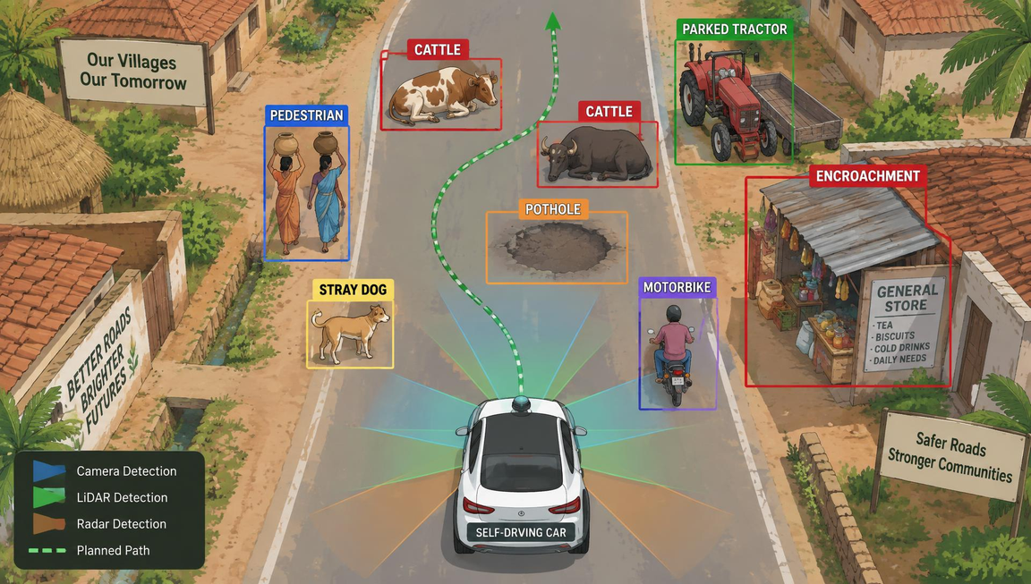

IDEA TITLE
Zapdos
  Proposed Solution
A ML based system which rely on object classification then collision-prediction based on sensor data to map optimal path.
﻿
Adressing the Problem:
  Abondoning the Lane marking approach, allows for expanded labels to be used for the dynamic environment present on indian road.
  Using Specific situation and then cross-training, to optimize for general situations, as indian streets change rapidly.
Solution Overview
Risk-Score per obstacle based on predictablity and danger.
Classification of Road and considering it when deciding suitable path.
2

Slide 3
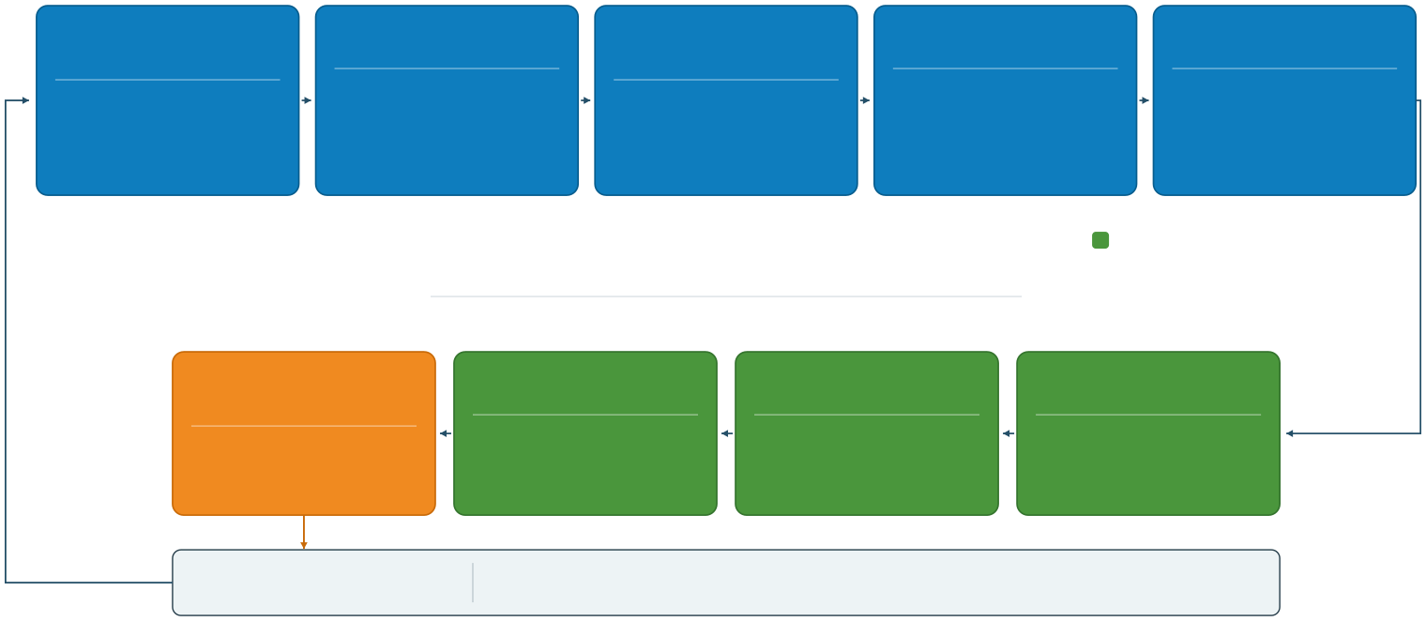
TECHNICAL APPROACH
Zapdos
1
SENSE · UNDERSTAND · ASSESS
SENSORS
LiDARToolbox · RadarToolbox Automated Driving Toolbox
SENSOR FUSION
PERCEPTION
Automated Driving Toolbox Deep Learning Toolbox
MOTION PREDICTION
RISK ASSESSMENT
MATLAB
Sensor Fusion & TrackingToolbox
MATLAB + ML Model
Camera / LiDAR / Radar
Unified view of surroundings
Object detection & classification Cars / Bikes / Pedestrians / Cattle / Autos / Carts
Future trajectories of detected objects
Collision probability and uncertainty
2
2
DECIDE · PLAN · ACT
HOW does the autonomous Driving System Work?
FEEDBACK LOOP
VEHICLE STATE
Vehicle Dynamics Blockset Bicycle Model
CONTROLLER
Simulink
PATH PLANNER
BEHAVIOR PLANNER
Stateflow
MATLAB · NavigationToolbox
Position / Velocity and orientation
Steering / Throttle and braking
Generate a safe driving trajectory
Stop / Yield / Pass Overtake / Replan
SIMULATION ENVIRONMENT
RoadRunner · RoadRunner Scenario
Simulated 3D roads, traffic, actors and test scenarios for the complete closed-loop stack
3

Slide 4
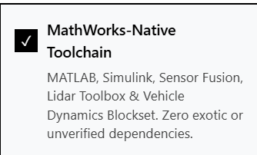
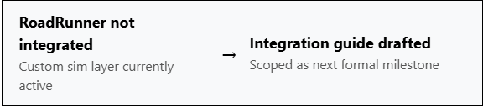
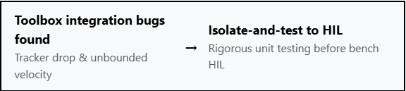
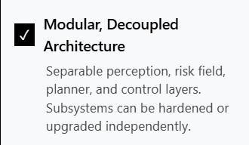
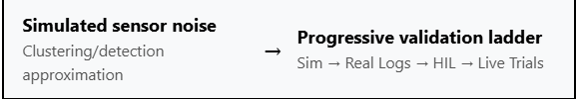
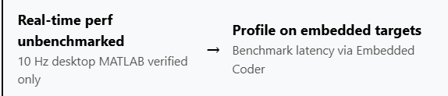
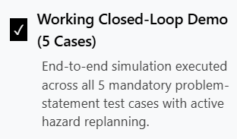

FEASIBILITY AND VIABILITY
Zapdos
5

Slide 5


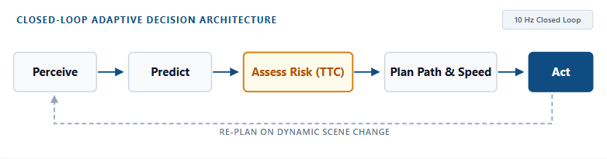
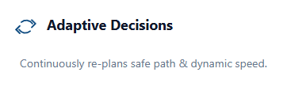

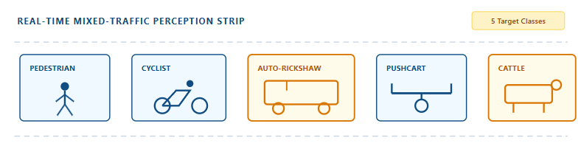
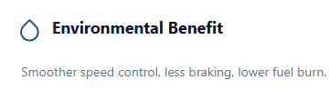
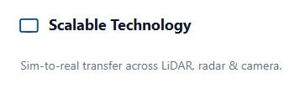
IMPACT AND BENEFITS
Zapdos
4

Slide 6
RESEARCH AND REFERENCES
Zapdos
GitHub REPO : https://github.com/prtkvrshny/NSUT-SIH-2026-26037
Demo Video : In GitHub REPO
6

