Slide 1
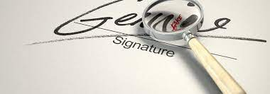
SIGNATURE FORGERY DETECTION & VERIFICATION
PRACHI KUMAR
ARTIFICIAL INTELLINGENCE AND DATA SCIENCE

Slide 2

INTRODUCTION
SRVS (signature recognition and verification) is a system which is capable of addressing two individuals
(a) Identification of the signature owner and who is forging it
(b) Decision whether the signature is genuine or forger
We will be creating a model that can test if a signature is forged
We will train the system by using a database of signatures
Once the model is trained on that dataset, it will be able to take that analysis as a reference for other future signature verification
If the absolute difference between the parameters of original signature and the verification signature is greater than a pre-defined threshold then the signature is identified as forgery

Slide 3

TOOLS & TECHNOLOGY
Technology:
Machine learning
Artificial Intelligence
Computer Vision
Neural Network
Tools:
NumPy
TensorFlow
Matplotlib
Pandas,
Keras
Google colab
DOMAIN: SECURITY

Slide 4

METHODOLOGY
This system will start with the input of the User ID [Format: XXX, i.e. 001]
The model will prompt user to enter the path of signature file we want to test
If the user ID is registered, the user will then be asked to sign for testing. The signatures will then proceed to the pre-processing (testing) stage and model can directly give results
If not registered, user has to drop down 5 sets of signature for training purposes.
Format of path signature image in our model is XXXZZZ_YYY.png
The input signs will be saved as reference signatures in the database while input testing signature will be saved as sample signature and proceed to the verification stage
In verification step, the sample sign will be compared with reference signs stored in the database
If the difference between 2 signs does not exceed the threshold value, the sample signature will be accepted as genuine signature if not it will be declared forged

Slide 5
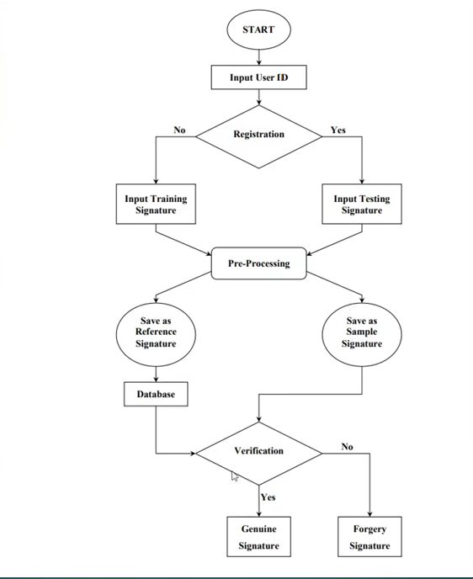
FLOWCHART
FLOW OF THE PROJECT
Prachi Kumar SDP

Slide 6
LITERATURE REVIEW
Have studied about 15 papers and inserted about 7 in my literature review
Overall idea:
- Technologies such as neural networks, parallel processing , etc. have been done to verify signatures
- New concept, ideas and algorithms are being experimented
- Measurements are made on the tracing of the signature points located on the skeleton of signature
- The results have however been observed to not be stable using the old techniques and model
- Hence online based verifications are now being more preferred using the latest and updated models with new algorithms

Slide 7
Conclusion & Result
Our model will be able to tell if the image part we entered into the model is forged or real
Format of signature image path in our model is XXXZZZ_YYY.png
XXX refers to the id of the person who has signed on the document(i.e -001)
ZZZ refers to the id of the person to whom the sign belongs in actual(i.e- 001)
YYY denotes the n’th number of attempt the model took to generate the result
We can verify if the model output is correct by the file name as XXX == ZZZ then image is genuine otherwise the signature is forged
or
We will be able to check the model’s accuracy of result by tracing back to the image file number in our files folder on desktop to ensure the model has given the correct output

Slide 8
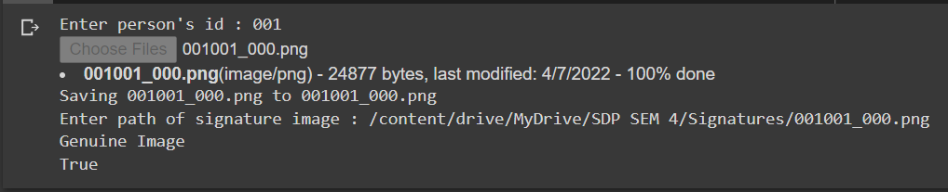
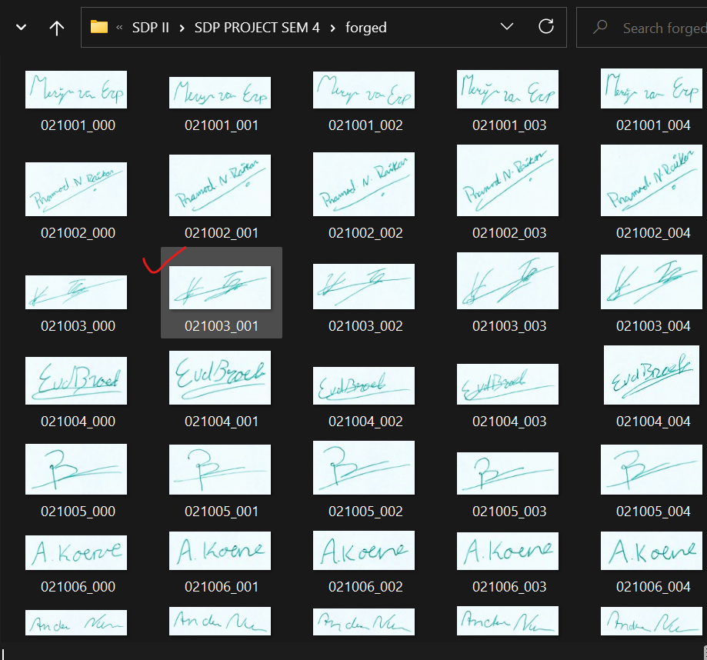
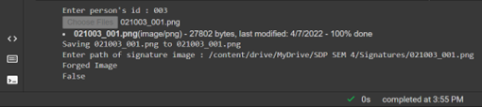
Cross checking if the model result was correct
Output for genuine
Output for forged

Slide 9
TIMELINE OF COMPLETION
Task | Start Date | End Date | Duration (Days)
Learn singnature forgery cases | 01-03-2022 | 15-03-2022 | 14
Study research papers | 15-03-2022 | 01-04-2022 | 17
Mid Sem Review Preparation | 01-04-2022 | 12-04-2022 | 11
Preprocess data | 12-04-2022 | 17-04-2022 | 5
Feature Extraction | 17-04-2022 | 25-04-2022 | 8
Saving the features | 25-04-2022 | 30-04-2022 | 5
TensorFlow Model creation | 30-04-2022 | 08-05-2022 | 8
Final Review (Presentation+Report) | 08-05-2022 | 15-05-2022 | 7

Slide 10
REFERENCES
https://towardsdatascience.com/signature-fraud-detection-an-advanced-analytics-approach-a795b0e588b2
Score Level Fusion of Classifiers in Off-line Signature Verification research paper
High Performance Offline Signature Verification and Recognition Method usingNeuralNetwork
A new system for offline signature identification and verification
Online Signature Forgery Prevention
Off-line Handwritten Signature Verification Using Compositional Synthetic Generation Of Signatures And Siamese Neural Networks
Image Splicing Forgery Detection Combining Coarse to Refined Convolutional Neural Network and Adaptive Clustering:
Handwritten Signature Forgery Detection using Convolutional Neural Networks
Algorithm for Bayesian Dynamic Signature Verification
THANK YOU

