Slide 1
Artificial neural and Adaptive systems
Home work 3
Prudhvi sai suggala
16236300

Slide 2
Task1
To find out the best configuration for tdnn for given Acc dataset and check performance of net using Subject specific and Subject independent type of training patterns .
Selected configuration for the tdnn Number of tap delay lines ,hidden layers = 22 ,10 by selecting the minimum err and maximum auc ,Evaluated for combinations of (19,22,23) delay lines and (10,13,16) for hidden layers

Slide 3


Slide 4
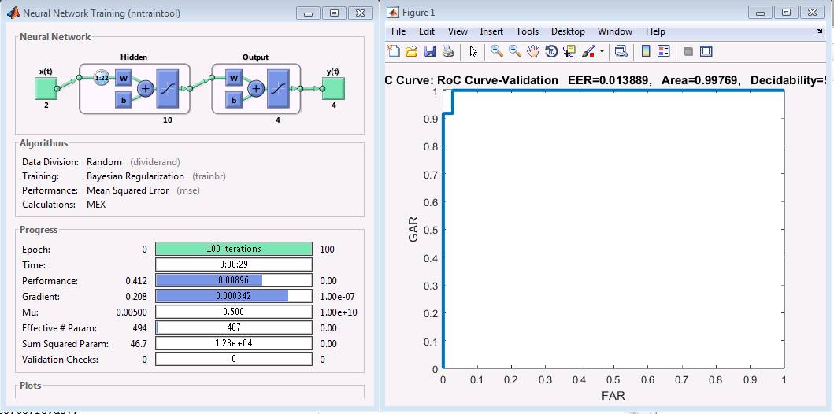
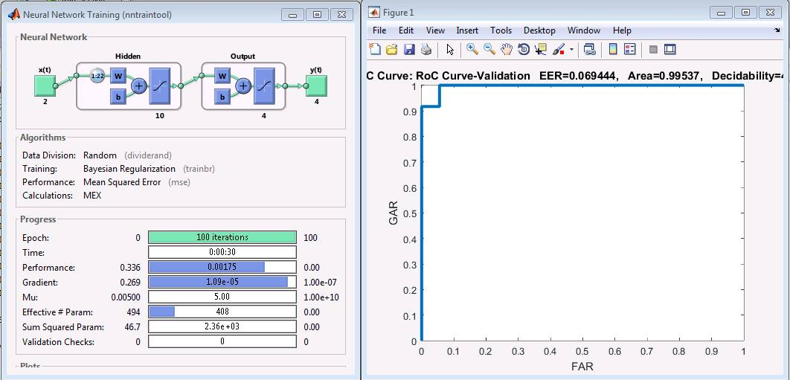
Results for Subject Specific Tdnn
User 1 & 2

Slide 5
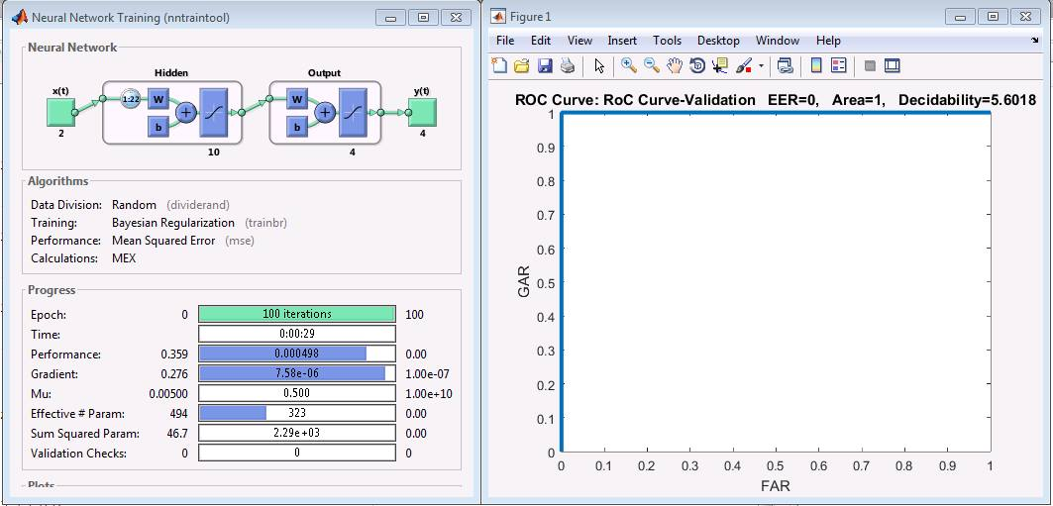
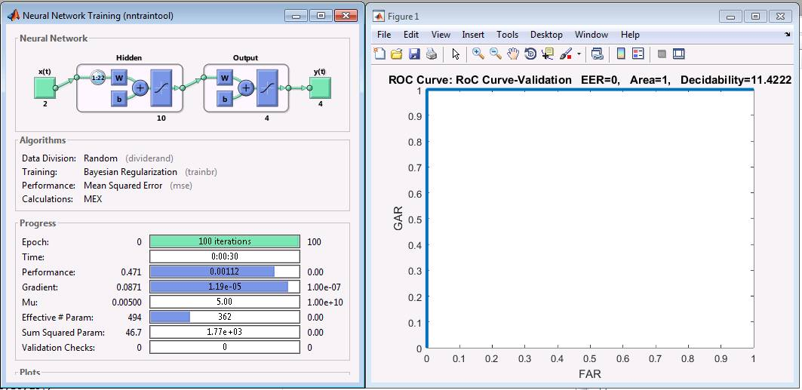
User 3 & 4

Slide 6
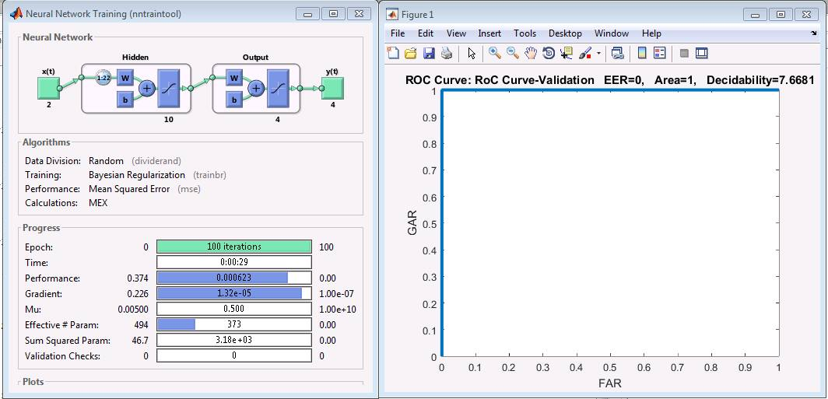
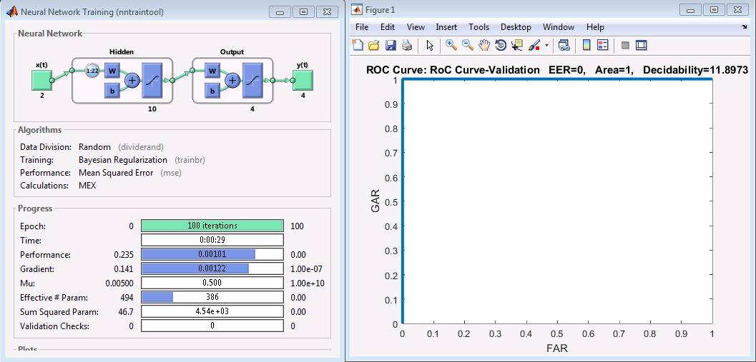
User 5 & 6

Slide 7
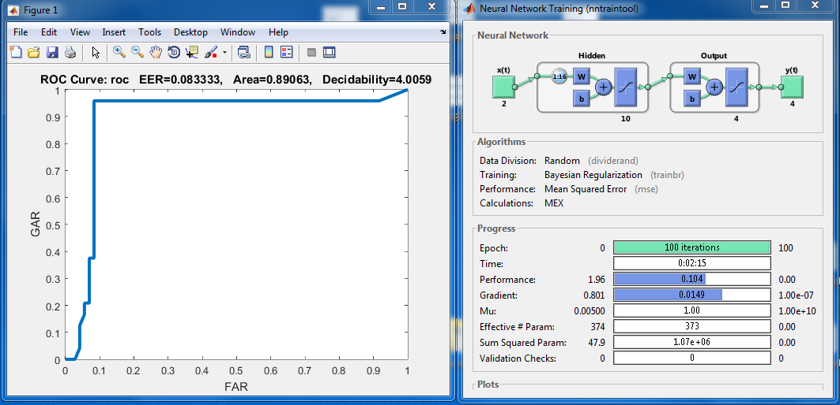
Results of subject independent Tdnn

Slide 8
Task 2
To find out the best configuration for Narx for given Acc dataset and check performance of net using Subject specific and Subject independent type of training patterns .
Selected configuration for the Narx Number of tap delay lines ,hidden layers = 6, 4, 3 by selecting the minimum err and maximum auc ,Evaluated in the below for loop pattern as n input delay line , N as feed back delay line length and hidden layer size
for n = 4:2:6
for N = 2:2:4
for H1=3:3:6

Slide 9
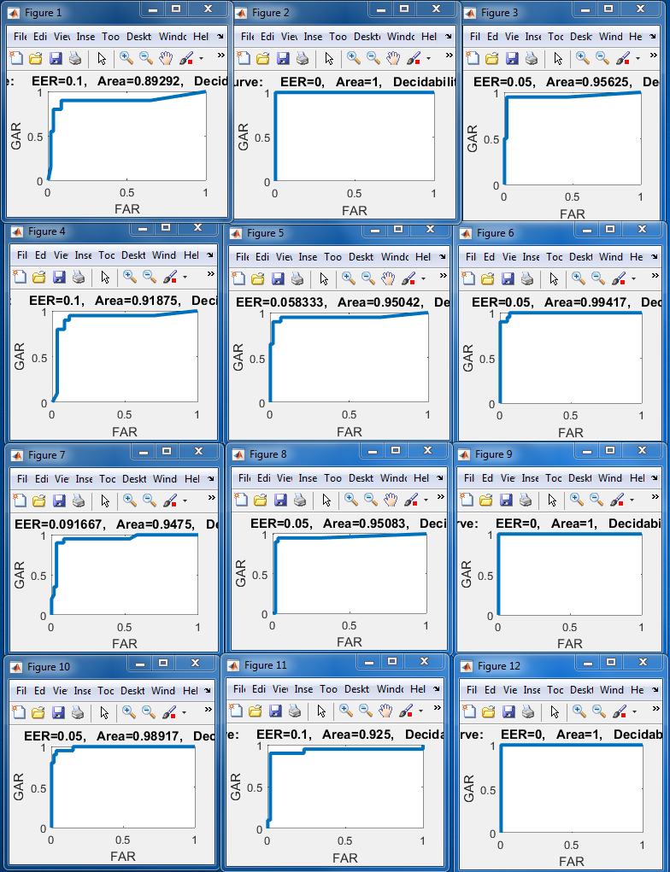

Slide 10
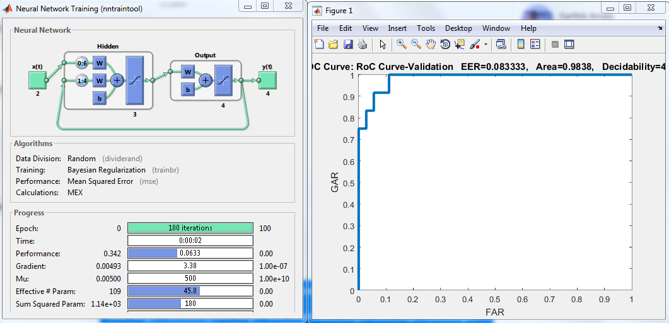
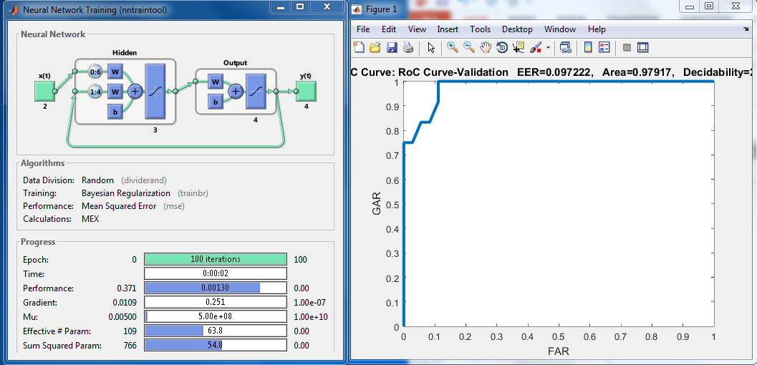
Results for Subject Specific Narx
User 1 & 2

Slide 11
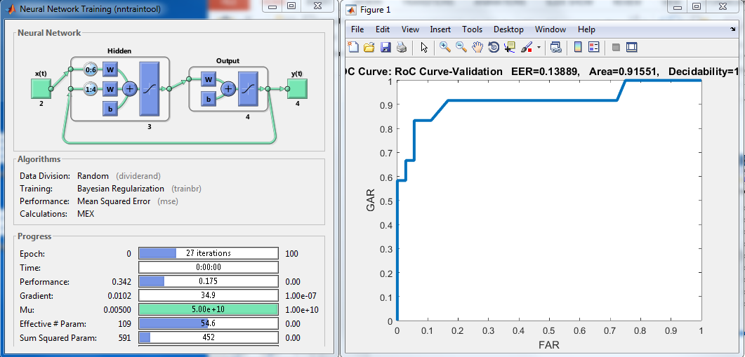
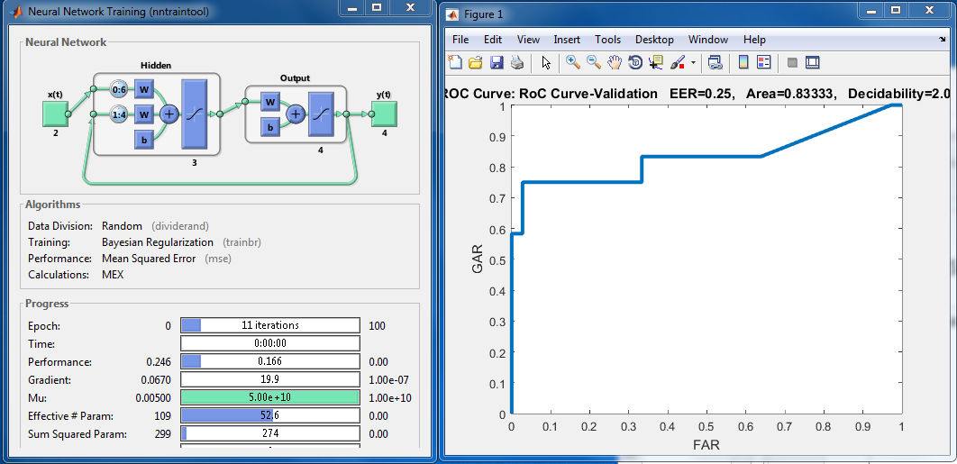
User 3 & 4

Slide 12
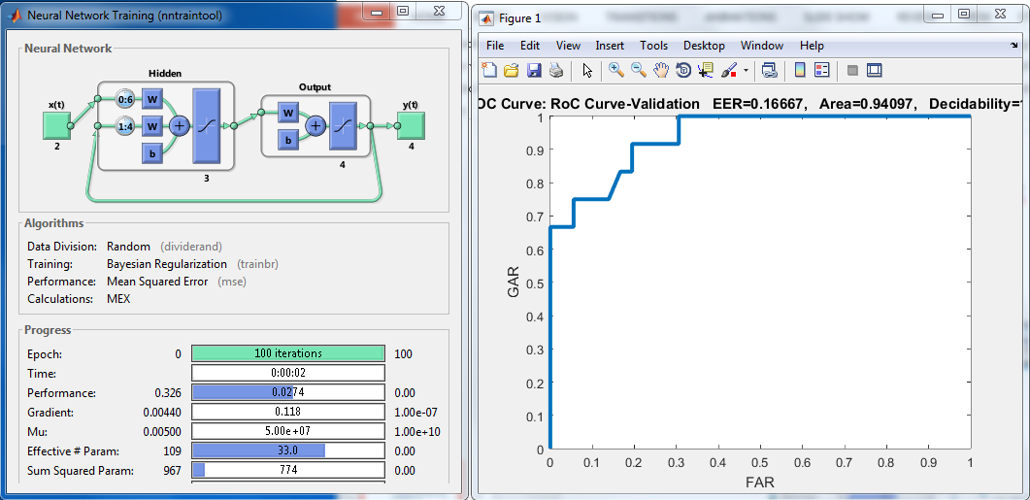
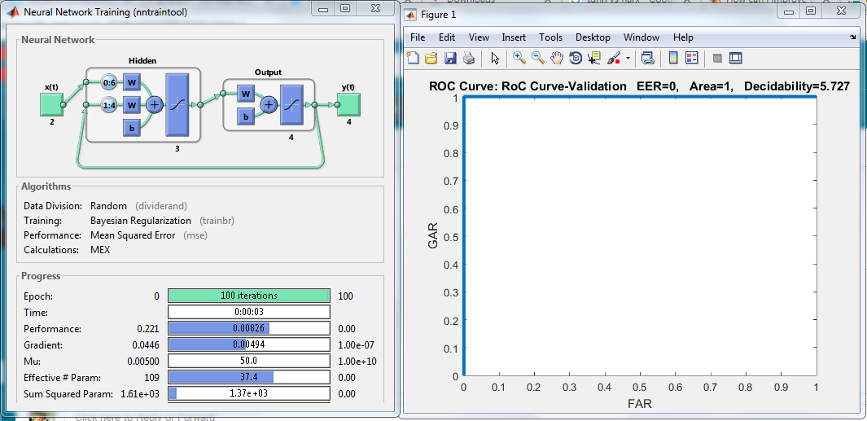
User 5 & 6

Slide 13
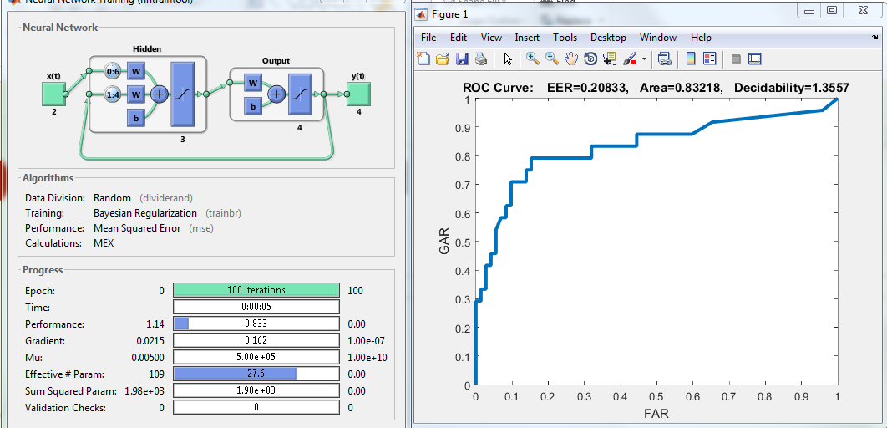
Results for subject independent narx

Slide 14
Conclusion
Accuracy of tdnn is more compared with narx
In terms of Complexity narx wins with the minimum tap delay , which makes it less calculative with good performance.
Though Subject specific got a great score it may / may not perform well because it had not seen much data , Subject independent kind of approach wins in real world scenarios .

