Slide 1
Enhancing E-Commerce Performance - A PySpark and ML Approach
Company Name: L&T Technology Services
Intern Guide :
Dr.N.Yamuna Devi
Associate Professor
Name: DHARUN PRUDHIV M
Roll No: 2033010
Course : M.Sc DCS

Slide 2
TABLE OF CONTENTS
About Organisation
Problem Statement
Dataset Description
Preprocessing
Exploration Data Analytics
Model Specification
Methodology
Evaluation Metrics
Model Performance
Inferences and Result
Conclusion

Slide 3
ABOUT ORGANIZATION
L&T TECHNOLOGY SERVICES
L&T Technology Services (LTTS) is an Indian multinational technology company that provides engineering research and development (ER&D) services, headquartered in Vadodara. The company's business interests include automotive engineering, embedded system and semiconductor engineering, industrial internet of things, manufacturing plant engineering, and medical engineering.

Slide 4
PROBLEM STATEMENT
Boost overall sales during the upcoming Christmas season.
Increase sales by a specified percentage.
Identify and showcase products with historically low sales and highlight those with higher profit margins.
Uncover trends, patterns, and customer preferences to inform strategic decisions.

Slide 5
DATASET DESCRIPTION
COLUMNS :
Invoice Number - Unique ID of Transaction
Product Code - Unique ID of Product
Description - Product Description
Brand - Product Brand
Category - Category of the Product
Sub Category - Sub Category of the Product
Actual Price - Actual Price printed on Product

Slide 6
DATASET DESCRIPTION
COLUMNS :
Profit Margin in Percentage
Discount Percentage - Discount offered on Product
Quantity - Quantity sold
Transaction Amount - Amount spent on purchasing product
Invoice Date - Date of Transaction
Customer ID - Unique ID of Customer
Country - Customer Country
Mode of Payment - Cash or Card

Slide 7
PREPROCESSING
Feature Engineering with PySpark UDF
Leveraged PySpark UDFs to derive key features, including Selling Price, Profit Price, Year, Month, Day of Week, and Profit/Loss.
This transformative step enhances the dataset, providing valuable insights for subsequent analyses.

Slide 8
PREPROCESSING
Checked for null values using the isnull() function in Pandas.
Detected duplicates through the duplicated() function for maintaining data integrity.
Utilized a custom Python UDF to identify and handle negative values in transaction amounts and actual prices, ensuring data integrity and bolstering analysis precision for reliable project outcomes.

Slide 9
PREPROCESSING
Parsed dates from ISO format to DD-MM-YYYY and performed data type casting, laying the foundation for streamlined analysis and enhanced model training.
Applied LabelEncoder to encode categorical variables, ensuring uniform data representation and facilitating seamless integration for subsequent analyses.

Slide 10
PREPROCESSING
Normalization
Employed MinMaxScaler for normalization, a crucial step to ensure consistent scales across numerical features.
The normalization process promoted a balanced and more accurate representation of the data, enhancing the overall effectiveness of the analysis.

Slide 11
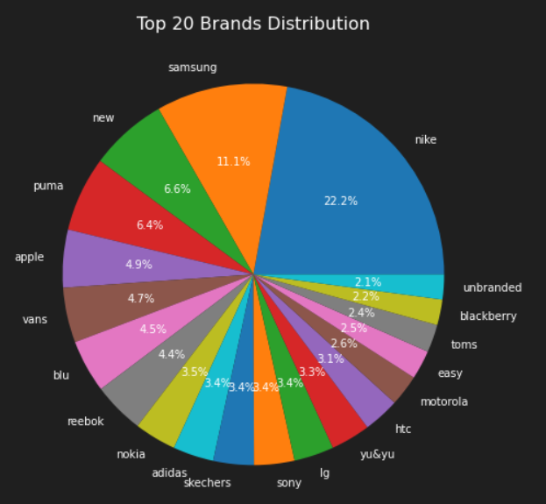
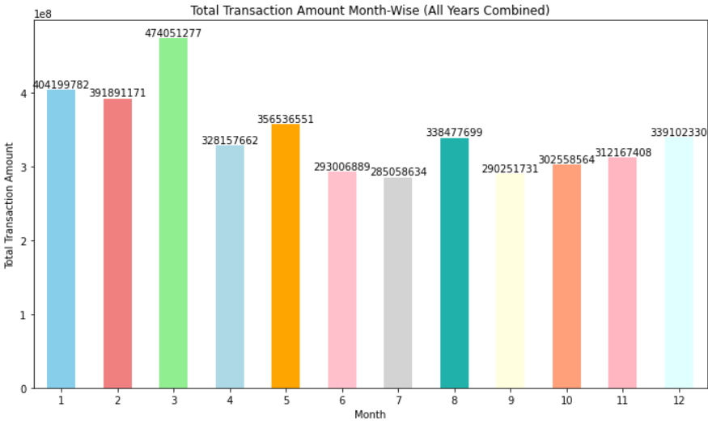
EXPLORATORY DATA ANALYSIS
Applied both univariate and bivariate analysis to gain insights into individual variable distributions, trends, and relationships between pairs of variables.

Slide 12
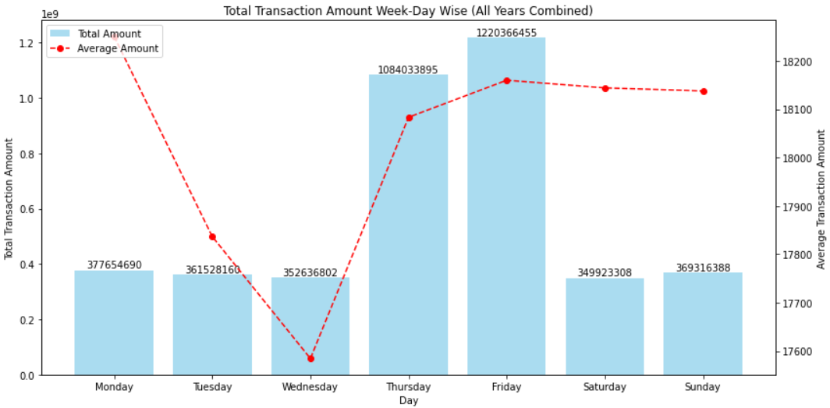
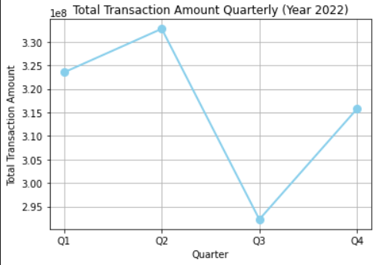
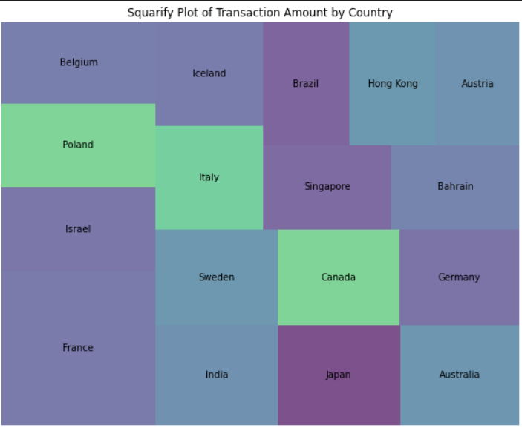
EXPLORATORY DATA ANALYSIS
Applied temporal and region-wise analysis to uncover patterns in transactional data, enabling insights into seasonal trends and regional preferences for targeted strategies.

Slide 13
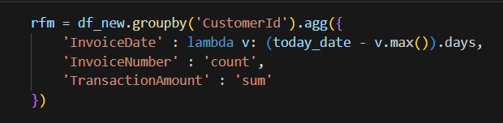
EXPLORATORY DATA ANALYSIS
RFM Analysis
Conducted RFM (Recency, Frequency, Monetary) analysis to categorize customers into segments based on their purchasing behavior. This segmentation aids in personalized targeting and tailored marketing strategies for enhanced customer engagement.
Categorized customers into three distinct rankings based on their RFM scores: Low, Medium, and High

Slide 14
EXPLORATORY DATA ANALYSIS
PySpark Analysis
Leveraged PySpark for focused inventory optimization, spotlighting leading brands in November, December, and January.
Recognized and prioritized top five brands each year, facilitating informed inventory strategies.
Quarterly breakdown of products sold, revenue generation, and category-wise and brand-specific sales metrics. Provides comprehensive insights for investors into sales trends, category performance, and brand-specific sales volume across the years 2020 to 2023.

Slide 15
EXPLORATORY DATA ANALYSIS
PySpark Analysis
Profitable Product Identification (2020-2023): The analysis pinpoints products with substantial profit potential during the years 2020 to 2023. Brands are strategically encouraged to channel their marketing efforts towards these products, aiming to maximize overall profitability.
Brand-wise Segregation: Categorized products by brand, highlighting best and least-performing categories. Company utilize this data for strategic marketing and optimized inventory decisions.

Slide 16
EXPLORATORY DATA ANALYSIS
PySpark Analysis
Optimizing Lightning Deals involves identifying consistent top-performers for impactful promotions, emphasizing high-profit Christmas season products, and addressing the strategy for the lowest-selling items.
This data-driven approach ensures a focused selection for lightning deals, aligning with the goal of profit maximization.

Slide 17
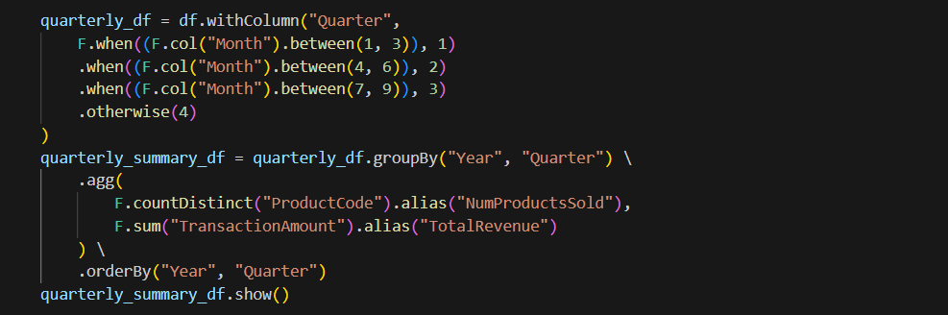
EXPLORATORY DATA ANALYSIS
PySpark Analysis - Sample Code

Slide 18
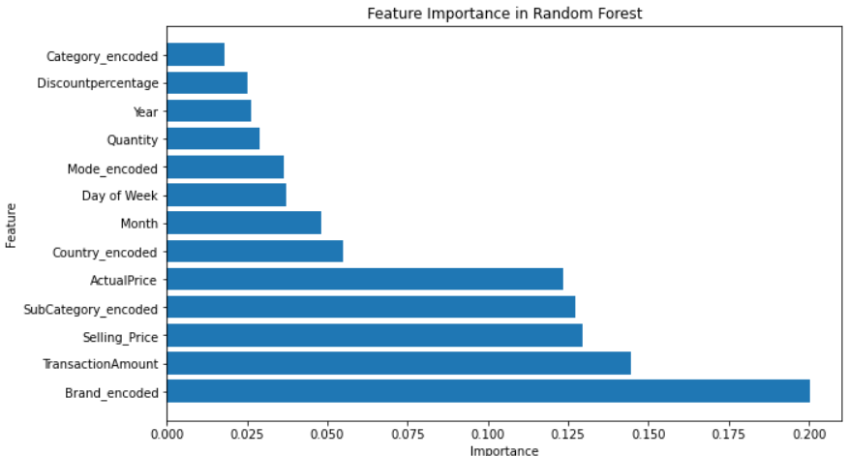
EXPLORATORY DATA ANALYSIS
Feature Importance
Leveraged RandomForest's Feature Importance for efficient feature selection in model implementation. Enhances model efficiency while offering insights into feature significance.

Slide 19
MODEL SPECIFICATION
Utilized both regression and classification models in the analysis.
This dual approach provides insights into pricing dynamics and overall product profitability.

Slide 20
MODEL SPECIFICATION
REGRESSION MODELS:
Multiple Linear Regression
Decision Tree Regressor
Leveraged the columns including brand, subcategory, and selling price to implement regression models for predicting profit prices in the e-commerce dataset.

Slide 21
MODEL SPECIFICATION
CLASSIFICATION MODELS:
Random Forest Classifier
XG Boost Classifier
KNN Classifier
Gradient Boosting Classifier
Implemented classification models utilizing columns such as brand, subcategory, and selling price. These models were employed to predict whether a transaction results in profit or loss in the e-commerce dataset.

Slide 22
METHODOLOGY
Rigorous assessment of model performance on training and test datasets.
Generation of comprehensive reports with metrics such as accuracy, AUC-ROC, precision, recall, and F1 score.
Visualization of model discrimination ability through AUC-ROC curves.
Insights into true positives, true negatives, false positives, and false negatives.

Slide 23
METHODOLOGY
Blend of Linear regressor and DecisionTree regressor models to enhance predictive accuracy.
Fusion of RandomForest and KNN classifier models to boost accuracy in classification tasks.
Implementation of ensemble learning approach for enhanced model robustness and classification performance.

Slide 24
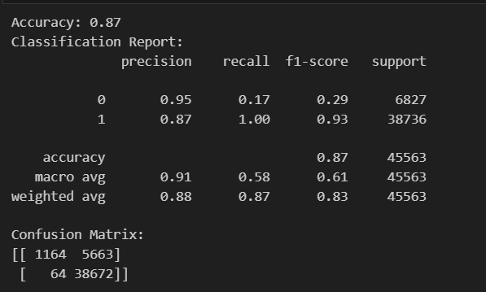
EVALUATION METRICS
Mean Squared Error (MSE): Measures the average squared difference between predicted and actual values, indicating the model's precision in regression tasks.
Common Evaluation Metrics: Accuracy measures overall correctness, Precision evaluates positive prediction accuracy, Recall assesses identifying relevant instances, and F1 Score balances precision and recall harmoniously.

Slide 25
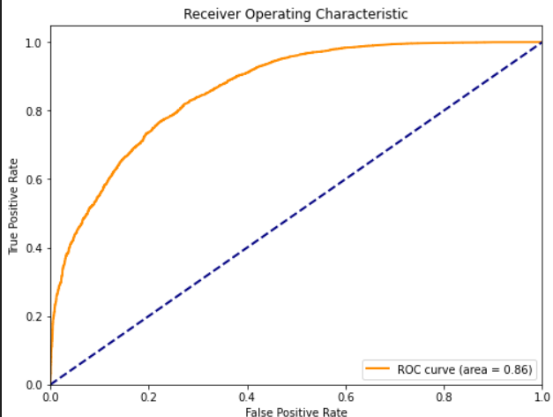
EVALUATION METRICS
AUC-ROC Score: Quantifies discrimination ability; a higher score indicates superior performance.

Slide 26
MODEL PERFORMANCE
Results of Regressor Models:
MODEL | MSE | R2 score
Linear Regression | 9.834 | 0.87
Decision Tree Regression | 3.269 | 0.95

Slide 27
MODEL PERFORMANCE
Results of Classification Models:
MODEL | ACCURACY | PRECISION | RECALL | F1 SCORE
Random Forest Classifier | 0.98 | 0.97 | 0.99 | 0.95 | 1.00 | 0.96 | 0.99
XG Boost Classifier | 0.87 | 0.95 | 0.87 | 0.17 | 1.00 | 0.29 | 0.93
Gradient Boosting Classifier | 0.85 | 0.97 | 0.85 | 0.00 | 1.00 | 0.01 | 0.92
KNN Classifier | 0.98 | 0.92 | 0.99 | 0.93 | 0.99 | 0.93 | 0.99

Slide 28

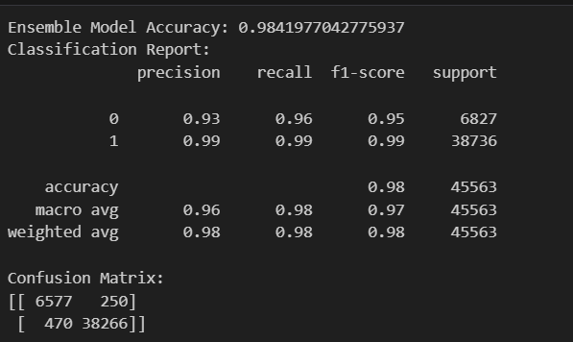
MODEL PERFORMANCE
Results for Ensemble approach - Regressor model:
Results for Ensemble approach - Classification model:

Slide 29
INFERENCES AND RESULT
Decision Tree Regression: Outperforms multiple linear regression with lower MSE and MAE. High R-squared (R²) value (0.958) indicates a strong performer.
Ensemble Model Outperforms Others: The ensemble model consistently provides the most accurate predictions with very low MSE, the highest R-squared (0.96408), and the lowest MAE. Precision in predictions is crucial for accuracy-critical tasks.

Slide 30
INFERENCES AND RESULT
XG Boost Classifier: Lower accuracy (87%) but maintains respectable precision, recall, and F1-score for positive class prediction.
Both RandomForest Classifier and KNN Classifier exhibit a remarkable level of accuracy.
Ensemble Model (KNN and RandomForest): High overall accuracy (98.4%) indicates effective data classification. The ensemble approach leverages strengths for balanced precision and recall.

Slide 31
CONCLUSION
Customer segmentation using RFM analysis paved the way for tailored marketing strategies, elevating customer experiences.
The seamless integration of PySpark ensured efficient data preprocessing and analysis.
Decision tree regression excelled over linear regression for profit price prediction, and the Random Forest Classifier achieved an impressive accuracy in classifications.
The implementation of ensemble learning techniques contributed to the enhancement of accuracy.

Slide 32
BIBLIOGRAPHY
1. Johnson,Emily. "Machine Learning Algorithms for E-commerce Optimization."
https://www.exampleconferencewebsite.com/conference-paper-123
2. Brown, Robert. "Customer Segmentation Strategies in E-commerce."
https://www.exampleecommercejournal.com/article-456
3. White, Michael. "Ensemble Learning Techniques for Improved Classification in E - commerce." https://www.examplemachinelearningconference.com/classification-paper
4. Apache Spark. https://spark.apache.org/docs/latest/api/python/index.htmL
5. Spark. https://sparkbyexamples.com

Slide 33
THANK YOU

