Slide 1
The Prediction of Transmembrane domain by GHMM
Chia-HsuanChou, Venkata Prudhvi Raj Indana, Jing Wang
Feb 19, 2016

Slide 2
Goal
Our goal is to apply Generalized Hidden Markov Model (GHMM) on the prediction of transmembrane domains.

Slide 3
Procedure
Input
TMseq.ffa
Six Elements
Observation, Hidden States, Initial, Transition, Emission, Length Duration
GHMM
Viterbi Algorithm
Output
Comparison
Probability of every hidden state at each amino acid, Maximum score, Prediction of transmembrane domain
TMHMM

Slide 4
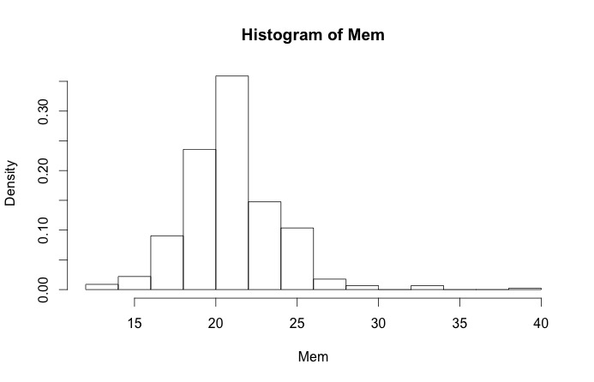
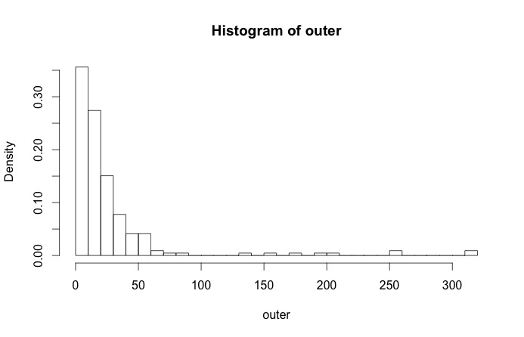
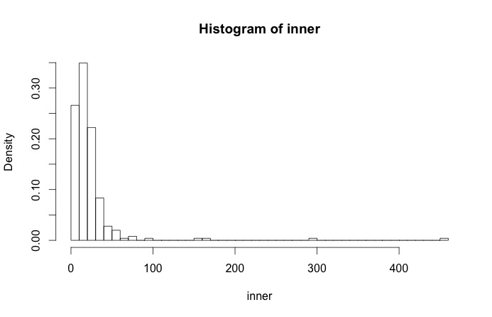
Length Duration
For each state, the length counts are binned by a certain range
R code is used to plot the binned data and calculate frequency

Slide 5
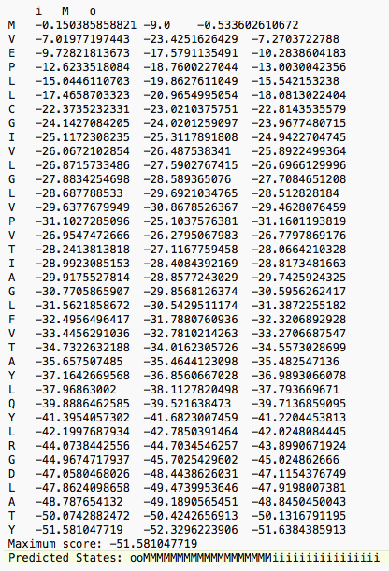
Result

Slide 6
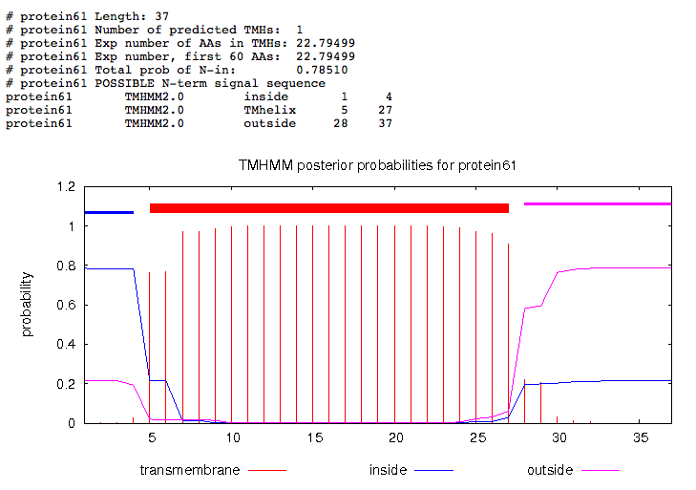
Compare with TMHMM
No.61 line of the protein sequence in TMseq.ffa MENLNMDLLYMAAAVMMGLAAIGAAIGIGILGGKFLEGAARQPDLIPLLRTQFFIVMGLVDAIPMIAVGLGLYVMFAVA

Slide 7
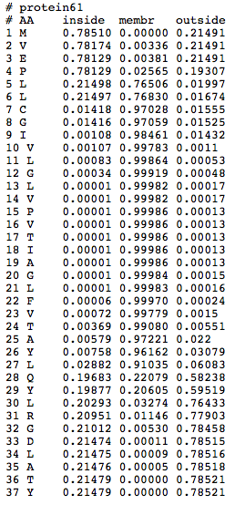
Compare with TMHMM (cont.)
They generate three scores (inside/membrane/outside) for every amino acid.
The highest score will determine the position of that amino acid.

Slide 8
Discussion
Real Annotation: ooooMMMMMMMMMMMMMMMMMMMMMMiiiiiiiiiii
Prediction by prodictMP_ghmm: ooMMMMMMMMMMMMMMMMMMMiiiiiiiiiiiiiiii
Prediction by TMHMM: iiiiMMMMMMMMMMMMMMMMMMMMMMMoooooooooo
Accuracy by our program: 81%
Accuracy by TMHMM: 59%

