Slide 1
Generalized Hidden Markov Models for Eukaryotic Gene Prediction
Ela Pertea
Assistant Research Scientist
CBCB

Slide 2
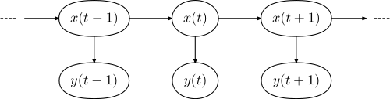
Recall: what is an HMM?
A hidden Markov model (HMM) is a statistical model in which the system being modeled is assumed to be a Markov process with unknown (hidden) parameters. The challenge is to determine the hidden parameters from the observable parameters.
hidden
observable

Slide 3
Recall: elements of an HMM
a finite set of states, Q={q₀, q₁, ... , q_{m}}; q₀ is a start (stop) state
a finite alphabet α ={s₀, s₁, ... , s_{n}}
a transition distribution P_{t} : Q×Q → [0,1] i.e., P_{t} (q_{j} | q_{i})
  an emission distribution P_{e}: Q×α → [0,1] i.e., P_{e} (s_{j} | q_{i})
An Example
5%
HMM=({q₀,q₁,q₂},{Y,R},P_{t},P_{e})
P_{t}={(q₀,q₁,1), (q₁,q₁,0.8),
(q₁,q₂,0.15), (q₁,q₀,0.05),
(q₂,q₂,0.7), (q₂,q₁,0.3)}
P_{e}={(q₁,Y,1), (q₁,R,0), (q₂,Y,0), (q₂,R,1)}
R=0%
Y = 100%
q₁
15%
Y=0%
R = 100%
q₂
q ₀
80%
30%
70%
100%

Slide 4
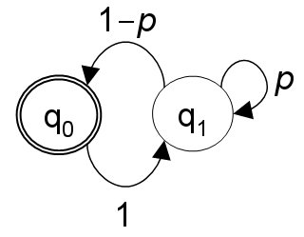
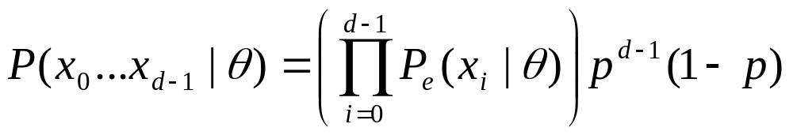
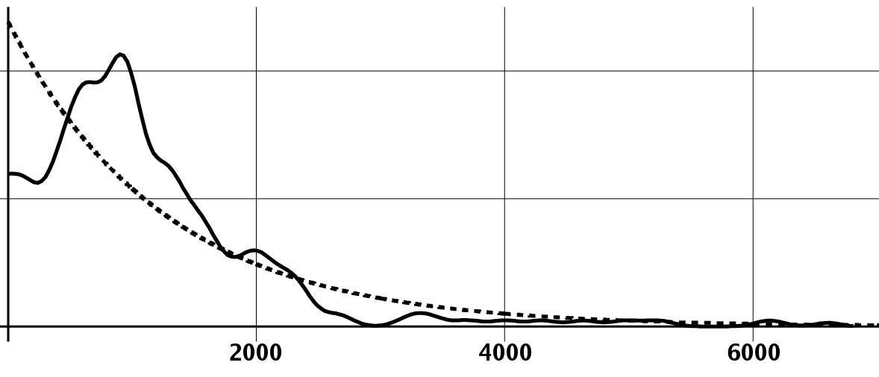
HMMs & Geometric Feature Lengths
geometric distribution
geometric
exon length

Slide 5
Generalized HMMs
A GHMM is a stochastic machine M=(Q, α, P_{t}, P_{e}, P_{d}) consisting of the following:
  a finite set of states, Q={q₀, q₁, ... , q_{m}}
  a finite alphabet α ={s₀, s₁, ... , s_{n}}
  a transition distribution P_{t} : Q×Q → [0,1] i.e., P_{t} (q_{j} | q_{i})
  an emission distribution P_{e} : Q×α*× N→ [0,1] i.e., P_{e} (s*_{j} | q_{i},d_{j})
  a duration distribution P_{e} : Q× N→ [0,1] i.e., P_{d} (d_{j} | q_{i})
Key Differences
each state now emits an entire subsequence rather than just one symbol
feature lengths are now explicitly modeled, rather than implicitly geometric
emission probabilities can now be modeled by any arbitrary probabilistic model
there tend to be far fewer states => simplicity & ease of modification
Ref: Kulp D, Haussler D, Reese M, Eeckman F (1996) A generalized hidden Markov model for the recognition of human genes in DNA. ISMB '96.

Slide 6
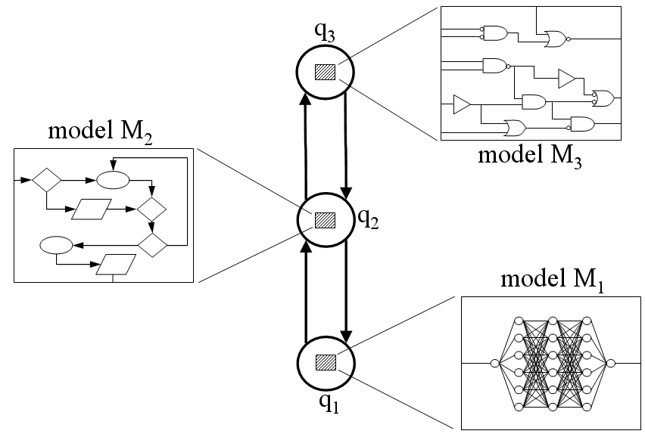
Model abstraction in GHMMs
Advantages:
* Submodel abstraction
* Architectural simplicity
* State duration modeling
Disadvantages:
* Decoding complexity

Slide 7
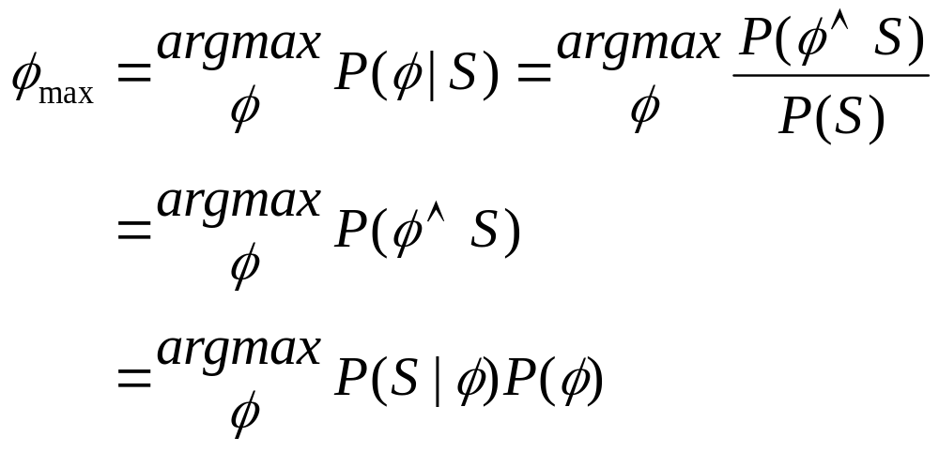
Recall: Decoding with an HMM
emission prob.
transition prob.

Slide 8
Decoding with a GHMM
emission prob.
transition prob.
duration prob.

Slide 9
Recall: Viterbi Decoding for HMMs
sequence
. . .
k
k+1
. . .
k-2
k-1
states
(i,k)
j
. . .
run time: O(L×|Q|²)

Slide 10
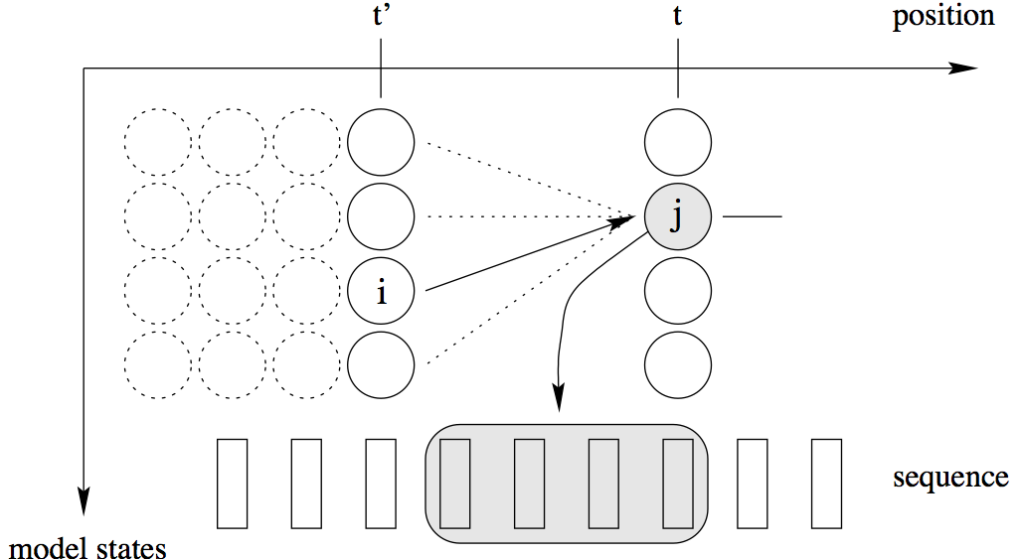
GHMM Decoding
run time: O(L³×|Q|²)

Slide 11
Training for GHMMs
We would like to solve the following maximization problem over the set of all parameterizations {θ =(P_{t} ,P_{e})} evaluated on training set T:
In practice, this is to costly to compute, so we simply optimize the components of this formula separately (or on separate parts of the model), and either:
hope that we haven’t compromised the accuracy too much (“maximum feature likelihood” training)
empirically “tweak” the parameters (automatically or by hand) over the training set to get closer to the global optimum

Slide 12
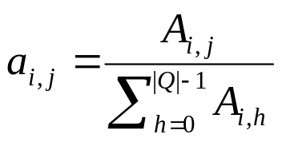
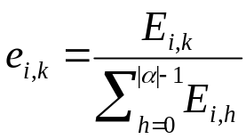
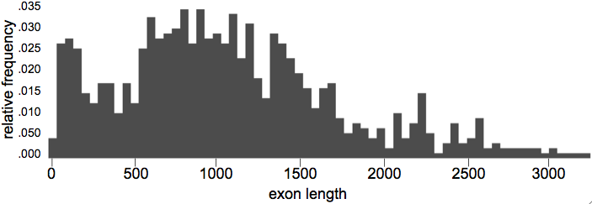
Maximum feature likelihood training
estimate via labeled training data
construct a histogram of observed feature lengths
estimate via labeled training data

Slide 13
GHMMs Summary
GHMMs generalize HMMs by allowing each state to emit a subsequence rather than just a single symbol.
Whereas HMMs model all feature lengths using a geometric distribution, feature lengths can be modeled using an arbitrary length distribution in a GHMM.
Emission models within a GHMM can be any arbitrary probabilistic model (“submodel abstraction”), such as a neural network or decision tree. GHMMs tend to have many fewer states => simplicity & modularity.
Training of GHMMs is often accomplished by a maximum feature likelihood model.

Slide 14
Gene Prediction as Parsing
The problem of eukaryotic gene prediction entails the identification of putative exons in unannotated DNA sequence:
exon
intron
exon
intron
exon
. . .
AG
. . .
GT
. . .
ATG
GT
AG
start codon
donor site
acceptor site
donor site
acceptor site
stop codon
This can be formalized as a process of identifying intervals in an input sequence, where the intervals represent putative coding exons:
gene
finder
TATTCATGTCGATCGATCTCTCTAGCGTCTACGCTATCGGTGCTCTCTATTATCGCGCGATCGTCGATCGCGCGAGAGTATGCTACGTCGATCGAATTG
TATTCATGTCGATCGATCTCTCTAGCGTCTACGCTATCGGTGCTCTCTATTATCGCGCGATCGTCGATCGCGCGAGAGTATGCTACGTCGATCGAATTG…
(6,39), (107-250), (1089-1167), ...
(6,39)
Notes:
Given a string S over the alphabet {A,C,G,T}, find the “optimal” parse (structure) of S (with respect to some coding score function):
S=s1,s2,…,sn
Here, si represents a coding or a non-coding subsequence of S.
-no UTRs

Slide 15
Common Assumptions in Gene Finding
No overlapping genes
No nested genes
No frame shifts or sequencing errors
No split start codons (ATGT...AGG)
No split stop codons (TGT...AGAG)
No alternative splicing
No selenocysteine codons (TGA)
No ambiguity codes (Y,R,N, etc.)

Slide 16
Gene Finding: Different Approaches
Similarity-based methods. These use similarity to annotated sequences like proteins, cDNAs, or ESTs (e.g. Procrustes, GeneWise).
Ab initio gene-finding. These don’t use external evidence to predict sequence structure (e.g. GlimmerHMM, GeneZilla, Genscan, SNAP).
Comparative (homology) based gene finders. These align genomic sequences from different species and use the alignments to guide the gene predictions (e.g. CONTRAST, Conrad,TWAIN, SLAM, TWINSCAN, SGP-2).
Integrated approaches. These combine multiple forms of evidence, such as the predictions of other gene finders (e.g. Jigsaw, EuGène, Gaze)
GlimmerHMM
Notes:
Homology based approaches: These are used to find a gene that is similar to those in a library of genes.
Ab initio approaches: These start from a DNA sequence, with no additional information (no database of existing genes) and try to find new genes purely from the given sequence
Hybrid approaches: These combine techniques from homology and ab initio methods, as well as cross-species data and experimental data.

Slide 17
HMMs and Gene Structure
Nucleotides {A,C,G,T} are the observables
Different states generate nucleotides at different frequencies
A simple HMM for unspliced genes:
AAAGC ATG CAT TTA ACG AGA GCA CAA GGG CTC TAA TGCCG
The sequence of states is an annotation of the generated string – each nucleotide is generated in intergenic, start/stop, coding state
A
T
G
T
A
A
Notes:
Given a model M and an observed string S, what is the most probable path through M generating S.

Slide 18
An HMM for Eukaryotic Gene Prediction
Intron
Donor
Acceptor
Exon
the Markov model:
Start
codon
Stop
codon
Intergenic
q₀
the input sequence:
AGCTAGCAGTATGTCATGGCATGTTCGGAGGTAGTACGTAGAGGTAGCTAGTATAGGTCGATAGTACGCGA
the gene prediction:
exon 1
exon 2
exon 3

Slide 19
Gene Prediction with a GHMM
Given a sequence S, we would like to determine the parse φ of that sequence which segments the DNA into the most likely exon/intron structure:
prediction
exon 1
exon 2
exon 3
parse φ
sequence S
AGCTAGCAGTCGATCATGGCATTATCGGCCGTAGTACGTAGCAGTAGCTAGTAGCAGTCGATAGTAGCATTATCGGCCGTAGCTACGTAGCGTAGCTC
The parse φ consists of the coordinates of the predicted exons, and corresponds to the precise sequence of states during the operation of the GHMM (and their duration, which equals the number of symbols each state emits).
This is the same as in an HMM except that in the HMM each state emits bases with fixed probability, whereas in the GHMM each state emits an entire feature such as an exon or intron.

Slide 20
GlimmerHMM architecture
Four exon types
Exon0
Exon1
Exon2
I0
I1
I2
Phase-specific introns
Init Exon
Term Exon
Exon Sngl
+ forward strand
Intergenic
- backward strand
Uses GHMM to model gene structure (explicit length modeling)
Each state has a separate submodel or sensor
The lengths of noncoding features in genomes are geometrically distributed.
Exon Sngl
Term Exon
Init Exon
I0
I1
I2
Exon0
Exon1
Exon2

Slide 21
Identifying Signals In DNA with a Signal Sensor
We slide a fixed-length model or “window” along the DNA and evaluate score(signal) at each point:
Signal sensor
…ACTGATGCGCGATTAGAGTCATGGCGATGCATCTAGCTAGCTATATCGCGTAGCTAGCTAGCTGATCTACTATCGTAGC…
When the score is greater than some threshold (determined empirically to result in a desired sensitivity), we remember this position as being the potential site of a signal.
The most common signal sensor is the Weight Matrix:
A = 31%
T = 28%
C = 21%
G = 20%
A = 18%
T = 32%
C = 24%
G = 26%
A
100%
T
100%
G
100%
A = 19%
T = 20%
C = 29%
G = 32%
A = 24%
T = 18%
C = 26%
G = 32%

Slide 22
Efficient Decoding via Signal Sensors
ATG’s
sensor n
. . .
insert into type-specific signal queues
. . .
signal queues
GT’S
sensor 2
AG’s
sensor 1
sequence:
GCTATCGATTCTCTAATCGTCTATCGATCGTGGTATCGTACGTTCATTACTGACT...
detect putative signals during left-to-right pass over squence
trellis links
...ATG.........ATG......ATG..................GT
elements of the “ATG” queue
newly detected signal

Slide 23
The Notion of “Eclipsing”
ATGGATGCTACTTGACGTACTTAACTTACCGATCTCT
ATGGATGCTACTTGACGTACTTAACTTACCGATCTCT
0 1 2 0 1 2 0 1 2 0 1 2 0 1 2 0 1 2 0 1 2 0 1 2 0 1 2 0 1 2 0 1 2 0 1 2 0
in-frame stop codon!

Slide 24
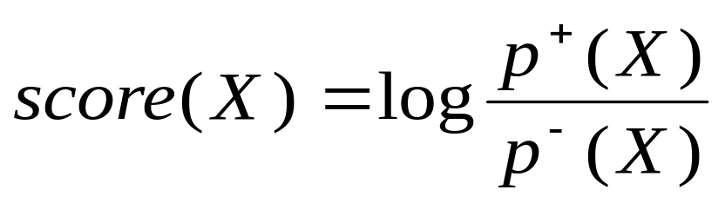
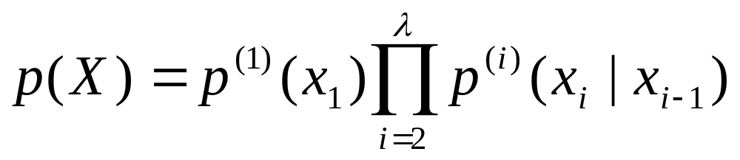
Start and stop codon scoring
…GGCTAGTCATGCCAAACGCGG…
…AAACCTAGTATGCCCACGTTGT…
…ACCCAGTCCCATGACCACACACAACC…
…ACCCTGTGATGGGGTTTTAGAAGGACTC…
Given a signal X of fixed length λ, estimate the distributions:
  p⁺(X) = the probability that X is a signal
  p⁻(X) = the probability that X is not a signal
Compute the score of the signal:
where
(WAM model or inhomogeneous Markov model)
Notes:
Use logs for computational reasons.

Slide 25
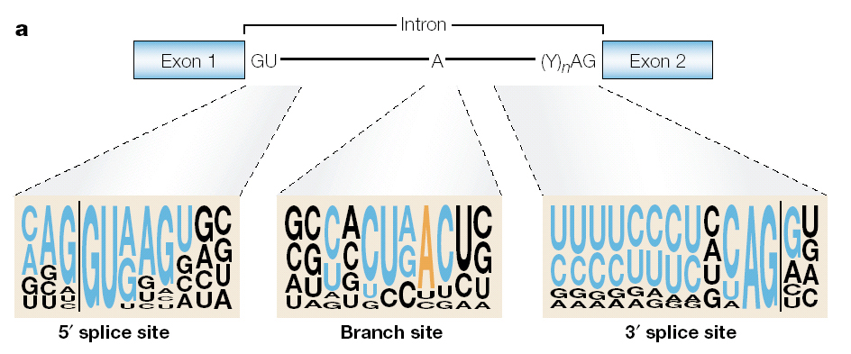
Splice site prediction
16bp
24bp
The splice site score is a combination of:
  first or second order inhomogeneous Markov models on windows around the acceptor and donor sites
  MDD decision trees
  longer Markov models to capture difference between coding and non-coding on opposite sides of site (optional)
  maximal splice site score within 60 bp (optional)
Notes:
Branch point – situated approximately 20 to 40 bp upstream of the intron/exon junction.

Slide 26
Emission probabilities for non-coding regions - ICMs
Given a context C=b₁b₂…b_{k}, the probability of b_{k+1} is determined based on those bases in C whose positions have the most influence (based on mutual information) on the prediction of b_{k+1}.
Given context length k:
Calculate j=argmax_{p} I(X_{p},X_{k+1}) where random variable X_{i} models the distribution in the ith position, and I(X,Y)=Σ_{i}Σ_{j}P(x_{i},x_{j})log(P(x_{i},x_{j})/P(x_{i})P(x_{j})
Partition the set of oligomers based on the four nucleotide values at position j
k=9
j=9
b₉=a
b₉=c
b₉=g
b₉=t
j=7
j=5
j=8
j=8
….
….
….
b₅=a
b₅=c
b₅=g
b₅=t
j=8
j=8
j=4
j=8
….
….
….
….
The probability that the model M generates sequence S:
P(S|M)=Π_{x=1,n}ICM(S_{x})
where S_{x} is the oligomer ending at position x, and n is the length of the sequence.
Ref: Delcher et al. (1999), Nucleic Acids Res. 27(23), 4636-4641.

Slide 27
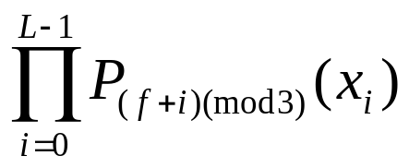
Coding sensors: 3-periodic ICMs
A three-periodic ICM uses three ICMs in succession to evaluate the different codon positions, which have different statistics:
P[C|M₀]
P[G|M₁]
ICM₀
P[A|M₂]
ICM₁
ICM₂
ATC GAT CGA TCA GCT TAT CGC ATC
The three ICMs correspond to the three phases. Every base is evaluated in every phase, and the score for a given stretch of (putative) coding DNA is obtained by multiplying the phase-specific probabilities in a mod 3 fashion:
GlimmerHMM uses 3-periodic ICMs for coding and homogeneous (non-periodic) ICMs for noncoding DNA.

Slide 28
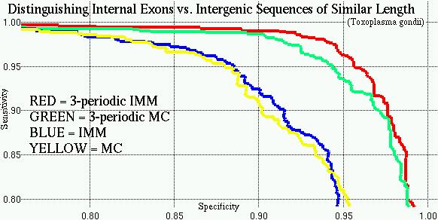
The Advantages of Periodicity and Interpolation

Slide 29
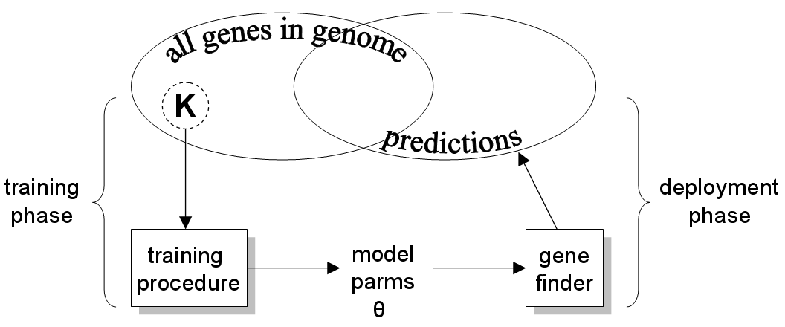
Training the Gene Finder
During training of a gene finder, only a subset K of an organism’s gene set will be available for training:
θ=(P_{t} ,P_{e} ,P_{d})
The gene finder will later be deployed for use in predicting the rest of the organism’s genes. The way in which the model parameters are inferred during training can significantly affect the accuracy of the deployed program.

Slide 30
Recall: MLE training for GHMMs
estimate via labeled training data
construct a histogram of observed feature lengths
estimate via labeled training data

Slide 31
SLOP
G (1000 genes)
SLOP = Separate Local Optimization of Parameters
train (800)
test
(200)
donors
acceptors
starts
stops
exons
train-model
train-model
introns
train-model
train-model
intergenic
train-model
train-model
evaluation
train-model
reported accuracy
model files

Slide 32
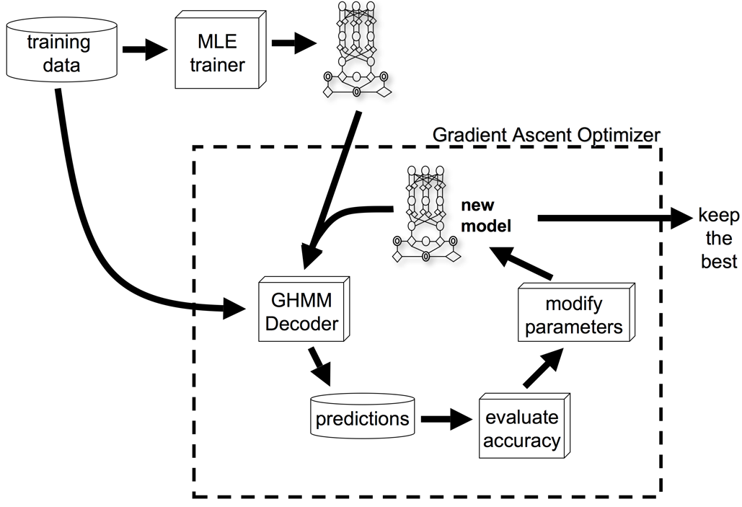
Discriminative Training of GHMMs
Parameters to optimize:
Mean intron, intergenic, and UTR length
Sizes of all signal sensor windows
Location of consensus regions within signal sensor windows
Emission orders for Markov chains, and other models
Thresholds for signal sensors

Slide 33
GRAPE
T (1000 genes)
GRAPE = GRadient Ascent Parameter Estimation
train (800)
test
(200)
unseen
(1000)
“peeking”
MLE
control parms
gradient ascent
model files
accuracy
evaluation
final evaluation
reported accuracy
final model files
Notes:
This leads us to two questions:
To what degree does GRAPE actually produce a more accurate gene finder than SLOP? (ie., how much of an advantage does hill-climbing really produce?)
The hill-climbing component of GRAPE must receive feedback about the accuracy of successive models during the iterative gradient ascent procedure. What is the best way to obtain that feedback – ie., from the training set, or from a separate “hold-out” set?
Question #2 brings up one more question:
How reliable are accuracy assessments based on testing a gene finder on the training set, with or without cross-validation?

Slide 34
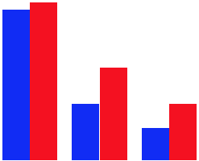
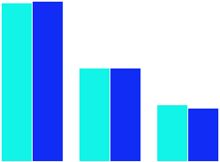
GRAPE vs SLOP
The following results were obtained on an A. thaliana data set (1000 training genes, and 1000 test genes):
Result: GRAPE is superior to SLOP:
GRAPE/H: nuc=87% exons=51% genes=31%
SLOP/H: nuc=83% exons=31% genes=18%
Result: No reason to split the training data for hill-climbing:
POOLED: nuc=87% exons=51% genes=31%
DISJOINT: nuc=88% exons=51% genes=29%
Conclusion: Cross-validation scores are a better predictor of accuracy than
simply training and testing on the entire training set:
test on training set: nuc=92% exons=65% genes=48%
cross-validation: nuc=88% exons=54% genes=35%
accuracy on unseen data: nuc=87% exons=51% genes=31%

Slide 35
Gene Finding in the Dark:
Dealing with Small Sample Sizes
  parameter mismatching: train on a close relative
  use a comparative GF trained on a close relative
  use BLAST to find conserved genes & curate them, use as training set
  augment training set with genes from related organisms, use weighting
  manufacture artificial training data
    long ORFs
  be sensitive to sample sizes during training by reducing the number of parameters (to reduce overtraining)
    fewer states (1 vs. 4 exon states, intron=intergenic)
    lower-order models
  pseudocounts
  smoothing (esp. for length distributions)

Slide 36
GlimmerHMM is a high-performance ab initio gene finder
Arabidopsis thaliana test results
 | Nucleotide |  |  | Exon |  |  | Gene
 | Sn | Sp | Acc | Sn | Sp | Acc | Sn | Sp | Acc
GlimmerHMM | 97 | 99 | 98 | 84 | 89 | 86.5 | 60 | 61 | 60.5
SNAP | 96 | 99 | 97.5 | 83 | 85 | 84 | 60 | 57 | 58.5
Genscan+ | 93 | 99 | 96 | 74 | 81 | 77.5 | 35 | 35 | 35
All three programs were tested on a test data set of 809 genes, which did not overlap with the training data set of GlimmerHMM.
All genes were confirmed by full-length Arabidopsis cDNAs and carefully inspected to remove homologues.

Slide 37
GlimmerHMM on other species
 | Nucleotide Level |  | Exon Level |  | Correclty Predicted Genes | Size of test set
 | Sn | Sp | Sn | Sp
Arabidopsis thaliana | 97% | 99% | 84% | 89% | 60% | 809 genes
Cryptococcus neoformans | 96% | 99% | 86% | 88% | 53% | 350 genes
Coccidoides posadasii | 99% | 99% | 84% | 86% | 60% | 503 genes
Oryza sativa | 95% | 98% | 77% | 80% | 37% | 1323 genes
GlimmerHMM is also trained on: Aspergillus fumigatus, Entamoeba histolytica, Toxoplasma gondii, Brugia malayi, Trichomonas vaginalis, and many others.

Slide 38
GlimmerHMM on human data
 | Nuc Sens | Nuc Spec | Nuc Acc | Exon Sens | Exon Spec | Exon Acc | Exact Genes
GlimmerHMM | 86% | 72% | 79% | 72% | 62% | 67% | 17%
Genscan | 86% | 68% | 77% | 69% | 60% | 65% | 13%
GlimmerHMM’s performace compared to Genscan on 963 human RefSeq genes selected randomly from all 24 chromosomes, non-overlapping with the training set. The test set contains 1000 bp of untranslated sequence on either side (5' or 3') of the coding portion of each gene.
Notes:
Nucleotide level accuracy is a comparison of the annotated nucleotides with the predicted nucleotides. Individual nucleotides appearing in more than one transcript in either the annotation or the predictions are considered only once for the nucleotide level statistics (Figure 3a). Nucleotide predictions must be on the same strand as the annotations to be counted as correct. At the nucleotide level, sensitivity (Sn) is the proportion of annotated nucleotides (as being coding or part of an mRNA molecule) that is correctly predicted, and specificity (Sp) the proportion of predicted nucleotides (as being coding or part of an mRNA molecule) that is so annotated. As a summary measure, we have computed either the simple average of these two measures, or the correlation coefficient between the annotated and the predicted nucleotides (see [22-27]).
The exon level accuracy is calculated with the requirement that an exon in the prediction must have identical start and end coordinates as an exon in the annotation to be counted correct. Only the unique exons in each set are considered (see Figure 3b for a graphical example of how unique exons are collected from both the annotation and prediction sets; also see [22-27] for more details on these definitions). At the exon level, sensitivity is computed as the proportion of annotated exons correctly predicted, and specificity as the proportion of predicted exons that is annotated. As a summary measure, we have computed the average of these two measures.

Slide 39
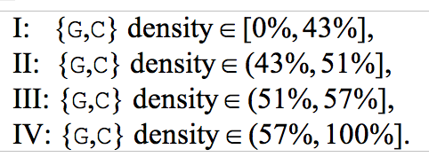
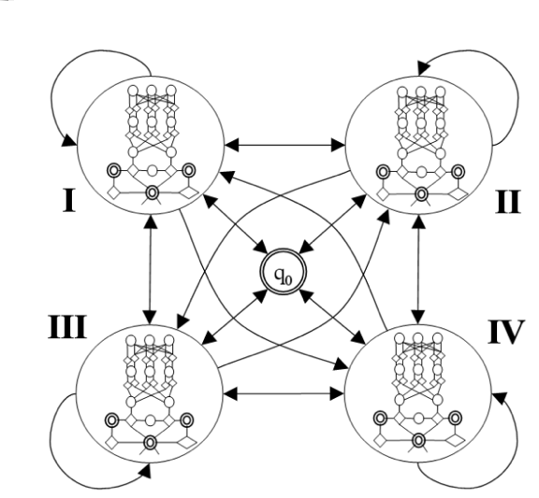
Modeling Isochores
Ref: Allen JE, Majoros WH, Pertea M, Salzberg SL (2006) JIGSAW, GeneZilla, and GlimmerHMM: puzzling out the features of human genes in the ENCODE regions. Genome Biology 7(Suppl 1):S9.

Slide 40


Slide 41
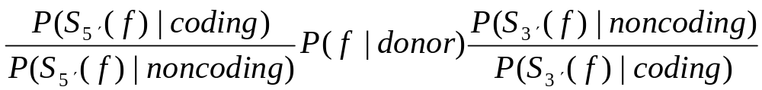
Codong-noncoding Boundaries
A key observation regarding splice sites and start and stop codons is that all of these signals delimit the boundaries between coding and noncoding regions within genes (although the situation becomes more complex in the case of alternative splicing). One might therefore consider weighting a signal score by some function of the scores produced by the coding and noncoding content sensors applied to the regions immediately 5′ and 3′ of the putative signal:

Slide 42
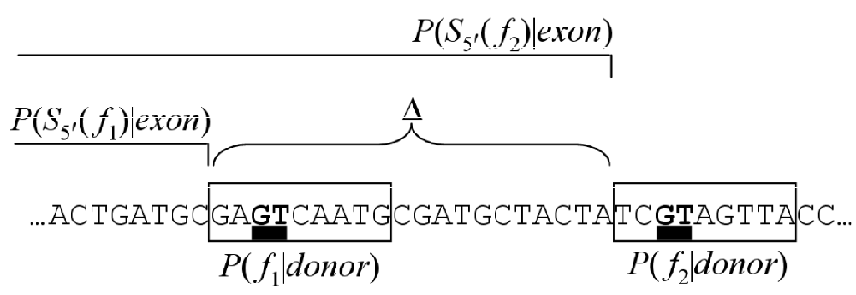
Local Optimality Criterion
When identifying putative signals in DNA, we may choose to completely ignore low-scoring candidates in the vicinity of higher-scoring candidates. The purpose of the local optimality criterion is to apply such a weighting in cases where two putative signals are very close together, with the chosen weight being 0 for the lower-scoring signal and 1 for the higher-scoring one.

Slide 43
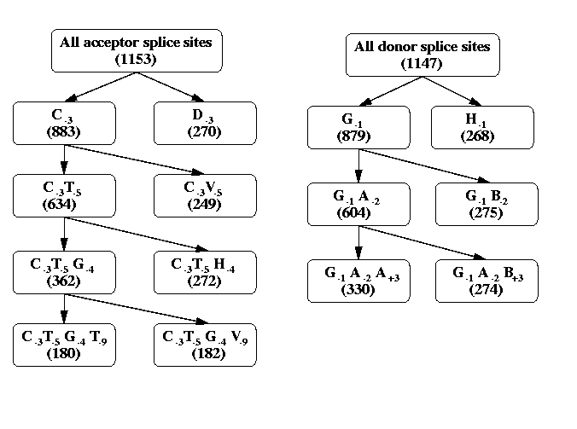
Maximal Dependence Decomposition (MDD)
Rather than using one weight array matrix for all splice sites, MDD differentiates between splice sites in the training set based on the bases around the AG/GT consensus:
(Arabidopsis thaliana MDD trees)
Each leaf has a different WAM trained from a different subset of splice sites. The tree is induced empirically for each genome.

Slide 44
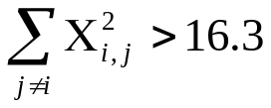
MDD splitting criterion
MDD uses the χ² measure between the variable K_{i} representing the consensus at position i in the sequence and the variable N_{j} which indicates the nucleotide at position j:
where O_{x,y} is the observed count of the event that K_{i} =x and N_{j} =y, and E_{x,y} is the value of this count expected under the null hypothesis that K_{i} and N_{j} are independent
Split if , for the cuttof P=0.001, 3df.
Example:
position=+5 consensus=-2
position:
-2 | -1 | +1 | +2 | +3 | +4 | +5
A | T | G | T | A | A | G
A | G | G | T | C | A | C
G | G | G | T | A | G | A
T | C | G | T | A | C | G
C | G | G | T | G | A | G
A | G | G | T | T | A | T
A | A | G | T | A | A | G
A | G | G | T | A | A | G
*
*
K₋₂ | N₊₅
 | A |  | C |  | G |  | T |  | All
 | O | E | O | E | O | E | O | E | O
A | 0 | 0.6 | 1 | 0.6 | 2 | 2.2 | 1 | 0.6 | 4
[CGT] | 1 | 0.4 | 0 | 0.4 | 2 | 1.8 | 0 | 0.4 | 3
All | 1 |  | 1 |  | 4 |  | 1 |  | 7
*
*
*
*
*
*
consensus:
Χ² =2.9

Slide 45
Splice Site Scoring
Donor/Acceptor sites at location k:
DS(k) = S_{comb}(k,16) + (S_{cod}(k-80)-S_{nc}(k-80)) +
(S_{nc}(k+2)-S_{cod}(k+2))
AS(k) = S_{comb}(k,24) + (S_{nc}(k-80)-S_{cod}(k-80)) +
(S_{cod}(k+2)-S_{nc}(k+2))
S_{comb}(k,i) = score computed by the Markov model/MDD method using window of i bases
S_{cod/nc}(j) = score of coding/noncoding Markov model for 80bp window starting at j

Slide 46
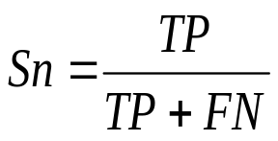
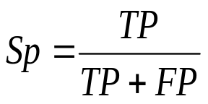
Evaluation of Gene Finding Programs
Nucleotide level accuracy
TN
FN
TP
FP
TN
FN
TP
FN
TN
REALITY
PREDICTION
Sensitivity:
Specificity:
Notes:
Sensitivity is a quantity measure
Specificity is a quality measure.

Slide 47
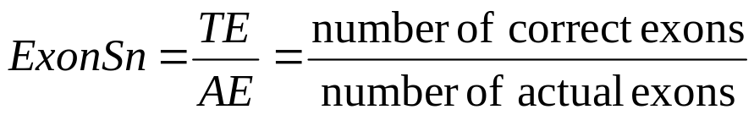
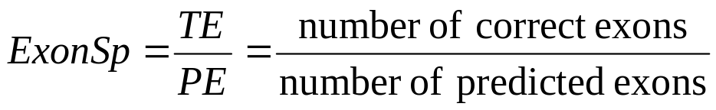
More Measures of Prediction Accuracy
Exon level accuracy
WRONG
EXON
CORRECT
EXON
MISSING
EXON
REALITY
PREDICTION
Notes:
Other measures: in frame exons, how many start/stop and splice sites are found
How many correct genes; how many genes are missed completely.

